Slide 1
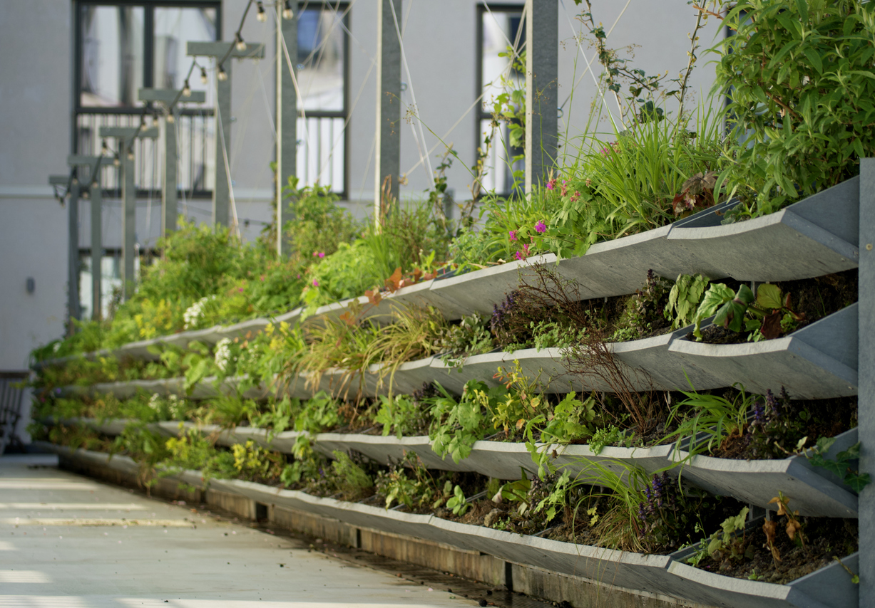
Nature Restoration Law webinar series
Webinar #1: urban nature restoration baselines and data
Heather Brooks
Policy Advisor
Eurocities

Slide 2
House rules
Use the code: #NRL

Slide 3
Webinar #1: nature restoration baselines and data
What are the definitions to be aware of?
Benjamin Rolles, Policy Officer at the European Commission
What data can be used? EU satellite and local level data?
Grazia Zulian, External Consultant at Joint Research Centre
Anne Franklin, Brussels Institute of Statistics and Analysis, Perspective Brussels
How can we use data for nature restoration?
Liv Toonen, Technology Project Lead at Space4Good
Meta Berghauser Pont, Professor of urban morphology and urban design at Chalmers University of Technology in Gothenburg

Slide 4
Use the code: #NRL

Slide 5
What organisation do you work for?
ⓘ Start presenting to display the poll results on this slide.

Slide 6
Member States shall ensure that there is no net loss in the total national area of urban green space and of urban tree canopy cover in urban ecosystem areas compared to 2024
Art.8 urban ecosystem restoration targets

Slide 7
Member States shall achieve an increasing trend in the total national area of urban green space, including through the integration of urban green space into buildings and infrastructure, in urban ecosystem areas (…) until a satisfactory level (…) is reached
Repeated for urban tree canopy
Art.8 urban ecosystem restoration targets

Slide 8
Do you think you are more likely to use the Local Administrative Unit (LAU) or the Urban Centres and Urban Clusters (UCC) as the boundary for the urban restoration targets in your city or country?
ⓘ Start presenting to display the poll results on this slide.

Slide 9
What are the definitions to be aware of?
Benjamin Rolles
Policy Officer, European Commission

Slide 10
Timeline
August 2024: Regulation already in force
August 2026: Member States submit National Restoration Plans
Based on the uniform format (text now agreed)
Will include decisions on boundaries for implementation (urban ecosystem areas), measurements of green space and tree cover, exemptions etc.
January 2027​: Assessment by the Commission ​
August 2027​: National Restoration Plans finalised by Member States​
Notes:
The proposal aims to ensure a steady increase in urban green space and tree canopy cover in densely populated areas from now to 2050. This can be achieved by ‘greening’ urban planning processes over time, restoring degraded industrial land, increasing green roofs, tree lining streets and creating micro parks and allotments, even by greening car parks.

Slide 11
Measuring green space and tree canopy cover

Slide 12
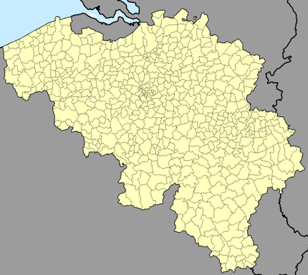
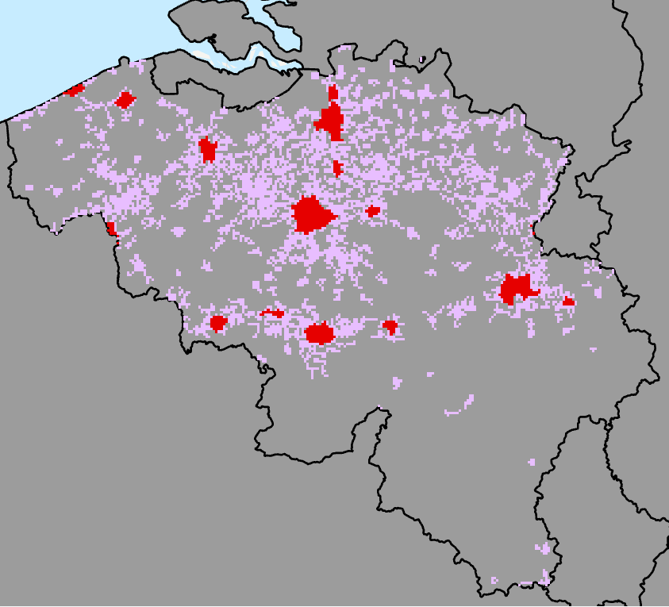
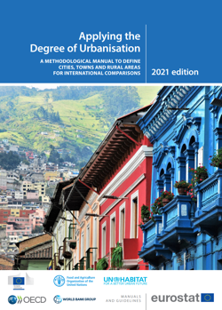
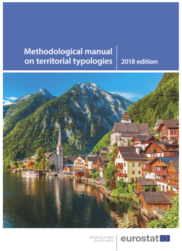
Local Administrative units / urban centers and urban clusters

Slide 13
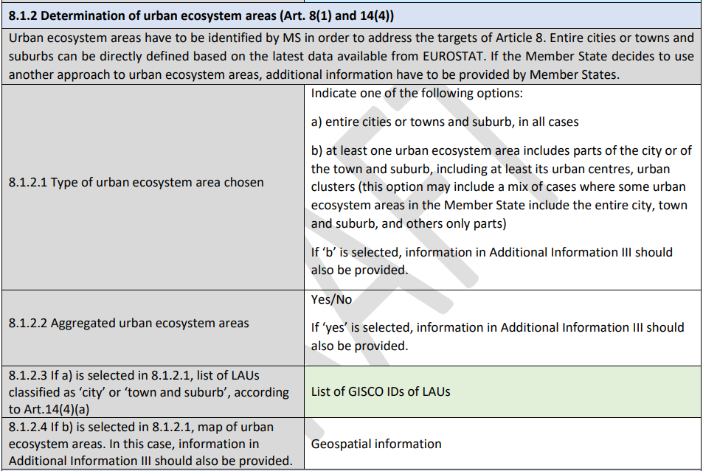
Urban Ecosystem Areas

Slide 14
Exclusions?

Slide 15
Supplementary Data?

Slide 16
Supplementary Data?
Improve or complement the information already included in the official datasets
i.e. allow an increase of data quality in terms of:
Precision: In the case of urban green or urban trees data identified with a higher spatial resolution
Accuracy (reliability): Accuracy refers to how close a measurement is to the true value. It measures the correctness and reliability of the spatial data in relation to the real-world values.
Be consistent over time: available in 2024 (baseline), 2030 and be maintained for the future monitoring
Be consistent over space: the data should be maintained to cover over time the area for which they are used, during all stages of the regulation implementation.
In all cases, supplementary data should be derived from systematic monitoring in which the methodology can be clearly described
Supplementary data needs to be reported at national level

Slide 17
References
A portal of reference documents on the Nature Restoration Regulation, hosted on the EEA website: Nature Restoration Regulation Reference Portal | Biodiversity Information System for Europe
An explanatory brochure on the nature restoration regulation: The nature restoration regulation - Publications Office of the EU

Slide 18
What data can be used? EU satellite and local level data?
Grazia Zulian, External Consultant at Joint Research Centre

Slide 19
Urban Ecosystem Areas and EU level green data: Implementing the Urban targets of the Nature Restoration Regulation
Annex
Notes:
C:\Users\grazi\OneDrive\Documents\JRC\AAENV
Excel file here

Slide 20
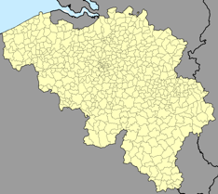
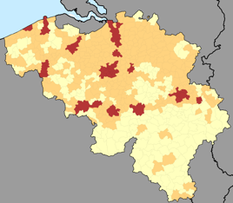
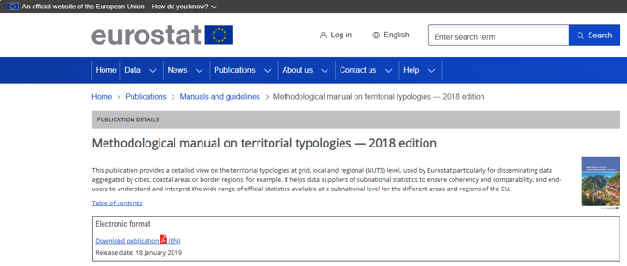
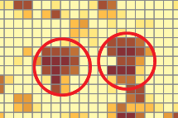
Building blocks of Urban ecosystem areas are 3 territorial typologies
LAU
Degree of urbanization classification
Urban centers and urban clusters
Resolution 1 km
1. Population grid 1km
GRID
2.Urban centers and clusters
GRID
3.LAU – degree of urbanisation
VECTOR
Resolution 1 km
Scale: 1:100000
Resolution 100 m
Methodological manual on territorial typologies — 2018 edition - Products Manuals and Guidelines - Eurostat
Notes:
Building blocks of Urban ecosystem areas
LAU
Degree of urbanization classification
Urban centers and urban clusters

Slide 21
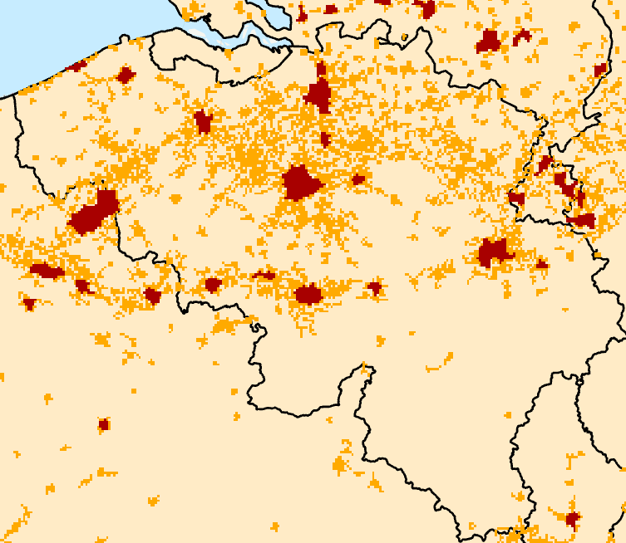
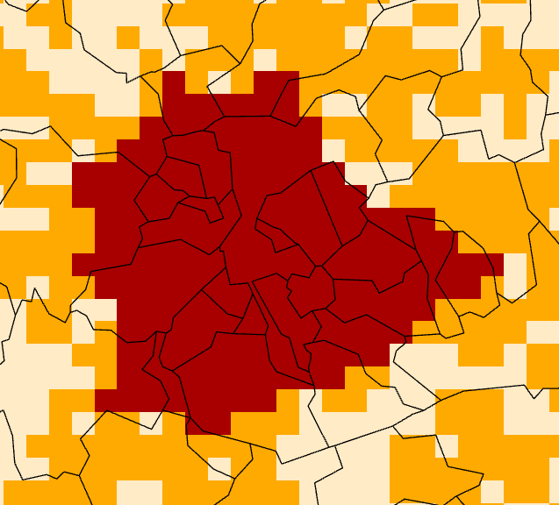
LAU and Urban Centers and clusters
(15) ‘local administrative unit’ or ‘LAU’
means a low-level administrative division of a Member State
(16) ‘urban centres’ and ‘urban clusters’
Means groups of 1 km2 population grid cells that share similar characteristics, based on a combination of their population density and geographical contiguity 4b(2) of Regulation (EC) No 1059/2003;
Notes:
(15) ‘local administrative unit’ or ‘LAU’ means a low-level administrative division of a Member State, below that of a province, region or state, established in accordance with Article 4 of Regulation (EC) No 1059/2003 of the European Parliament and of the Council
(16) ‘urban centres’ and ‘urban clusters’ means territorial units classified in cities and towns and suburbs using the grid-based typology established in accordance with Article 4b(2) of Regulation (EC) No 1059/2003;
(17) ‘cities’ means LAUs where at least 50 % of the population lives in one or more urban centres, measured using the degree of urbanisation established in accordance with Article 4b(3), point (a), of Regulation (EC) No 1059/2003;
(18) ‘towns and suburbs’ means LAUs where less than 50 % of the population lives in an urban centre, but at least 50 % of the population lives in an urban cluster, measured using the degree of urbanisation established in accordance with Article 4b(3), point (a), of Regulation (EC) No 1059/2003;
(19) ‘peri-urban areas’ means areas adjacent to urban centres or urban clusters, including at least all areas within 1 kilometer measured from the outer limits of those urban centres or urban clusters, and located in the same city or the same town and suburb as those urban centres or urban clusters;
Scale 1:100000

Slide 22
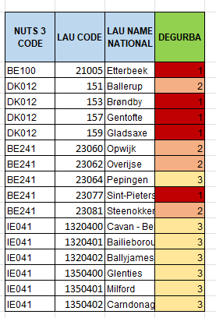
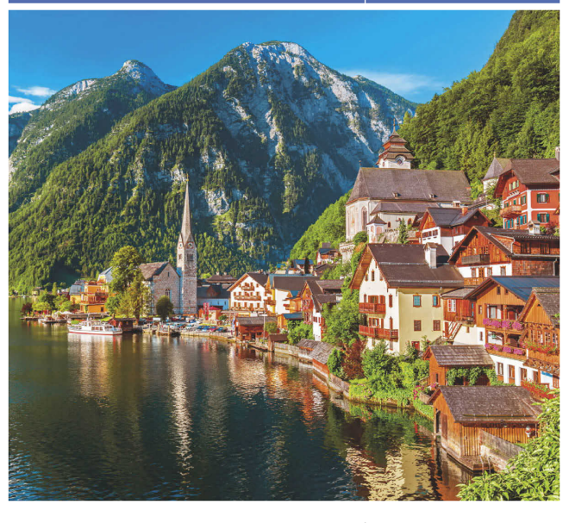
The degree of urbanisation classifies the LAU in local typologies
(17) LAU classified as cities
(18) LAU classified as towns and suburbs
LAUs where at least 50 % of the population lives in one or more urban centres [category 1]
LAUs where less than 50 % of the population lives in an urban centre, but at least 50 % of the population lives in an urban cluster [category 2]
Rural areas
Thinly populated areas: more than 50 % of the population lives in rural grid cells) [category 3]
Notes:
The degree of urbanisation classifies local administrative units (LAUs) as cities, towns and suburbs
or rural areas based on a combination of geographical contiguity and population density, measured by
minimum population thresholds applied to 1 km² population grid cells; each LAU belongs exclusively to
one of these three classes.

Slide 23
8.1.2 Determination of urban ecosystem areas (Art. 14(4))
Urban ecosystem areas must be identified by MS in order to address the targets of Article 8
Data used for the example:
LAU 2021
Degree of urbanisation 2011
Urban centres and clusters 2011
The following is a demonstrative exercise
Notes:
(15) ‘local administrative unit’ or ‘LAU’ means a low-level administrative division of a Member State, below that of a province, region or state, established in accordance with Article 4 of Regulation (EC) No 1059/2003 of the European Parliament and of the Council
(16) ‘urban centres’ and ‘urban clusters’ means territorial units classified in cities and towns and suburbs using the grid-based typology established in accordance with Article 4b(2) of Regulation (EC) No 1059/2003;
(17) ‘cities’ means LAUs where at least 50 % of the population lives in one or more urban centres, measured using the degree of urbanisation established in accordance with Article 4b(3), point (a), of Regulation (EC) No 1059/2003;
(18) ‘towns and suburbs’ means LAUs where less than 50 % of the population lives in an urban centre, but at least 50 % of the population lives in an urban cluster, measured using the degree of urbanisation established in accordance with Article 4b(3), point (a), of Regulation (EC) No 1059/2003;
(19) ‘peri-urban areas’ means areas adjacent to urban centres or urban clusters, including at least all areas within 1 kilometer measured from the outer limits of those urban centres or urban clusters, and located in the same city or the same town and suburb as those urban centres or urban clusters;

Slide 24
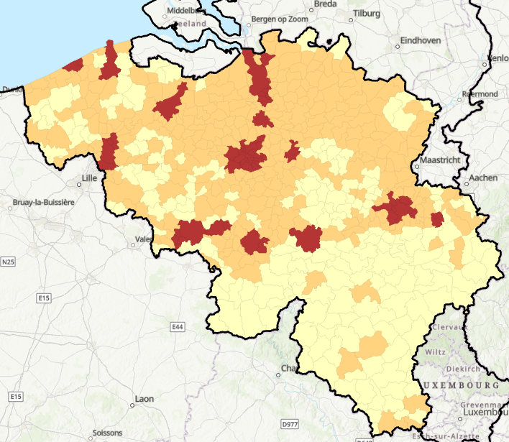
8.1.2.1. Type of urban ecosystem area chosen
A) Entire cities / towns and suburb
In Belgium it represents 54% of the country surface and 66.2% of the LAU
if option (a) is selected by MS: the entire city or town and suburb list is mapped and reported
Cities
Towns and suburbs
Rural settlements
Notes:
If the entire LAU (cities towns and suburbs is selected)

Slide 25
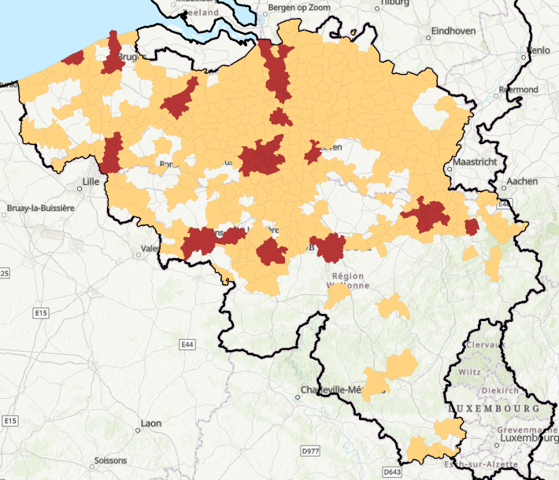
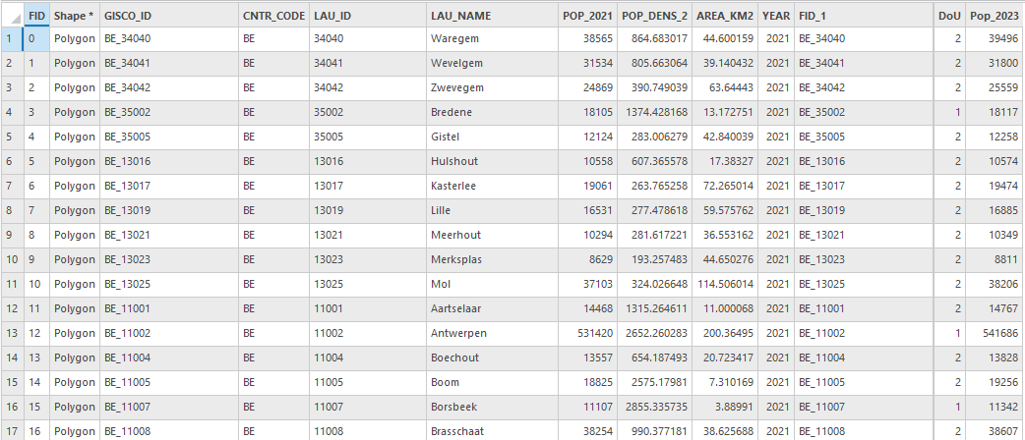
8.1.2.1. Type of urban ecosystem area chosen
Example of spatial information
table and spatial data
Table
*.csv
spatial data
*.shp
Notes:
8.2.2. Map of urban ecosystem areas (Art. 14(4)).
List and map of LAUs classified as ‘city’ or ‘town and suburb’ in accordance with the latest available EUROSTAT data

Slide 26
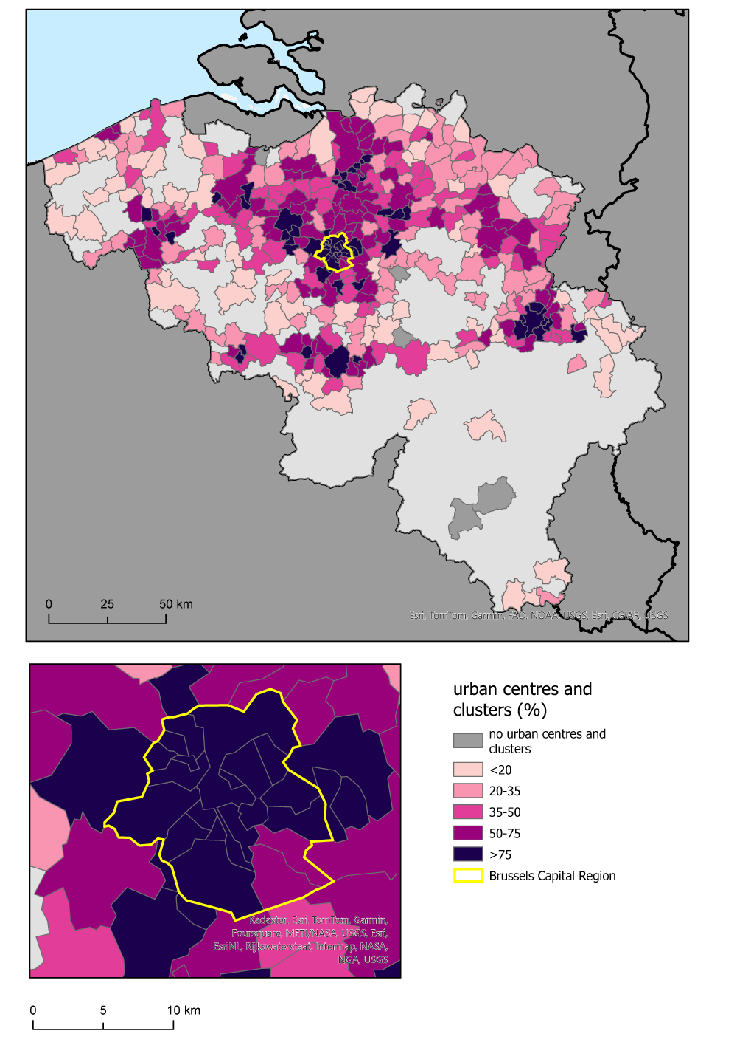
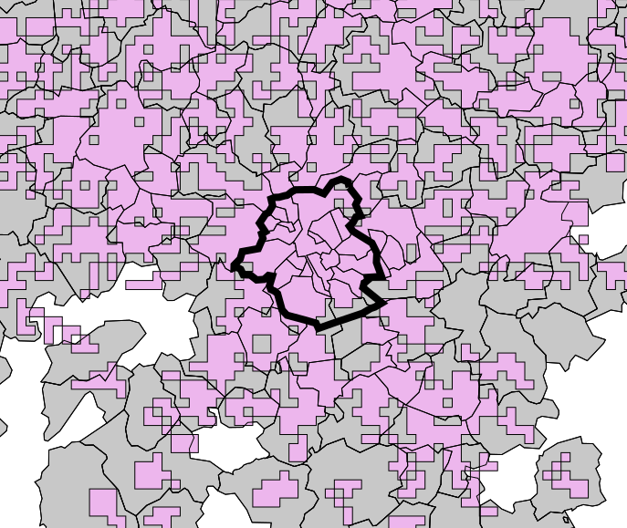
8.1.2.1. Type of urban ecosystem area chosen if option (b) is selected by MS: - parts of the city or of the town and suburb, including at least its urban centres, urban clusters
Urban centers and clusters
LAU (cities-towns & suburbs)
Not overlapped by urban centers and clusters
Example of parts of the city or of the town and suburb, including at least its urban centres, urban clusters

Slide 27
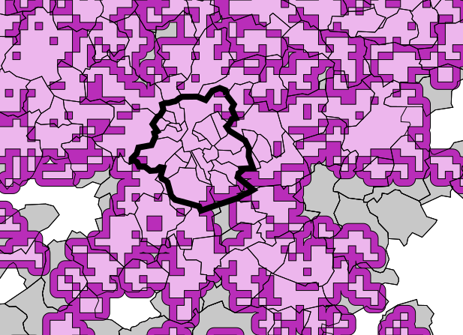
8.1.2.1. Type of urban ecosystem area chosen if option (b) is selected by MS: - parts of the city or of the town and suburb, including at least its urban centres, urban clusters AND, if deemed appropriate by the Member State concerned, peri-urban areas.
Example of parts of the city or of the town and suburb, including at least its urban centres, urban clusters + peri-urban areas
MS can decide in which LAU to define UEA including peri-urban area
Urban centers and clusters
Peri-urban area (1 km buffer)
LAU (cities-towns & suburbs)
Not overlapped by urban centers and clusters and peri-urban area
Peri-urban areas are defined in the NRR as “areas adjacent to urban centres or urban clusters, including at least all areas within 1 kilometre measured from the outer limits of those urban centres or urban clusters, and located in the same city or the same town and suburb as those urban centres or urban clusters”.

Slide 28
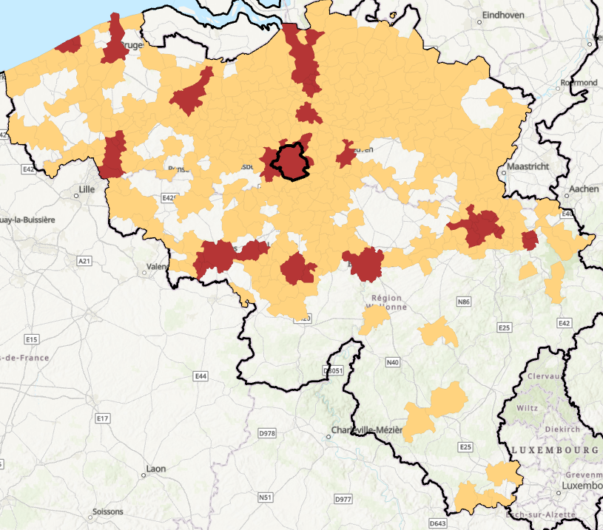
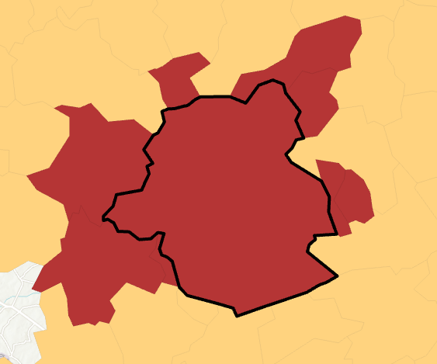
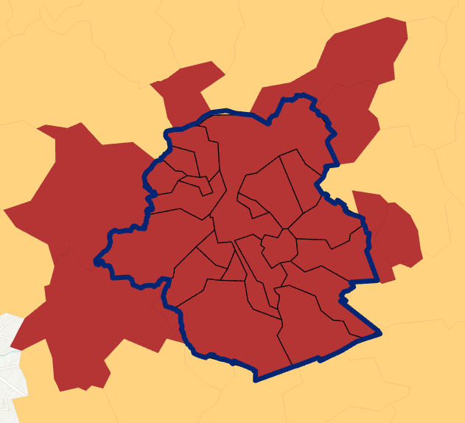
8.1.2.2 Aggregated urban ecosystem areas
Member States may aggregate the urban ecosystem areas of two or more adjacent cities, or two or more adjacent towns and suburbs, or both, into one urban ecosystem area common to those cities, or towns and suburbs, respectively.
Example- IF Belgium aggregates the municipalities of the Brussels-Capital Region
Cities-Towns-suburbs = 367
aggregated
original
Notes:
Determine and map Urban Ecosystem Areas (UEAs) for all cities and towns and suburbs, in line with the options set out in Article 14.4, indicating where any UEAs have been aggregated to form a single management unit
table and spatial data
1 extract LAU to be aggregated (e.g. 19 municipalities Brussels Capital Region)
2

Slide 29
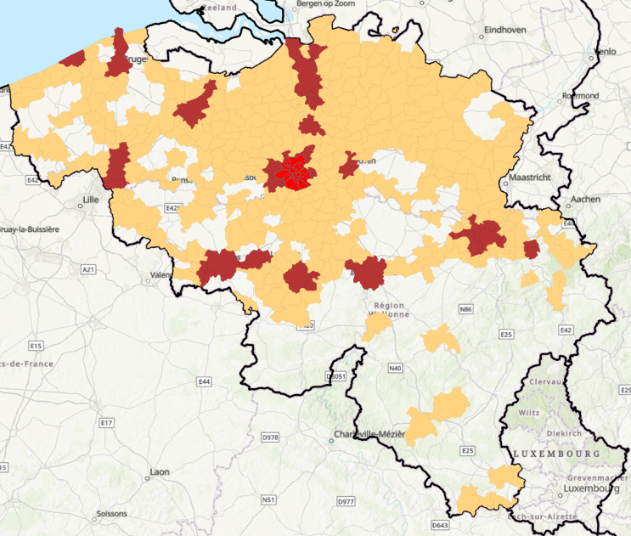
8.1.2.4 If b) is selected in 8.1.2.1, map of urban ecosystem areas. In this case, information in Annex III should also be provided
in line with the options set out in Article 14.4, indicating where any UEAs have been aggregated to form a single management unit
table (*.csv) and spatial data (*.shp)
Always keep the GISCO_ID
Create an additional code to identify which LAU have been aggregated
Notes:
List and map of LAUs classified as ‘city’ or ‘town and suburb’ in accordance with the latest available EUROSTAT data
table and spatial data
Determine and map Urban Ecosystem Areas (UEAs) for all cities and towns and suburbs, in line with the options set out in Article 14.4, indicating where any UEAs have been aggregated to form a single management unit
table and spatial data
8.1.2.4 If b) is selected in 8.1.2.1, map of urban ecosystem areas. In this case, information in Annex III should also be provided

Slide 30
urban green space
(20) Urban green spaces
means the total area of trees, bushes, shrubs, permanent herbaceous vegetation, lichens and mosses, ponds and watercourses found within cities or towns and suburbs
calculated on the basis of data provided by the Copernicus Land Monitoring Service
Notes:
20) ‘urban green space’ means the total area of trees, bushes, shrubs, permanent herbaceous vegetation, lichens and mosses, ponds and watercourses found within cities or towns and suburbs, calculated on the basis of data provided by the Copernicus Land Monitoring Service under the Copernicus component of the Union Space Programme, established by Regulation (EU) 2021/696, and, if available for the Member State concerned, other appropriate supplementary data provided by that Member State;
(21) ‘urban tree canopy cover’ means the total area of tree cover within cities and towns and suburbs, calculated on the basis of the Tree Cover Density data provided by the Copernicus Land Monitoring Service under the Copernicus component of the Union Space Programme, established by Regulation (EU) 2021/696, and, if available for the Member State concerned, other appropriate supplementary data provided by that Member State;

Slide 31
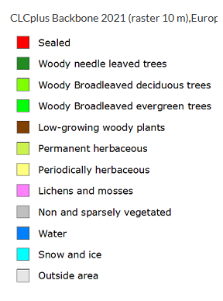
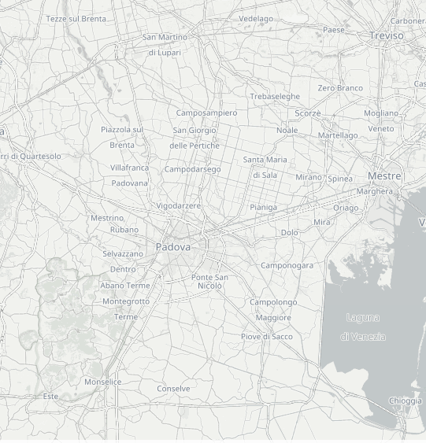
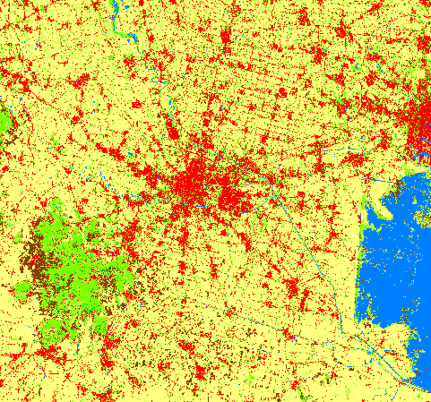
Notes:
20) ‘urban green space’ means the total area of trees, bushes, shrubs, permanent herbaceous vegetation, lichens and mosses, ponds and watercourses found within cities or towns and suburbs, calculated on the basis of data provided by the Copernicus Land Monitoring Service under the Copernicus component of the Union Space Programme, established by Regulation (EU) 2021/696, and, if available for the Member State concerned, other appropriate supplementary data provided by that Member State;
(21) ‘urban tree canopy cover’ means the total area of tree cover within cities and towns and suburbs, calculated on the basis of the Tree Cover Density data provided by the Copernicus Land Monitoring Service under the Copernicus component of the Union Space Programme, established by Regulation (EU) 2021/696, and, if available for the Member State concerned, other appropriate supplementary data provided by that Member State;

Slide 32
Exploring CLCplus Backbone — Copernicus Land Monitoring Service
Notes:
Exploring CLCplus Backbone — Copernicus Land Monitoring Service

Slide 33
urban green space
(21) urban tree canopy cover
means the total area of tree cover within cities and towns and suburbs, calculated on the basis of the Tree Cover Density data provided by the Copernicus Land Monitoring Service
Notes:
20) ‘urban green space’ means the total area of trees, bushes, shrubs, permanent herbaceous vegetation, lichens and mosses, ponds and watercourses found within cities or towns and suburbs, calculated on the basis of data provided by the Copernicus Land Monitoring Service under the Copernicus component of the Union Space Programme, established by Regulation (EU) 2021/696, and, if available for the Member State concerned, other appropriate supplementary data provided by that Member State;
(21) ‘urban tree canopy cover’ means the total area of tree cover within cities and towns and suburbs, calculated on the basis of the Tree Cover Density data provided by the Copernicus Land Monitoring Service under the Copernicus component of the Union Space Programme, established by Regulation (EU) 2021/696, and, if available for the Member State concerned, other appropriate supplementary data provided by that Member State;

Slide 34
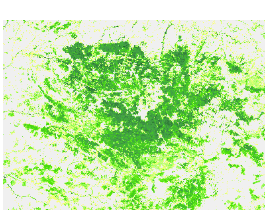
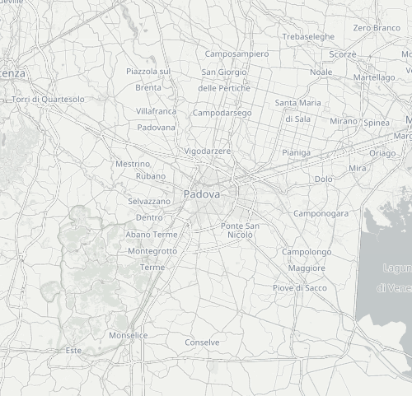
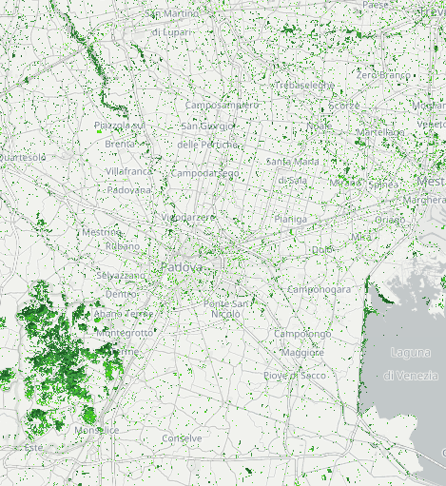
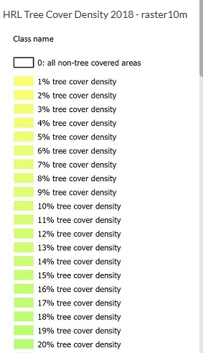
Notes:
20) ‘urban green space’ means the total area of trees, bushes, shrubs, permanent herbaceous vegetation, lichens and mosses, ponds and watercourses found within cities or towns and suburbs, calculated on the basis of data provided by the Copernicus Land Monitoring Service under the Copernicus component of the Union Space Programme, established by Regulation (EU) 2021/696, and, if available for the Member State concerned, other appropriate supplementary data provided by that Member State;
(21) ‘urban tree canopy cover’ means the total area of tree cover within cities and towns and suburbs, calculated on the basis of the Tree Cover Density data provided by the Copernicus Land Monitoring Service under the Copernicus component of the Union Space Programme, established by Regulation (EU) 2021/696, and, if available for the Member State concerned, other appropriate supplementary data provided by that Member State;

Slide 36
Investigating the options
Anne Franklin, Brussels Institute of Statistics and Analysis, Perspective Brussels

Slide 37
Nature Restoration Regulation
Investigating options for implementing Article 8 in the Brussels-Capital Region
Anne Franklin | Brussels Institute for Statistics and Analysis

Slide 38
Contents
01 Context
02 Understanding Article 8
03 Delimiting the geographical area
04 Identifying the urban ecosystem area
05 Identifying the Urban green spaces & tree cover
06 Identifying possible Exemptions
07 Conclusion & future issues

Slide 39
context
01

Slide 40
Context
Update of Brussels’ Nature Plan (2016)
→ “Re-nature”: nature conservation + nature restoration
Update of Brussels’ Regional Land Use Plan (2001)
→ “Share the City”: climate & biodiversity, social justice, urban economies
Notes:
The PRAS, the Regional Land Use Plan determines whether each block of the Brussels Region is buildable and what it is intended for (housing, businesses, natural areas, etc.). Since 2001, the PRAS has only undergone partial amendments. Today, an in-depth modification is necessary to adapt the city, through its land use, to current and future social and environmental developments.

Slide 41
Understanding Article 8
02

Slide 42
Article 8 Urban ecosystems
Now → 2030
2031 and after
No net loss
Exemptions
Urban green spaces
Urban tree cover
Increasing trend
Urban green spaces
Urban tree cover
As compared to 2024
Nationally
Art. 8§1 / Art 14§4 / Art 3§20
Art. 8§1
In each urban ecosystem area
Art. 8§1
Art. 8§1 / Art 14§4 / Art 3§21
Art. 8§1
UGS ≥ 45%
UTC ≥ 10%
In urban centres & in urban clusters
Art 8§1
Art 3§16
Nationally
Measured every 6 years
Art. 8§2 / Art 14§4 / Art 14§5 / Art 3§20
Art. 8§2+3
Art. 8§2+3
In each urban ecosystem area
Art. 8§3 / Art14§4 / Art 14§5 / Art 3§21
Exemptions

Slide 43
Delimiting the geographical area
03

Slide 44
Article 14 §4
Preparation of the national restoration plans
4. Member States shall determine and map urban ecosystem areas as referred to in Article 8 for all their cities and towns and suburbs.
The urban ecosystem area of a city or of a town and suburb shall include:
(a) the entire city or town and suburb; or
(b) parts of the city or of the town and suburb, including at least its urban centres, urban clusters and, if deemed appropriate by the Member State concerned, peri-urban areas.
Member States may aggregate the urban ecosystem areas of two or more adjacent cities, or two or more adjacent towns and suburbs, or both, into one urban ecosystem area common to those cities, or towns and suburbs, respectively.

Slide 45
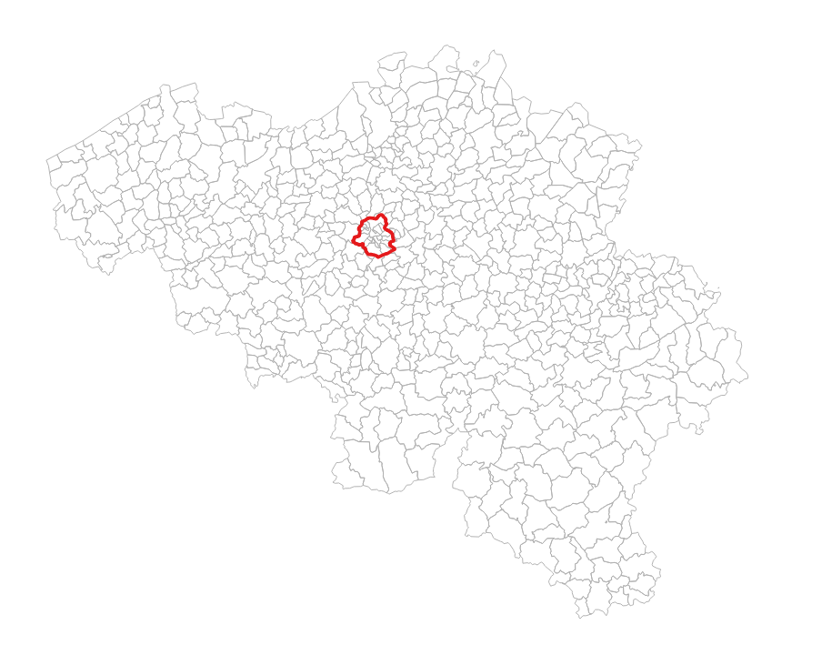
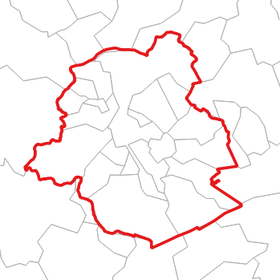
Brussels-Capital Region
1 administrative region (red)
19 local administrative units (grey) → all classified as cities
Main nature policies/legislation @ regional level

Slide 46
Identifying the urban ecosystem area
04

Slide 47
Article 14 §4
Preparation of the national restoration plans
4. Member States shall determine and map urban ecosystem areas as referred to in Article 8 for all their cities and towns and suburbs.
The urban ecosystem area of a city or of a town and suburb shall include:
(a) the entire city or town and suburb; or
(b) parts of the city or of the town and suburb, including at least its urban centres, urban clusters and, if deemed appropriate by the Member State concerned, peri-urban areas.
Member States may aggregate the urban ecosystem areas of two or more adjacent cities, or two or more adjacent towns and suburbs, or both, into one urban ecosystem area common to those cities, or towns and suburbs, respectively.

Slide 48
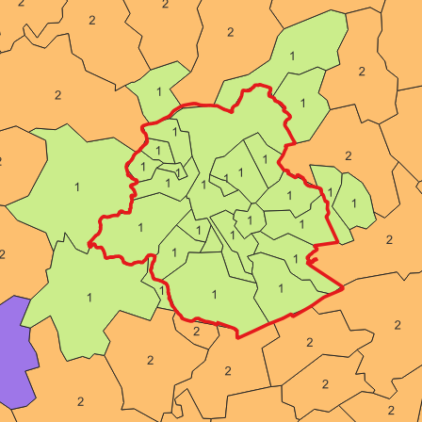
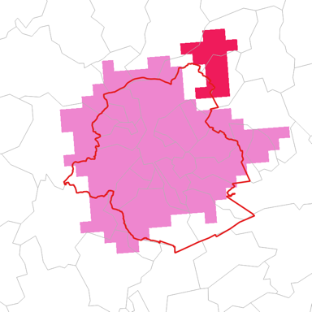
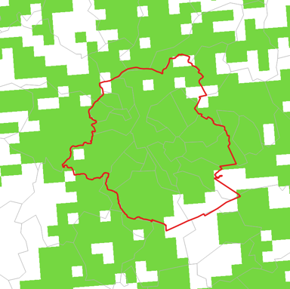
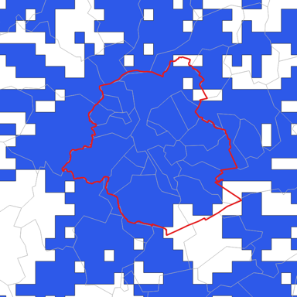
Option (a): entire city
Option (b): part of the city
Degree of Urbanisation (DGURBA_RG_01M_2021)
Urban centres (HDENS_CLST_2021)
Urban clusters (URBAN_CLST_2021)
D ≥ 1500 inhab./km²
P ≥ 50000 inhab.
4 point contiguity
D ≥ 300 inhab./km²
P ≥ 5000 inhab.
8 point contiguity
Source: Eurostat, mapping by BISA

Slide 49
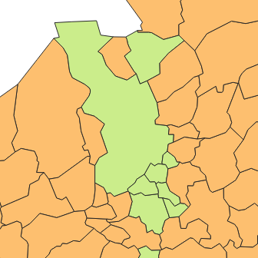
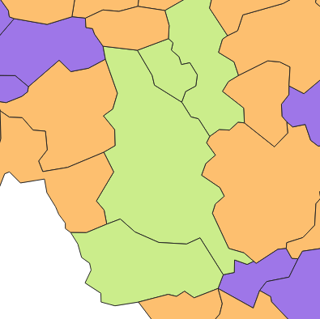
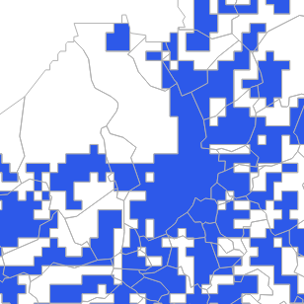
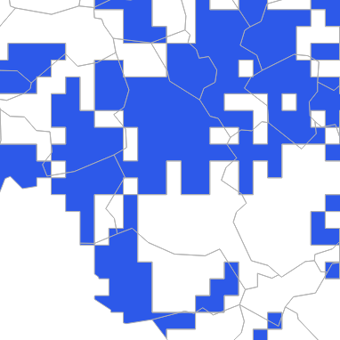
Brussels Capital-Region
Antwerp
Kortrijk - Mouscron
A
K
(a)
M
(b)
Source: Eurostat, mapping by BISA

Slide 50
Identifying the urban ecosystem area
Which option to select?
Parameters to consider:
Ease of method (calculations, delimitation)
Degree of ambition
Representativity of the situation on the field
Feasibility

Slide 51
Identifying the urban green spaces and urban tree cover
05

Slide 52
Article 3
Definitions
(20) ‘urban green space’ means the total area of trees, bushes, shrubs, permanent herbaceous vegetation, lichens and mosses, ponds and watercourses found within cities or towns and suburbs, calculated on the basis of data provided by the Copernicus Land Monitoring Service […], and, if available for the Member State concerned, other appropriate supplementary data provided by that Member State;
(21) ‘urban tree canopy cover’ means the total area of tree cover within cities and towns and suburbs, calculated on the basis of the Tree Cover Density data provided by the Copernicus Land Monitoring Service […], and, if available for the Member State concerned, other appropriate supplementary data provided by that Member State;

Slide 53
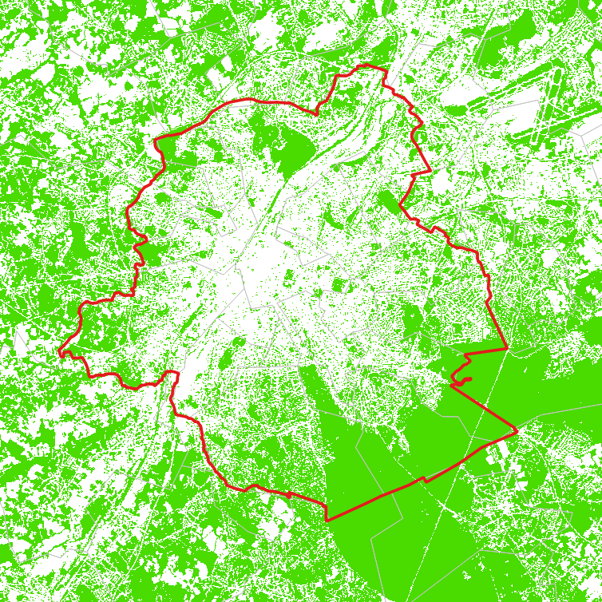
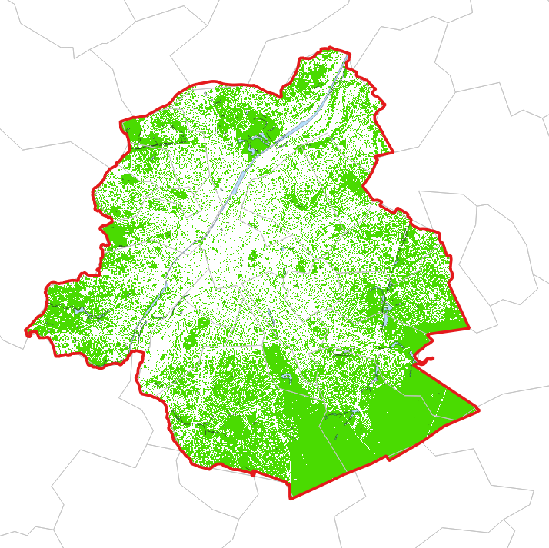
Copernicus Land Monitoring Service: CLC+ Backbone (2021)
Brussels Environment: vegetation (2021) + water (2025)
Woody (2-3-4)
Bushes & shrubs (5)
Permanent herbaceous (6)
Lichens & mosses (8)
Water (10)

Slide 54
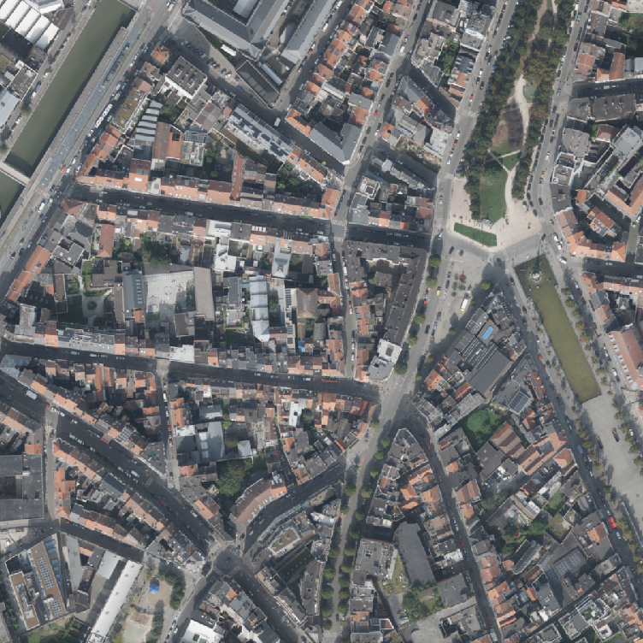
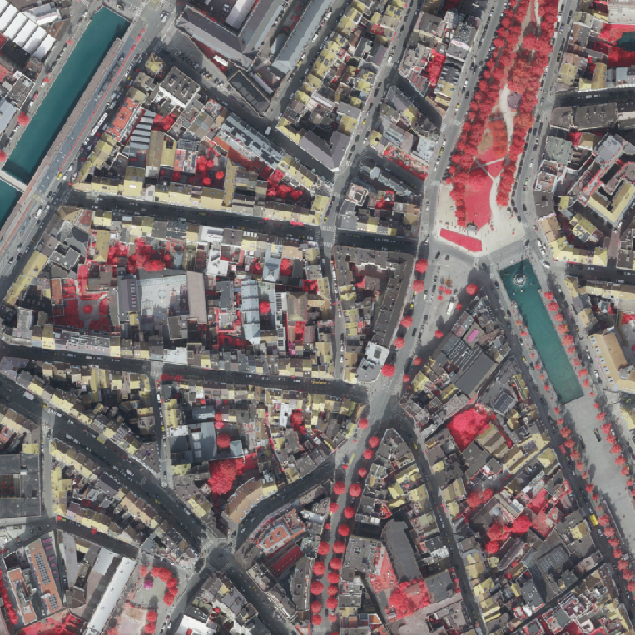
Paradigm (IT resources) : Orthophotoplan East-West (2021)
Paradigm (IT resources) : Orthophtoplan East-West – Near infrared (2021)

Slide 55
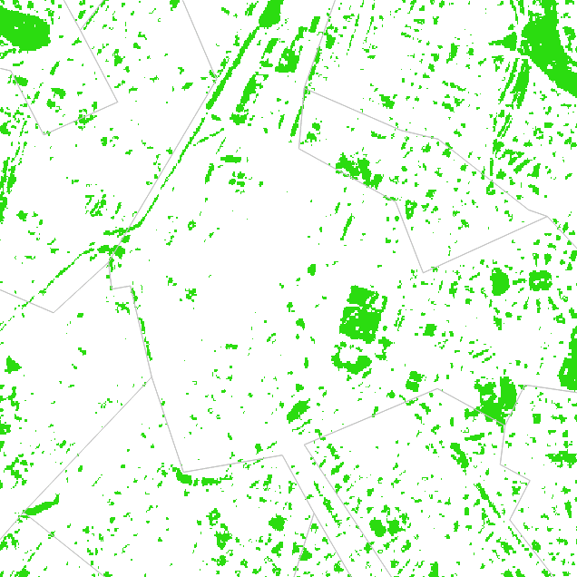
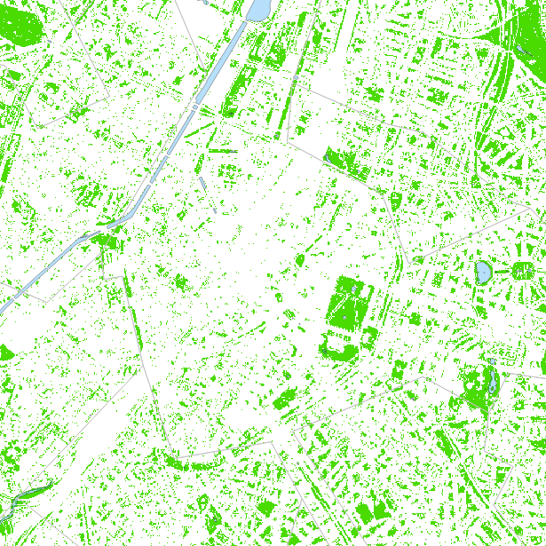
Copernicus Land Monitoring Service: CLC+ Backbone (2021)
Brussels Environment: vegetation (2021) + water (2025)

Slide 56
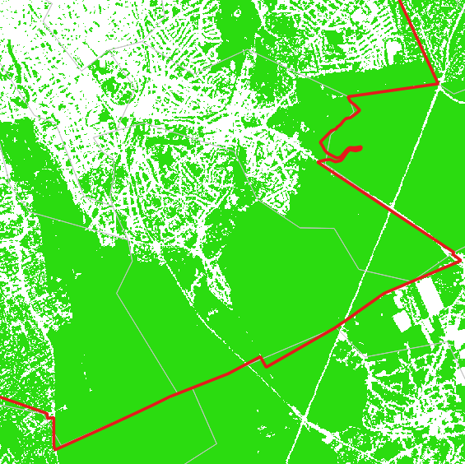
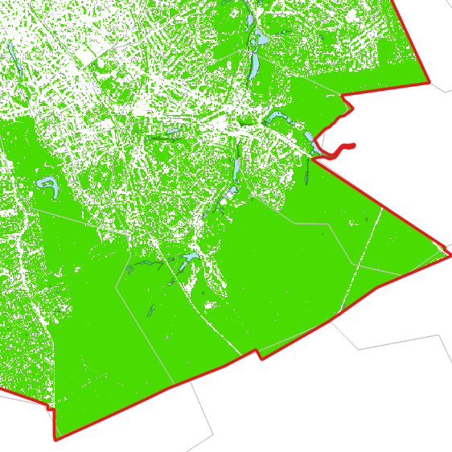
Copernicus Land Monitoring Service: CLC+ Backbone (2021)
Brussels Environment: vegetation (2021) + water (2025)

Slide 57
Article 3
Definitions
(20) ‘urban green space’ means the total area of trees, bushes, shrubs, permanent herbaceous vegetation, lichens and mosses, ponds and watercourses found within cities or towns and suburbs, calculated on the basis of data provided by the Copernicus Land Monitoring Service […], and, if available for the Member State concerned, other appropriate supplementary data provided by that Member State;
(21) ‘urban tree canopy cover’ means the total area of tree cover within cities and towns and suburbs, calculated on the basis of the Tree Cover Density data provided by the Copernicus Land Monitoring Service […], and, if available for the Member State concerned, other appropriate supplementary data provided by that Member State;

Slide 58
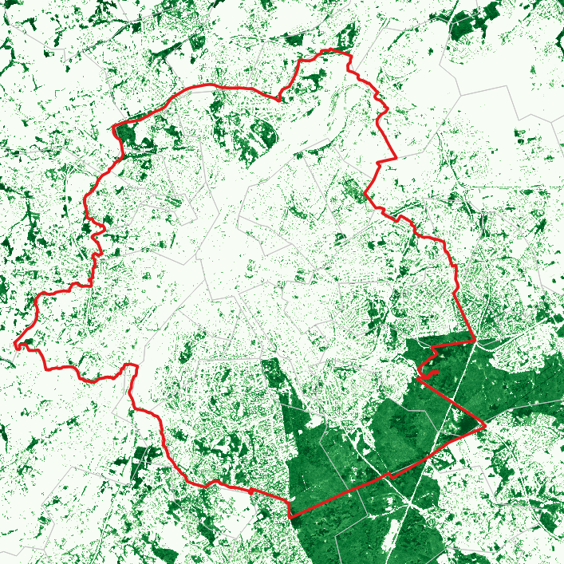
Copernicus Land Monitoring Service: tree cover density (2018)
Brussels Environment: high vegetation (2021)

Slide 59
Copernicus Land Monitoring Service: tree cover density (2018)
Brussels Environment: high vegetation (2021)

Slide 60
Copernicus Land Monitoring Service: tree cover density (2018)
Brussels Environment: high vegetation (2021)

Slide 61
Identifying the green spaces & Tree Cover
Which data to select?
Parameters to consider:
European obligation → working with Copernicus data as a basis
‘Other appropriate supplementary data’ → what is ‘appropriate’? what is ‘supplementary’?
Data that allow an increase in quality (precision, accuracy/reliability)
Data consistent over time and space
Methodology clearly described
How similar to the Copernicus data?
How can it be combined with the Copernicus data?
National level data?

Slide 62
Identifying possible exemptions
06

Slide 63
Article 8
Restoration of urban ecosystems
By 31 December 2030, Member States shall ensure that there is no net loss in the total national area of urban green space and of urban tree canopy cover in urban ecosystem areas, [...]. Member States may exclude from those total national areas the urban ecosystem areas in which the share of urban green space in the urban centres and urban clusters exceeds 45 % and the share of urban tree canopy cover exceeds 10 %.
From 1 January 2031, Member States shall achieve an increasing trend in the total national area of urban green space, including through the integration of urban green space into buildings and infrastructure, in urban ecosystem areas, […], until a satisfactory level […].
Member States shall achieve, in each urban ecosystem area, […] an increasing trend of urban tree canopy cover, […] until the satisfactory level […].

Slide 64
Target is met
Target is not met
EU data (Copernicus 2021/2018)
Supplementary data (2021)
≥ 45%
≥ 10%
≥ 45%
≥ 10%
1 region
19 LAUs
4
15
13
6
10
9
19
0

Slide 65
Target is met
Target is not met
EU data (Copernicus 2021/2018)
Supplementary data (2021)
≥ 45%
≥ 10%
≥ 45%
≥ 10%
1 region
No exemption
Possible exemption (is the data appropriate)?
19 LAUs
4
15
13
6
10
9
19
0
Exemption for 4 LAUs
No exemption for 15 LAUs
Possible exemption for 10 LAUs?
No exemption for 9 LAUs?

Slide 66
Conclusion and future issues
06

Slide 67
Implementing Article 8
Highly complex
Technically: the article itself, the data, statistical concepts, cartographic processing…
Politically: defining the territories, degree of ambition…
Concertation with the other two Belgian regions is desirable / needed (cf. national targets)
Questions remain
Availability of final Copernicus datasets (data for 2024)?
How to use the supplementary local data?
Future calculations: what happens after 2031?
From 1 January 2031, Member States shall achieve an increasing trend in the total national area of urban green space, including through the integration of urban green space into buildings and infrastructure, in urban ecosystem areas, […] until a satisfactory level […]

Slide 68
Thank you
Anne Franklin
afranklin@perspective.brussels
https://ibsa.brussels/
https://perspective.brussels/
https://environnement.brussels/

Slide 70
How can we use data for nature restoration?
Liv Toonen, Technology Project Lead, Space4Good

Slide 72
Find the trees
Sentinel 2 (Red Green Blue composite)

Slide 73
Find the trees
Sentinel 2 (False color composite)

Slide 74
Find the trees
Pleiades neo (Red Green Blue composite)

Slide 75
False color (NIR, RED, Green)
Sentinel 2 (Copernicus)- 10m
Pleiades Neo (Airbus) - 0.3m
Freely available in EU
Made freely available in NL by NSO

Slide 76
Satelliet data portaal
Funded by the Netherlands Space Office (NSO) to support national-scale monitoring.
Centralized access to high-resolution (up to 0.3m) multispectral imagery for all municipalities and provinces.
Broad application potential beyond vegetation monitoring: water quality, carbon assessment, air quality, and more.

Slide 77
Actueel hoogte bestand (AHN)
Nationwide digital elevation model (LiDAR-based)
Freely available & standardized data
Essential for water system and flood defense mechanisms
Also usable to monitor in detail vegetation, (infra)structures, and more.
Cost-effective: one central dataset, no redundant efforts

Slide 78
Project showcase: RetreevAIble
RetreevAIble aims to create a tree data and analytics platform that helps policymakers make data-driven decisions by providing insights into tree species, vegetation distribution, carbon sequestration, canopy cover, and tree health.
Earth Observation | Local Geoinformation | Artificial Intelligence
In collaboration with LucidMinds and UNL
Notes:
Space4Good’s mission is (read out)
We are doing this by combining
Earth observation which allows for Global scalability and cost efficiency,
Local geoinformation ensuring the highest accuracy and local context
As well as AI to create actionable insights and predict future outcomes

Slide 79
RetreevAIble
Data collection
AHN4 LiDAR & with HR multispectral nationwide coverage
Amsterdam area for training because of comprehensive tree database
AHN4 LiDAR
HR images
Tree database Amsterdam

Slide 80
RetreevAIble
Methodology flowchart
Tree segmentation on AHN4-based Canopy Height Model. Using existing tree database from Amsterdam to label species as training data. Calculate individual tree features from HR images and AHN LiDAR data. Train AI model to predict species.
Canopy cover/ Height Model
Segmented trees
Calculate features
Predicted species

Slide 81
RetreevAIble
Features LiDAR (Geometry & Intensity)
Linde
Acacia
Sierkers
Kastanje
Populier

Slide 82
Conclusions
High-resolution datasets (and LiDAR) are essential for detailed monitoring of non-uniform areas (e.g. green spaces in municipalities, and agroforestry systems), and tree-based analyses.
Remote sensing & machine learning can scale in-situ measurements, making monitoring more affordable and efficient.
Centralized data enhances nationwide environmental and climate monitoring, supporting initiatives like urban greening.
Biomass: 125 KG
Carbon: 62.5 KG
Height: 15 M
Health: Good

Slide 83
How can we use data for nature restoration?
Meta Berghauser Pont, Professor in Urban Morphology and Urban Design, Chalmers University of Technology in Gothenburg

Slide 84
Can we build denser cities without jeopardizing biodiversity and human wellbeing?
Meta Berghauser Pont, professor in Urban Morphology and Urban Design
Research Area

Slide 85
Knowledge gaps
Based on a review of research findings and pratcice
Variables used in density studies
Densification
Effects
63% population data
17% morphometrics
Berghauser Pont, M., Haupt, P., Berg, P., Alstäde, V., & Heyman, A. (2021). Systematic review and comparison of densification effects and planning motivations. Buildings and Cities, 2(1), 378–401. https://journal-buildingscities.org/article/10.5334/bc.125/

Slide 86
How the urban environment affects people and other species
Combining the fields of urban planning and urban ecology
PLATSENS
CENTRALITET
PLATSENS
TÄTHET
HABITAT
KVALITÉ
HABITAT
KONNEKTIVITET
Multiplyer
effect
MÄNNISKORS RÖRELSEMÖNSTER
movement and co-presence
ANDRA ARTERS ÖVERLEVNAD
Mortality, mobility and diversity
SOCIOEKONOMISKA
PROCESSER
EKOLOGISKA
PROCESSER

Slide 87
How the urban environment affects people and other species
Combining the fields of urban planning and urban ecology
PLATSENS
CENTRALITET
PLATSENS
TÄTHET
HABITAT
KVALITÉ
HABITAT
KONNEKTIVITET
Multiplyer
effect
MÄNNISKORS RÖRELSEMÖNSTER
movement and co-presence
ANDRA ARTERS ÖVERLEVNAD
Mortality, mobility and diversity
SOCIOEKONOMISKA
PROCESSER
EKOLOGISKA
PROCESSER

Slide 88
Synliggöra samband mellan stadsfrom och stadsliv
Interdiciplinära, kvantitativa, empiriska studier
1
PLATSENS
CENTRALITET
PLATSENS
TÄTHET
2
HABITAT
KVALITÉ
HABITAT
KONNEKTIVITET
Multiplyer
effect
MÄNNISKORS RÖRELSEMÖNSTER
movement and co-presence
ANDRA ARTERS ÖVERLEVNAD
Mortality, mobility and diversity
SOCIOEKONOMISKA
PROCESSER
3
EKOLOGISKA
PROCESSER

Slide 89
Social-Ecological Urbanism approach
Improve understanding, provide evidence, data and tools
Zofie Cimburova, PhD thesis 2022 (Trondheim University, Norway), Capturing the context: Developing GIS methods for modelling the ecosystem services of urban trees.

Slide 90
Advances Ecological Analysis
Habitat Network Analysis Tool (HNAT)

Slide 91
Advances Ecological Analysis
Habitat Network Analysis Tool (HNAT)
Other data can be added
Friction map
Patches and networks
Biotope map
Land cover data that consist of integer numbers (i.e. Biotope codes) corresponding to different Biotopes and types of exploited land.
higher probability of movement
Dispersal map
Habitat quality map
Functionality map
Parameter settings
The parameter table with information with three model-specific parameters. Most important is the disposal distance for the species studied.
Further, it defines a set of biotope-specific parameters that link the biotope to the species under investigation, including
Quality of the biotope,
Friction (is the biotope regarded a barrier?),
Source for reproduction.
Higher intensity of occupation

Slide 92
Advances Ecological Analysis
Habitat Network Analysis Tool (HNAT)
Other data can be added
Friction map
Patches and networks
Biotope map
Land cover data that consist of integer numbers (i.e. Biotope codes) corresponding to different Biotopes and types of exploited land.
higher probability of movement
Dispersal map
Habitat quality map
Functionality map
Parameter settings
The parameter table with information with three model-specific parameters. Most important is the disposal distance for the species studied.
Further, it defines a set of biotope-specific parameters that link the biotope to the species under investigation, including
Quality of the biotope,
Friction (is the biotope regarded a barrier?),
Source for reproduction.
Higher intensity of occupation

Slide 93
Advances Ecological Analysis
Habitat Network Analysis Tool (HNAT)
The ‘Habitat quality’ raster shows the rela.ve quality of exis.ng biotopes in terms of habitat
used by the focal species.
Friction map
Patches and networks
Biotope map
The Fricton map shows how resistance to dispersing individuals varies in the landscape
due to biotope compositon and existence of barriers. High values indicate greater barrier
effects compared to low values.
higher probability of movement
Dispersal map
Habitat quality map
Functionality map
Parameter settings
The Habitat quality map shows the relative quality of existing biotopes in terms of habitat
used by the focal species.
Higher intensity of occupation

Slide 94
Advances Ecological Analysis
Habitat Network Analysis Tool (HNAT)
Friction map
Patches and networks
Biotope map
higher probability of movement
Dispersal map
The Dispersal map shows the habitat connectivity, which has been calculated based on the Cost-distance Raster in combination with the Average dispersal distance specified in the Habitat Network
Parameter table.
the exported ‘Dispersal’ raster shows the habitat connec.vity in terms of costweighted
dispersal probabili.es, which has been calculated based on the Cost-distance
- 8 -
Raster in combina.on with the Average dispersal distance(x) specified in the Habitat Network
Parameter table.
Habitat quality map
Functionality map
Parameter settings
Higher intensity of occupation

Slide 95
Advances Ecological Analysis
Habitat Network Analysis Tool (HNAT)
Friction map
Patches and networks
Biotope map
By multiplying the pixel values representing the Quality and the likelihood that individuals
reach the pixel (i.e. the Dispersal probability), one gets map where habitat quality is weighted by the habitat connectivity.
A high value of functionality is only achieved if the habitat is both of good quality and highly reachable from the habitat types needed for e.g. reproduction or nesting.
higher probability of movement
Dispersal map
Habitat quality map
Functionality map
Parameter settings
Higher intensity of occupation

Slide 96
Habitat Network Analysis Tool (HNAT)
Required data
Naturvårdsverket’s Marktäckedata
Resolution 10x10 meter

Slide 97
Habitat Network Analysis Tool (HNAT)
Results dispersal with different datasets
Kindvall, O., Berghauser Pont, M., Stavroulaki, I., Lanemo, E., Wigren, L., & Levan, M. (2024). Predicting habitat functionality using habitat network models in urban planning. Environment and Planning B: Urban Analytics and City Science, 0(0). https://doi.org/10.1177/23998083241299165

Slide 98
Habitat Network Analysis Tool (HNAT)
Results functionality with different datasets
Kindvall, O., Berghauser Pont, M., Stavroulaki, I., Lanemo, E., Wigren, L., & Levan, M. (2024). Predicting habitat functionality using habitat network models in urban planning. Environment and Planning B: Urban Analytics and City Science, 0(0). https://doi.org/10.1177/23998083241299165

Slide 99
Habitat Network Analysis Tool (HNAT)
Habitat restoration potential where quality is high, but dispersal limited

Slide 100
Habitat Network Analysis Tool (HNAT)
Technical details and license
Technical details
Habitat Network Analysis Tool is a plugin for the open-source Geographic Informa.on System QGIS (hIps://qgis.org/en/site/).
The plugin is written in Python and uses QGIS GDAL(Geospa.al Data Abstrac.on Library) and GRASS (Geographic Resources Analysis SupportSystem) via the QGIS processing framework for some of its calcula.ons.
The plugin adds a processing algorithm to the QGIS Processing Toolbox, which means it can be used either directly from the QGIS Processing Toolbox or in QGIS Modeler.
Download and Licence
The application is available via: hIps://github.com/SMoG-Chalmers/hnat
You can also download the documenta on and training input files.
The code is released under GNU General Public License and is available at hIps://github.com/SMoG-Chalmers/hnat/releases/tag/v0.1.3

Slide 102
What is the main challenge for you in understanding and monitoring urban green space and tree canopy cover in cities?
ⓘ Start presenting to display the poll results on this slide.

Slide 103
Final thoughts
Leon Kapetas, Lead for Programs and Climate Resilience for the Resilient Cities Network Europe and Middle East

