Slide 1

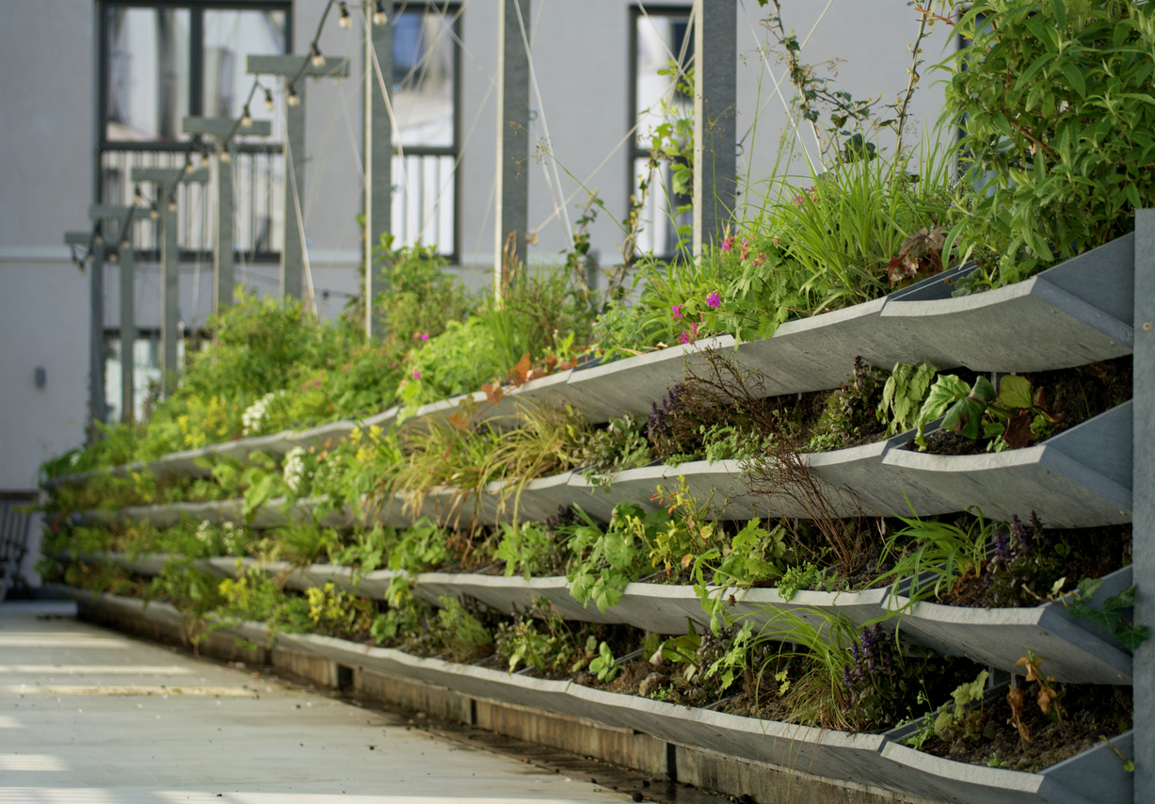
Nature Restoration Law webinar series
Webinar #2: developing a municipal roadmap for urban ecosystem restoration
Leon Kapetas
External Expert EUI
Resilient Cities Network

Slide 2



House rules
Use the code: #NRL

Slide 3
Nature Restoration Law webinar series
Article 8: urban ecosystem restoration
No net loss of urban green space or tree canopy cover in urban ecosystem areas by 2030
March-June 2025 supporting cities with the implementation of the NRL
Cities need to rethink urban planning …
Baselines and data
What are the baselines for green space and tree canopy? What data to use?
Municipal roadmap
Which departments need to be involved?
What policies need to be considered?
Building and spatial regulations
Policies for new developments
Policies for retrofitting existing developments
Citizen owned land
Policies to engage citizens and raise awareness
Policies to support greening efforts
Privately owned land (business)
Policies to support business investment in offsetting?
Targets for business?
National Restoration Plan
What do cities need to do? How can cities work with member states?
Notes:
Member States shall determine and map urban ecosystem areas as referred to in Article 8 for all their cities and towns and suburbs.

Slide 4
Nature Restoration Law webinar series
No net loss of urban green space or tree canopy cover in urban ecosystem areas by 2030
Webinar #1 looked at the starting point: what are the definitions to be aware of? what are the baseline years?
Data is based on land cover; not land use
URBAN ECOSYSTEM AREA: (Article 14)
The urban ecosystem area of a city or of a town and suburb shall include:
the entire city or town and suburb; or
parts of the city or of the town and suburb, including at least its urban centres, urban clusters and, if deemed appropriate by the Member State concerned, peri-urban areas.
Member States may aggregate the urban ecosystem areas of two or more adjacent cities, or two or more adjacent towns and suburbs, or both, into one urban ecosystem area (…).”
URBAN CENTRE + CLUSTER
URBAN GREEN SPACE
URBAN TREE CANOPY COVER
Data set: Eurostat
Baseline for NRL: 2021 ref
Data set: CLC+ backbone
Baseline for NRL: 2023 ref
Data set: High Resolution Layer Tree Cover Density
Baseline for NRL: 2023 ref
What supplementary data can be used? How often would that data need to be updated? How can we address the lack of quality in the urban targets?
Notes:
Member States shall determine and map urban ecosystem areas as referred to in Article 8 for all their cities and towns and suburbs.

Slide 5
Webinar #2: how to develop a municipal roadmap for nature restoration
How can your city plan for urban ecosystem restoration?
  Philipp Lahaela-Walter, Head of Biodiversity Head of Biodiversity and Nature-Based Solutions, ICLEI
What is needed in the short term? In the longer-term?
  Victoria Perez Garcia, Fondation Biodiversidad
How are cities working on this already?
  Tarja Soderman, Director of Environment, city of Espoo
  Albin Hunia, Senior Policy Advisor, city of Utrecht
Notes:
Before we jump into this, we’re going to explore some of the main findings of a survey some of you responded to on how to monitor nature plans. I’ll hand over now to Leon Kapetas who will share these key findings and take us through the presetnations today.

Slide 6
Greening Cities Partnership:
Monitoring Urban Nature Plans Across Europe
Initial findings from 89 municipalities across 11 EU countries
Leon Kapetas
NBS expert EUI - Greening Cities Partnership
Resilient Cities Network

Slide 7
Scope and Objectives
Assess current status and capacity of cities/towns in planning and monitoring Urban Nature Plans (UNPs)
Gather examples of local greening strategies, success stories, and challenges
Inform policy and support structures for the Urban Agenda for the EU

Slide 8

Survey Design and Participation
Structured online questionnaire with both closed and open-ended questions
89 responses from 11 EU countries (highlight Spain and Croatia’s high participation)
Mix of municipal sizes: The vast majority (74 cities/towns, 83.1%) reported having more than 20,000 residents, while 15 respondents (16.9%) came from smaller municipalities.
Mix of respondent profiles (technical, political, managerial)
Distribution of responses by country (number of responses by country,
darker green indicates higher participation).

Slide 9
Status of the UNPs
Status of Urban Nature Plans development among respondents
Out of the 89 participating cities/towns, 29.2% (26 cities) reported having an established UNP or equivalent, 44.9% (40 cities) indicated they are currently developing one, 11.2% (10 cities) were uncertain about the existence of such a plan, while 14.6% (13 cities) stated they do not have a UNP and are not planning to develop one in the short term.
45
29
15
11

Slide 10
Barriers to develop a UNP
Funding Gaps– Limited budgets, especially in smaller cities
Lack of Staff & Coordination– Few trained personnel, siloed departments
Territorial & Legal Complexity – Overlapping jurisdictions, outdated spatial plans
Overlapping Strategies – Existing plans seen as sufficient
Low Priority / Unclear Mandates – “No capacity” or political disinterest
Barrier Theme | Mentions | Percentage
Insufficient Financial Resources | 8 | 20.5%
Limited Institutional Capacity & Coordination | 8 | 20.5%
Territorial Complexity & Legal Overlaps | 6 | 15.4%
Perceived Redundancy with Existing Plans | 4 | 10.3%
Other or Unspecified Barriers | 9 | 23.1%

Slide 11
Existence of other related strategies
Green Infrastructure & Biodiversity Plans: focus on native species protection, ecological connectivity, and nature-based solutions.
Climate Adaptation & Resilience Strategies: use of green infrastructure to manage heat, floods, and water systems.
Integrated Urban Planning Approaches: embedding greening goals into broader urban agendas and planning frameworks.
Participatory & Place-Based Projects: community-led initiatives to co-design and transform local green spaces.
Flagship Renaturation Projects: large-scale restoration of natural assets like riverbeds and urban forests.
EU-Linked Strategies & Frameworks: greening strategies developed through EU-funded projects or national sustainability plans.

Slide 12
Local Monitoring Readiness
26
52
2
26
Indicators monitored by cities
Awareness among respondents regarding how their city or town will measure urban green space and tree canopy cover

Slide 13
Methods for measuring indicators
Method/Source | Count | % of Total (out of 31)
GIS and mapping tools | 20 | 64.5%
Remote sensing (NDVI, LiDAR, satellite) | 17 | 54.8%
Urban tree/green space inventories | 14 | 45.2%
Management software (e.g. i-Tree, ENVIMET) | 9 | 29.0%
Citizen science / open data platforms | 6 | 19.4%
Academic / expert collaboration | 5 | 16.1%
National framework / indicator-based | 4 | 12.9%
Not sure / insufficient information | 3 | 9.7%

Slide 14
Monitoring of additional indicators
Indicator Category | %
Biodiversity and Species Monitoring | 27
Renaturation and Restoration | 16.2
Tree Canopy and Coverage | 16.2
Green Area per capita | 13.5
Air and Water Quality | 10.8
Climate Adaptation and Resilience | 8.1
Soil and Land Use | 5.4
Connectivity and Ecological Networks | 2.7
Carbon Sequestration and Emissions | 2.7
Monitoring of additional indicators by responding cities
Frequently mentioned categories of additional indicators

Slide 15
Additional Suggested Indicators
Thematic Area | Example Indicators
Biodiversity and Habitat Enhancement | • Number of flora/fauna species • Area of renaturalised or protected habitats • Invasive/native species balance
Green Space Management and Accessibility | • Green space per inhabitant (m²) • Distance to nearest green space • Number of green areas created or maintained
Climate Change Adaptation and Resilience | • Urban heat island reduction • Number of climate-adapted species • Volume of reused stormwater
Air and Water Quality | • PM2.5 / NO2 concentrations • Water quality (e.g. dissolved oxygen, turbidity) • Days exceeding pollution thresholds
Green Connectivity and Corridors | • Length of ecological corridors (km) • Number of connected green spaces • Continuity of canopy or habitat corridors
Citizen Engagement and Education | • Number of citizens in greening initiatives • Perception of space quality • Number of environmental education programs
Social Justice and Health | • Accessibility of green spaces by vulnerable groups • Physical activity or health outcomes linked to nature • Gender participation in planning
Circular Economy and Resource Efficiency | • Recycling rates of materials used in green infrastructure • Reuse of permeable or sustainable materials • Green job creation
Governance, Planning, and Monitoring | • Annual municipal budget for urban nature • Existence of indicator monitoring systems • Integration of indicators in strategic planning documents

Slide 16
Challenges in the implementation of UNPs

Slide 17
Key Findings
UNPs are expanding: nearly three-quarters of respondents have a UNP in place, in development, or planned for the future.
Strong strategy backbone: 75% of cities have other strategies (e.g., green infrastructure, adaptation, or biodiversity plans) that support urban greening.
Innovative local actions: Cities shared diverse initiatives, often multi-thematic, linking renaturation, biodiversity, climate action, and public engagement.
Monitoring readiness varies: Over half of cities monitor green space and canopy cover, but many are unsure about boundaries or indicators for EU reporting.
Rich use of tools: Methods include NDVI, LiDAR, i-Tree, local GIS apps, biodiversity inventories, and open datasets.
Thematic priorities: Most mentioned include green space management, biodiversity, climate resilience, connectivity, and air/water quality.
Locally relevant indicators: Cities proposed detailed and locally adapted indicators under each theme, going beyond surface-level metrics.
Capacity gaps remain: Key barriers include financial constraints, lack of technical staff, and limited know-how.
Reflections call for action: Cities ask for clearer EU guidance, recognition of local ecosystems, quality-focused indicators, and a greater role for local governments in implementation.

Slide 18
Thank you
Leon Kapetas
lkapetas@resilientcitiesnetwork.org

Slide 19
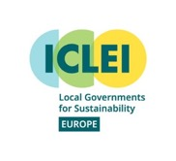
UNP+
Enhanced Urban Nature Plans for Biodiversity Mainstreaming in Society
Horizon Europe Project, 2024-2026

Slide 20



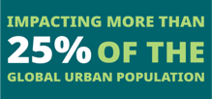



About ICLEI
ICLEI - Local Governments for Sustainability is a global network of more than 2,500 local and regional governments committed to sustainable urban development.
Active in 100+ countries, we influence sustainability policy and drive local action for low emission, nature-based, equitable, resilient and circular development.
Our Members and team of experts work together through peer exchange, partnerships and capacity building to create systemic change for urban sustainability.

Slide 21

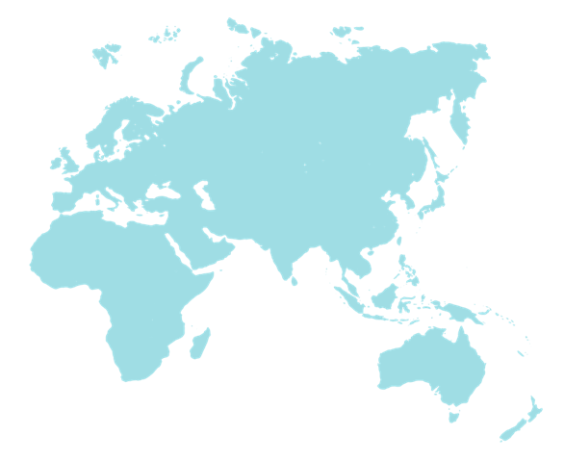
ICLEI, Local Governments for Sustainability
USA Office
Denver, USA
World Secretariat
Bonn, Germany
East Asia Secretariat
Seoul, South Korea
Canada Office
Toronto, Canada
Berlin Office
Berlin, Germany
Japan Office
Tokyo, Japan
Mexico, Central America & Caribbean Secretariat
Mexico City, Mexico
Korea Office
Seoul, South Korea
Kaohsiung Capacity Center
Seoul, South Korea
Brussels Office
Brussels, Belgium
European Secretariat
Freiburg, Germany
South America Secretariat
São Paulo, Brasil
South Asia Secretariat
New Delhi, India
South East Asia Secretariat
Manila, Philippines
Indonesia Project Office
Jakarta, Indonesia
Project Office
Country Office
Secretariat office
Africa Secretariat
Cape Town, South Africa
Oceania Secretariat
Melbourne, Australia
21
iclei-europe.org
ICLEI_Europe
@ICLEI_Europe
@ICLEI_Europe
@ICLEI Europe
ICLEI_Europe

Slide 22





THE FIVE ICLEI PATHWAYS
LOW EMISSION DEVELOPMENT
NATURE-BASED DEVELOPMENT
EQUITABLE AND PEOPLE CENTERED DEVELOPMENT
RESILIENT DEVELOPMENT
CIRCULAR DEVELOPMENT
The FIVE ICLEI PATHWAYS reflect ICLEI’s approach to achieving a sustainable city as well as local contributions to implementing the goals laid out in international frameworks such as the Sustainable Development Goals. We also look at how the pathways connect to bring about change in an INTEGRATED way.
In UNP+, ICLEI is actively working with cities to support their work in the nature-based development pathway, supported by topical and communication experts.
iclei-europe.org
ICLEI_Europe
@ICLEI_Europe
@ICLEI_Europe
@ICLEI Europe
ICLEI_Europe

Slide 23















Impact through projects
NBS4Drought
SoilTribes
iclei-europe.org
ICLEI_Europe
@ICLEI_Europe
@ICLEI_Europe
@ICLEI Europe
ICLEI_Europe

Slide 24
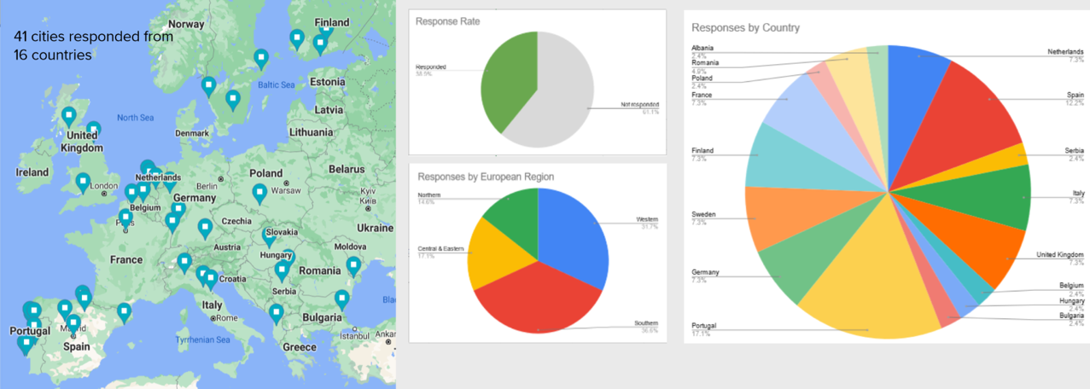
Written Consultation
Notes:
Since early 2021, we engaged in the development process for the UNP guidance & toolkit in a contract with the European Commission.
We drew from a number of key publications and incorporated input from over 100 key stakeholders including over 40 municipalities with an excellent track record in bringing nature back to cities.

Slide 25
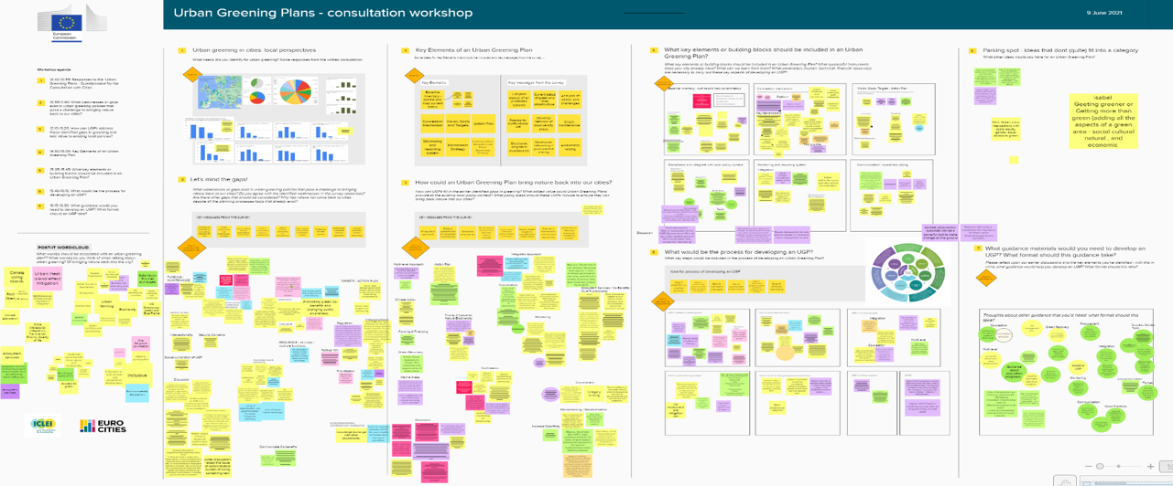
Workshops

Slide 26
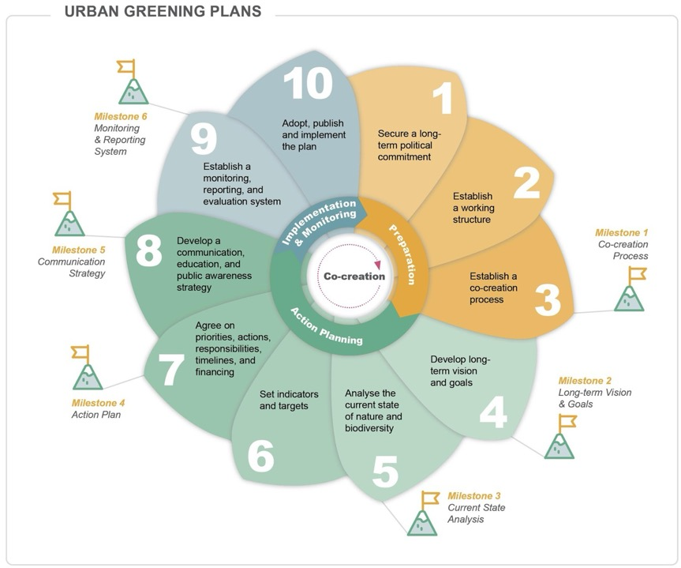
Urban Nature Plans Methodology

Slide 27
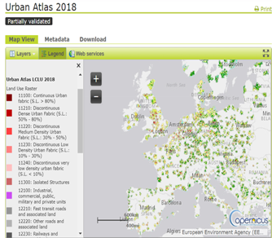
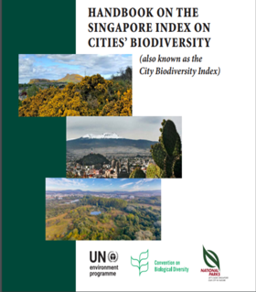
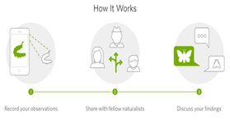

Urban Nature Plan Toolkit
Support cities in the implementation of the Urban Nature Plans
Structured around the phases and steps
Tools ranging from EU level data to citizen-led initiatives
Each tool includes an overview, ‘how to use’ and ‘alternatives’

Slide 28
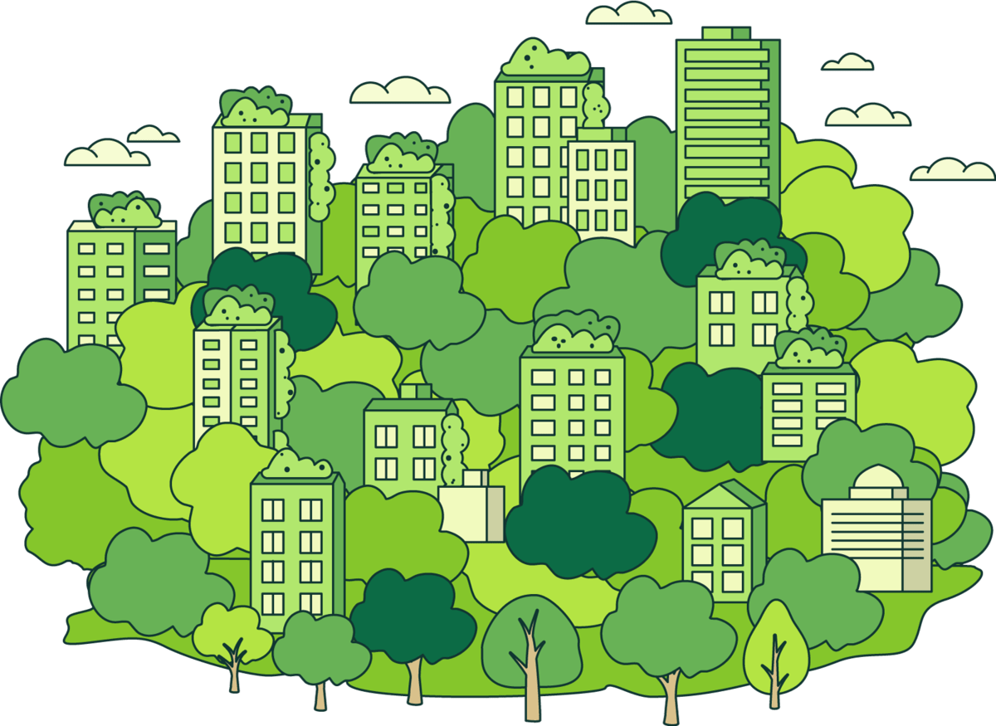
The UNP+ Project
UNP+ proposes a next generation Urban Nature Plan framework for European Cities.
This is a forward-looking, systemic, integrated, and inclusive planning instrument capable of realising meaningful and lasting impacts in bending the curve of biodiversity loss.

Slide 29





Intended Outcomes
Leverage the power of co-creation to test, assess, and ultimately improve the UNP framework, supporting partner cities in achieving ambitious EU environmental targets.
Facilitate peer to peer and reflexive learning opportunities for participating cities.
Support participating cities in integrating justice and equity into spatial planning processes.
Foster public private partnerships, inspire collaborative business models, and encourage innovative financing within the field of nature-based solutions.
Create and test planning and evaluation tools that link social, environmental, and more-than-human justice and resilience perspectives.
Transform urban ecosystems by embracing and enhancing
biodiversity protection and sustainability

Slide 30
Process and Tools
Mission: Develop thriving, biodiverse cities across Europe with green spaces accessible to all.
Scaling Mechanisms
Greening Cities
  Learning by doing
  Learning by interacting
  Reflexive Learning
  Paris
  Barcelona
Approach: Integrate city-led initiatives into national sustainability strategies
  Scaling up
  Scaling out
  Scaling Deep
  Burgas
  Belgrade
  Mannheim
Knowledge Creation
Lighthouse Cities
Goal: Make urban nature the norm, not the exception.

Slide 31
What‘s the PLUS?
Develop
further tools
Foster
co-creation
Propose integration strategies
Overcome departmental silos
UNP+
Promote the existing Process
Support coordination and collaboration between levels of government

Slide 32

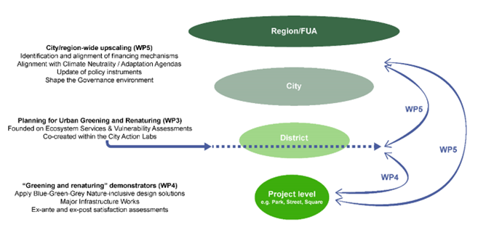
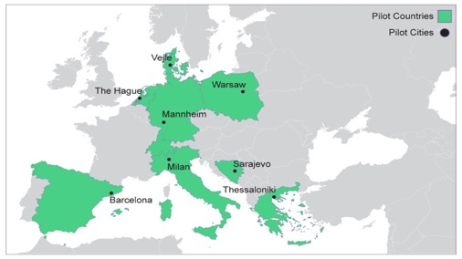
Participatory urban greening and renaturing towards climate neutrality and resilience in European cities
Notes:
A new project just starting is Commit2Green. Utilising a Cross-Scaler Approach, commit 2 green will build on the UNP+ project by creating urban nature plan guidelines for the eight pilot cities involved in the project. EAch pilot city will co-design and implement cross-scalar, participatory greening and renaturing strategies at the community level. These cities serve as pilot sites for testing and scaling effective approaches. The project connects the district-level initiatives with broader urban strategies, ensuring that green interventions contribute to long-term ecological connectivity and integrated urban planning.. The primary aim of C2G is to help cities unleash the transformative potential of urban greening and renaturing towards becoming more inclusive, equitable, liveable, resilient, healthy, and climate neutral environments.
Pilot cities are
Barcelona
Veijle​,
The Hague​
Mannheim​
Milan​
Sarajevo​
Thessaloniki​
Warsaw

Slide 33


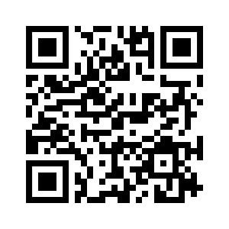
One-stop-shop for YOU
Local and sub-national governments and public authorities
NbS investors and entrepreneurs
Subnational, national and EU policy-makers
Educators, education institutions and students
... expand their skills and knowledge along policy areas of the EGD through dedicated tools and best practices, a peer-to-peer exchange and capacity-building programme.
…benefit from guidance to help understand and enhance the attractiveness of NbS for investors, access opportunities for collaborations with investors, extend and create peer- and cross-sector networks through the delivery of guidance and training
…benefit from better implementation of policies with the support of NN+ NbS products & services packages, and recommendations for policy integration
…benefit from NbS educational materials, and innovative engagement methods to reach new audiences (including artist co-production with scientists, gaming, festivals) - all to foster the integration and excitement of NbS in transdisciplinary education (at different levels).
33

Slide 34
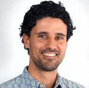
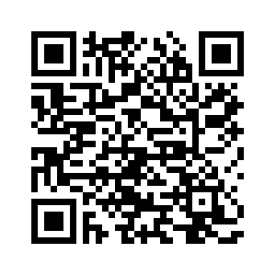
Thank You for Your Attention!
    Philipp LaHaela Walter
    Head of Biodiversity & NbS
    ICLEI Europe
Notes:
Many thanks for inviting us to this presentation and for your attention!
Here a few links you might find useful:
ICLEI Europe
UNP+ Project
NetworkNature
Commit2Green
Feel free to contact me directly at philipp.lahaela-walter@iclei.org
Thank you!

Slide 35
Urban Nature Restoration
How to develop a metric-based roadmap for urban natura restoration
April 22nd
Victoria Pérez
Cities Area Coordinator
Fundación Biodiversidad
Ministry for Ecological Transition and the Demographic Challenge, Spain

Slide 36
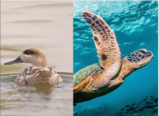
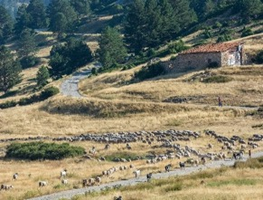
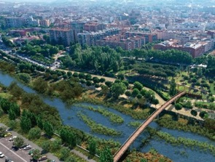
Biodiversity Foundation
Fundación Biodiversidad’s mission is to integrate the conservation and restoration of nature across sectors and territories (natural, rural and urban) and address the causes behind the loss of biodiversity

Slide 37

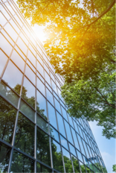
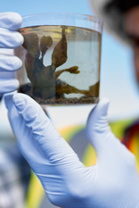
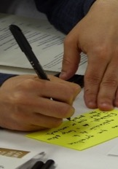
Biodiversity Foundation
Our work involves different stakeholders:
Public sector
Private sector
Academia
Civil society

Slide 38
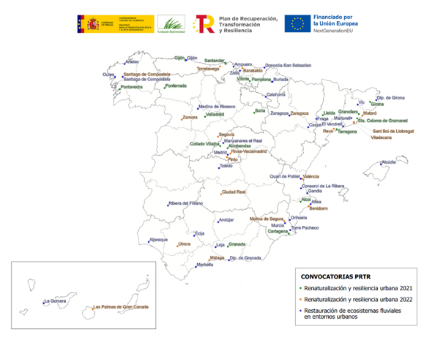
Renaturalization and urban resilience calls
Recovery, Transformation and Resilience Plan (Next Generation)
194 M€
73 projects
Restoration of fluvial ecosystems in urban environments 2021
36 projects
Renaturalization and urban resilience 2021
18 projects
Renaturalization and urban resilience 2022
19 projects

Slide 39
Renaturalization and urban resilience projects
Participation of research centers and non-profits permitted
Citizen participation and communication activities required
Interventions integrated into the city's strategic planning and with the support of the municipal council

Slide 40





Expected results
Resilient, sustainable, inclusive and just cities
Green
strategy
Multi sectorial
Climate
Change
NbS
Alliances

Slide 41
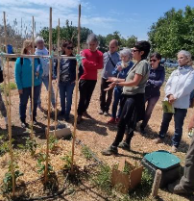
Renaturalization and urban resilience projects
MULTIFUNCTIONAL, MULTILEVEL, MULTIDISCIPLINARY AND PARTICIPATORY APPROACH
Action A
Action B
Action C
STRATEGIC TOOLS
NATURALIZATION ACTIONS
OTHER ACTIONS
TRANSFORMATIVE, SCALABLE, TRANSFERABLE AND SUSTAINABLE PROJECTS

Slide 42
Action A: Urban Nature Plan
Basic elements (short term)
Desirable (short or medium term)
MULTISCALE DIAGNOSIS:
  Identity the elements of the Green Infrastructure
  Conservation status of habitats
  Knowledge about local flora and fauna
  GIS MAPPING AND ANALYSIS
  Urban and peri-urban connectivity
  Climate change risks
  Opportunities
LINES AND ACTIONS to strengthen and manage Green Infrastructure
Urban tree inventory
Compatibility with urban planning
Quantification of ecosystem services
Biodiversity monitoring
Ecological maintenance plan

Slide 43







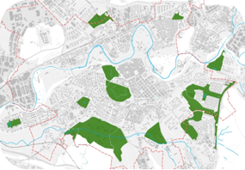
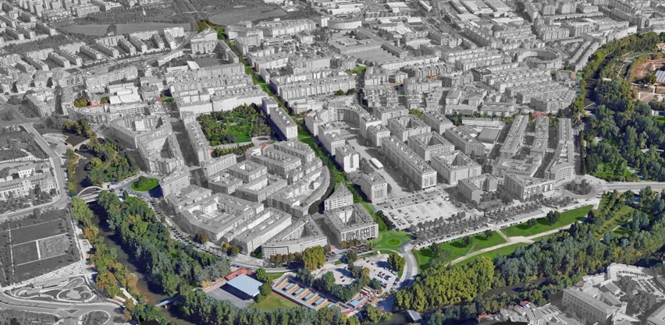
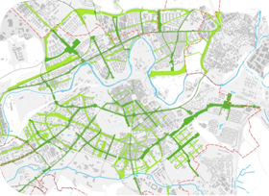
Some examples
Green and blue infrastructure plan in Pamplona. Proyecto RUNA. Pamplona
Corredor Verde Urbano CVU-17
Avda. de San Jorge
Territorio Fluvial del Arga
Refugios de biodiversidad en el Arga RB-13
Acción Piloto AP-02
Red de Refugios de Biodiversidad
Itinerario Verde ITV-02
Vía Verde del Plazaola
Corredor Verde Urbano CVU-02
C/ Bernardino Tirapu
Acción Piloto AP-08
Pérgola de Anelier
Acción Piloto AP-07
Calle Urzainqui
Corredor Verde Urbano CVU-055
Paseo de los Enamorados
Acción Piloto AP-06
SUDS aparcamiento Cardenal Ilundain
Nodo NU-03
OBLATAS
PARQUE FLUVIAL DEL ARGA
APARCAMIENTO DE CORRALILLOS. Rotxapea
Zona Territorio Fluvial
BARRIO DE Rochapea / Arrotxapea

Slide 44
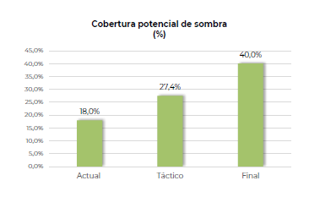
Some examples
Updating of the UGI System in Granollers.
FEUT. Proyecto CoCoNat_ Granollers

Slide 45
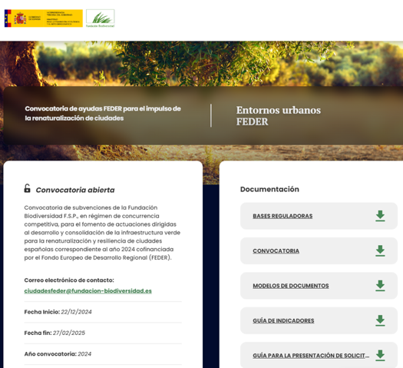
www.fundacion-biodiversidad.es
Renaturalization and urban resilience calls
“Guidance for measuring and monitoring indicators for re-naturalisation and resilience projects in Spanish cities”
Indicator Matrix

Slide 46
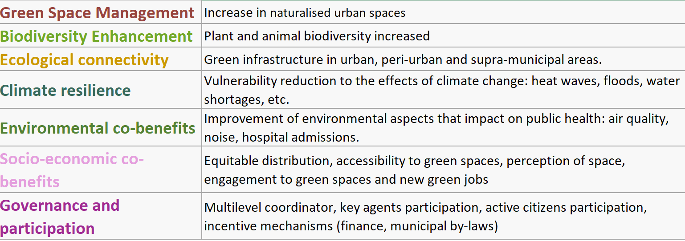
Indicators system

Slide 47
Ecological connectivity
Urban tree cover
It is recommended to calculate it based on available resources (LIDAR, I-Tree, etc.)
GRANOLLERS
Propuesta final
15.938 árboles en la vía pública +113%

Slide 48
Social-Economic co-benefits
Provision of green áreas for public use per capita
Proximity to a green area for public use
Green area >0,1 ha <300m
Green area >0,5 ha <500m
Green area >1 ha <900m
Green area >10 ha < 4 km
Urban green infrastructure strategy of Sant Boi. Barcelona. Sant Boi Breathes Project

Slide 49
Thank you
Victoria Pérez
Cities Area Coordinator
vperez@fundacion-biodiversidad.es

Slide 50

How to develop a municipal roadmap for urban nature restoration
Nature-wise Espoo roadmap
Greening cities webinar
22 April 2025
Tarja Söderman,
Director of Environmental Affairs
City of Espoo
Nature-wise Espoo

Slide 51
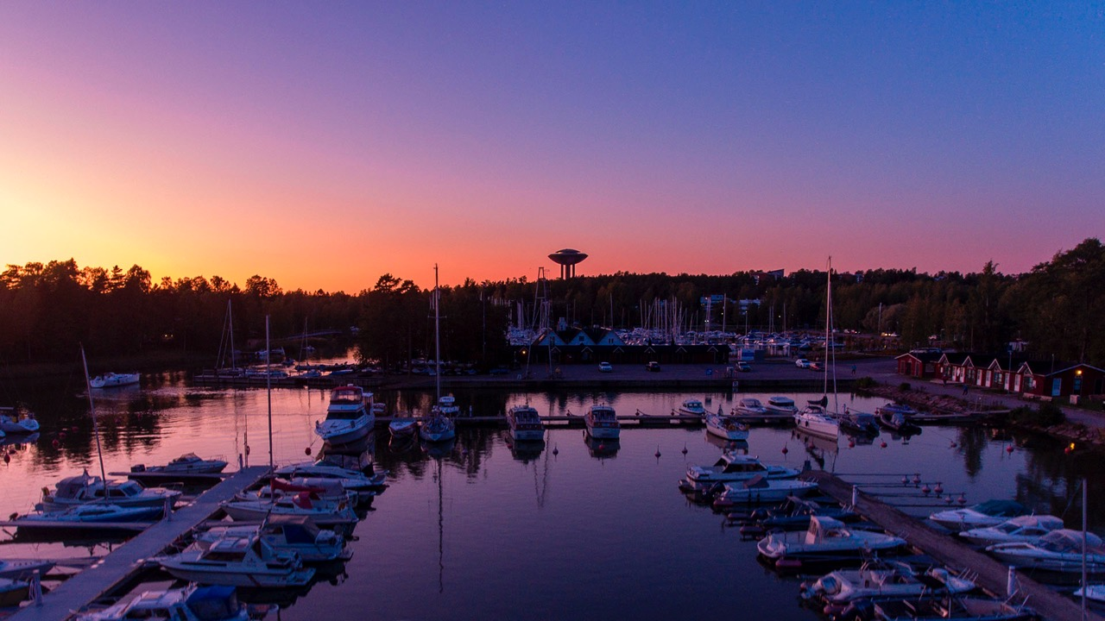
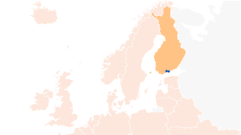
Challenge: How to grow
and stay green?
Espoo
Espoo is the second-largest city in Finland and a part of the Helsinki Metropolitan Area.
Espoo
Helsinki
321,030 Population 31 Dec 2024
7,500
Population growth
Jan-Dec 2024 (approx)
2,2%
Annual growth rate
Jan-Dec 2024
528 km²
Area
185 km²
Green areas
13%
Strictly protected nature of the land area

Slide 52
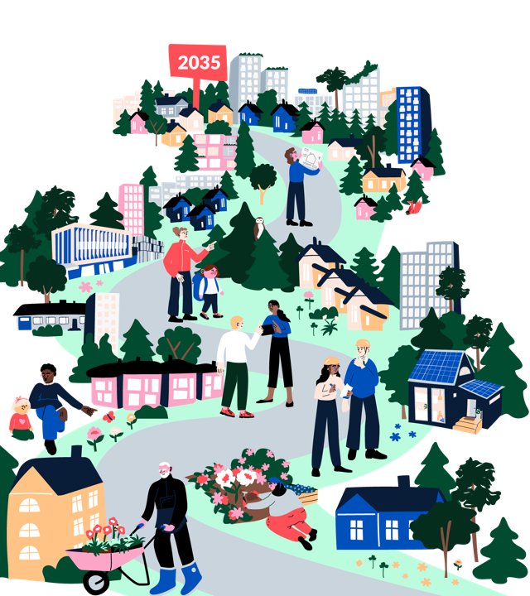
Presentation
Journey of preparing and implementing the No Net Loss of biodiversity municipal roadmap in the City of Espoo
Example of a concrete measure of the roadmap
– piloting ecological restoration on 18 sites
Concluding with political and managerial context
– what factors contribute success in developing a municipal roadmap to halt biodiversity loss
Drawings: City of Espoo

Slide 53
Goals of Nature-wise roadmap
We need new ways to safeguard biodiversity
The city strategy, the Espoo story, for this council season 2021 – 2025 set an objective to prepare a roadmap so that biodiversity can recover, and we can achieve No Net Loss of biodiversity by 2035
The best means at our disposal
Preparing for changes in EU-level and national legislation
Encourage the entire Espoo community to act for biodiversity

Slide 54
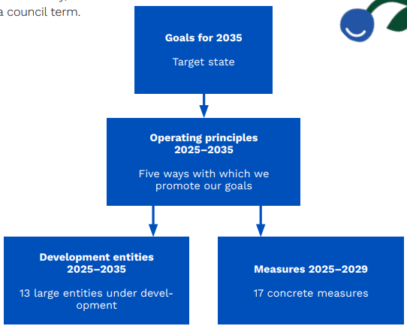

Putting strategic goals into action step by step
Espoo Story
Espoo is a pioneer in combining a growing city and diverse nature. Espoo’s urban development fosters, revives and increases biodiversity. We prepared a roadmap to support the recovery of biodiversity and achievement of no net loss of biodiversity by 2035.
The roadmap consists of four different steps:
goals,
operating principles,
development entities,
measures

Slide 55
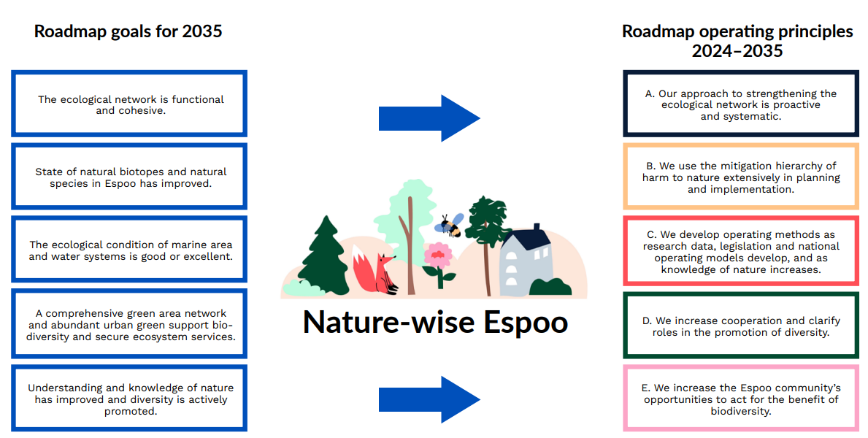
Achieving goals through operating principles
B. We use the mitigation hierarchy in planning and implementation to alleviate harm to nature.

Slide 56


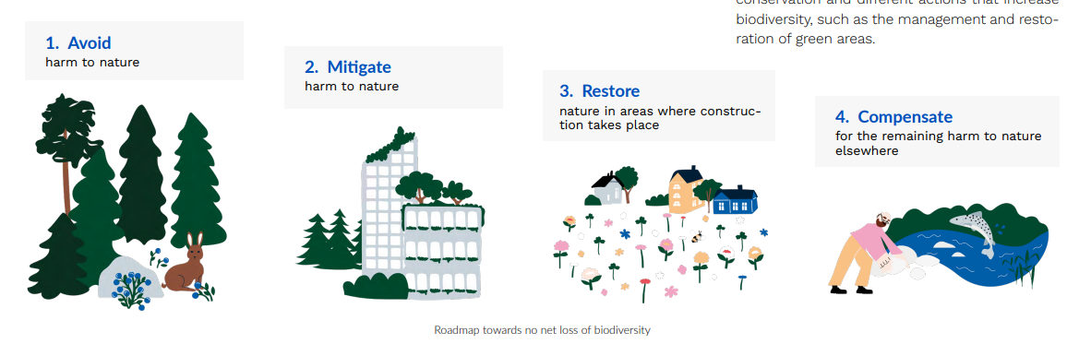
Operating principle: We use mitigation hierarchy in planning and implementation to alleviate harm to nature

Slide 57
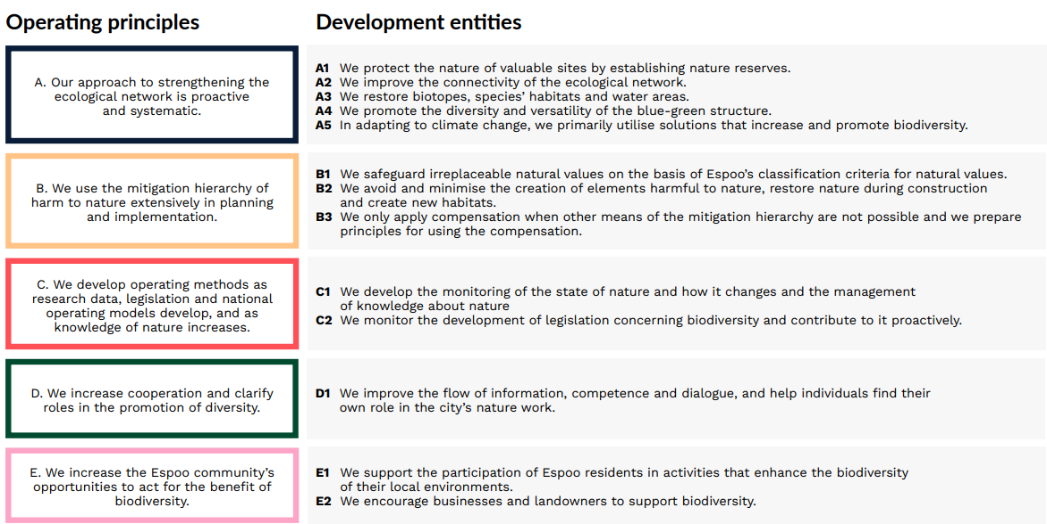
Development entities 2025–2035, guided by operating principles

Slide 58
Starting measures for 2025–2029,
based on development entities
Our approach to strengthening the ecological network is proactive and systematic
The city will buy valuable natural sites to be protected when it is critical for nature values and the integrity of protected areas.
We will improve the functionality of key development points for ecological corridors.
We will support the connectivity of protected areas with broader nature entities.
We will consider the need to prepare for climate change when establishing protected areas.
We will explore areas suitable for restoration and prepare restoration plans.
We will pilot ecological restoration on city land in 2–4 locations.
We will develop the natural construction of green areas and pilot new solutions and materials in things such as technical structures.
We develop operating methods as research data, legislation and national operating models develop, and as knowledge of nature increases
We will enhance the collection and sharing of nature data by, for example, establishing a nature knowledge system.
To form an understanding of the initial situation, we will increase the coverage of information on biotopes in Espoo.
We increase cooperation and clarify roles in the promotion of diversity
We will prepare the city units’ own tool kits for taking biodiversity into account and report on them in the scorecards of the units.
To alleviate harm to nature, we use the mitigation hierarchy extensively in planning and implementation
We will develop and establish tools, such as regional and city-block-specific green factors, for planning and assessing impacts.
We will adjust the building ordinance so that it better guides to safeguarding and increasing biodiversity and urban green.
We pilot compensation calculation in city projects in 2–4 locations.
We will develop and implement sustainability criteria for commitments related to the plot conveyance terms and land use agreements.
We increase the Espoo community’s opportunities to act for the benefit of biodiversity
We will create a website that is open and understandable to everyone and contains information about nature work in Espoo and the progress of the measures.
We will develop and adopt a cooperation model with which we encourage, guide and coordinate the actions of residents and communities for the benefit of nature as a partner of the city.

Slide 59

Making the roadmap happen
The roadmap was prepared multi-professionally by the Urban Environment Sector
  A concise project plan, developing by doing
  Over 60 management meetings,
  and numerous informal brainstorms in 2022-2025
Involving other city units and actors
  A policymaker-workshop
  Business actors group
  The follow-up group
  Participatory workshops for key experts
  Nature-wise expert network with researcher’s talks
Final decision on 10th February 2025 by the city government
Implementation is supported by a steering group (directors) and working group
(managers) and nature-wise expert network as part of daily leadership and expert work
”Everyone can be nature-wise”

Slide 60

Nature-wise Espoo work-packages
- to survey, develop and solve
Participation in research projects and follow-up of new legislation
No Net Loss and ecological compensation practices in other growing cities *
Website, also in English
www.espoo.fi/nature-wise Espoo
Communication and knowledge sharing
Updating present biodiversity practices* based on Urban Nature plan - Full English version on the website
Mapping, developing and testing planning tools*
No Net Loss as part of the land use examination
Compiling the Roadmap
- Full English version soon to be published on the website
Survey of ecological restoration potential *
* Final report only in Finnish with English summary

Slide 61
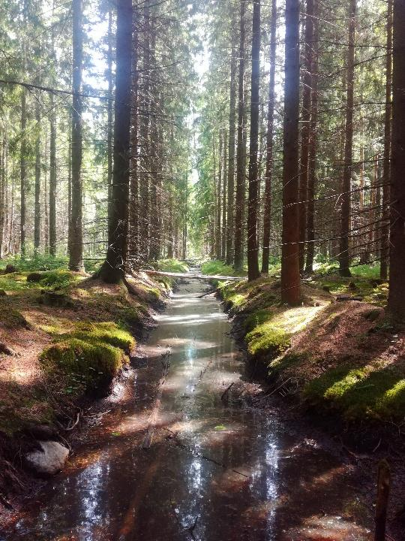
Example measure of the roadmap: Ecological restoration project
Piloting ecological restoration and compensation,
slowing down the loss of biodiversity
Restoring forests, peatlands and small waters
on the land owned by the City of Espoo
Spatial data was used to find sites potentially suitable for restoration, particular interest was paid to:
  endangered habitats in poor condition
  habitats of endangered species, EU directive species or otherwise valuable species habitats in poor condition
Approximately 100 site have been examined so far, of which
  18 sites potentially suitable for restoration
  33 sites possibly suitable for restoration
Potential restoration sites are being inventoried during summer 2025
  restoration needs and possibilities
  restoration plans for restorable sites
Drained forest. Photo: Suvi Kolu

Slide 62
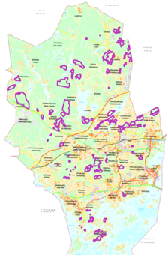
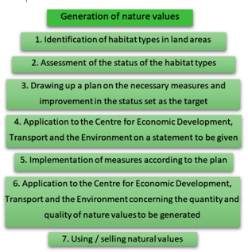
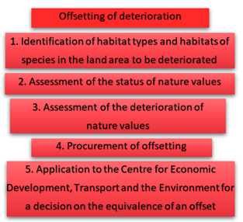
Ecological restoration and compensation
Restored sites will be approved to the Compensation Register, maintained by the national authority
The restored sites will be earmarked so that the City of Espoo can later use them as compensation sites
Finnish Nature Conservation Act recommends to voluntary ecological compensation
Writing offset plan applications for ecological compensation in 2026
Implementation of restoration measures in 2026
Use of restored sites for ecological compensation in the future for the voluntary ecological compensation in Finland
Sites potentially/possibly suitable for restoration in Espoo
Restoration–compensation procedure in the Finnish Nature Conservation Act

Slide 63
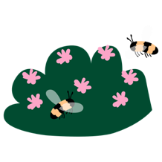
Progress and monitoring of the roadmap until 2035
2035-
2030-2035
Roadmap goals achieved
Monitoring continues
Continued development of new practices
2025-2030
Implementation of the roadmap will continue
Establishing of new practices and changes to routine work in all units
Continued development of new practices
2021-2025
Implementation of the roadmap
Piloting and implementation of new practices
Changing of routine work practices in all units
Change management
Development of new practices
Preparation of the roadmap
Reports and new information needs
Overall picture and the need for change
Ways to increase nature wisdom in routine work in key units
Monitoring in accordance with the appropriate level of precision to support the achievement of the objectives

Slide 64
Contextual factors enabling the No Net Loss roadmap
Factor | In Espoo
Current political commitment | Objective by the present city council, the final roadmap accepted by the city government
Mandate to from residents | Residents value highly the natural environment – evidence by resident polls
Tradition of nature policy | Nature and biodiversity programmes since 1980’s
Data on nature | Good quality spatial data on species, habitat types, ecological connections
Multi-professional preparation process | Co-created by the whole urban environment sector staff (in total 1300 employees). Process ownership by the Director/vice-mayor of the sector.
Bridging and broking knowledge – collaboration and discussion | Large number of discussions for four years, shared agreement of everything!
Responsibility of the long-term realisation of the roadmap | Everybody is responsible for nature-wisdom as part of daily work
Utilising networks | Being active in city biodiversity networks, sharing and learning from peers and others

Slide 65
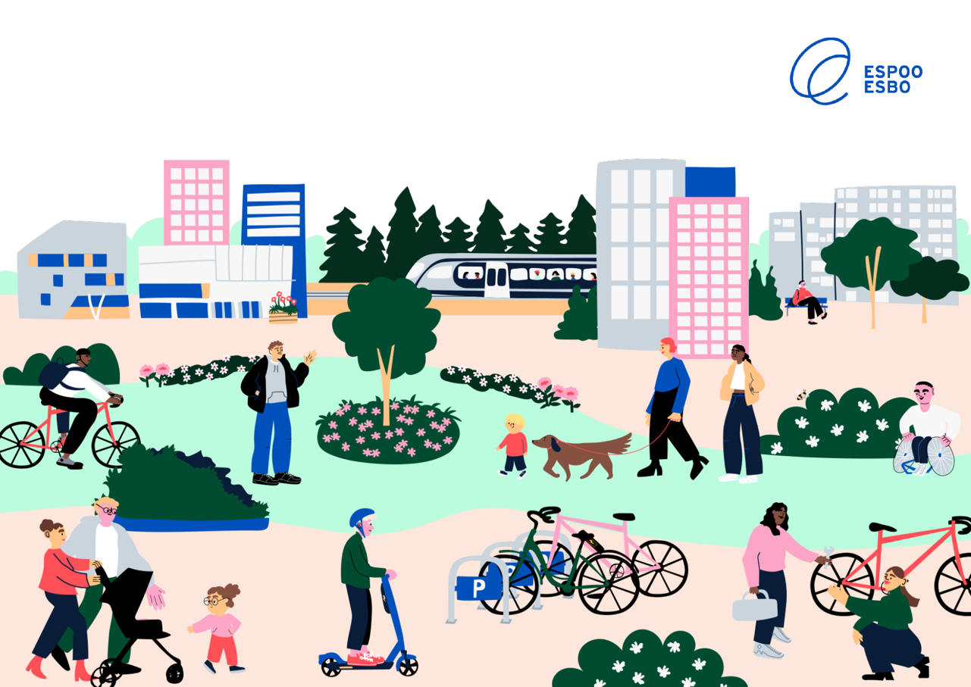
Thank you!

Slide 66
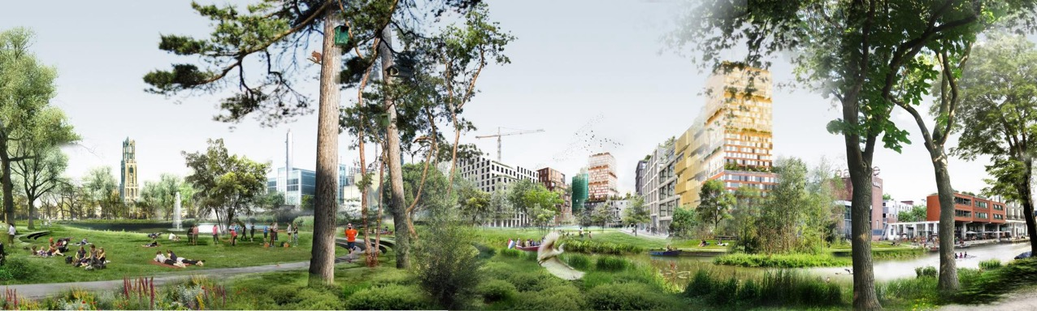


pieces of the Green Puzzle
Utrecht:
City of Utrecht |
Partnership Greening Cities
22 April 2025 | Albin Hunia

Slide 67
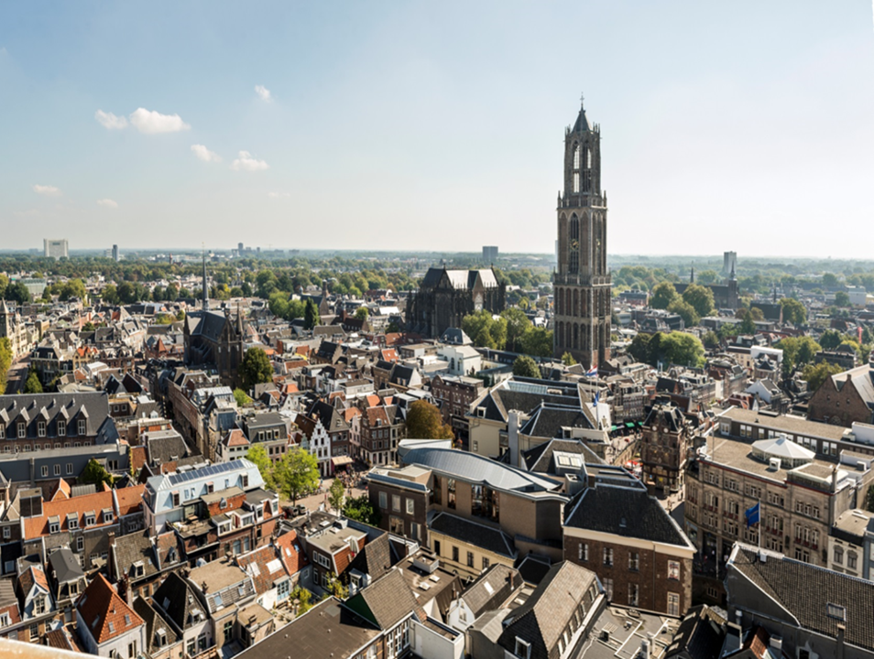
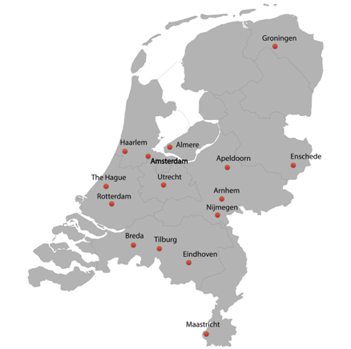
Utrecht
Netherlands 4th city
>350.000 inhabitants
old
modern
fast growing
green

Slide 68
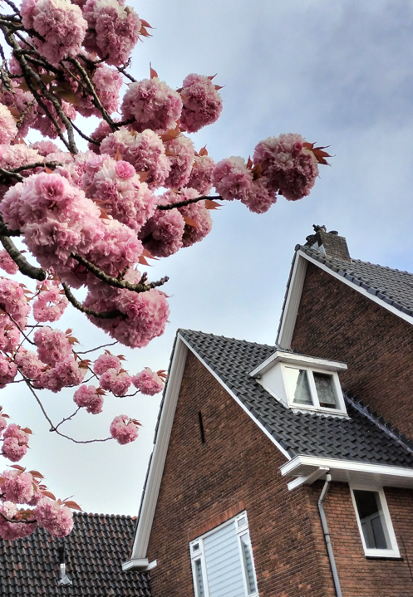
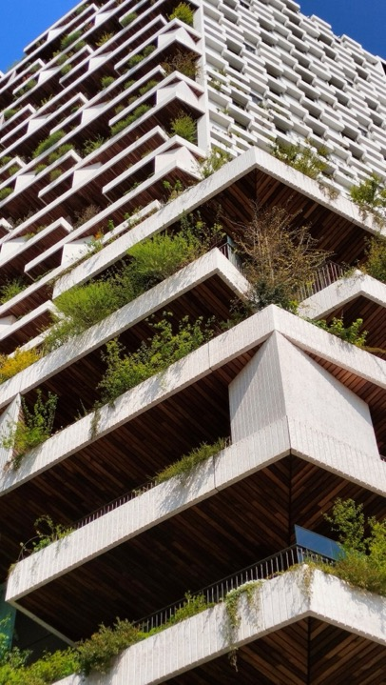
Utrecht

Slide 69
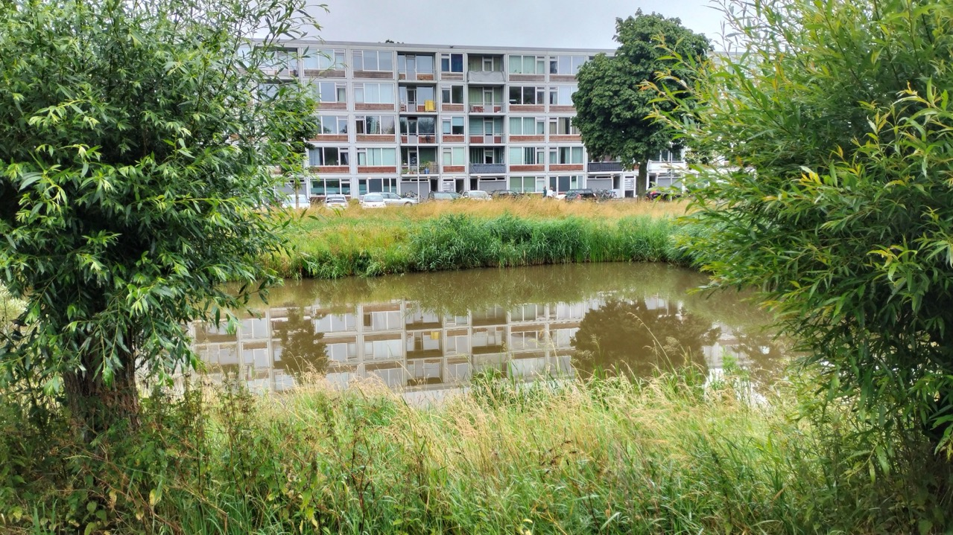

Slide 70
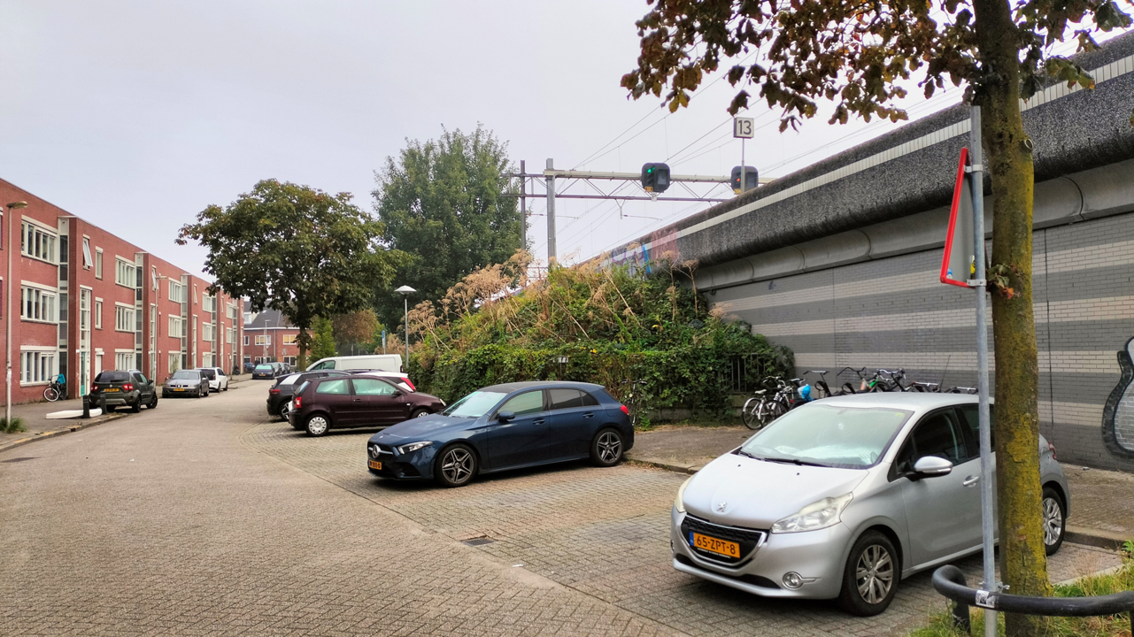

Slide 71


Healthy urban living for all 

Slide 72

Healthy urban living for all
+ 100.000 inhabitants = + 40.000 households
→ 440 hectares new green & 60.000 trees

Slide 73


Green Structure Plan
2007/2018
designation existing green
structuring new green
connecting green
recreation & landscape
STRUCTURE

Slide 74

Green Structure Plan
2007/2018
Spatial Strategy Utrecht 2040
2021
designation existing green
structuring new green
connecting green
recreation & landscape
STRUCTURE
10 minute city
expansion & densification
multifunctional ‘barcode’
QUANTITY
Notes:
Green Structure Plan
conservative
STRUCTURE
Spatial Strategy Utrecht 2040
-

Slide 75

Green Structure Plan
2007/2018
Spatial Strategy Utrecht 2040
2021
Utrecht Species List
2018(/2021)
designation existing green
structuring new green
connecting green
recreation & landscape
STRUCTURE
10 minute city
expansion & densification
multifunctional ‘barcode’
QUANTITY
protection
guiding development
monitoring
QUALITY

Slide 76



‘Intelligent barcode’
Spatial Strategy Utrecht 2040
change of function
densification
vertical programming
increase of quality
multifunctional usage
smart organisation of the city
regional collaboration
profit
Notes:
We also find out the barcode in a traditional urban planning system doesn't meet the demands of a densifying 10-minute city.
Therefore we need to use several spatial principles in order to save space and make the city more attractive

Slide 77






Greening our city at 5 different levels
Spatial Strategy Utrecht 2040
Greening
streets
2. New park
areas
3. Green-blue
connections
4. Green corridors
5. Green around
the city

Slide 78

Greening our city at 5 different levels
Spatial Strategy Utrecht 2040
440 hectares = € 1.6 billion
‘make work with work’
additional funding
BUDGET 2040
PLANNING 2040
Greening
streets
2. New park
areas
3. Green-blue
connections
4. Green corridors
5. Green around
the city
Notes:
BUDGET 2040: for realising ‘satisfying levels’ of green in quantity (m2 & trees)
PLANNING 2040: speeding up greening on all levels, for realising ‘satisfying levels’

Slide 79



Quantitative indicators
Spatial Strategy Utrecht 2040
Norm | Norm | Aim | Conditions
 | 75 m² of green for every household | Sufficient green infrastructure for recreation and biodiversity | Public green maintained by the city [no qualitative indicator set]
 | 40% green in every neighourhood | To counter climate-effects like heat stress, stormwater runoff, and for water retention | Green as much as possible at surface level (as an exception canopy cover can be added to the calculation)
 | Maximum distance to green with a function to play, sport, relax or other uses | Proximity to green, accesible for all | Real distance to park entrances (not as the crow flies) The distance depends of the level of functionality (neighbourhoodplayground versus recreational-and nature area for the weekend)

Slide 80

QUALITY
Notes:
The Green Leap approach to greening Utrecht, based on the strategic Spatial Strategy Utrecht 2040,
is a fine first piece-of-the-puzzle finding the ROADMAP TO GREENING
But it has a heavy focus on QUANTITY of green ~ understandably so, because the main restraints in urban areas are around space and finding multifunctional use.
But a roadmap to greening should also describe the steps towards QUALITY of green. How not to end up with a drawing-board sterile city, where no wild-flowers bloom and no butterflies can be seen during the Summer months ?

Slide 81

TRANSITION
Notes:
What we tend to forget when we are talking about deliberately greening our cities, is that we are starting up a veritable TRANSITION!
Which means that we cannot continue doing what we always did ~ risking getting what we always had: hot cities that can’t get rid of torrential rain, with a few street trees and parks, and the occasional Sparrow in a back-garden where people did NOT put in stone-pavement for easy maintenance.
What we are ACTUALLY trying to achieve are NATURE INCLUSIVE CITIES, where urban nature is integrated in the very lay-out and infrastructure of the city, and where we are not just tolerating the habitats and species that can thrive in cities, but find a way to live together with them.
We want this because we understand that BIODIVERSITY and GREEN SPACES make us happier and healthier, contribute to our wellbeing.
And there are subtle demographic changes too, where we look different at work-versus-home, at public space and mobility.
And last but not least, change is upon us in the form of more extreme weather: heat-waves & peak-rains.

Slide 82




TRANSITION
Notes:
We have the PIECES OF THE PUZZLE, and LAID PARTS OF THE PUZZLE in the last 25 years in UTRECHT!
We can dazzle you with 25 years of successes, and then you’d say: please send me that Utrecht ‘ROADMAP FOR GREENING’
But it looks like the hard part has only just begun, in a period of
RAPID GROWTH
CLIMATE CHANGE
BUDGET CUTS

Slide 83






Protecting existing biodiversity
Transforming existing green/blue
QUALITY
Greening the existing city
Development by densification
Development by expansion
Notes:
Protecting existing biodiversity
what: Utrecht-species, protected species
how: specific measures (coppice trees, snake-heaps, nature-inclusive measures), fauna connections, work protocols for green AND infrastructure
by: Groene Web programme projects, volunteers, responsible maintenance and reconstruction
Transforming existing green/blue/grey
what: public grassland, waterways, infrastructure, parks & green corridors
how: ecological maintenance (mowing regime!), ecological banks/canalsides, nature-inclusive building additions, darkening street-lights
by: municipal maintenance department work practices, Groene Web programme projects, private initiatives, renovation projects
Greening the existing streets
what: removing street paving and replacing it by water, urban green, trees.
how: from taking out a few tiles, creating gardens around street-trees and building-facades, to transforming entire squares and restructuring streets. Often by (partially) removing parking spaces and car driveways.
by: municipal maintenance department projects, municipal support for co-creative local projects, volunteer projects
Urban development transforming existing neighbourhoods (densification)
what: existing urban plots (like ‘brown fields’) and buildings are repurposed, restructured and rebuilt, including new waterways and urban green. Space is expensive, houses are stacked as apartments, other urban functions are integrated and new green space is limited. Alternative developments: large mobility projects reshaping major routes, canals and traffic junctions
how: by re-designing the existing space and ideally creating ‘satisfying levels of green’ on the street and park level, with the needs of a few guiding urban nature species in mind (House Sparrow, Swifts, Pipistrelle-bats, solitary bees).
by: the municipality sets out the planning rules in the urbanism phase, that are adopted by the developer and contractor (depending on the type of project and the amount of municipal owned real estate).
Urban development by expansion
what: transforming larger (often previously agricultural) areas into urban areas, often with a great diversity of houses and facilities.
how: by designing new urban areas from the ground up, ideally creating ‘satisfying levels of green’ on all greening levels from the start: from street-level to the connection to green areas around the city.
by: strategic long-term planning of housing development, facilities, mobility needs, climate adaptation needs and urban nature. Joint venture by Municipality, developers, energy companies, mobility companies, and support from regional and national policies.

Slide 84

TAKE AWAYS

Slide 85

TAKE AWAYS
STRUCTURE
QUANTITY
QUALITY

Slide 86


TAKE AWAYS
STRUCTURE
QUANTITY
QUALITY
STRUCTURAL SPACE FOR GREENING

Slide 87

TAKE AWAYS
STRUCTURE
QUANTITY
QUALITY
STRUCTURAL SPACE FOR GREENING
STRUCTURAL FUNDS FOR GREENING

Slide 88

TAKE AWAYS
STRUCTURE
QUANTITY
QUALITY
STRUCTURAL SPACE FOR GREENING
STRUCTURAL FUNDS FOR GREENING
NATURE INCLUSIVE DEVELOPMENT

Slide 89

further questions: albin.hunia@utrecht.nl

Slide 90
Webinar #2: how to develop a municipal roadmap for nature restoration
Q&A
Notes:
Before we jump into this, we’re going to explore some of the main findings of a survey some of you responded to on how to monitor nature plans. I’ll hand over now to Leon Kapetas who will share these key findings and take us through the presetnations today.

Slide 91
Nature Restoration Law webinar series: what’s next?
Webinar #3: Building regulations for nature restoration
Wednesday 7 May at 10.00-12.00 CEST
➡️ Sarah Hawes, Biodiversity Net Gain Officer, city of Bristol
➡️ Mattia Leone, Associate Professor in Architectural Technology and Environmental Design, University of Naples
➡️ Lea Gratas, Green Spaces and Environment Department, city of Paris
Save the date for Webinar #4: Regulations for nature restoration on municipal owned land
Wednesday 14 May at 10.00-12.00 CEST
https://www.urbanagenda.urban-initiative.eu/news-events

