Slide 1

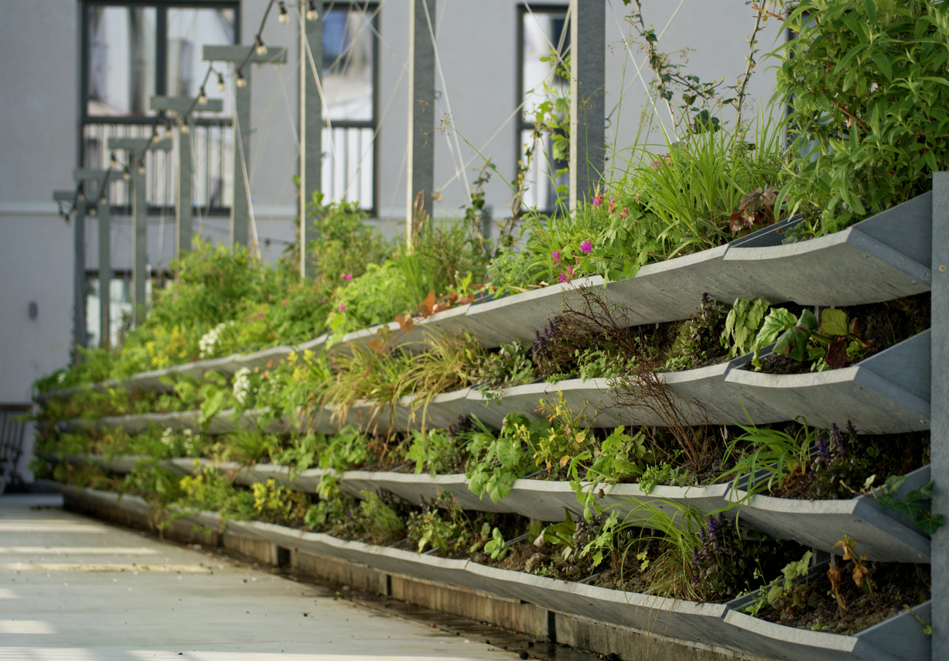
Nature Restoration Law webinar series
Webinar #3: Building regulations for nature restoration
Leon Kapetas
External Expert EUI
Resilient Cities Network

Slide 2



House rules
Use the code: #NRL

Slide 3
Nature Restoration Law webinar series
Article 8: urban ecosystem restoration
No net loss of urban green space or tree canopy cover in urban ecosystem areas by 2030
March-June 2025 supporting cities with the implementation of the NRL
Cities need to rethink urban planning …
Baselines and data
What are the baselines for green space and tree canopy? What data to use?
Municipal roadmap
Which departments need to be involved?
What policies need to be considered?
Building and spatial regulations
Policies for new developments
Policies for retrofitting existing developments
Citizen owned land and business collaboration
Policies to engage citizens and raise awareness
Policies to support greening efforts
Policies to support business investment in offsetting?
Targets for business?
National Restoration Plan
What do cities need to do? How can cities work with member states?
Notes:
Member States shall determine and map urban ecosystem areas as referred to in Article 8 for all their cities and towns and suburbs.

Slide 4
Nature Restoration Law webinar series
No net loss of urban green space or tree canopy cover in urban ecosystem areas by 2030
Webinar #1 looked at the starting point: what are the definitions to be aware of? what are the baseline years?
Webinar #2 looked at urban nature plans: how can cities plan for nature restoration? What guidance is out there?
Urban Nature Plans + project:
Building on Guidance and Toolkit for Urban Nature Plans
Testing and improving the UNPs
Focus on integrating justice and equity into spatial planning
Foster PPPs and collaborative business models for NbS
Ministry for Ecological Transition and the Demographic Challenge:
Aims to integrate the conservation and restoration of nature across sectors and territories (natural, rural and urban) and address the causes behind the loss of biodiversity
Supporting the development of Urban Nature Plans through baselines, mapping and analysis etc
Espoo's roadmap for Nature Wise Espoo:
How the city developed and is implementing a roadmap for No Net Loss of biodiversity
Examples of concrete measures such as piloting ecological restoration in 18 sites
Factors that contributed to success such as political commitment, co-creation with all urban environment sector city staff, and data
Utrecht on green puzzle:
Challenge of densifying and committing to green
Saw 3 interlocking plans: Green Structure Plan, Spatial Strategy Utrecht and Utrecht Species List covering 'structure', 'quantity' and 'quality' of green in Utrecht
Notes:
Member States shall determine and map urban ecosystem areas as referred to in Article 8 for all their cities and towns and suburbs.

Slide 5
Webinar #3: Building regulations for nature restoration
Implementation of the Biodiversity Net Gain Regulation
  Sarah Hawes, Biodiversity Net Gain Specialist, Bristol City Council
The Bioclimatic Urban Master Plan of Paris
  Léa GRATAS, Project Manager, Agency for Urban Ecology, City of Paris
Greening the Gap: Soft Policy Tools to Support Urban Nature in a Changing Climate
  Mattia Leone, Professor of Sustainable Architecture, Università di Napoli Federico II
Notes:
Before we jump into this, we’re going to explore some of the main findings of a survey some of you responded to on how to monitor nature plans. I’ll hand over now to Leon Kapetas who will share these key findings and take us through the presetnations today.

Slide 6
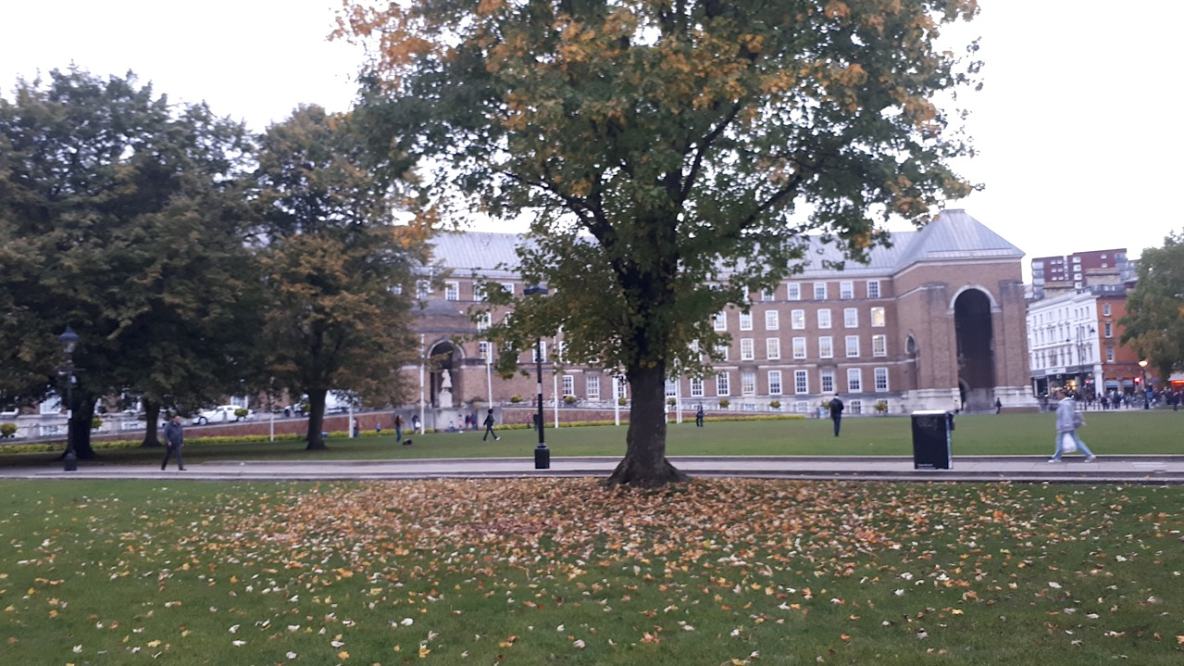
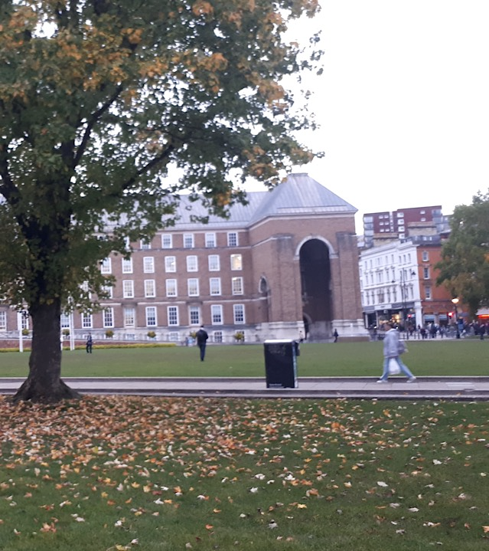

Biodiversity Net
Gain
Bristol City Council

Slide 7

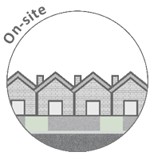
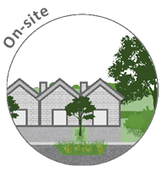

Biodiversity Net Gain
Prior to BNG Introduction
A quantitative approach to biodiversity
Legally secured for 30 years
An approach which comprises guidance, metric, rules and principles
BNG Approach to Development

Slide 8
Legislation
2021
The Environment Act (2021) has introduced a mandatory requirement for developments which require planning permission to achieve a minimum 10% net gain in biodiversity.
29 Nov. 2023
Draft secondary legislation was published on the 29th November 2023, providing further details for the BNG framework.
12th Feb 2024 Major applications
2nd April 2024 Minor applications
As part of a wider Government strategy to address the biodiversity decline in England a requirement for developments to demonstrate a minimum 10% net gain in biodiversity following development has been mandatory from the 12th February 2024 for major projects, and for small sites since the 2nd April 2024. This gain in biodiversity will need to be secured for a minimum of 30 years.
The Environment Act (2021) introduced a mandatory requirement for developments which require planning permission to achieve a minimum 10% net gain in biodiversity.
In England, biodiversity net gain is required under a statutory framework introduced by Schedule 7A of the Town and Country Planning Act 1990 (inserted by the Environment Act 2021).
Delivery of 10% BNG became mandatory for major projects
Delivery of 10% BNG becomes mandatory for minor projects

Slide 9



Approach
User guidance:
Set of rules, principles and hierarchies.
Statutory Metric: Input of data to provide biodiversity value output
Legislation and legal mechanisms: Conservation covenants and S106s to secure Biodiversity delivery
Design: Multi-disciplinary approach to maximise biodiversity delivery and retain functionality

Slide 10
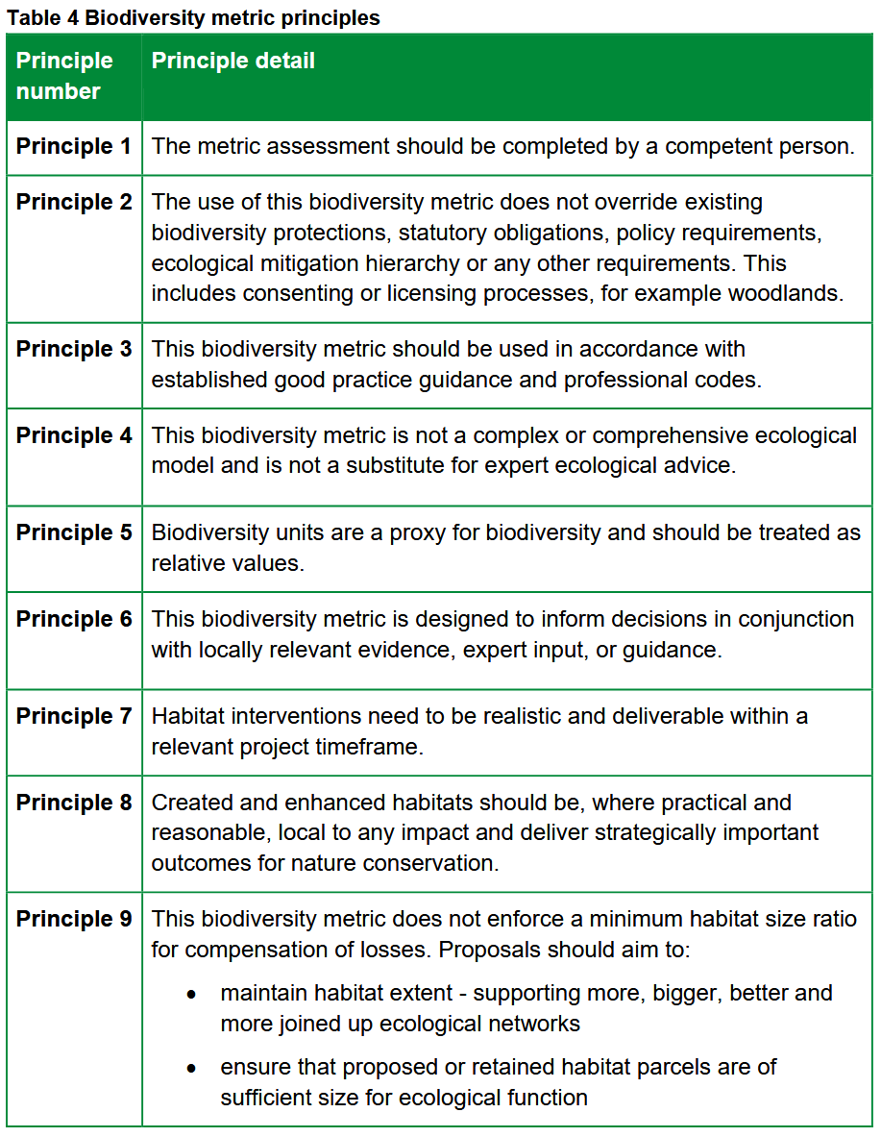
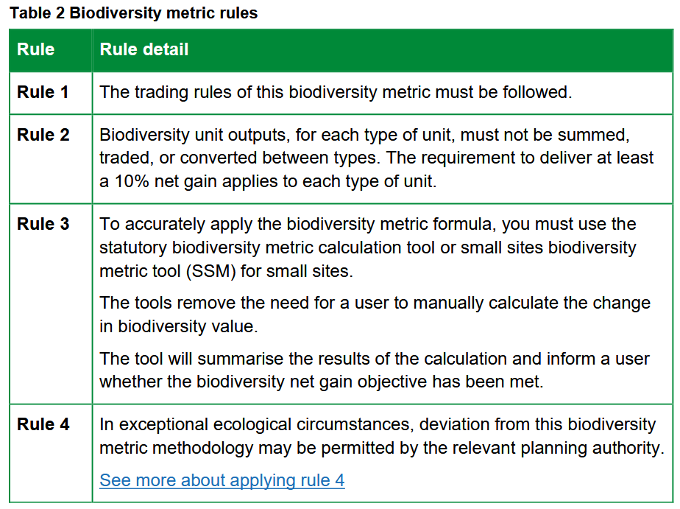
User Guidance
User guidance:
Set of rules, principles and hierarchies.

Slide 11
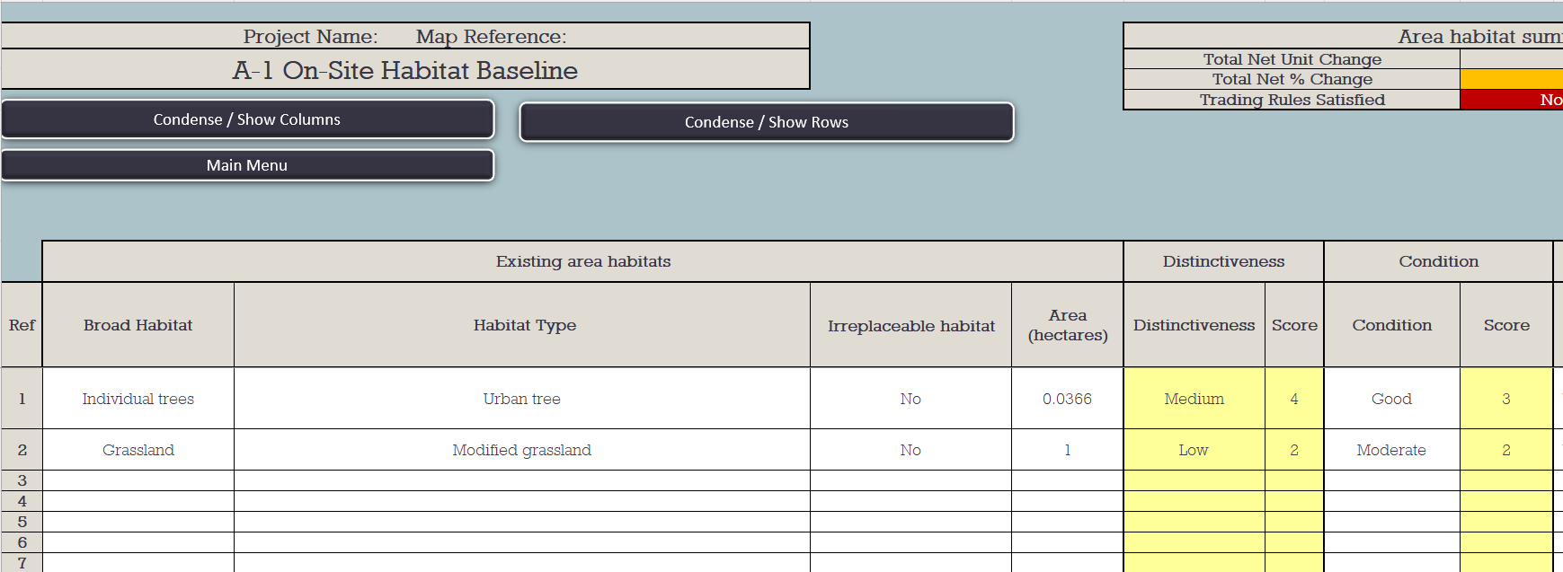
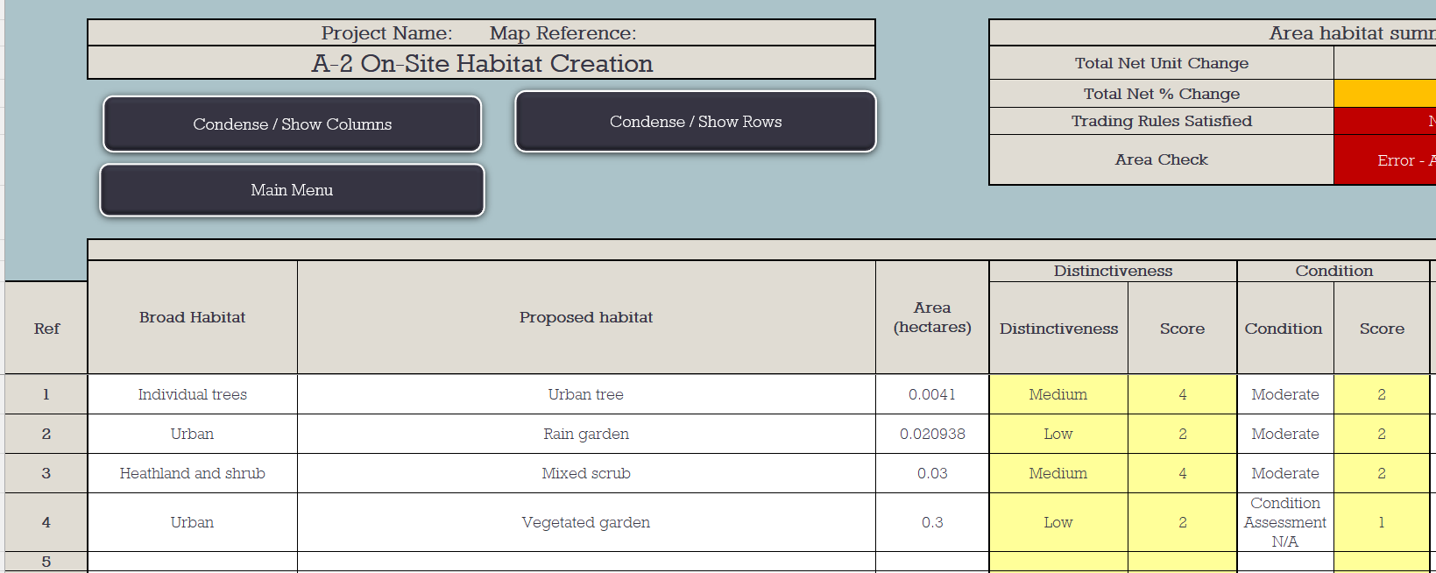
Metric
Statutory Metric: Input of data to provide biodiversity value output

Slide 12
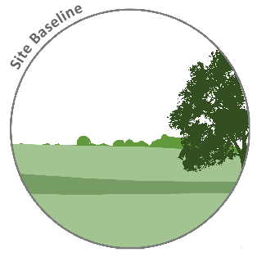
The Metric: On-Site Pre-development
Distinctiveness
Size
Condition
Strategic Significance

Slide 13
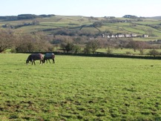
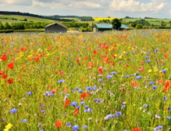
The Metric: On-Site Pre-development
Distinctiveness
Size
Condition
Strategic Significance
Modified Grassland
Lowland meadows
Low
Very high

Slide 14
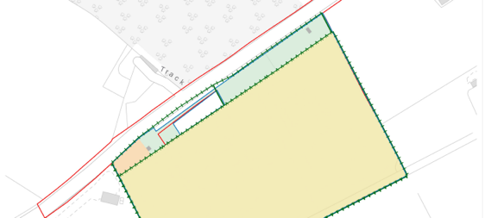
The Metric: On-Site Pre-development
Distinctiveness
Size
Condition
Strategic Significance
Example mapping from EDP.

Slide 15
The Metric: On-Site Pre-development
Distinctiveness
Size
Condition
Strategic Significance
A | The parcel represents a good example of its habitat type, with a consistently high proportion of characteristic indicator species present relevant to the specific habitat type (and relative to Footnote 3 suboptimal species which may be listed in the UKHab description).¹
B | Sward height is varied (at least 20% of the sward is less than 7 cm and at least 20% is more than 7 cm) creating microclimates which provide opportunities for insects, birds and small mammals to live and breed.
C | Cover of bare ground is between 1% and 5%, including localised areas, for example, rabbit warrens².

Slide 16
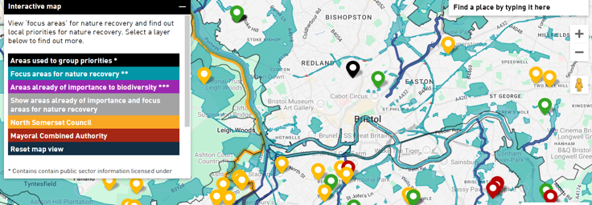
The Metric: On-Site Pre-development
Distinctiveness
Size
Condition
Strategic Significance

Slide 17
The Metric: On-site Post-development
Distinctiveness
Size
Condition
Strategic Significance
Difficulty to create
Time to Target Condition

Slide 18
The Metric: Calculating net gain
Post-development value
Pre-development value
Change in Biodiversity units
10% net gain example
11 units
10 units
+1 unit
10% net gain

Slide 19

Legislation and legal mechanisms
Submission
Validation
Consultation
Decision
Legislation and legal mechanisms:
Conservation covenants and S106s to secure Biodiversity delivery
Town and Country Planning Act
Statutory User Guidance application
Condition
Commencement of Development

Slide 20
Planning Process
Submission
At the point of initial application submission, the application must include a statement of exemption which provides sufficient evidence if the applicant believes the proposed development is exempt from mandatory biodiversity net condition.
If the development is subject to mandatory biodiversity net gain a BNG report and corresponding metric is required.
Validation
Consultation
Decision
Development impacting <25m², and <5m linear habitats with no priority habitat impacted, or householder, biodiversity net gain sites, small scale self-build or custom housebuilding which are ≤9 dwellings, and ≤ 0.5ha.
Condition
Commencement of Development
BNG not required
Statement of exemption only .

Slide 21
Planning Process
Submission
Ecological consultation to determine if the assessment has been carried out correctly and accurately reflects the baseline biodiversity value in line with user guidance and the Town and Country Planning Act 1990.
Validation
Consultation
Trading Rules
Decision
Biodiversity Gain Hierarchy
Condition
Habitat Degradation
Commencement of Development

Slide 22
Planning Process
Submission
Validation
Biodiversity gain condition
Deemed condition which automatically applies to those development projects which require planning permission and meet the requirements for mandatory net gain as set out within the Town and Country Planning Act 1990.
Purchase of units
Any off-site delivery of biodiversity units required to achieve the 10% net gain in biodiversity needs to have demonstrated that it has been legally secured. This sets the target habitats and condition and ensures delivery and management for 30 years.
Consultation
Decision
Condition
Commencement of Development

Slide 23
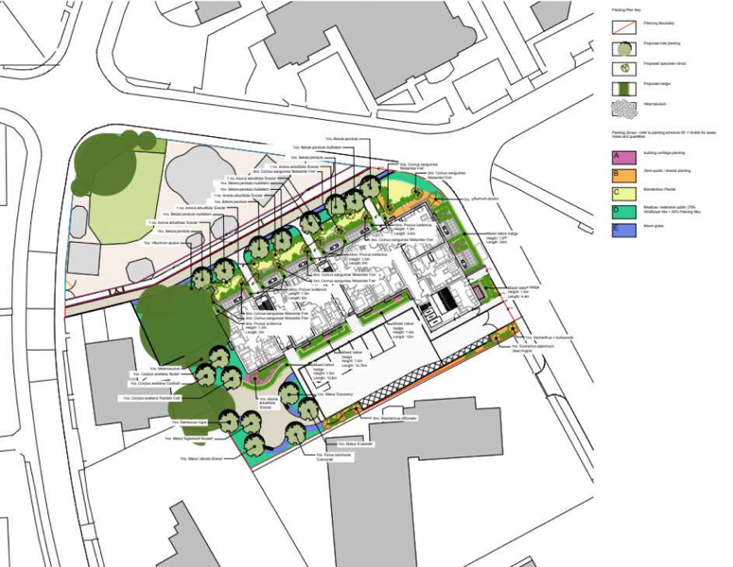

Design
Design: Multi-disciplinary approach to maximise biodiversity delivery and retain functionality

Slide 24
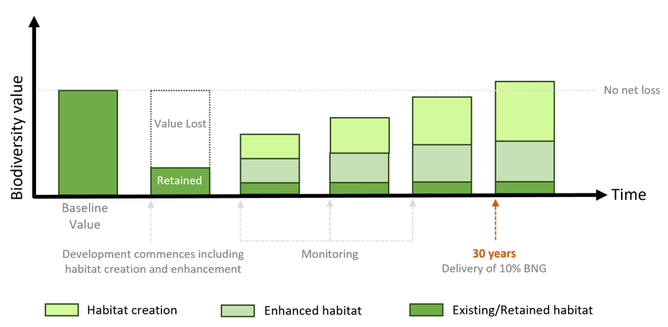
Design
Any biodiversity value lost from the baseline through habitat loss or degradation will need to be replaced in addition to achieving a 10% gain (110% from baseline value).

Slide 25
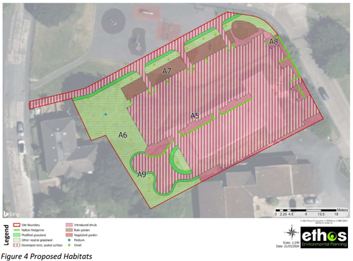
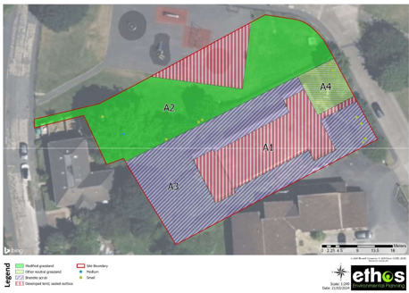
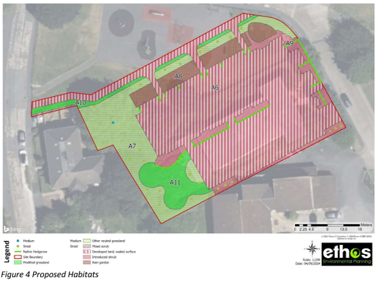
Example of design process

Slide 26
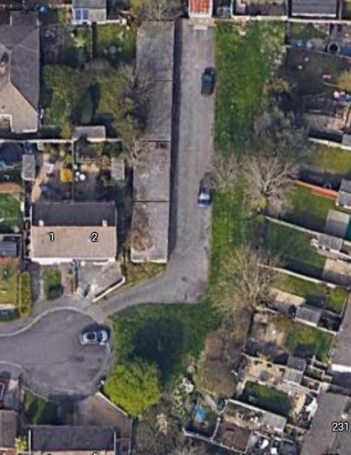
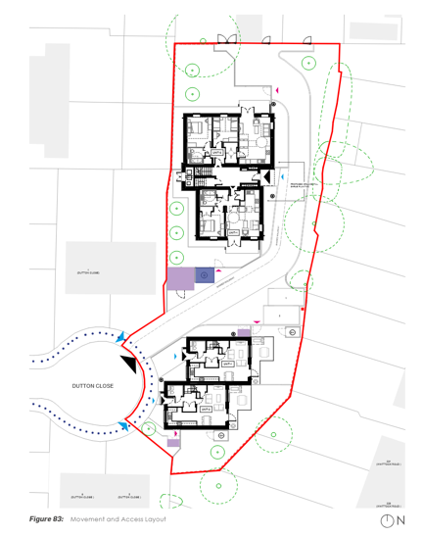
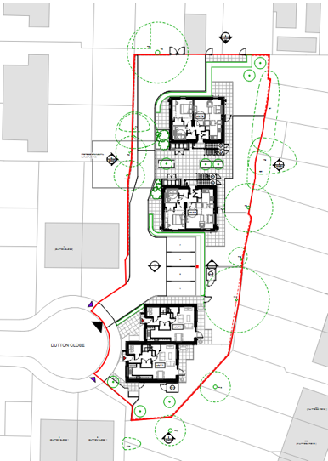
Example of design process

Slide 27
Key Factors
Integrated: BNG is considered from the development design, through the planning process and into the project delivery and occupation.
Quantitative: Biodiversity units ensures we are replacing the value of what is lost.
Supported: Statutory guidance on how to carry out assessments, with a standardised approach
Long-term: 30 years management rather than what was previously often only five.
Secured: Ability to legally secure the delivery of the habitats.
Market: It has created an incentive for landowners to be involved in the delivery of biodiversity.

Slide 28
References
User guidance and Tools: https://www.gov.uk/government/publications/statutory-biodiversity-metric-tools-and-guides
Planning Advisory Service legal templates: https://www.local.gov.uk/pas/environment/biodiversity-net-gain-bng-local-planning-authorities/pas-biodiversity-net-gain-bng
Bristol Practice Note: https://services.bristol.gov.uk/files/documents/9094-bristol-city-council-biodiversity-net-gain-practice-note/file

Slide 29
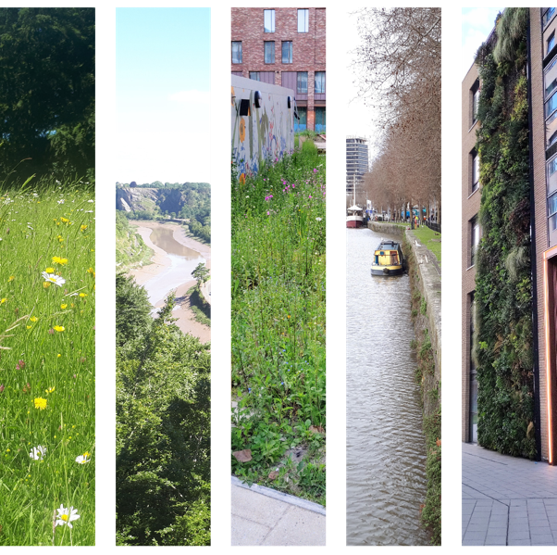
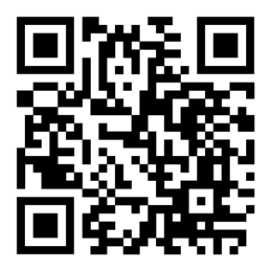
Contact
Sarah.hawes@bristol.gov.uk
LinkedIn

Slide 30
Building regulations for nature restoration
The Bioclimatic Urban Master Plan of Paris
Léa GRATAS, Agency for Urban Ecology, City of Paris
Notes:
Thank you, Kelly, for giving me the floor to begin this presentation on greening built infrastructure and engaging the private sector. Today, we will also focus specifically on the case of Paris.

Slide 31

Summary
01
Context
02
The Bioclimatic Urban MasterPlan and Biodiversity
03
Support for project leaders
Notes:
Our presentation will be structured around three key points: the context, the main drivers for action, and finally, the limitations and challenges we face."

Slide 32



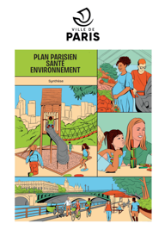




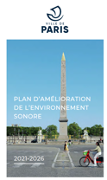
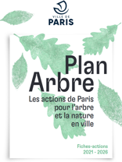

01 – CONTEXT
The city of Paris directed all its strategic planning towards adaptation to climate change.

Slide 33
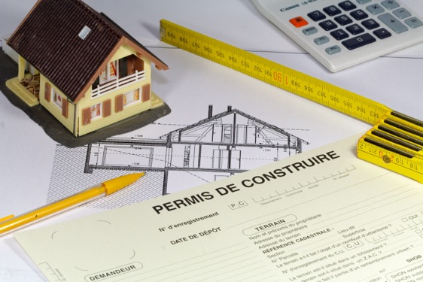
01 – CONTEXT
The Bioclimatic Urban Master Plan - A regulation for land use in Paris
A Master Plan (Plan Local d'Urbanisme - PLU) is a compulsory urban planning document for every cities or group of cities in France.
It is the expression of an overall development and urban planning project, and consequently sets out the rules for development and land use.
The Master Plan is the spatial and temporal expression of a territorial project. All construction projects must comply with the PLU in order to obtain a building or development permit.
The Master PLan is established in coherence with inter-communal, regional and national planning schemes.

Slide 34
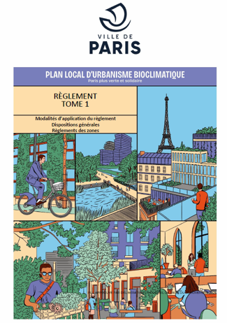
01 – CONTEXT
The Bioclimatic Urban Master Plan - A regulation for land use in Paris
In November 2024, the City of Paris adopted
the bioclimatic Urban Master Plan.
It defines the capital's major development guidelines for the coming years, reconciling adaptation to climate challenges with improving the living environment of Parisians.
The main axis are :
Enabling everyone to find a place to live in Paris
Adapting Paris to meet the ecological emergency
A new way of thinking about buildings
A bioclimatic Master Plan for the city of the quarter-hour

Slide 35
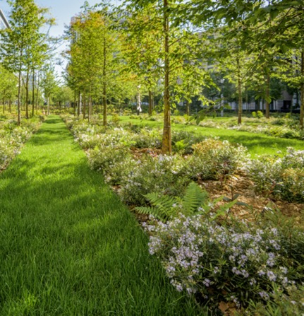
02 – The Bioclimatic Urban Master Plan of Paris and Biodiversity
An overall strategy - Green and blue frameworks
The protection of green spaces and trees
Regulation in favor of biodiversity

Slide 36
02 – The Bioclimatic Urban MasterPlan of Paris and Biodiversity
An overall strategy : The main objectives
Sanctuary for all protected green spaces;
Approximately 55 hectares of new green spaces created in 10 parks, which will be largely enlarged or created. Contributing to the goal of 300 hectares of additional green space open to the public by 2040;
A major metropolitan park in the north of Paris, : a green network of over 25 hectares, including 15 hectares of parkland
40% of Parisian public space will be desilted by 2050;
On all plots of land larger than 150 m2, up to 65% of open space must be provided in projects, with no possibility of derogation;
Identification and protection of 266 remarkable trees in the public domain and on private plots;
Approximately 100,000 aligned trees protected;
The greening of building courtyards will be encouraged as part of energy-efficient building renovations.

Slide 37
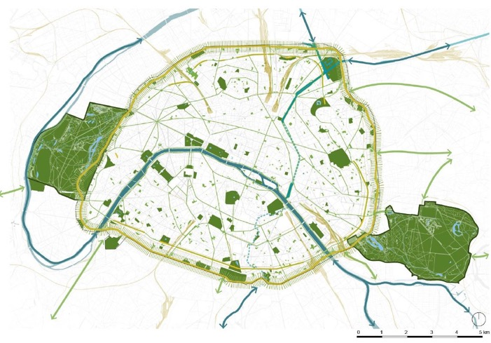
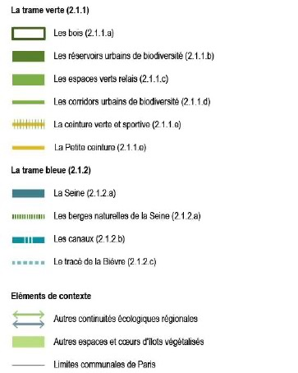
02 – The Bioclimatic Urban Master Plan of Paris and Biodiversity
An overall strategy : A “Biodiversity and adaptation to climate change” planning guideline

Slide 38
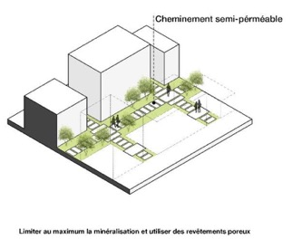
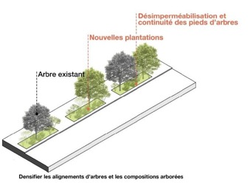
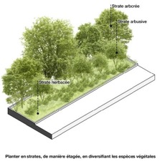
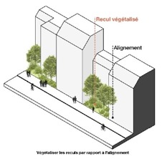
02 – The Bioclimatic Urban Master Plan of Paris and Biodiversity
An overall strategy : A “Biodiversity and adaptation to climate change” planning guideline
Guidelines are designed to integrate the challenges of biodiversity erosion into land, public space planning and the private sector

Slide 39
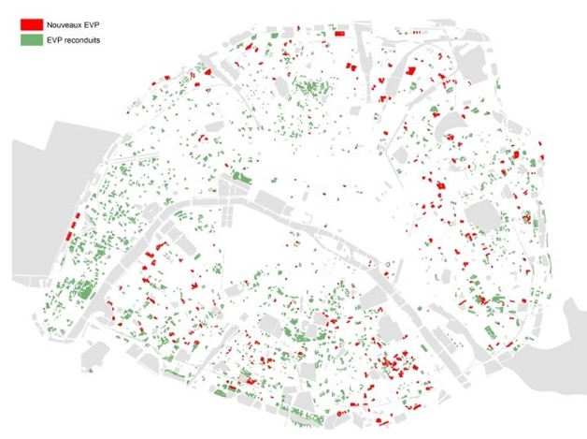
02 – The Bioclimatic Urban MasterPlan of Paris and Biodiversity
The protection of green spaces and trees
Increase of protected green spaces :
  Increase of protected private green spaces (+ 90 ha), i.e. around 330 ha
  Protection of remarkable trees (260 listed) and avenue trees (approx. 100,000), unless there is a proven reason for cutting down.
  Increase in the surface area of classified public wooded areas (+ 48 ha), i.e. approx. 1860 ha
Evolution of the private green spaces rule:
Removal of the possibility of "restoring" the surface area of private green spaces
Tree preservation, except in the case of irreversibly dying or dangerous trees
bike or garbage premises -> minimal distance (D > 3m) away from trees

Slide 40
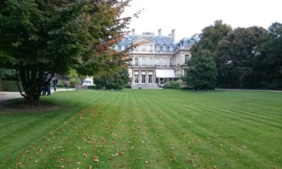
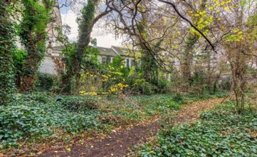
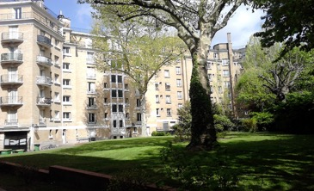
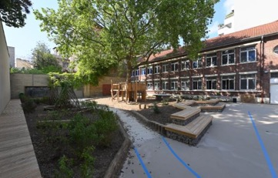
02 – The Bioclimatic Urban Master Plan of Paris and Biodiversity
The protection of green spaces and trees
1- EVP ornemental d’ambassade
2 - EVP de logements privés
3- EVP de logements sociaux
4 - EVP d’établissement scolaire -> ELPV

Slide 41
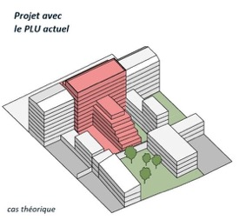
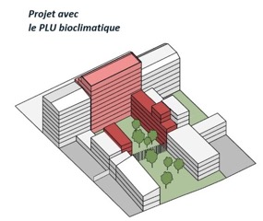
02 – The Bioclimatic Urban Master Plan of Paris and Biodiversity
Regulation in favor of biodiversity
increased open spaces (S elc = S terrain x 20% to 60% in SRV) and plants in open spaces (except for paths with green pavements and bicycle or garbage premises)
Fences with clear lanes are required between parcels with EVPs
building heights > 15m may only be exceeded when adjoining neighbouring buildings

Slide 42
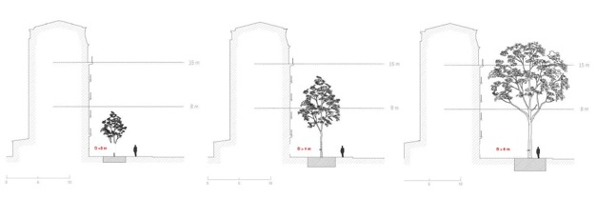
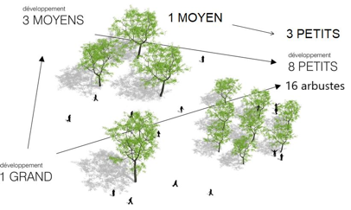
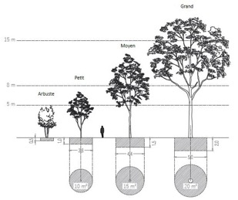
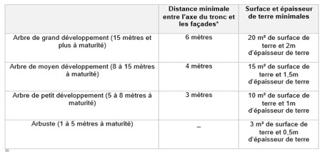
02 – The Bioclimatic Urban Master Plan of Paris and Biodiversity
Regulation in favor of biodiversity
Avoid
Reduce
Compensate

Slide 43
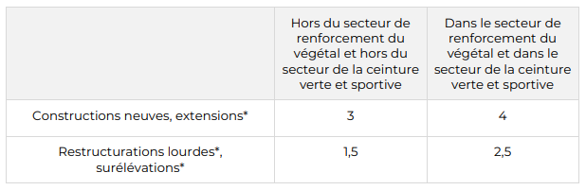
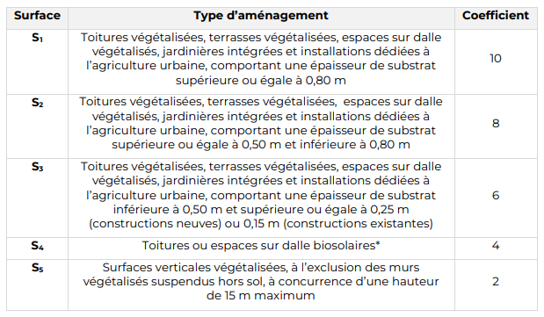
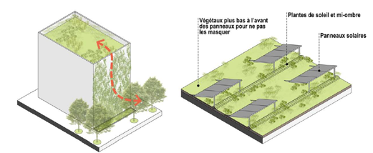
02 – The Bioclimatic Urban Master Plan of Paris and Biodiversity
Regulation in favor of biodiversity
In order to obtain their building permit issued by the city, new buildings, major renovations, extensions and elevations must meet a minimum green building index (GVI), which depends on the type of project and its location.
Numerical weights have been assigned according to the type of greening envisaged.
I_{VB} = [(S₁ × 10 ) + (S₂ × 8) + (S₃ × 6) + (S₄ x 4) + (S₅ x 2)] /
Semprise au sol de la construction
Notes:
One of its key innovations is the introduction of the Green Building Index.
For all new constructions, major renovations, extensions, or building elevations, a minimum Green Building Index must be achieved. The required score varies depending on the nature of the project and its geographical location.
Each type of intervention is assigned a numerical value based on specific criteria—including local context, project type, and structural possibilities. The slide you see shows the detailed breakdown (in French), but the key message is that this index has been compulsory since 2025.
Failure to meet the minimum required Green Building Index may result in the project being rejected by the City. This regulatory tool therefore plays a crucial role in ensuring that future developments actively contribute to urban resilience and biodiversity

Slide 44


03 – Support for project leaders
Having a exemplary municipality
Encouraging
the involvement of the private and semi-private sectors
Notes:
"This presentation will highlight three key drivers for action.
First, the importance of setting an example through municipal leadership.
Second, the need to support and engage the private and semi-private sectors.

Slide 45





03 – Support for project leaders
The example of the greening of municipal facilities
Greening municipal assets :
A target of : +200 green municipal facilities between 2020 and 2026
Assessment 2024: + 159 green facilities
Before
After (june 2023)
The 103 Amandiers school (650 m² / 2022)
Notes:
Greening municipal facilities plays a key role in encouraging the private sector to adopt similar practices. On the one hand, it allows the city to build technical expertise; on the other hand, it provides private stakeholders with a reference point—they can consult with us and learn from concrete examples of successful projects.
Our goal is to green over 200 municipal facilities. As of today, we’ve reached 159, which shows that we’re making steady progress, even though there’s still work ahead. Greening rooftops has become a learning process, and we’re improving with each new project.
One notable example is the Amandiers School in Paris, where the city’s technical services paid particular attention to biodiversity. You can clearly see a variety of species thriving in different corners of the green roof, and special attention was also given to making the space accessible to children.
This kind of project exemplifies our growing expertise in rooftop greening—and, as you’ll see in the next slide, it also directly supports and inspires the private sector.

Slide 46


03 – Support for project leaders
Raising awareness : sharing documentation and ressources
*What is building greening?
* Greening roofs and walls
Extract of paris.fr website
Notes:
To support the private sector and engage all citizens in the greening of built infrastructure, we have developed a set of tools and resources.
First, we created an online platform on the city’s website called ‘Greening Roofs and Walls’, which provides general information on building greening. This serves as an accessible first step for anyone interested in the topic.

Slide 47

03 – Support for project leaders
A tool encouraging building design to avoid impacts on biodiversity : Biodivscore
For new construction, the aim is to achieve Class A.
For rehabilitation, it's case-by-case.
The tool is comprehensive and encourages the greening of buildings to achieve the highest possible score.
Notes:
We have also developed a tool designed to encourage building design that minimizes negative impacts on biodiversity. This tool is known as the Biodiversity Score.
It functions similarly to a label, with the objective for new constructions being to reach Class A. The score is based on a comprehensive evaluation and strongly encourages the greening of buildings in order to achieve the highest possible rating.
While the Biodiversity Score is currently a voluntary measure, it serves as an important incentive and guidance tool for promoting more nature-friendly urban development."

Slide 48


03 – Support for project leaders
Providing financial support to encourage social landlords to green their properties
Since 2014 + 10ha of green building in the social estate thanks to financial support from the City of Paris.
→ A funding scheme, dedicated to the creation of islands of coolness, was introduced in 2022
+ 89 operations ongoing
Paris Habitat : Square de la Salamandre 20e
Paris Habitat 20e
Notes:
We also support the greening of built infrastructure through financial incentives, in order to encourage all stakeholders to take action.
Here, we’d like to highlight the role of social landlords. Since 2022, we’ve implemented a dedicated funding mechanism to support the creation of 'Islands of Coolness'—a program that includes the greening of roofs, walls, or both, as shown in the photo on this slide.
This initiative has proven highly effective: over 10 hectares of green buildings have already been created within the social housing sector in Paris, and more than 89 projects are currently under

Slide 49


03 – Support for project leaders
Financial assistance for greening co-owned properties : CoprOasis
Creation in 2023 of an investment subsidy for co-owned properties to encourage them to :
  Unseal
  Disconnect rainwater
  Green open spaces (courtyards, facades, roofs)
Two types of subsidy:
  Study cheque of 5,000 € : geotechnical study, permeability, topography, permeability, bearing capacity, project management
  Subsidy : from 30% to 60% of the cost of the works, depending on the quality of the project. Limited to €30,000 per project.
Notes:
"We also provide support to more local actors, such as co-owned properties, through dedicated investment subsidies. These aim to encourage actions such as depaving, water disconnection, and the creation of green open spaces.
There are two types of financial support available: feasibility study vouchers, and direct subsidies—granted based on the quality of the proposed project. These subsidies are capped at €30,000 per projec

Slide 50

03 – Support for project leaders
Financial assistance for greening the private sector : Éco-rénovons Paris+
The City of Paris can provide subsidies to all owners, subject to certain conditions, to enable them to carry out :
  Global audit : to help the co-ownership make a complete assessment of the building's current architectural and energy status, and to project proposed work scenarios.
  → Grant of €5,000 for the co-ownership
  Energy renovation work : the greater the energy gain (minimum 15%), the higher the rate of subsidy, up to 35% of the amount of subitizable.
  Environmental improvements : in the form of grants, these subsidies aim to integrate into projects the issue of improving summer comfort, waste management, renewable energies or connection to the “urban heating network”, bio-sourced materials or high energy performance objectives ….
The City can also grant individual assistance to low-income owner-occupiers.
Notes:
Another financial mechanism to support greening in the private sector is the Éco-Rénovons Plus program. Through this scheme, the City of Paris can provide subsidies to property owners—under certain conditions—to carry out comprehensive audits, energy renovation works, or environmental improvements. These subsidies also cover green roof installations.
The images on this slide illustrate the types of projects supported by this program. It’s important to note that this initiative is not limited to municipal funding—it also benefits from national-level support provided by the State.

Slide 51
Thank you for your attention

Slide 52
To go further:
Tout savoir sur le Plan Local d’Urbanisme - Ville de Paris
Guide_projet_biodiversite_.pdf
Végétaliser les toits et les murs - Ville de Paris : 590db2b821326d13a6b47ddd316e09fa.pdf ; LTV-LVR-A4-ToituresVegetalisees-220907.indd
BiodivScore : l’outil qui fait rimer construction et - Ville de Paris
La rénovation des logements sociaux, un enjeu social - Ville de Paris
Tout savoir sur le Plan Local d’Urbanisme - Ville de Paris
apur.org/sites/default/files/bd_toitures_paris.pdf?token=StB-la8C
Avec CoprOasis, votre copropriété se met au vert… et - Ville de Paris
Forum Habiter Durable : tout savoir pour rénover une - Ville de Paris
An international label : 13_3plaquette_biodivercity.pdf

Slide 53






Greening Cities Partnership
Public Webinar - Building and spatial regulations for nature restoration
Greening the Gap: Soft Policy Tools to Support Urban Nature in a Changing Climate
Mattia Federico Leone
Università di Napoli Federico II, Dipartimento di Architettura (DiARC), Centro Studi PLINIVS (LUPT)
Urban Climate Change Research Network (UCCRN)
Green Building Council Italia (GBC)

Slide 54

From climate risk to climate resilient development: climate, ecosystems and human society as coupled systems (source: IPCC AR6 - WG2, 2022)

Slide 55

Chester, M. V., Miller, T. R., Muñoz-Erickson, T. A., Helmrich, A. M., Iwaniec, D. M., McPhearson, T., ... & Markolf, S. A. (2023). Sensemaking for entangled urban social, ecological, and technological systems in the Anthropocene. npj Urban Sustainability, 3(1), 39.

Slide 56



Research informing Practice – Practice informing Research
ARC3.3 Element Planning, Urban Design and Architecture for Climate Action
Cambridge University Press, 2025.
CLAs: Mattia Leone, Università di Napoli Federico II, Jeffrey Raven, New York Institute of Technology

Slide 57

Urban practitioners
Local and regional authorities
National authorities and international agencies
Climate change capacity building at the systemic, institutional and individual levels with a focus on urban decision makers and practitioners (Adapted from UNFCCC, 2023).
ARC3.3 Element Planning, Urban Design and Architecture for Climate Action
Cambridge University Press, 2025.
CLAs: Mattia Leone, Università di Napoli Federico II, Jeffrey Raven, New York Institute of Technology

Slide 58














Hard vs Soft Regulation for Nature Restoration in Cities
POLICY
Local Authorities
Planning and Design Practitioners
SCIENCE &
TECHNOLOGY
COMMUNITIES

Slide 59
Hard vs Soft Regulation for Nature Restoration in Cities
Aspect | Hard Regulation | Soft Regulation
Definition | Legally binding laws, standards, codes, and compliance requirements (e.g. building codes, zoning) | Voluntary guidelines and protocols, incentives, collaborative tools, and informal norms (e.g. green charters, pacts)
Strengths | - Clear, enforceable obligations - Creates minimum standards - Can mobilize significant funding - Ensures accountability and legal clarity | - Flexible and adaptive - Fosters cross-sector collaboration - Encourages innovation and experimentation - More acceptable in politically complex environments
Weaknesses | - Often sectoral and siloed with limited cross-cutting integration - Poor at addressing systemic complexity - Hard to implement across multiple governance scales - Risk of non-compliance or legal disputes | - No enforcement mechanism - Risk of low uptake or uneven impact - Relies on goodwill and leadership - Limited effect without alignment with hard rules or funding
Impact on Governance | Reinforces vertical governance (top-down); rarely engages community-level or informal actors | Enables horizontal and multi-level coordination; supports co-creation across sectors and communities
Strategic Urban Planning | Fragmented outcomes if not integrated in a system change perspective (e.g. green space mandated in zoning but disconnected from mobility, water, housing) | Allows for systemic framing: cities can integrate NbS, climate, and social equity goals across departments
Urban Design Implications | Focused on compliance (e.g. green coverage %), can result in superficial or tokenistic greening | Allows emergence of context-sensitive, multifunctional spaces that provide full ecosystem services
Examples | EU Nature Restoration Law (binding targets) Environmental Impact Assessments (EIAs) Urban zoning laws Building codes | Urban Nature Plans Climate City Contracts Local Climate Pacts, Community-led pacts SECAPs Green Building Protocols

Slide 60




Hard vs Soft Regulation for Nature Restoration in Cities
Emerging Tools:
Urban Nature Plans as strategic instruments to implement NRR objectives → synergy with SECAP plans, city planning and building regulations
Local-level indicators and monitoring frameworks → supporting city-to-neighbourhood scale assessments, evolving green building standards and widespread monitoring enhanced by community engagment
Knowledge-sharing and co-design methods and tools → Greater community ownership and civic engagement; tailoring and adaptation of strategies and solutions to local contexts

Slide 61
The Napoli case: enabling effective policies through incremental capacity building
Despite being among the primary beneficiaries of national and EU green investment frameworks, southern regions struggle to transform funding into effective action.
Key Barriers
Low Spending Capacity
  Consistent underspending of both EU cohesion funds and national resources.
  Delays and under-implementation of PNRR projects related to climate, energy efficiency, and urban greening.
  Example: In past EU programming periods, some regions spent <50% of available structural funds by deadlines.
Weak Technical and Administrative Capacity
  Lack of adequately trained personnel in regional and municipal administrations.
  Low absorption capacity due to fragmented governance, poor inter-departmental coordination, and staff turnover.
Limited Private Investment and Low Innovation Uptake
  Weak ecosystems for green entrepreneurship and nature-based solutions.
  Lack of bankable projects to attract climate finance or PPPs (public-private partnerships).
Governance Failures and Legal Obstacles
  Pervasive over-bureaucracy, regulatory delays, and red tape.
  Presence of systemic illegality, including urban planning violations and illegal construction; infiltration of organized crime in waste management and construction sectors.
  High-profile cases such as illegal coastal concessions highlight enduring failures in transparency and enforcement of existing laws.

Slide 62






The Napoli case: enabling effective policies through incremental capacity building
2017-2020: H2020 Clarity: local climate services to support climate adaptation in planning and urban design
2022: Joining the Covenant of Mayors for Climate and Energy
2022-2026: Horizon Europe KNOWING: tools and guidelines to support the implementation of climate resilient development pathways at the local level
2024-2025: Approval process of the Sustainable Energy and Climate Action Plan (SECAP)
2024-2028: Horizon Europe healthRiskADAPT: public health focus, enhancing regulating ecosystem services and community resilience

Slide 63
The Napoli case: enabling effective policies through incremental capacity building
1. Develop spatial tools incorporating data analytics
Integrate data from available sources to provide high-resolution spatial information
Allow multi-scale analyses to enhance coeherence between planning and urban design
Build relevant narratives based on spatial analyses
2. Harmonize local projects and initiatives
Create an integrated database of projects and initiatives with technical specifications and targeted KPIs
Cluster projects and initiatives to support local targets achievement
Enable scenario comparisons
Link strategic planning to guidelines for project assessment and bid awarding
3. Engage stakeholders and communities
Identify local shared challenges and visions through multi-stakeholder co-design exercises
Map community knowledge, needs and priorities
Elaborate stakeholders and community input to develop transformative system change visions

Slide 64



Integrate data from available sources to provide high-resolution spatial information
Comune di Napoli: LULC GIS database (accessible via WMS)

Slide 65


Allow multi-scale analyses to enhance coeherence between planning and urban design

Slide 66

Build relevant narratives based on spatial analyses
Green Infrastructure as a ‘living material’
Impact of health status of vegetation on: 1) mitigation and adaptation; 2) social, environmental, and economic co-benefits (e.g. spatial justice, biodiversity, habitat restoration)
Define technical specification with respect to a harmonized framework of goals, criteria, and indicators
Need for interdisciplinary expertise in project teams (e.g. biological and ecological sciences; Urban Climate science; Social sciences)

Slide 67









Create an integrated database of projects and initiatives with technical specs and targeted KPIs
Napoli SECAP Mitigation KPIs
Energy savings
Renewable energy production
CO2 reduction
Napoli SECAP Adaptation KPIs
Tmrt
UTCI
Soil infiltration
Napoli SECAP intervention sheets

Slide 68



Stato di fatto
Azioni PAESC
Adattamento
Cluster projects and initiatives to achieve targets
Effect of ongoing projects on Tmrt as key heat stress adaptation indicator

Slide 69

Enable scenario comparisons

Slide 70

Enable scenario comparisons
(source: UCCRN)

Slide 71






Link strategic planning to guidelines for project assessment and bid awarding
Priority | Design principles and guidelines
Emission Reduction | Reference buildings used to assess energy efficiency levels according to the most advanced international standards in the field. Reduction of dependence on local combustion (limited to low temperatures), aligning with the electrification of systems for self-production and storage. Reduction of embodied carbon (Global Warming Potential) in structures, envelopes, and horizontal surfaces through Whole Building Life-Cycle Assessments or the use of products with appropriate environmental labels.
Adaptation | Assessment of expected hazard levels based on reference emission scenarios such as Shared Socioeconomic Pathways (SSP) introduced by IPCC-AR6, for at least two types of extreme events (e.g. heatwave intensity or urban flooding). Evaluation of exposure, vulnerability, and expected risk/impact levels for the intervention area and the potential effects of climate hazards on the project site and building functions, both during construction and operational phases. Development of climate-resilient design solutions for buildings and open spaces, measuring expected reductions in impacts from extreme events and ensuring occupant safety in emergencies.
Spatial Justice | Analysis of significant demographic data in the intervention area (ethnicity, gender, age, income, occupation rate, population density, education levels, family types, and vulnerable groups). Availability of public housing, proximity to basic services, and presence of mixed-use functions (commerce, culture, sports, recreation). Walkability and access to public transport; access to healthcare, education, and social support networks; community safety and support for local community development. Use of renewable and community-based energy systems. Quality of views, surrounding soundscapes, lighting, and local microclimate comfort conditions.
Habitat and Biodiversity | Urban reforestation, tree rows, and isolated trees; ecological continuity via green facades, building rooftops, sidewalks, and streets. Use of evaporative cooling solutions in open space design (e.g. fountains, misting systems, water play features). Use of permeable paving and reduction of sealed surfaces (compatible with load requirements and accessibility). Preference for native and climate-adapted vegetation, detailing different species of trees, shrubs, and ground cover based on water needs, biodiversity potential, and attractiveness for fauna. Inclusion of local productive or community gardens with fruit trees and edible plants.
SECAP to design guidelines aligned with green building certification protocols (e.g. LEED v5, GBC)

Slide 72

Identify local shared challenges and visions through multi-stakeholder co-design exercises

Slide 73

Identify local shared challenges and visions through multi-stakeholder co-design exercises
Climate-resilient development vision for Napoli 2050 (source: KNOWING Vision workshop)

Slide 74

Map community knowledge, needs and priorities
Collaborative mapping exercise with local community in San Giovanni a Teduccio neighbourhood (source: UCCRN_edu project)

Slide 75

Map community knowledge, needs and priorities
Collaborative mapping exercise with local community in San Giovanni a Teduccio neighbourhood (source: UCCRN_edu project)

Slide 76




Elaborate stakeholders and community input to develop transformative system change visions
Image courtesy UCCRN_edu students

Slide 77


Elaborate stakeholders and community input to develop transformative system change visions
Image courtesy UCCRN_edu students

Slide 78





Elaborate stakeholders and community input to develop transformative system change visions
Image courtesy UCCRN_edu students

Slide 79





Energy hub
Elaborate stakeholders and community input to develop transformative system change visions
Multi-hazard resilient urban design and system transformation
Napoli Est
Circularity hub
Food hub
Image courtesy: UCCRN_edu students

Slide 80
Conclusions
Hard regulations, though necessary to ensure ambition and legal consistency, tend to reinforce siloed administrative structures both in terms of sectors (e.g. mobility vs environment) and scales (e.g. local vs regional). This can lead to fragmented and superficial implementation of urban nature restoration.
In contrast, soft regulations and governance tools – such as Urban Nature Plans, collaboration pacts, voluntary green building protocols and strategic planning and design guidelines – help build a shared systemic vision, revealing the full value proposition of renaturing cities across climate, health, equity, and biodiversity.
The full integration of climate-resilient development (CRD) principles into urban and architectural design is increasingly supported by the evolution of soft regulations, understood as platforms to foster multi-stakeholder engagement, multi-disciplinary knowledge, eco-socio-technical innovation, thus enabling transformative system change strategies grounded on ecosystems health and just transitions.

Slide 81




THANKS FOR YOUR ATTENTION
Mattia Leone, PhD
University of Naples Federico II
Department of Architecture (DiARC), PLINIVS Study Centre
mattia.leone@unina.it
www.diarc.unina.it
www.plinivs.it
https://uccrn.ei.columbia.edu/
www.uccrn-europe.org
www.uccrn.education
www.gbcitalia.org
www.gbcitalia.org/chapter-campania-calabria

Slide 82
Q&A
Notes:
Before we jump into this, we’re going to explore some of the main findings of a survey some of you responded to on how to monitor nature plans. I’ll hand over now to Leon Kapetas who will share these key findings and take us through the presetnations today.

Slide 83
Nature Restoration Law webinar series: what’s next?
Webinar #4: Regulations for nature restoration on municipal owned land
Wednesday 14 May at 10.00-12.00 CEST
➡️ Albert Gassull, Director of Public Space Services, Barcelona Metropolitan Area on the Sustainability Protocol
➡️ The Hague on Binckhorst (tbc)
Save the date for Webinar #5: citizen and business collaboration for nature restoriaton
Wednesday 28 May at 10.00-12.00 CEST
https://www.urbanagenda.urban-initiative.eu/news-events

