Slide 1
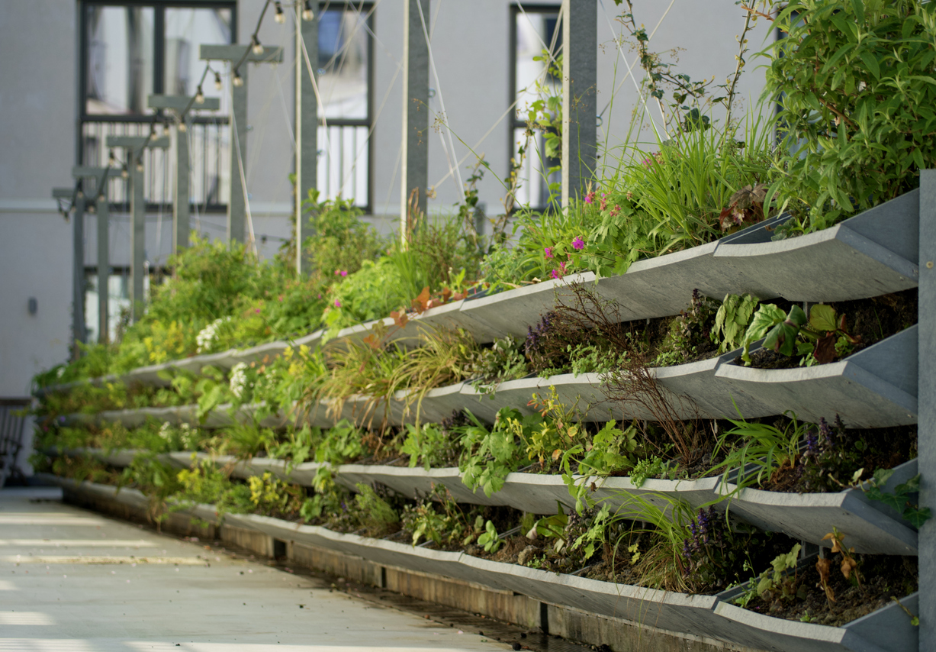
Nature Restoration Law webinar series
Webinar #4: Greening Regulations on municipally-owned land
Leon Kapetas
External Expert EUI
Resilient Cities Network

Slide 2
House rules
Use the code: #NRL

Slide 3
Nature Restoration Law webinar series
Article 8: urban ecosystem restoration
No net loss of urban green space or tree canopy cover in urban ecosystem areas by 2030
March-June 2025 supporting cities with the implementation of the NRL
Cities need to rethink urban planning …
Baselines and data
What are the baselines for green space and tree canopy? What data to use?
Municipal roadmap
Which departments need to be involved?
What policies need to be considered?
Building and spatial regulations
Policies for new developments
Policies for retrofitting existing developments
Citizen owned land and business collaboration
Policies to engage citizens and raise awareness
Policies to support greening efforts
Policies to support business investment in offsetting?
Targets for business?
National Restoration Plan
What do cities need to do? How can cities work with member states?
Notes:
Member States shall determine and map urban ecosystem areas as referred to in Article 8 for all their cities and towns and suburbs.

Slide 4
Nature Restoration Law webinar series
No net loss of urban green space or tree canopy cover in urban ecosystem areas by 2030
Webinar #1 looked at the starting point: what are the definitions to be aware of? what are the baseline years?
Webinar #2 looked at urban nature plans: how can cities plan for nature restoration? What guidance is out there?
Webinar #3 looked building regulations and spatial plans: what policies for new and existing developments?
Bristol on the Biodiversity Net Gain
All new developments must achieve biodiversity gain of 10%
How UK policy of BNG applied in Bristol
Process for understanding biodiversity baseline of a site and calculating whether a planning proposal needs the requirements
Paris on their BioClimatic Plan
BioClimatic Urban Master Plan sets out regulations for land use and developments
On all plots of land larger than 150 m2, up to 65% of open space must be provided in projects, with no possibility of derogation
Green Building Index: all new constructions, major renovations, extensions, or building elevations (numerical value based on specific criteria—including local context, project type, and structural possibilities)
University of Naples on soft and hard policies
Definitions and benefits of each hard and soft regulations: hard regulations set minimum standards and can mobilise funding, while soft regulations can foster cross-collaboration and provide more flexibility
Emerging tools for hard and soft regulation in relation to the NRL including Urban Nature Plans / Master Plans (hard and knowledge sharing and co-design methods (soft)

Slide 5
Webinar #4: Greening regulations on municipally-owned and managed land
The Sustainability Protocol of the Area Metropolitan Barcelona
Speaker: Albert Gassull, Director of Public Space Services, AMB

Slide 6
Sustainability protocol
Environmental criteria for AMB and IMPSOL projects and works
Albert Gassull
Director of Public Space Services

Slide 7
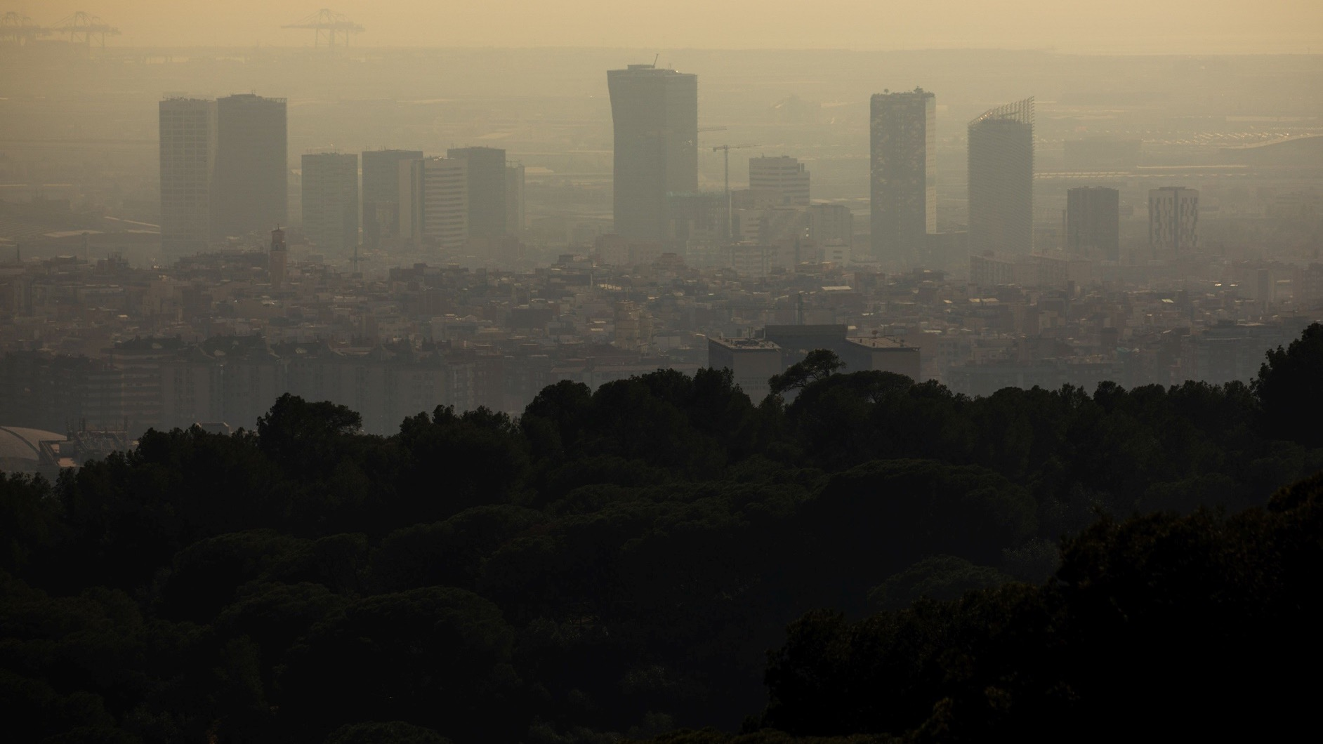
Premature deaths in urban areas in Europe
ISGlobal 2021
PM_{2,5} 125.000 NO₂ 80.000 Lack of green spaces 43.000 Noise-related ischemic heart disease 3.600
ISGlobal 2023
High temperatures in summer 47.000
+ 300.000 annual deaths
-36 extinct species since 2015

Slide 8
EU
Dec 2019
May 2020
Aug 2024
European Green Deal
Biodiversity strategy 2030
Nature Restoration Law

Slide 9
EU
Members
Dec 2019
May 2020
Aug 2024
Sep 2026
Sep 2027
June 2032
European Green Deal
Biodiversity strategy 2030
Draft of the National Restoration Plans
Final version of the National Restoration Plans
Review the National Restoration Plans and every 10 years
Nature Restoration Law

Slide 10
Nature Restoration Law Article 8
No net loss of urban green areas and urban tree canopy by December 2030 (compared to 2024).
From 2031 onwards an increase trend is necessary up to a satisfactory level.

Slide 11
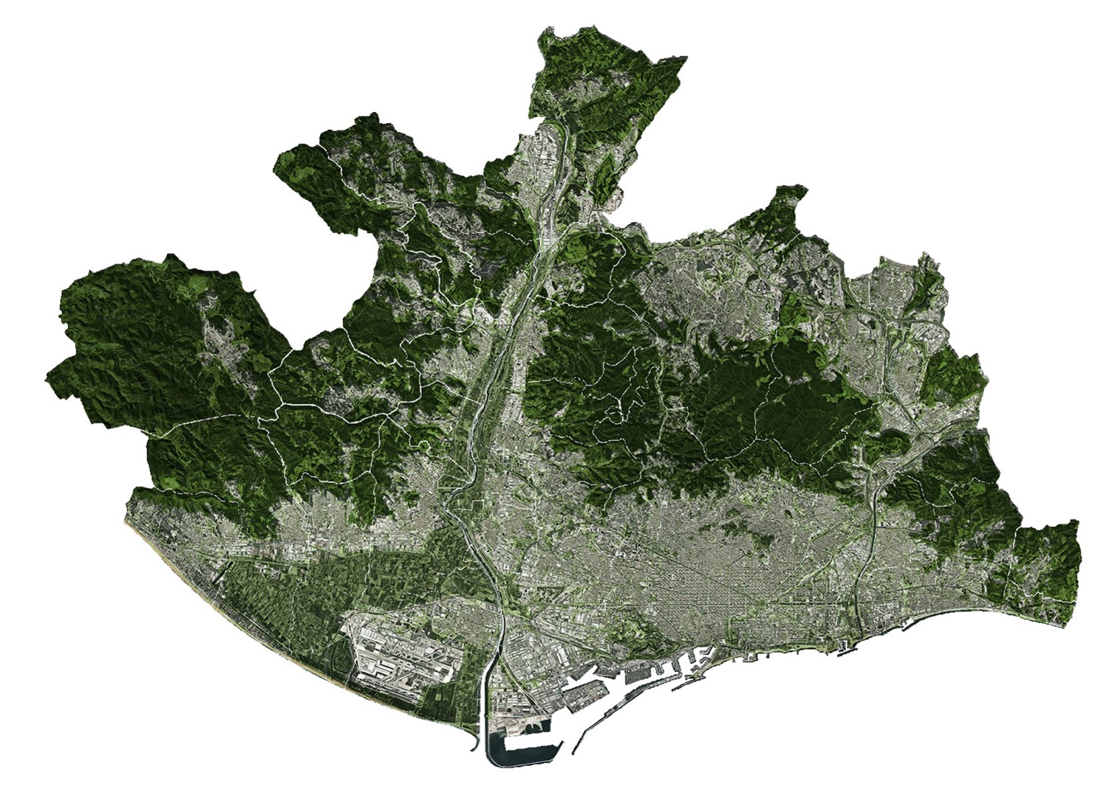
Metropolitan territory
52%
of open spaces
900 km
of contact between
urban and open spaces

Slide 12
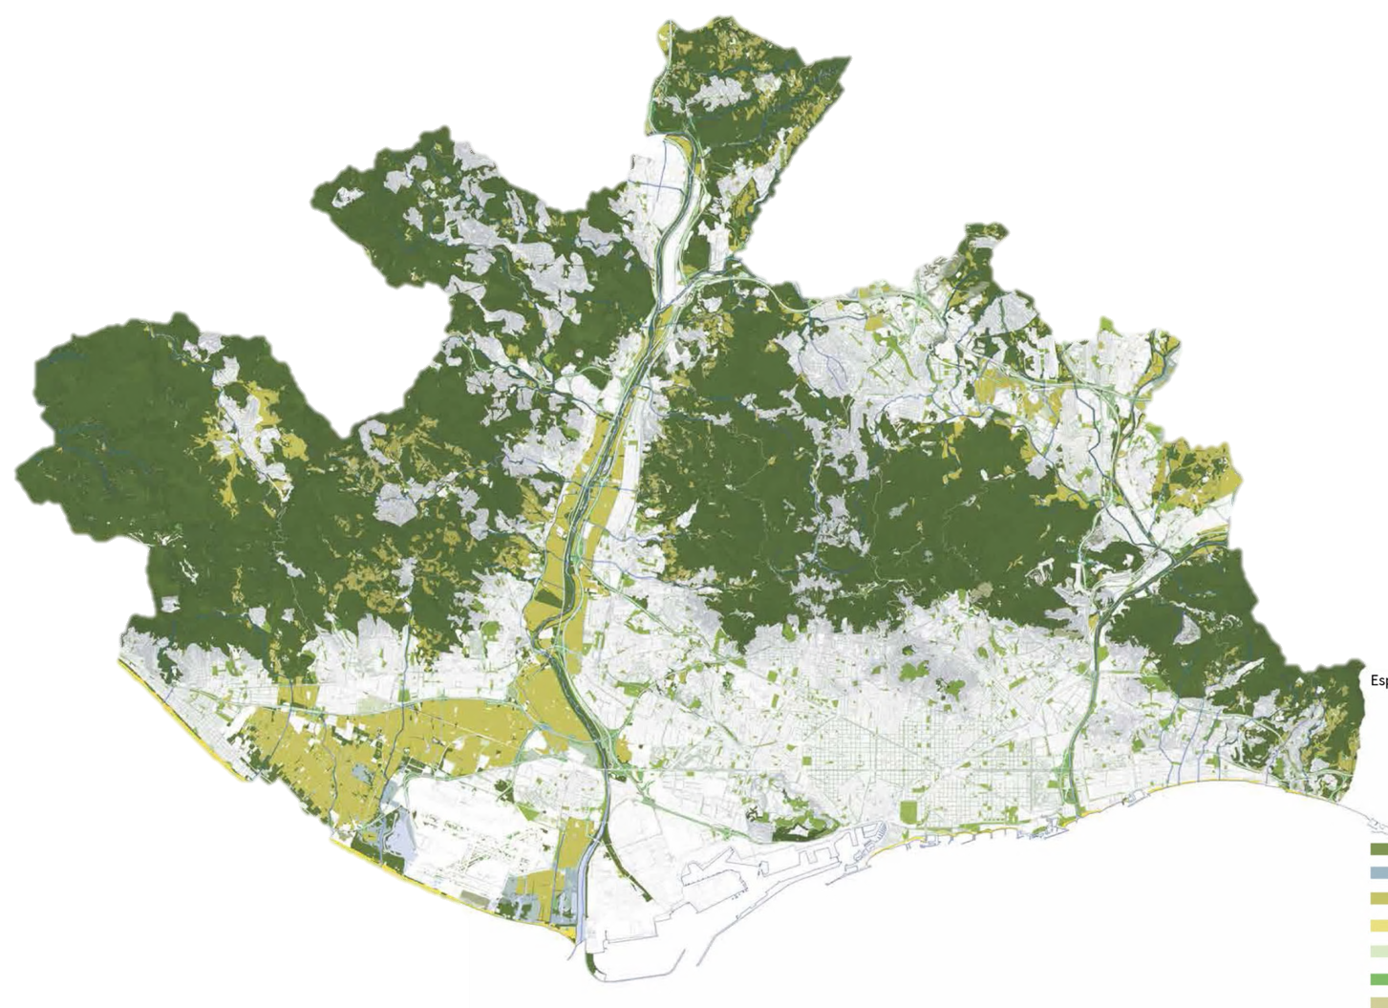
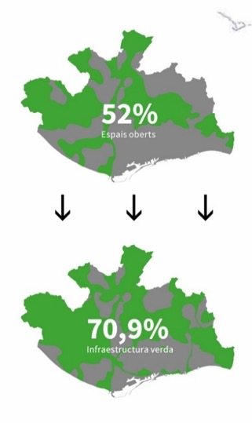
Metropolitan territory
up to
71%
of green
infrastructure

Slide 13
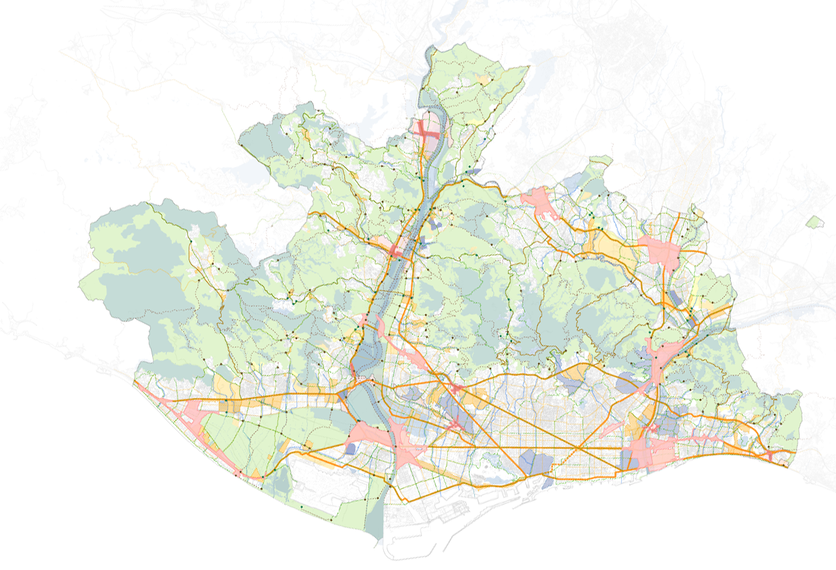
Metropolitan Urban Master Plan / PDUM
Urban planning instrument that will organise the metropolitan territory in an integrated manner in the coming decades.
It is based on five principles:
Preserve ecological functions and ecosystem services
Consolidate a polycentric articulated system for metropolitan avenues and green hubs
Foster sustainable active mobility by rethinking metropolitan infrastructures
Planning urban settlements to guarantee balance, cohesion and habitability
Improve the efficiency of urban metabolism and minimise environmental impacts

Slide 15
Sustainability protocol
Environmental criteria for AMB and IMPSOL projects and works

Slide 16
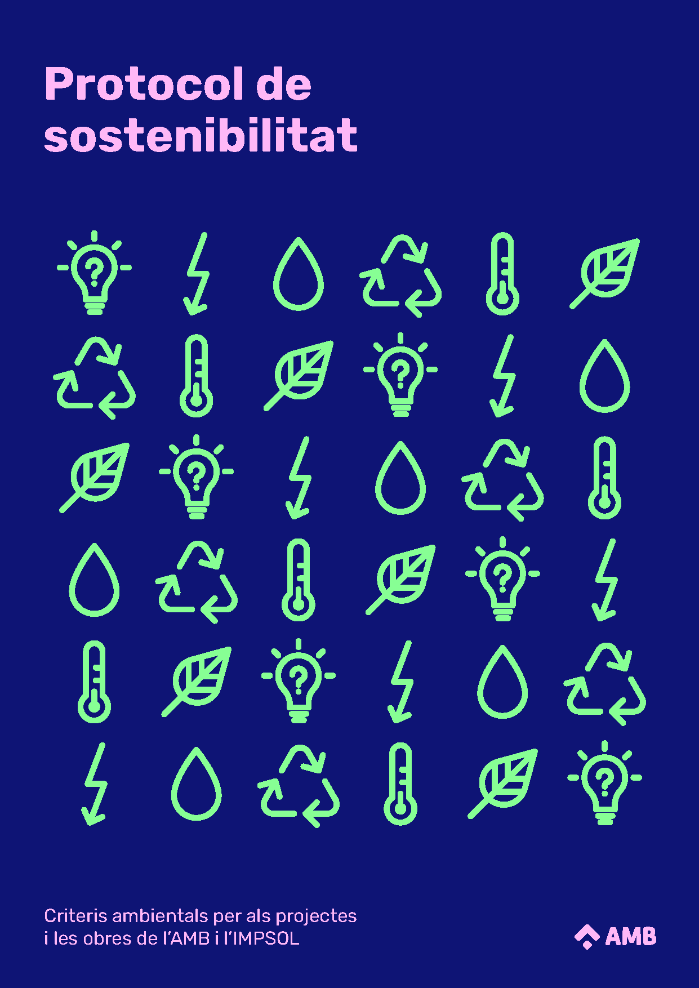
Sustainability protocol
6
fields
Transversal analysis and follow-up
Water
Energy
Comfort and health
Materials
Sustainability of the site
19
Environmental criteria for AMB and IMPSOL projects and works
criteria

Slide 17
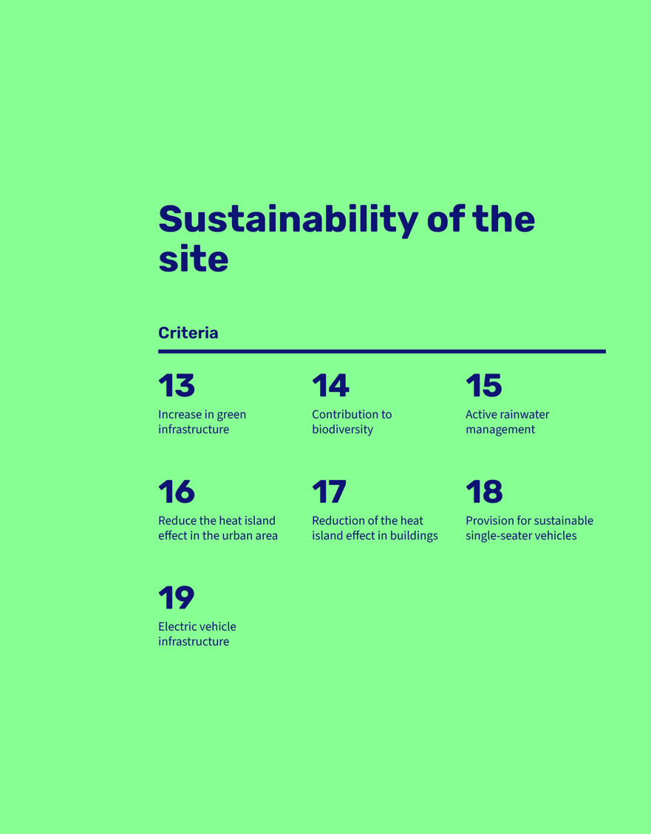
Sustainability protocol
Environmental criteria for AMB and IMPSOL projects and works

Slide 18
13
Increase in green infrastructure
Preservation of green spaces and their ecosystem services

Slide 19
13
Increase in green infrastructure
Preservation of green spaces and their ecosystem services
Minimum percentage of green space area

Slide 20
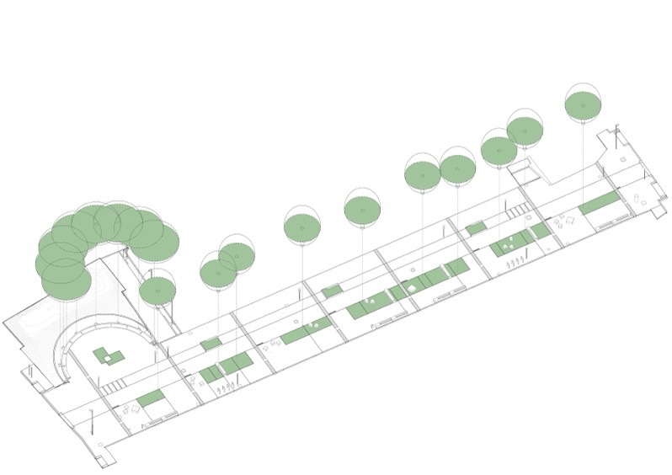
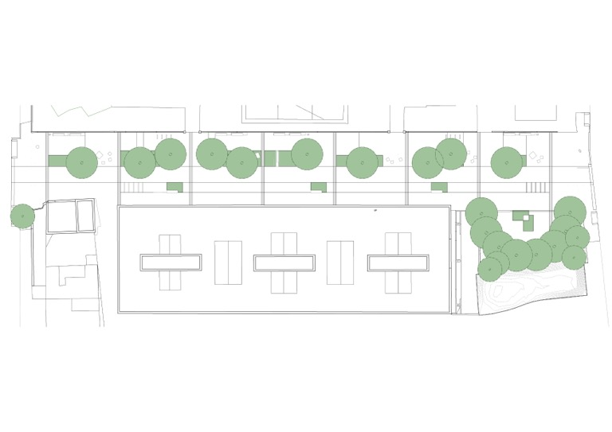
Sustainability protocol in 2025
Green infrastructure
Project: Joan de Batlle street in Sant Feliu de Llobregat (2021)

Slide 21
Sustainability protocol in 2025
Green infrastructure
25 %
110 %
75 %
55 %
70 %
30 %
30 %
25 %
25 %

Slide 22
14
Contribution to biodiversity
Identify whether there are any species of special interest or degree of threat in the area

Slide 23
14
Contribution to biodiversity
Identify whether there are any species of special interest or degree of threat in the area
Minimum number of actions to increase biodiversity in the area of the project

Slide 24
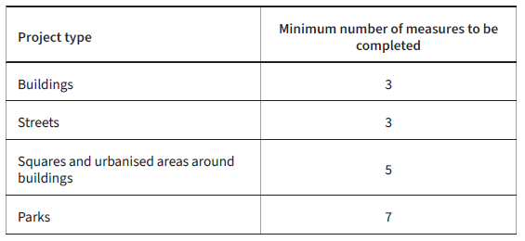
Sustainability protocol in 2025
Contribution to biodiversity
40 %
40 %
65 %
40 %

Slide 25
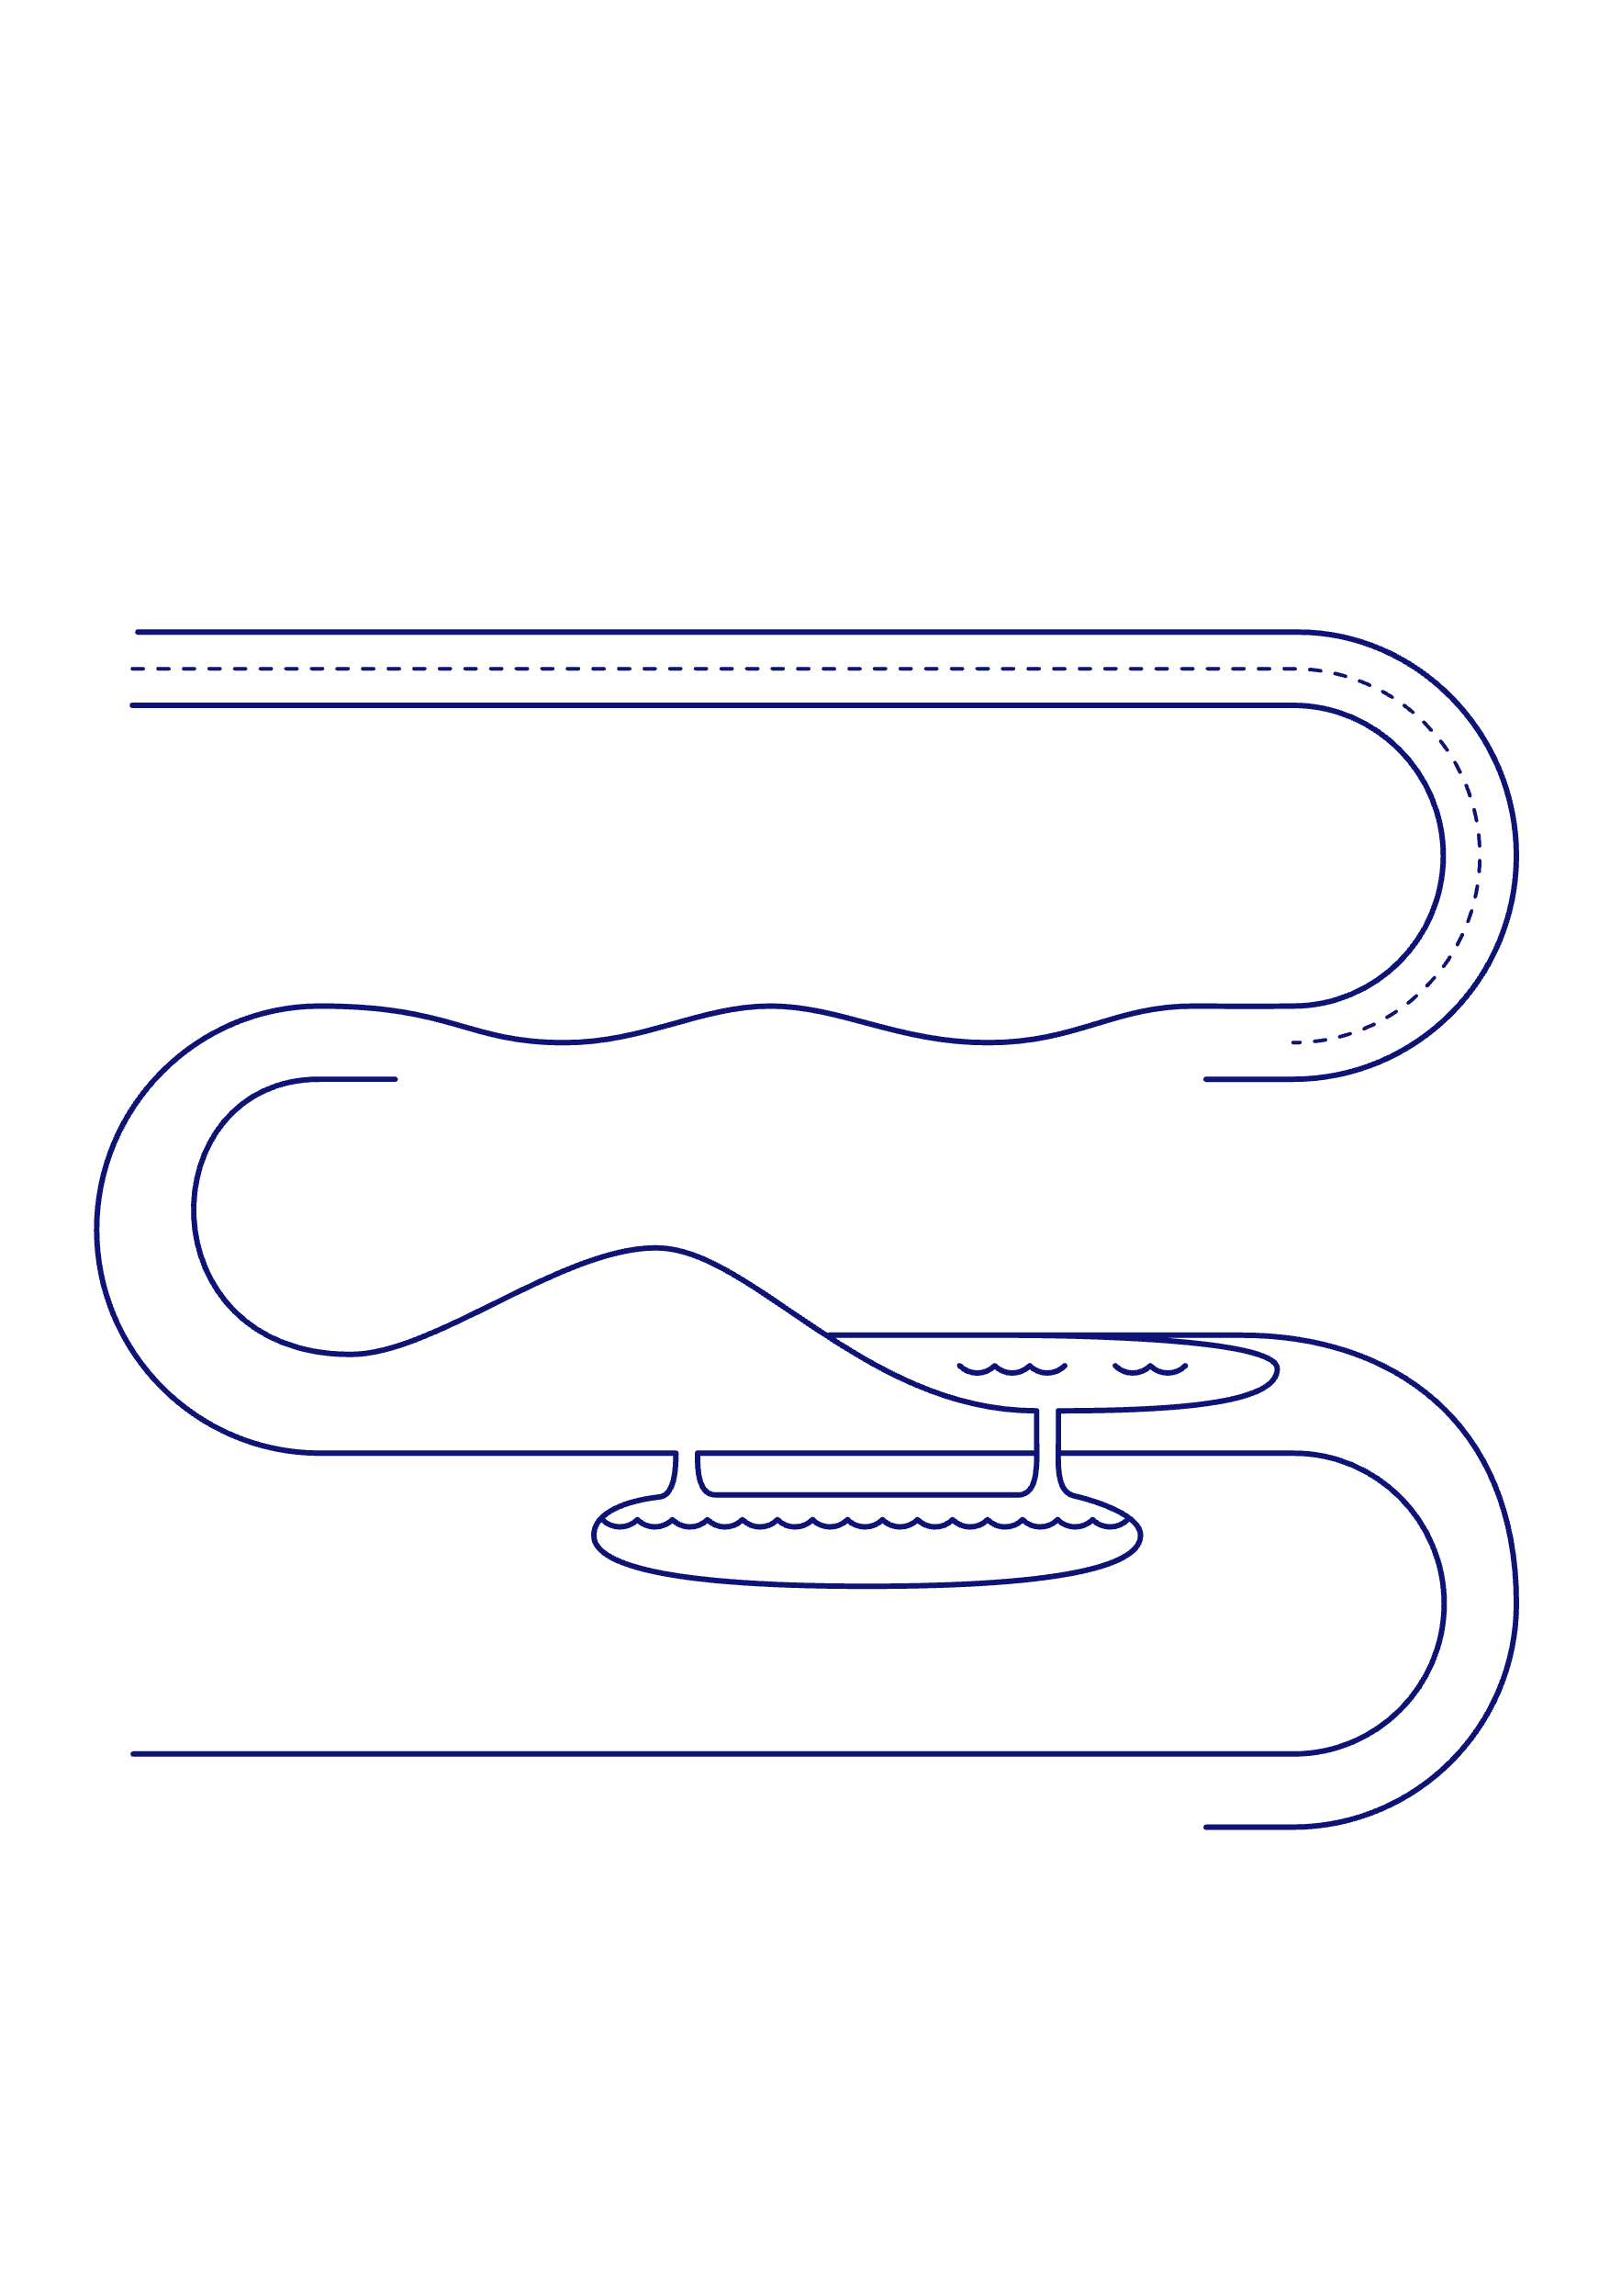
15
Active rainwater management
Minimum volume of surface run-off to manage

Slide 26
Sustainability protocol in 2025
Active rainwater management
Qualitative and quantitative identification of the main water flows in the area, soil permeability and infiltration rate.
Management of part of the rain that falls over the drainage basin.
40 %
40 %
65 %
40 %

Slide 27
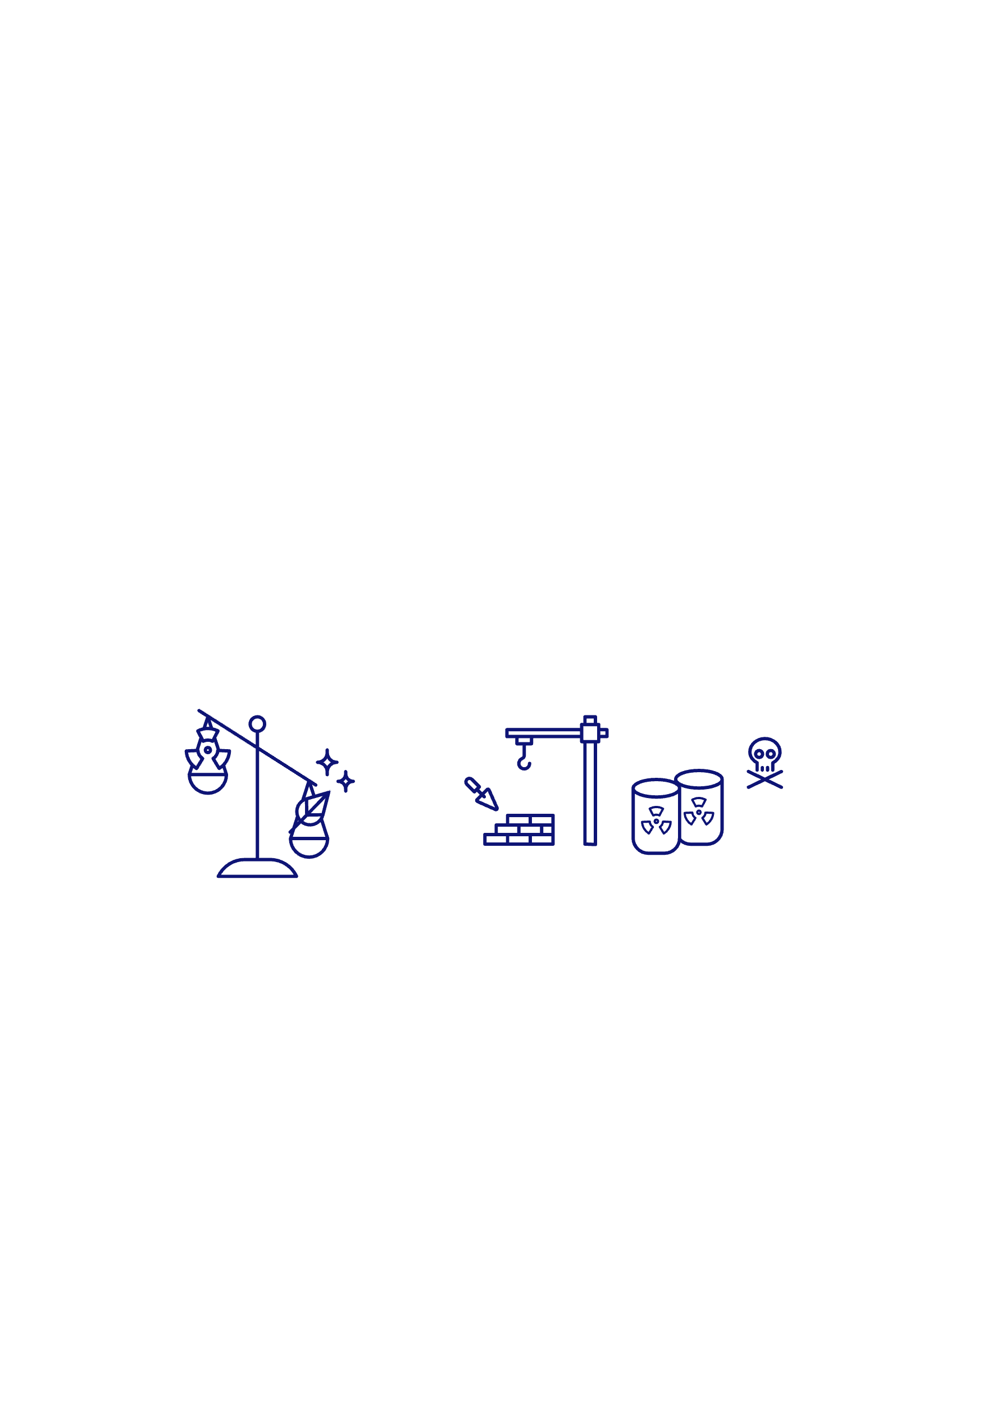
16
Reduce the heat island effect in the urban area
Maximum percentage of surface area covered by heat-retaining pavement

Slide 28
17
Reduce the heat island effect in buildings
Maximum percentage of envelope surface area that retains heat

Slide 29
Sustainability protocol in 2025
Reduction of the heat island effect
20 %
40 %
40 %
65 %
40 %

Slide 30
Projects

Slide 31
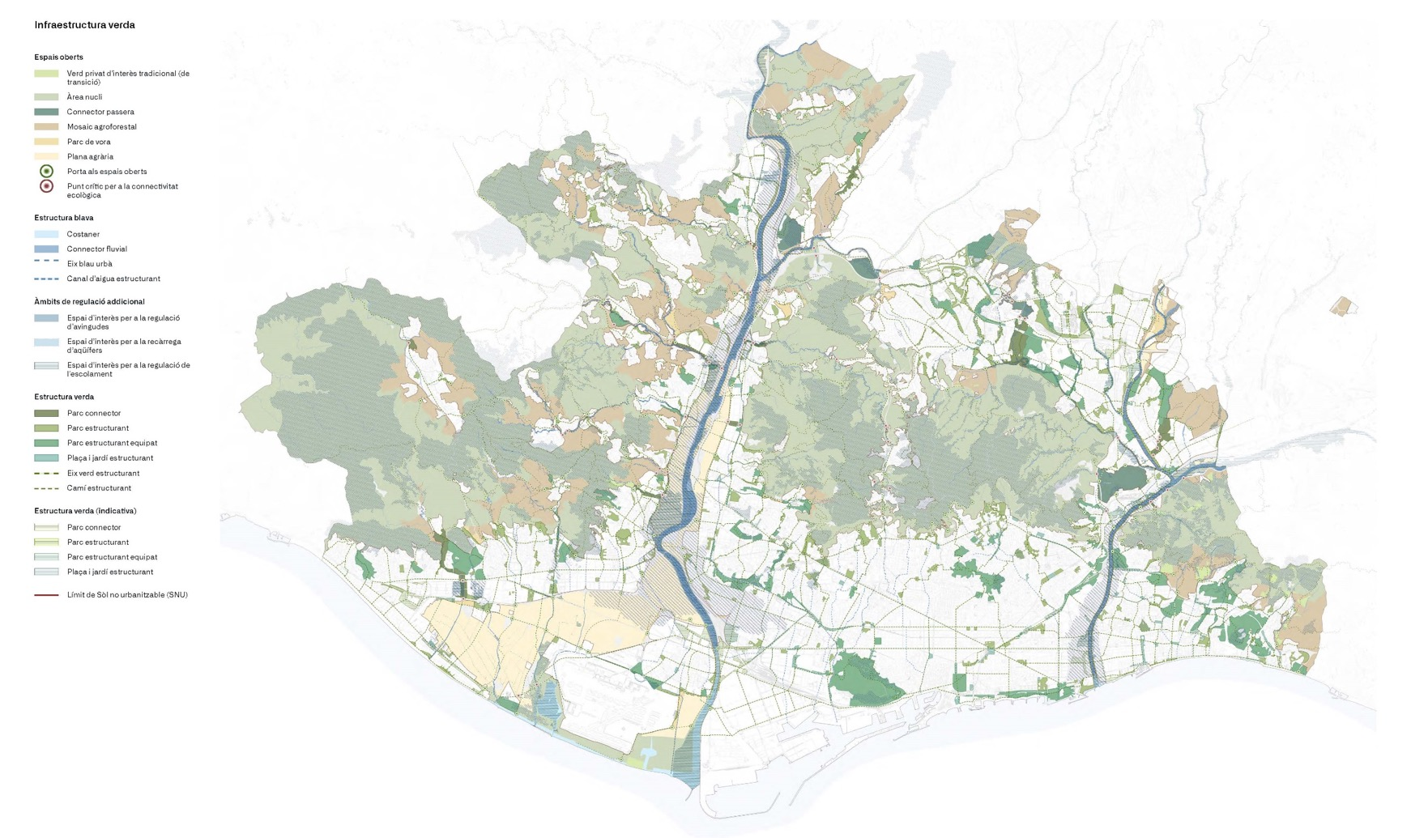
Green axis
The green comb
Cornellà Natura

Slide 32
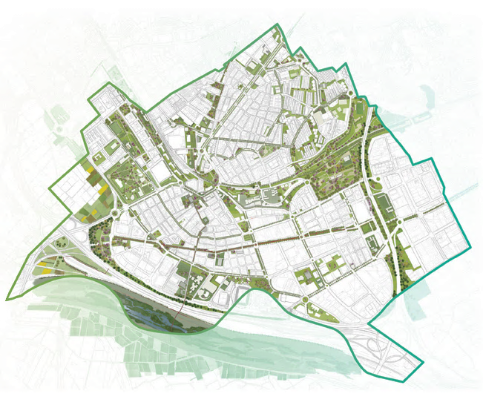
Cornellà Natura
Cornellà de Llobregat

Slide 33
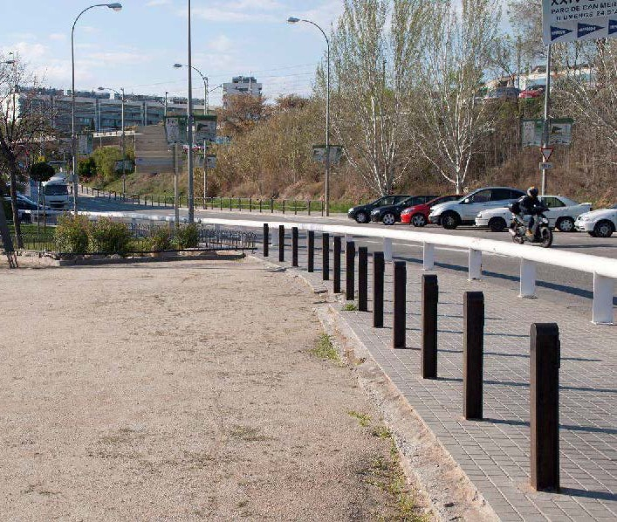
Alps Avenue and Rosa Sensat Park
Cornellà de Llobregat

Slide 34
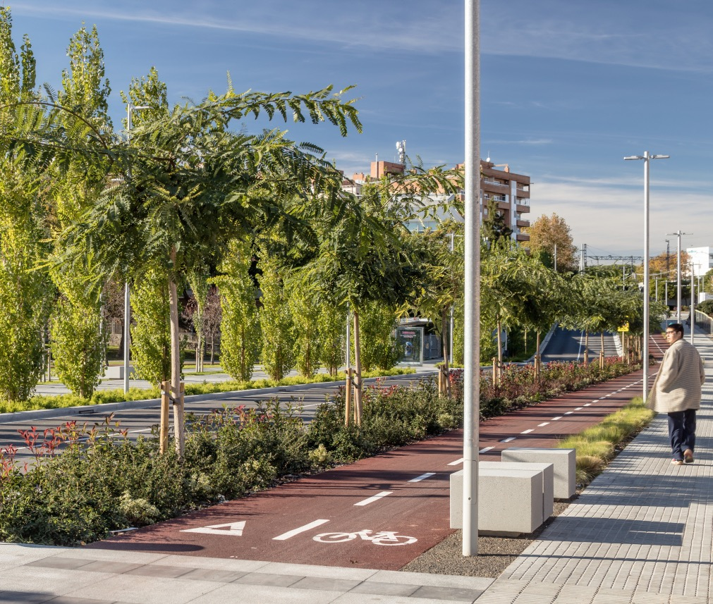
Alps Avenue and Rosa Sensat Park
Cornellà de Llobregat

Slide 35
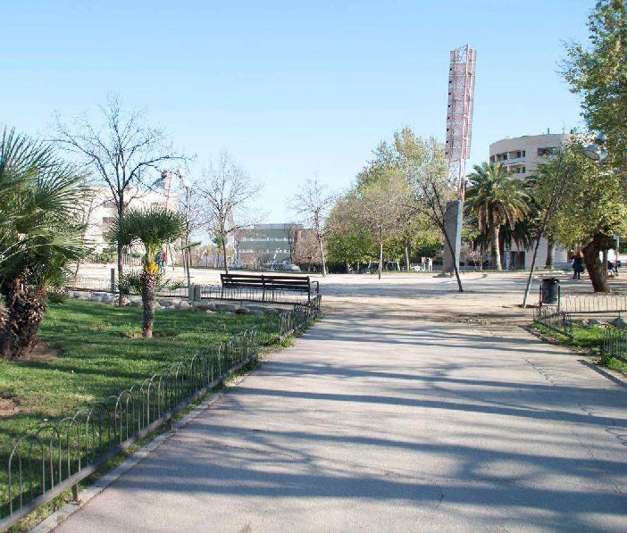
Alps Avenue and Rosa Sensat Park
Cornellà de Llobregat

Slide 36
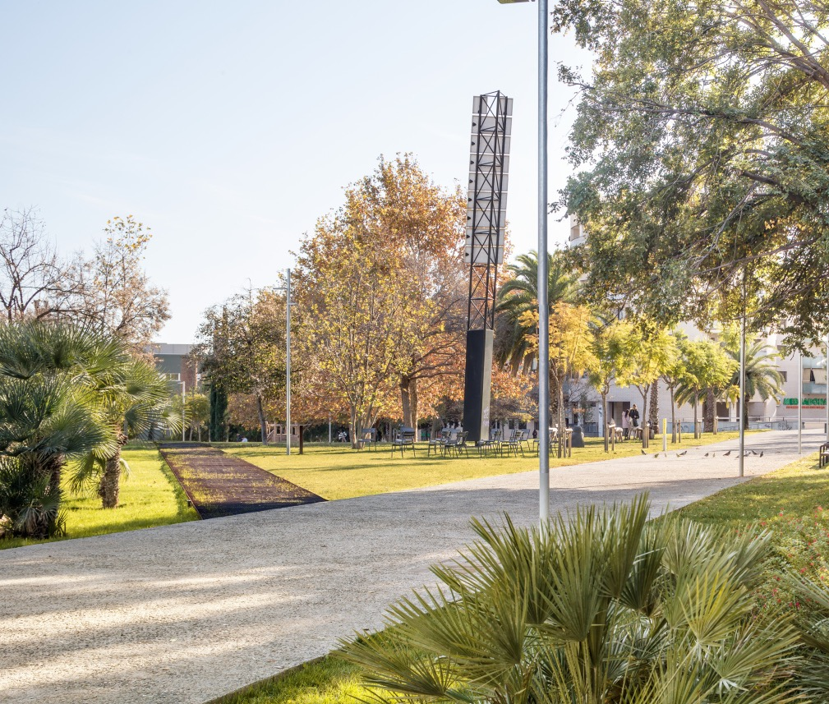
Alps Avenue and Rosa Sensat Park
Cornellà de Llobregat

Slide 37
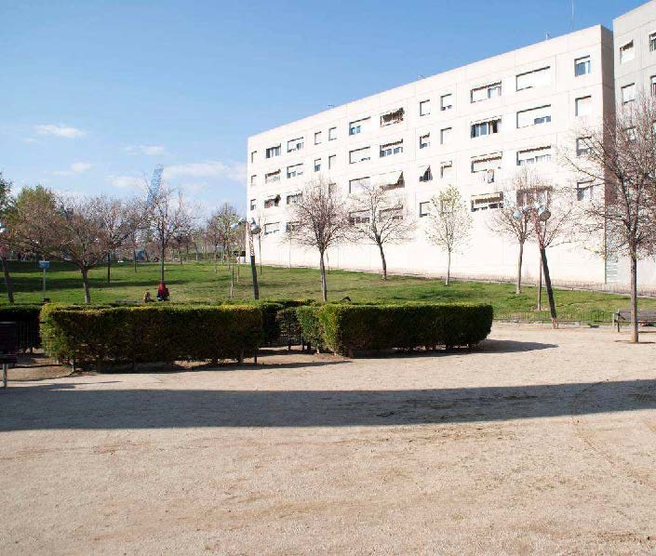
Alps Avenue and Rosa Sensat Park
Cornellà de Llobregat

Slide 38
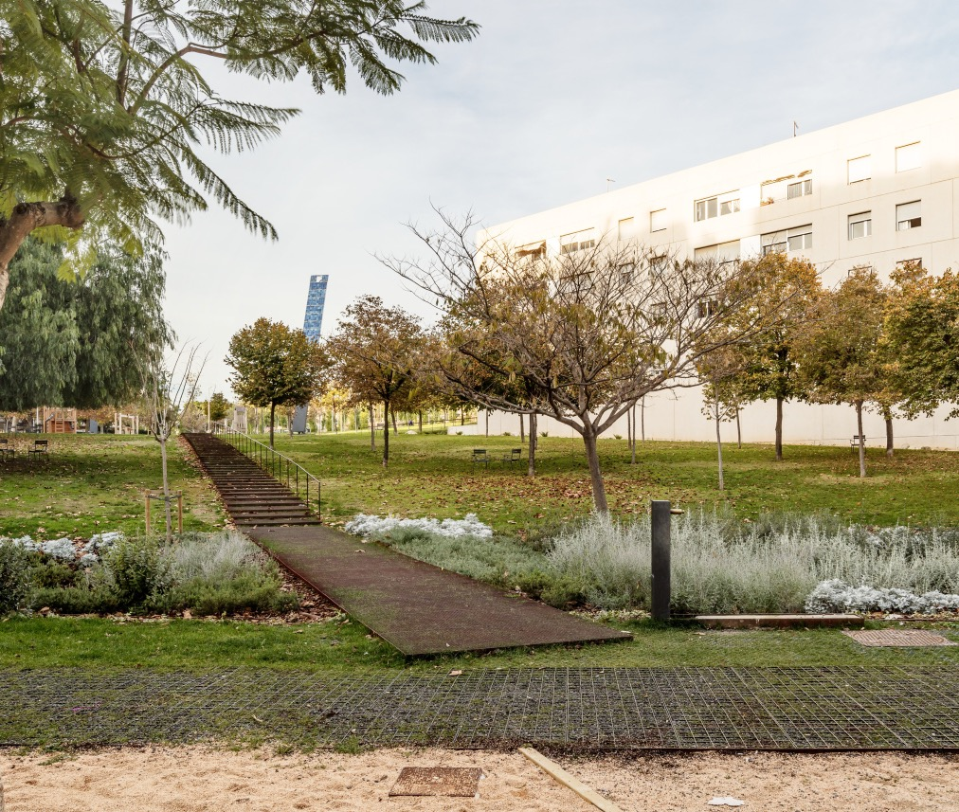
Alps Avenue and Rosa Sensat Park
Cornellà de Llobregat

Slide 39
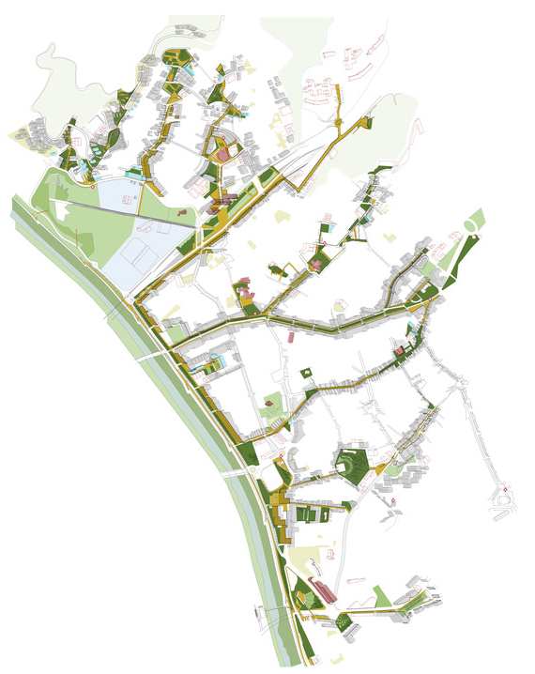
The green comb
Santa Coloma de Gramenet

Slide 40
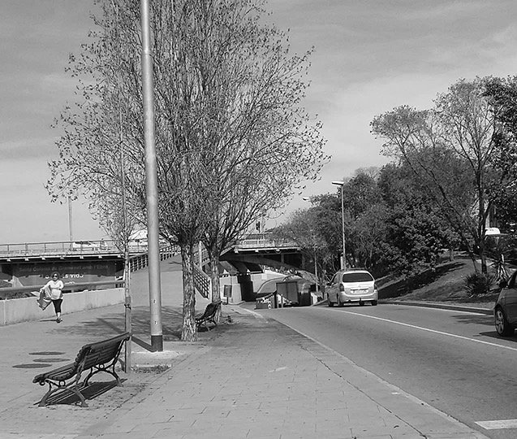
Salzereda Promenade
Santa Coloma de Gramenet

Slide 41
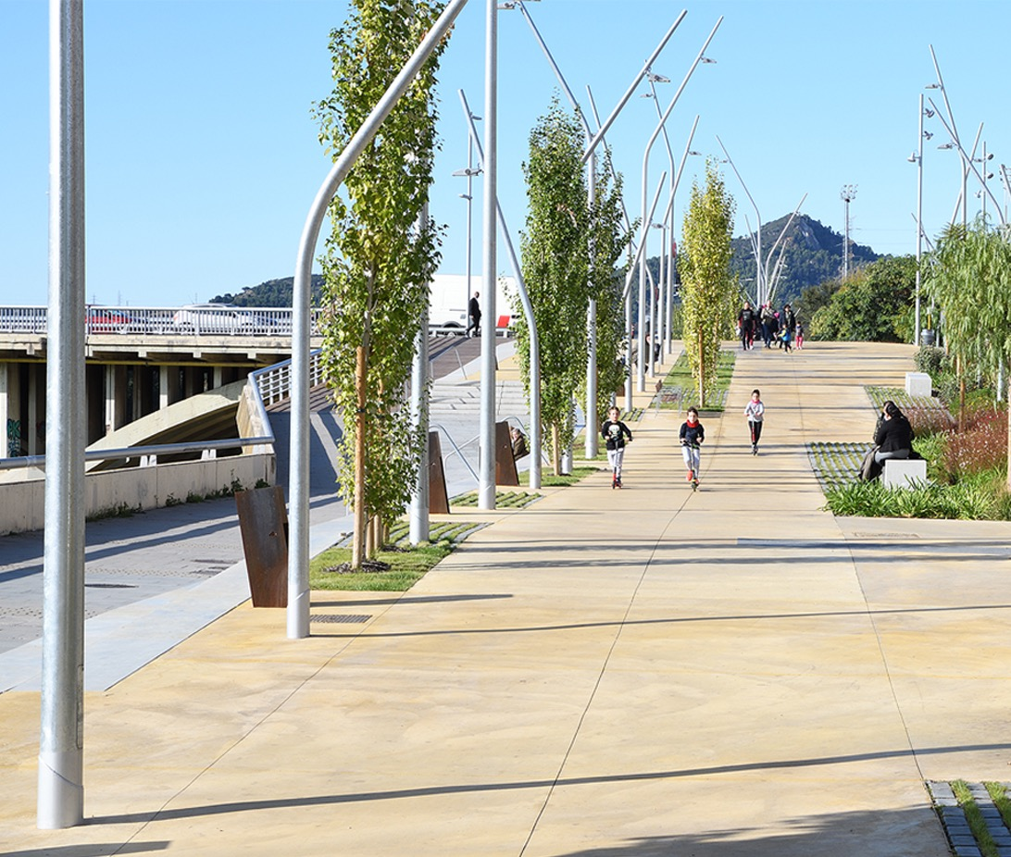
Salzereda Promenade
Santa Coloma de Gramenet

Slide 42
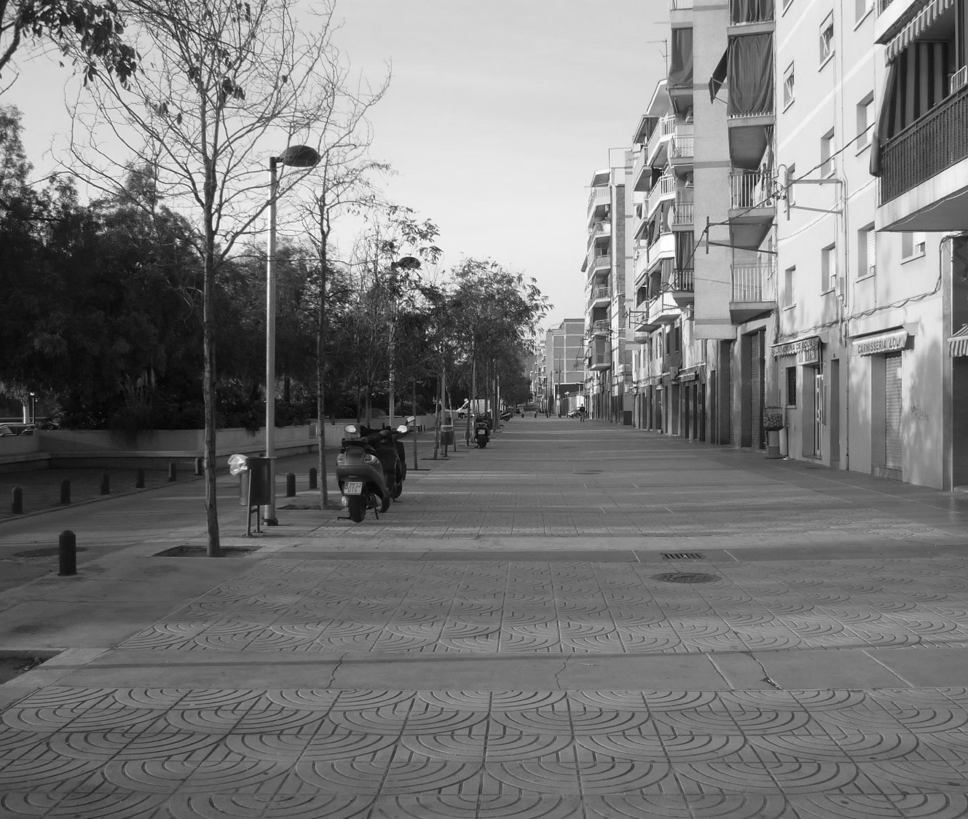
Salzereda Promenade
Santa Coloma de Gramenet

Slide 43
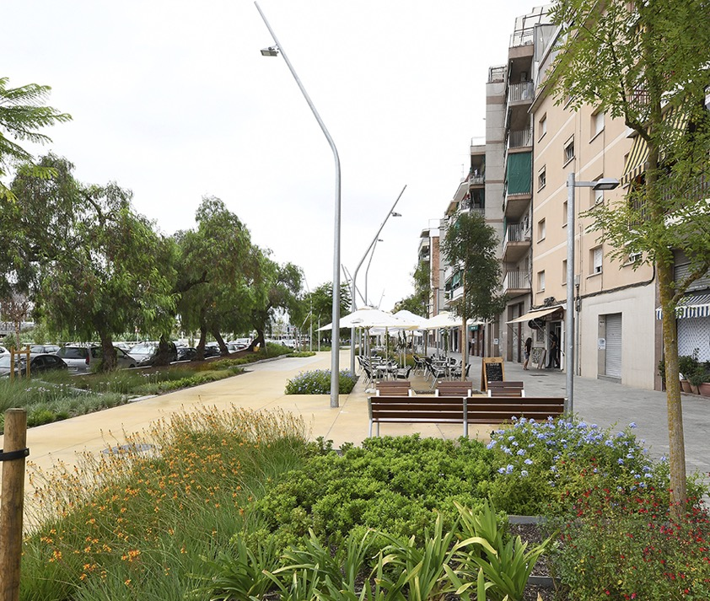
Salzereda Promenade
Santa Coloma de Gramenet

Slide 44
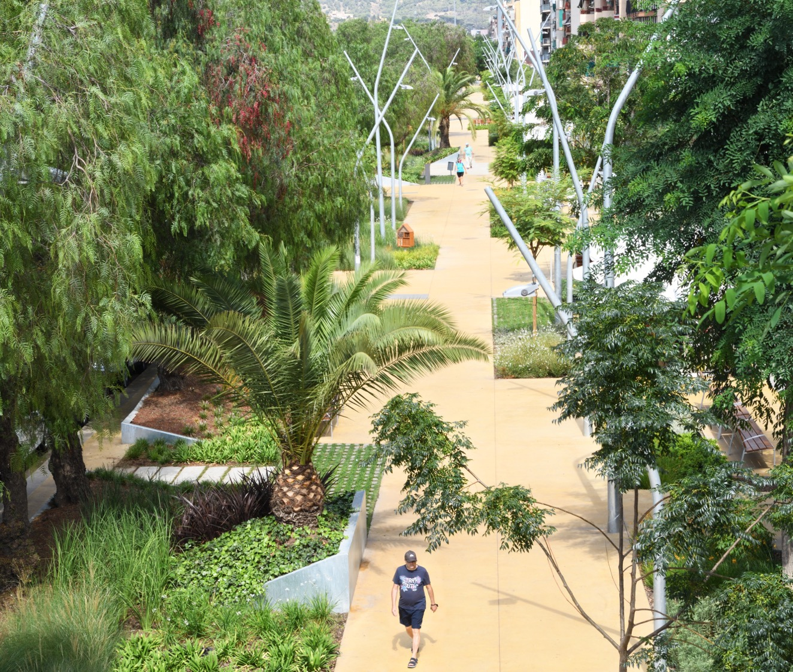
Salzereda Promenade
Santa Coloma de Gramenet

Slide 45
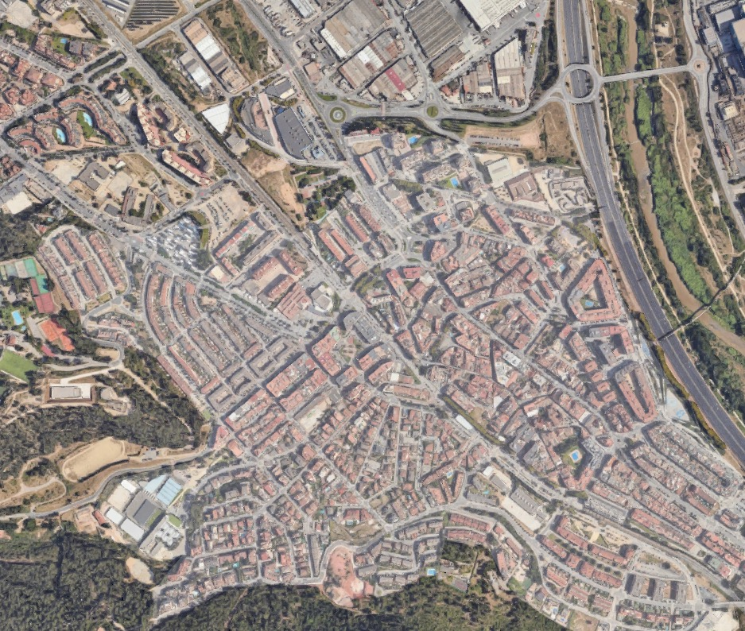
Green axis
Santa Andreu de la Barca

Slide 46
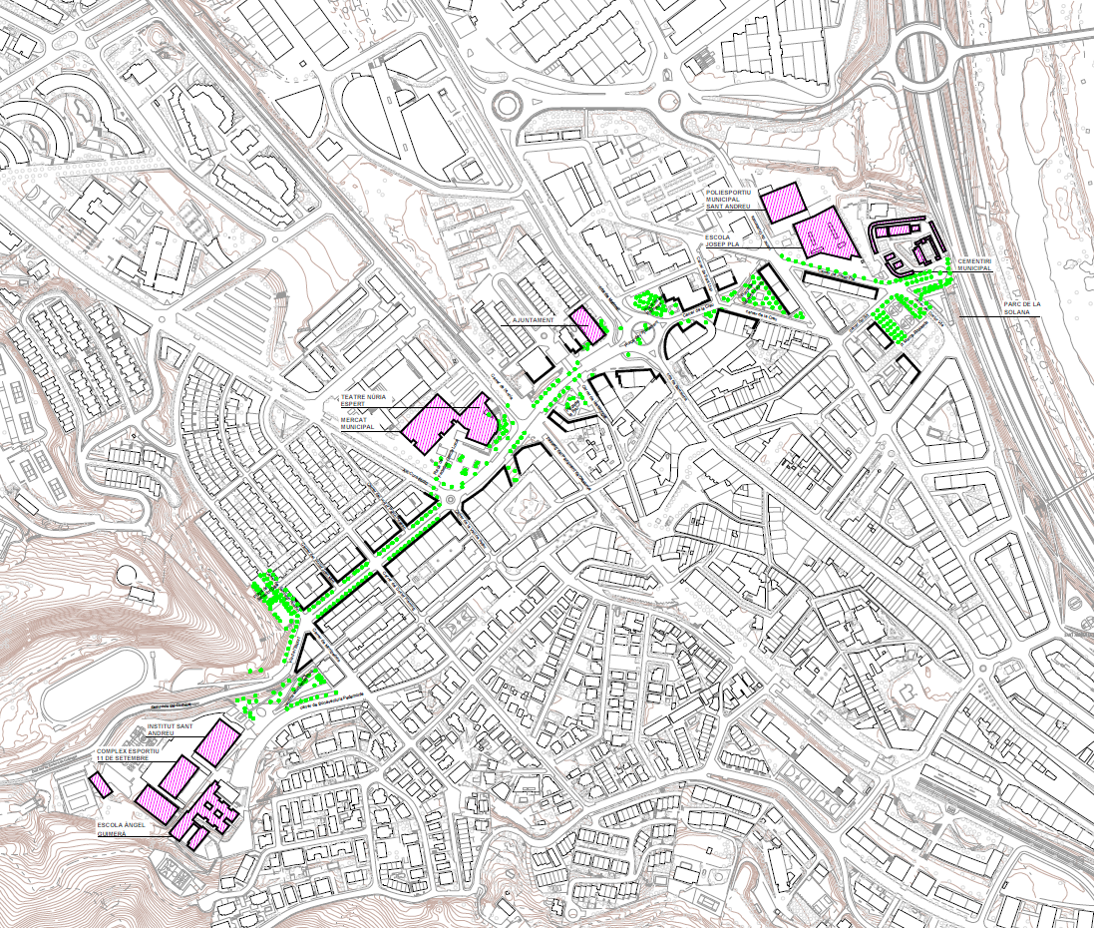
Green axis
Santa Andreu de la Barca

Slide 47
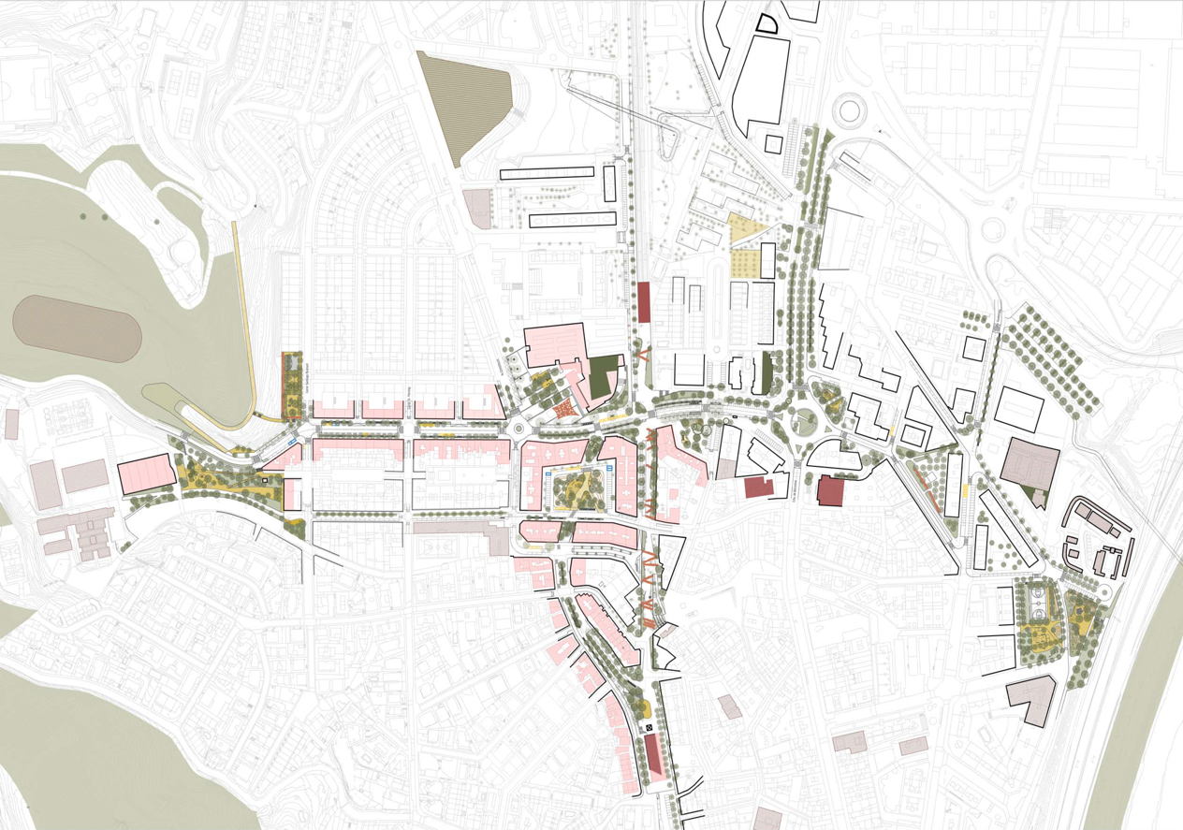
Green axis
Santa Andreu de la Barca

Slide 48
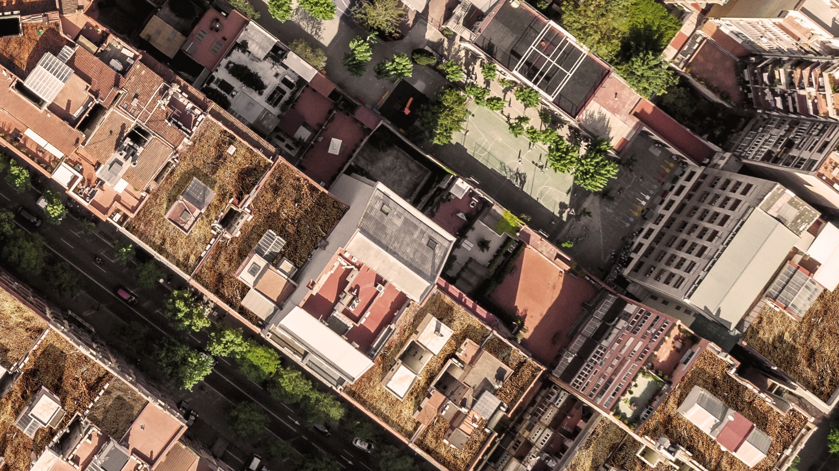
TOP
SEC

Slide 49
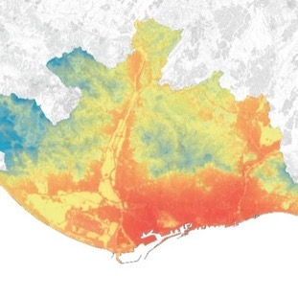
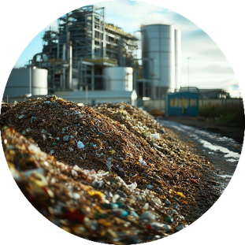
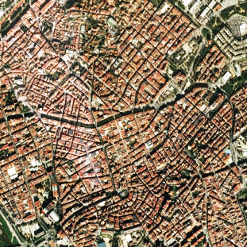
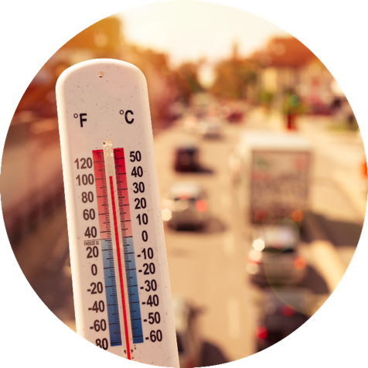
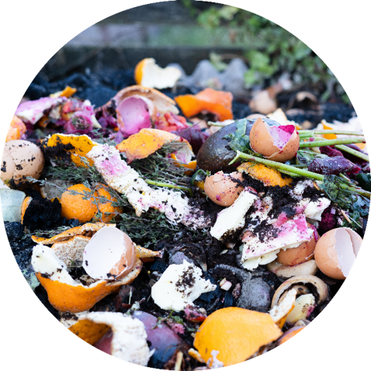
EUI – Innovative Actions
TOP SEC
Heat waves and
recurring drought periods
Increase in organic waste
Loss of biodiversity
within urban areas
Challenges
Notes:
55% menos de precipitación en 2023 (Institut Metropoli)
1.5 millones de toneladas de residuos sólidos municipals al año
33% de los residuos sólidos son bioresiduos
24% de pérdida de biodiversidad en los últimos 20 años (Dato de la Generalitat)
TOP SEC aborda algunos de los desafíos urbanos más urgentes de nuestro tiempo: el cambio climático y la gestión de residuos. En la metrópolis de Barcelona, y en muchas ciudades del sur de Europa, nos enfrentamos a veranos más calurosos, sequías más prolongadas y una creciente acumulación de residuos orgánicos. Junto a estos problemas, la biodiversidad urbana está disminuyendo y, a veces, encontrar un equilibrio entre los habitantes humanos y la fauna urbana resulta un desafío.

Slide 50
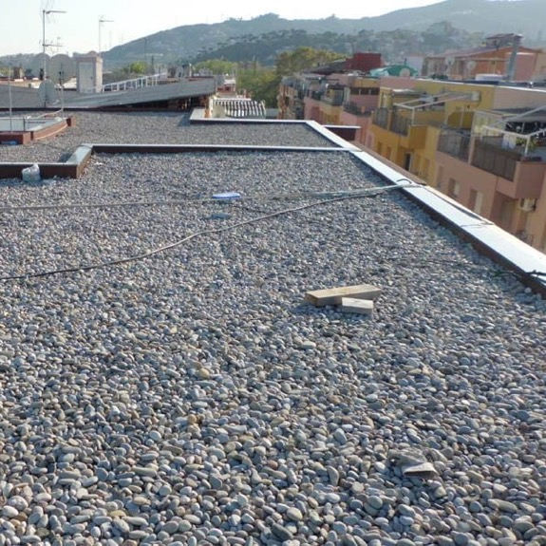
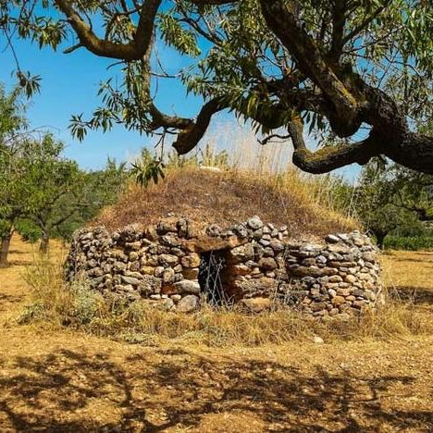
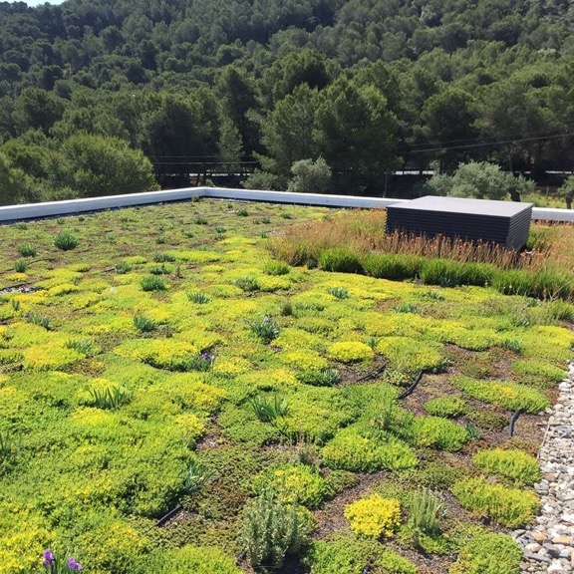
EUI – Innovative Actions
TOP SEC
Roof with maximum benefits and minimal investment
↓ COST
↑ BIODIVERSITY
↓ COST
↓ BIODIVERSITY
↑ COST
↑ BIODIVERSITY
TOP SEC
Notes:
TOP SEC is an innovation project that aims to address urban challenges related to climate change and waste generation, proposing the installation of self-sustaining green roofs that do not require irrigation.
Additionally, the project will investigate techniques for water retention and the selection of suitable plants, using an innovative substrate made with biochar produced from local organic waste.

Slide 51
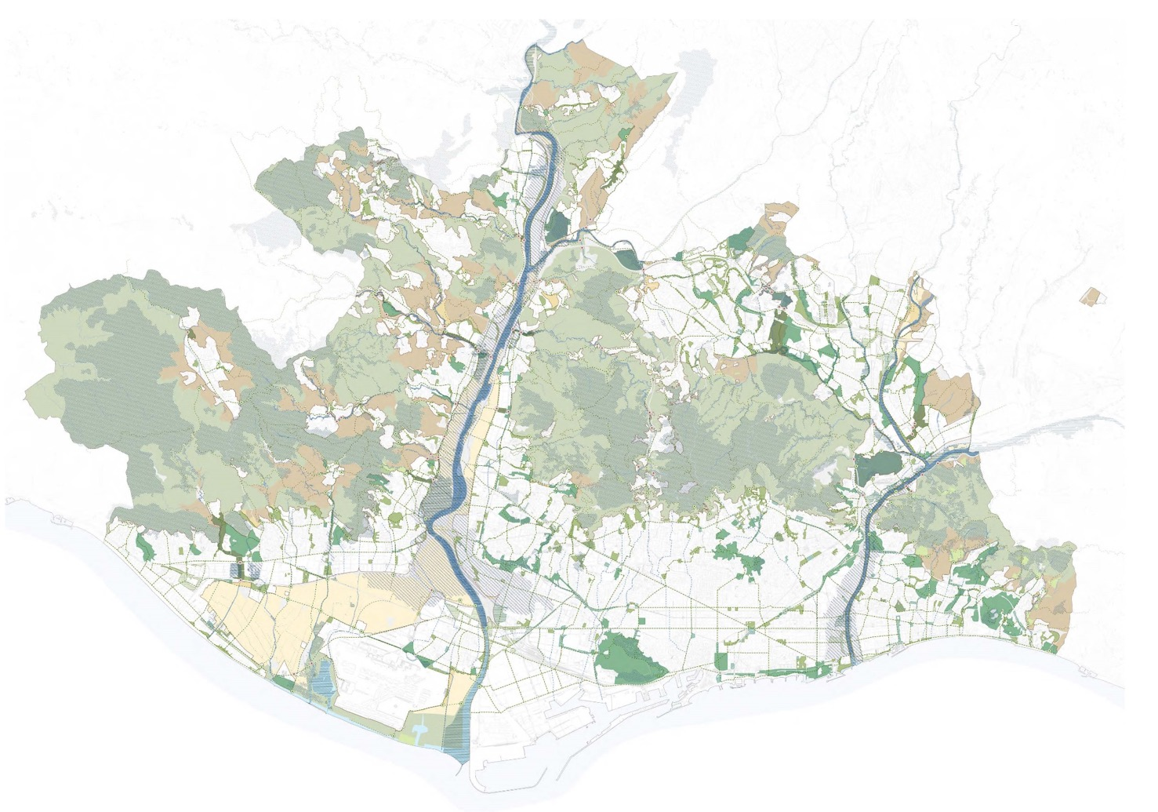

Slide 52
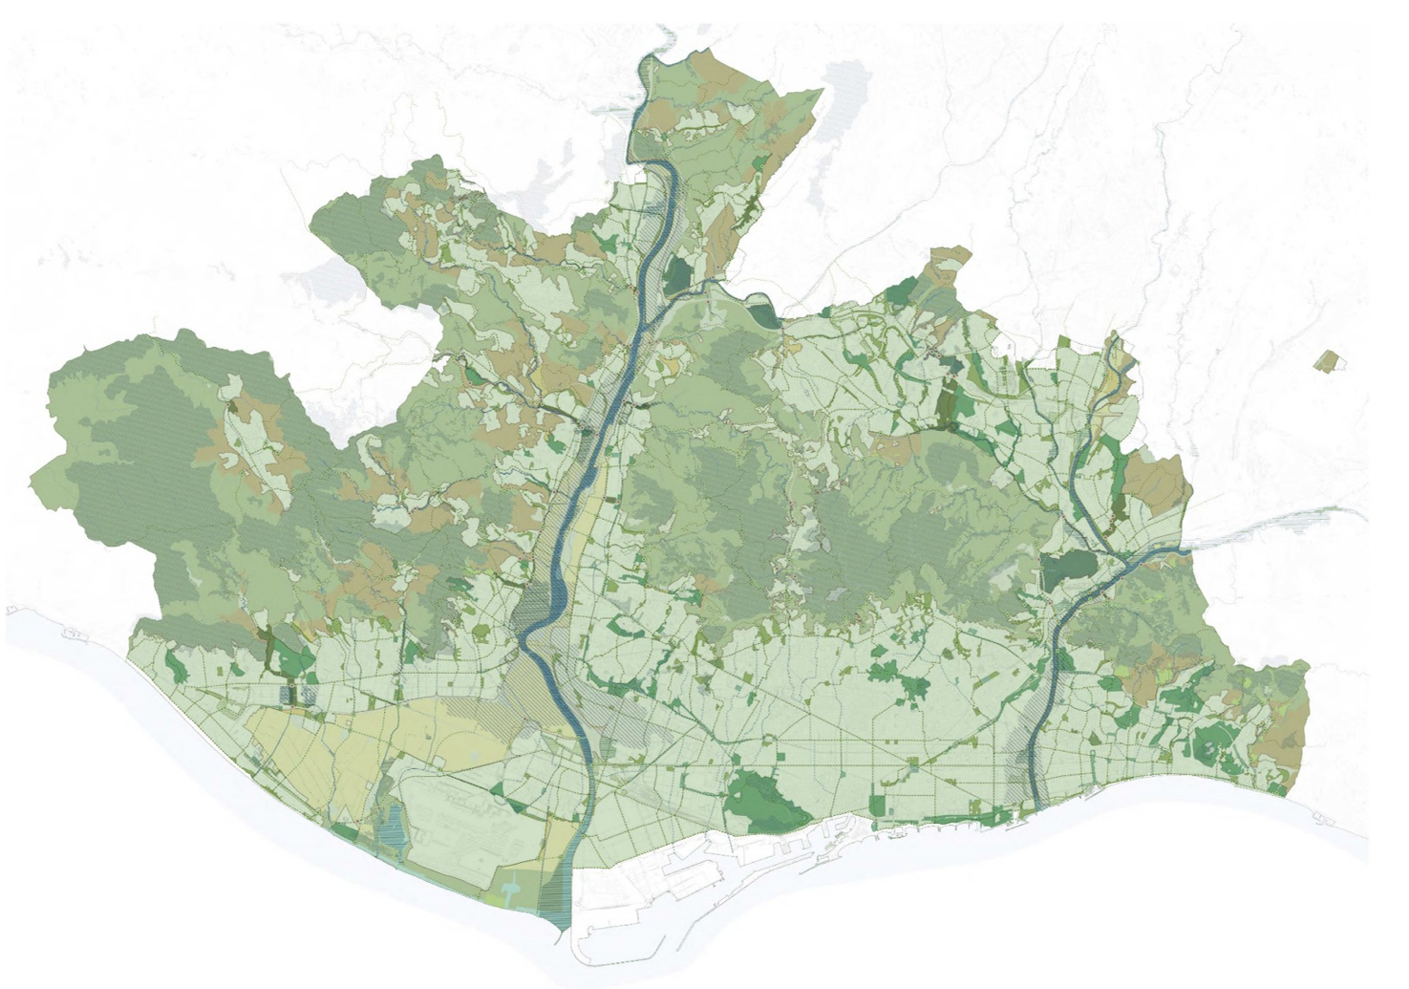

Slide 53
Download the protocol
Thank you! Albert Gassull
More information
espaipublic@amb.cat
www.amb.cat
amb_metropolis
espaipublicAMB
espai públic AMB

Slide 54
Q&A
Notes:
Before we jump into this, we’re going to explore some of the main findings of a survey some of you responded to on how to monitor nature plans. I’ll hand over now to Leon Kapetas who will share these key findings and take us through the presetnations today.

Slide 55
Nature Restoration Law webinar series: what’s next?
Webinar #5: Restoring nature on citizen owned land and business collaboration
Wednesday 28 May at 10.00-12.00 CEST
➡️ Gijs Norden, Greening without Borders, city of Rotterdam
Save-the-date
Webinar #6 (final): collaboration for National Restoration Plans
Thursday 12 June at 10.00-11.45 CEST
➡️ Kristian Kvist, Expert, Forest Ecosystem Restoration, European Environment Agency
➡️ Axelle Griffon, Senior Policy Advisor Environment and Mobility, Council of European Municipalities and Regions
➡️ Laura Maki, Senior Advisor, Finish Association of Municipalities
➡️ Virve Hokkanen, Senior Specialist in the Ministry for Environment
Registration: here
https://www.urbanagenda.urban-initiative.eu/news-events

