Slide 1
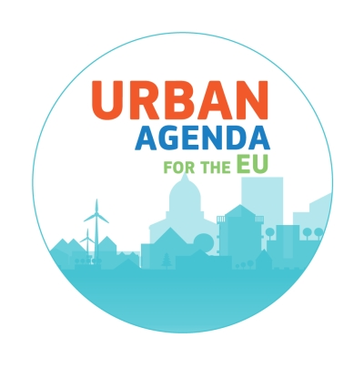
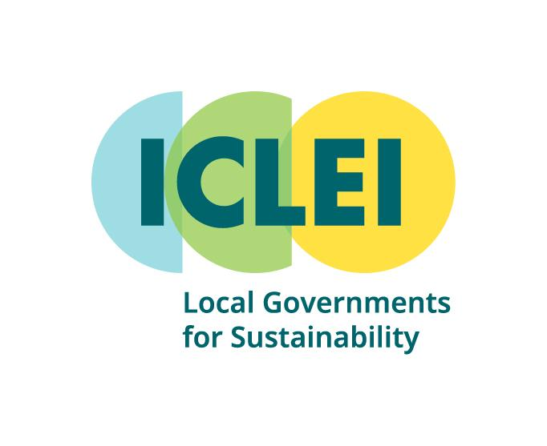
Advancing Green Infrastructure through Innovative Financing
ICLEI & EUA Greening Cities Partnership
27 May 2025
Kelly Baldwin Heid
Expert, Biodiversity and Nature-based Solutions
ICLEI Europe
Notes:
1

Slide 2
ICLEI, Local Governments for Sustainability
USA Office
Denver, USA
World Secretariat
Bonn, Germany
East Asia Secretariat
Seoul, South Korea
Canada Office
Toronto, Canada
Berlin Office
Berlin, Germany
Japan Office
Tokyo, Japan
Mexico, Central America & Caribbean Secretariat
Mexico City, Mexico
Korea Office
Seoul, South Korea
Kaohsiung Capacity Center
Seoul, South Korea
Brussels Office
Brussels, Belgium
European Secretariat
Freiburg, Germany
South America Secretariat
São Paulo, Brasil
South Asia Secretariat
New Delhi, India
South East Asia Secretariat
Manila, Philippines
Indonesia Project Office
Jakarta, Indonesia
Project Office
Country Office
Secretariat office
Africa Secretariat
Cape Town, South Africa
Oceania Secretariat
Melbourne, Australia
2
Notes:
First, for those of you who are new to ICLEI or need a refresher, we are a global network of more than 1,750 local and regional governments committed to sustainable urban development.
Active in over 100 countries, we influence sustainability policy and drive local action for low emission, nature-based, equitable, resilient and circular development.
Our Members and teams of experts work together through peer exchange, partnerships and capacity building to create systemic change for urban sustainability.

Slide 3
ICLEI in EUROPE: >210 Members, >39 countries
35
Projects & funding
Platforms & campaigns
Consultancy & trainings
Events & capacity building
Advocacy
Notes:
Our members participate in ICLEI projects that support and enable them to achieve success in sustainable development. ICLEI connects cities and facilitates experience-sharing so that successes can be replicated.

Slide 4
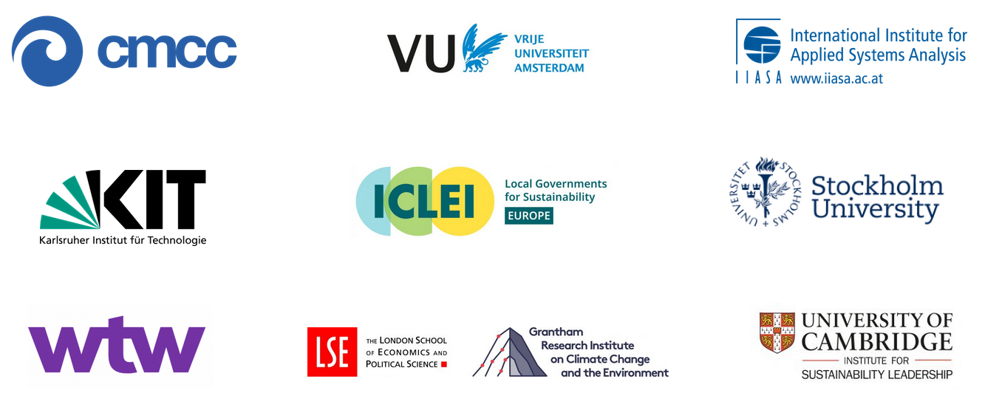
…aims to examine the technical, financial and operational feasibility and performance of solutions built on a combination of disaster risk financing and Nature-based Solutions investments
About the Project
www.naturanceproject.eu
Partners: 9
Duration: Oct 2022-Mar 2026
@naturance_eu

Slide 5
About the Project
Create “network of existing networks” by connecting existing major knowledge networks across fields of nature-based insurance & investment solutions
Organise innovation finance and policy labs to assess existing and explore new areas for insurance & investment solutions and revenue models supporting NbS
Analyse policy and governance conditions that are conducive to or hamper adoption of sustainable and equitable innovative green insurance and investment solutions
Analyse models, methods, scenarios and metrics used for assessing risk-reduction performance of NbS
Build awareness and capabilities for green financial innovations

Slide 6
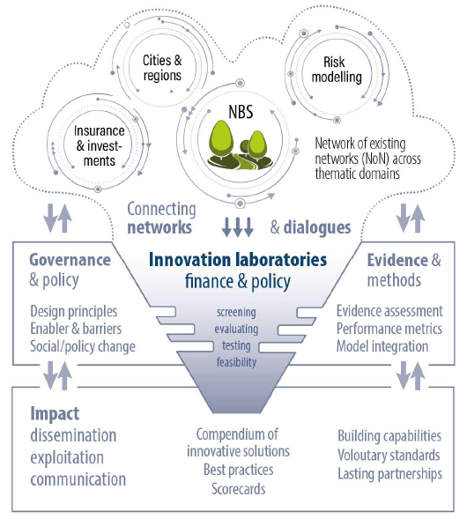
Naturance Innovation Labs
Physical or virtual spaces that allow for collaboration (private sector, academia and civil society)
Safe space give participants the freedom to challenge dominant ideas or business-as-usual approaches
Allow diverse voices to be heard and considered in an open decision-making process
Main outcome is a business case analysis describing innovation and how it can be implemented

Slide 7
Do not edit How to change the design
Join at slido.com #InnovativeFinance
The Slido app must be installed on every computer you’re presenting from

Slide 8
Do not edit How to change the design
Do you work in a
The Slido app must be installed on every computer you’re presenting from

Slide 9
Urban Agenda for the EU
focuses on three pillars of EU policy making and implementation.
Better regulation
A more effective and coherent implementation of existing policies, legislation, and instruments
Better funding
Contribute to supporting, integrating & improving traditional, innovative sources of funding for urban areas
Better knowledge
Enhancing the knowledge base on urban issues and exchange of best practices and knowledge

Slide 10
Coordinator(-s) of the Greening cities Partnership (31 members)
Ministry of Development, Public Works and Administration (RO)
Nuovo Circondario Imolese (Bologna - IT)
Cities (Urban Authorities)
Nuovo Circondario Imolese (IT) – Co-coordinator
City of Roeselare (BE)
City of Ostrava (CZ)
City of Tampere (FI)
Roma Capitale (IT)
Ādaži municipality (LV)
City of Utrecht (NL) - Action Leader
Lisbon Metropolitan Area (PT) - Action Leader
City Council of Pontevedra (ES) - Action Leader
City of 's-Hertogenbosch (NL)
Regions
Brussels Environment (BE) - Action Leader
Marshal’s Office of the Masovian Voivodeship (PL)
Flemish Environment Agency (BE) – [Active until December 2023]
National Authorities
Ministry of Development, Public Works and Administration (RO) – Co-coordinator, Action Leader
Ministry of Physical Planning, Construction and State Assets (HR) - Action Leader
Ministry of Development Funds and Regional Policy (PL)
Other Stakeholders
INCASÒL – Catalan Land Institute (ES)
JPI Urban Europe/DUT Partnership (EU)
Aristotle University of Thessaloniki (AUTH) / Environmental Engineering Laboratory (Enve-Lab) (GR)
European/National City Umbrella Organizations
Eurocities (BE) - Action Leader
European Investment Bank (LU)
Association of Urban Municipalities of Slovenia (SI)
European Urban Knowledge Network (EUKN EGTC) (NL) - Action Leader
European Institutions
DG REGIO
DG ENV
DG EMPL
DG GROW
DG CLIMA
DG MARE
DG EAC
DG AGRI
Joint Research Centre (JRC)

Slide 11
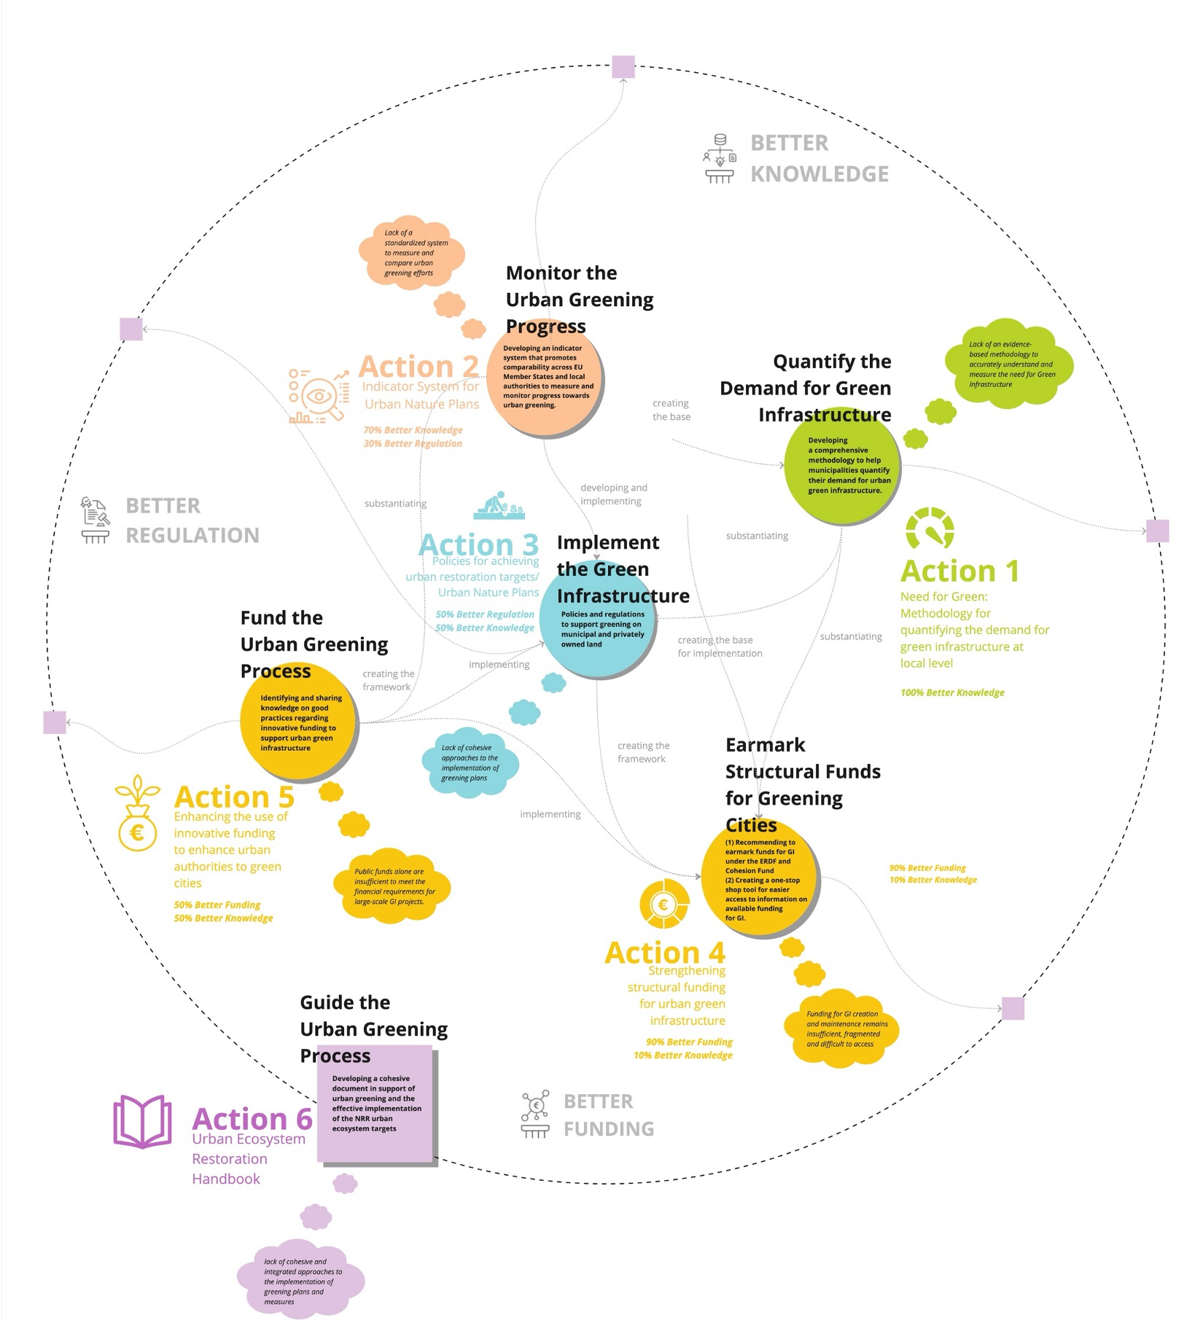
https://www.urbanagenda.urban-initiative.eu/partnerships/greening-cities

Slide 12
Barriers & Enablers to Funding Green Infrastructure in Cities: Results of the EUA Greening Cities Partnership Survey to Cities
Eileen Crowley, Funding Expert Greening Cities Partnership
ICLEI & EUA Greening Cities Partnership
27 May 2025
Notes:
12

Slide 13
About the Survey
2 Surveys prepared by Urban Agenda Partnership on Greening Cities – one for cities, one for financial actors
Circulated during January & February 2025
85 city responses, 3 financial actor responses.
Survey focused on both GI development and maintenance
AIM To better understand the barriers & enablers to funding GI in cities (outside of the core municipal budget) from the perspective of (a) cities & (b) funders | INTENDED OUTCOME Gather feedback from cities and funders on the barriers and enablers to funding GI in cities so that we can use this as a starting point for constructive dialogue with strategic partners at the European level | RESULTS 85 city responses 3 financial actor responses

Slide 14
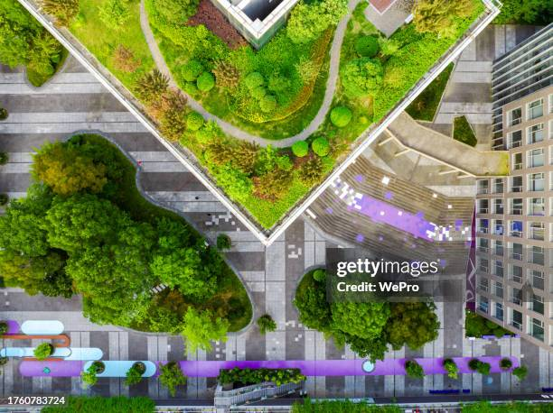
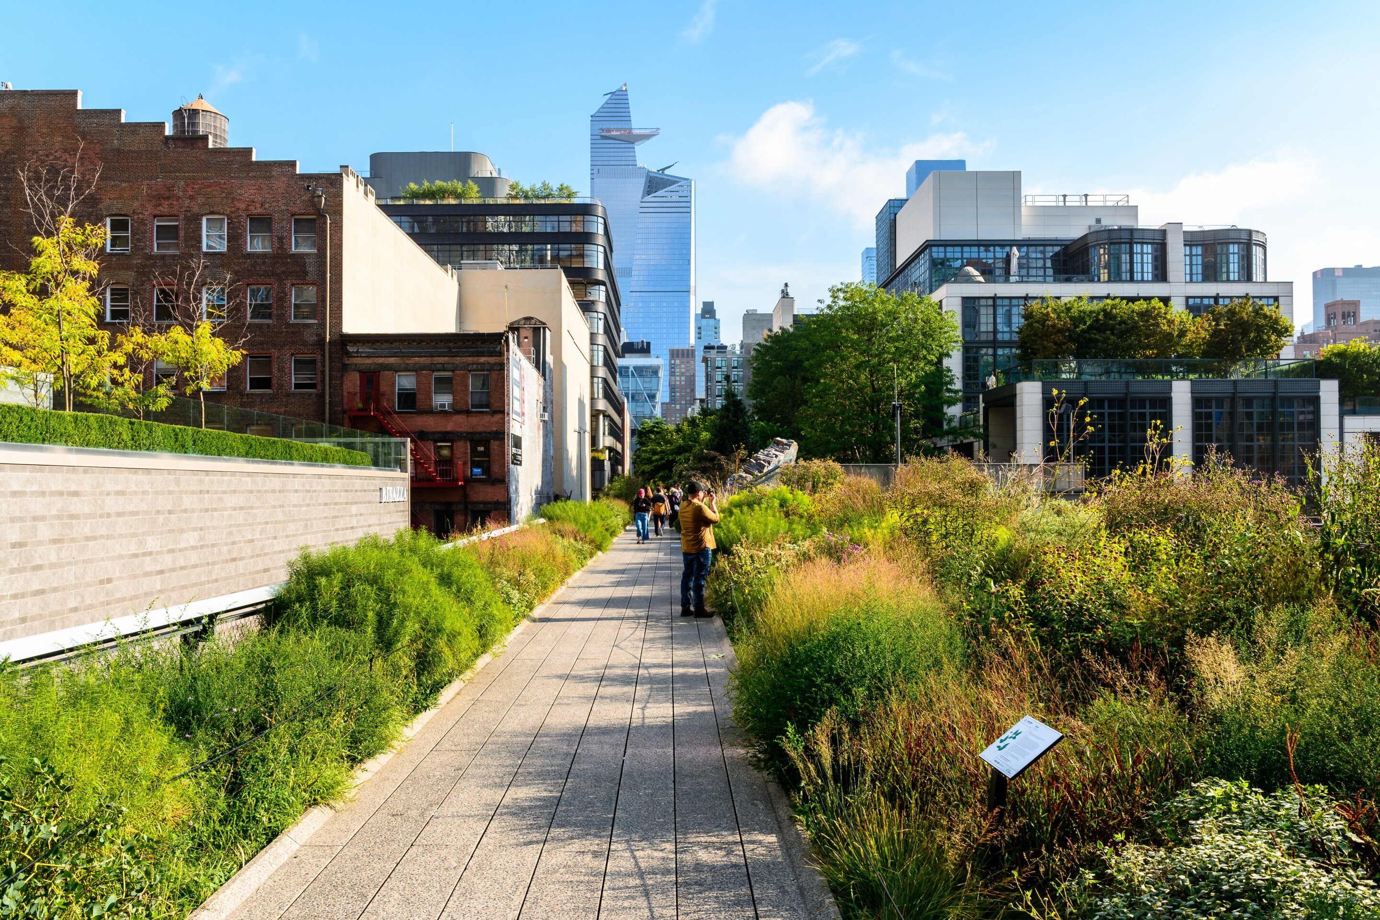
What do we mean by Urban Green Infrastructure?
Examples: urban parks and gardens, green roofs and walls, SUDs, urban forests, ecological corridors
Can be at micro (neighbourhood scale), meso (urban scale) or macro (metropolitan/regional scale)

Slide 15
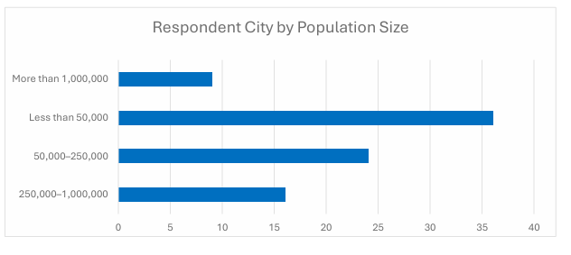
City Respondents by Population Size
85 city responses
42% were cities of less than 50,000 population

Slide 16
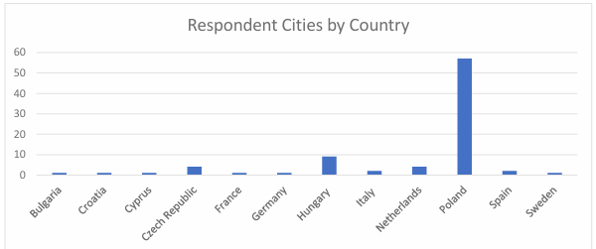
Respondent Cities by Country
67% of respondents from Poland

Slide 17
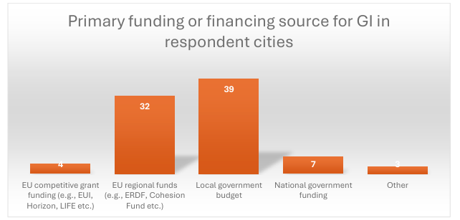
Cities Rely Heavily on Public Funds
46% listed local government funding as the primary GI funding source.
38% listed EU regional funds (2 cities listed ‘other’ funding but specified European funds and Norway funds as the primary funding source)
8% listed national funding
No city listed private sector funding as a primary funding source.

Slide 18
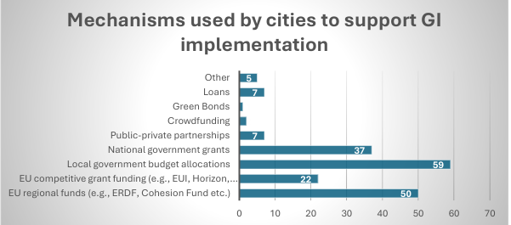
For GI Implementation - Cities Rely Heavily on Public Funds
69% of cities use local government funding for GI implementation.
EU regional funds (59%) and national funds (44%) follow
Private and philanthropic finance is nearly absent. Only 1% use green bonds, 2% use crowdfunding, and 8% use PPPs and loans.

Slide 19
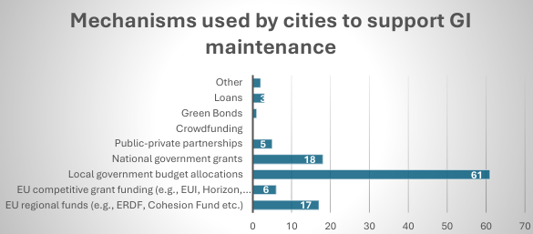
Maintenance Funding is Even Harder to Secure
72% rely on local budgets for maintenance.
21% rely on national government grants and/or EU regional funds
Competitive EU grants and innovative financial schemes (bonds, PPPs, crowdfunding) are rarely used here.

Slide 20
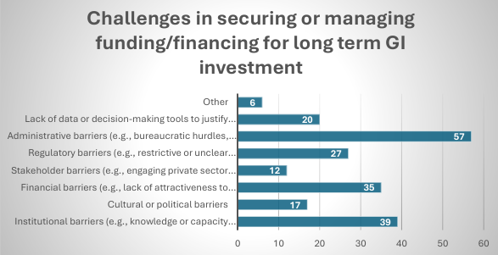
Top Barriers to long term GI investment for cities
Administrative complexity (67%) - lengthy, bureaucratic processes.
Institutional gaps (46%) – capacity, coordination, political will.
Financial limitations (41%) – unattractiveness to investors, lack of eligible structures

Slide 21
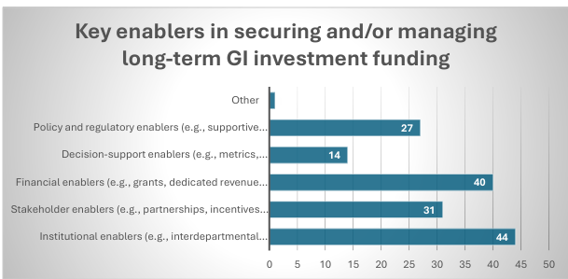
Key Enablers
Institutional support (52% for development, 41% for maintenance) - cross-department collaboration, strong leadership.
Grants and dedicated revenue streams (47% development, 75% maintenance): critical to both funding and sustaining GI.

Slide 22
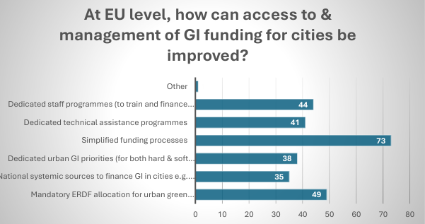
Cities Want Simpler, More Accessible Support
86% call for simplified EU funding processes.
Strong support for:
Mandatory ERDF allocation for urban GI
Technical assistance and staff capacity programs
Tailored support for smaller cities

Slide 23
Missed Opportunities in Innovative Finance
Cities in general are not using tools like: Green bonds, Impact investing, Philanthropic grants (23 identified)
Many cite lack of awareness, skills, or viable project packaging.

Slide 24
Survey Finding 1: Cities Rely Heavily on Public Funds
– Slido ‘What’s one change that would unlock private/philanthropic finance for your city?’
- Why are cities not accessing private or philanthropic finance?
- What is missing – project pipeline, risk appetite, or knowledge?
Notes:
24

Slide 25
Do not edit How to change the design
What’s one change that would unlock private/philanthropic finance for your city?
The Slido app must be installed on every computer you’re presenting from

Slide 26
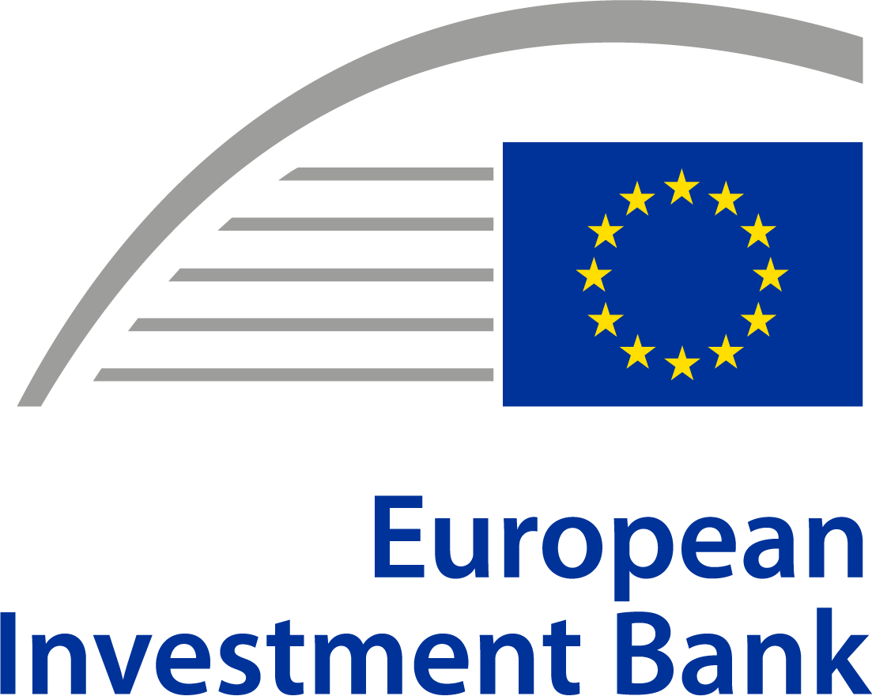
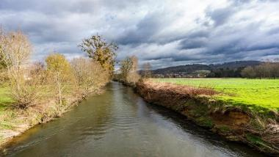
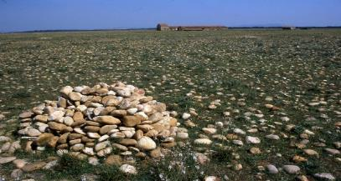
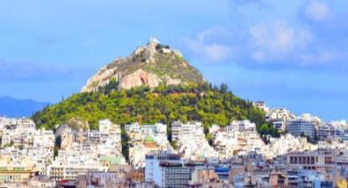
Advancing Nature-based Solutions through Innovative Resilience Finance: Exploring Funding Mechanisms for Cities and Towns
Case study. Further steps.
Ana-Maria MITROI-CIOBICA
Projects Directorate
Housing, Cities & Regions Department

Slide 27
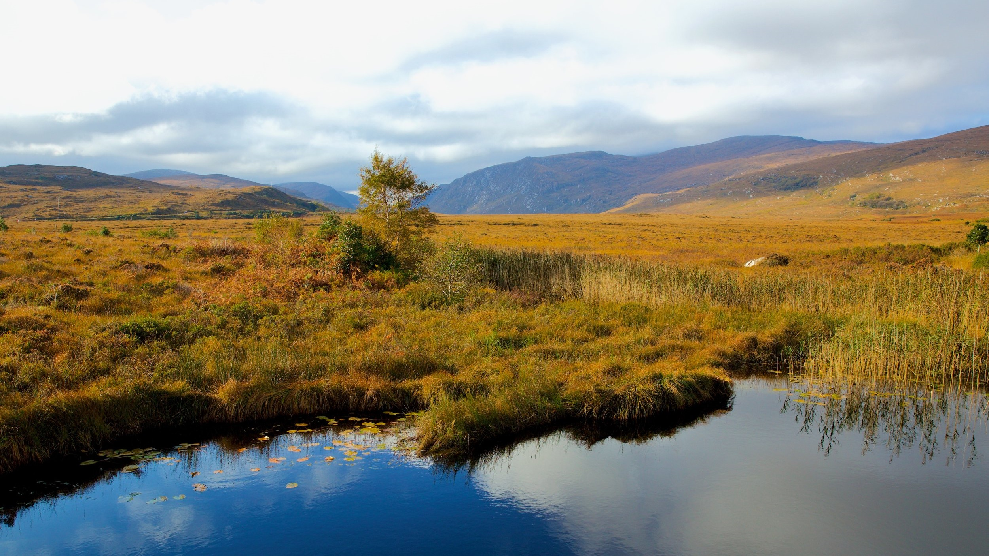
NCFF experience – investing in NbS

Slide 28
Key insights
Support nature-based solutions (NbS) with clear biodiversity and climate adaptation benefits
Overview
Joint initiative by EIB and European Commission (LIFE Programme)
Ambition
First EU-level blended finance for NbS
Target Projects and Sectors
Ecosystem restoration, biodiversity offsets, sustainable forestry
Operational Period: 2015–2022
Goal: Demonstrate bankability of nature-based solutions (NbS) - of ecosystem services and public-good oriented environmental interventions
Instruments: Contingent loans, equity-type finance, advisory support
Aimed to unlock private capital in public-good domains
Embedded monetisation challenge into finance
Urban green infrastructure and natural flood management
Eligible beneficiaries: public & private entities
Investment size: €2M–15M
Projects => revenue streams (e.g., from biodiversity credits, eco-tourism) + environmental outcomes (e.g., restored wetlands or forests)
Offered technical assistance for structuring, monitoring, and capacity building
Required bankable business models, ideally with direct or indirect ROI

Slide 29
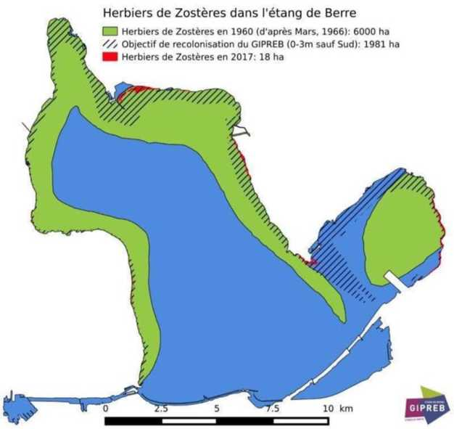
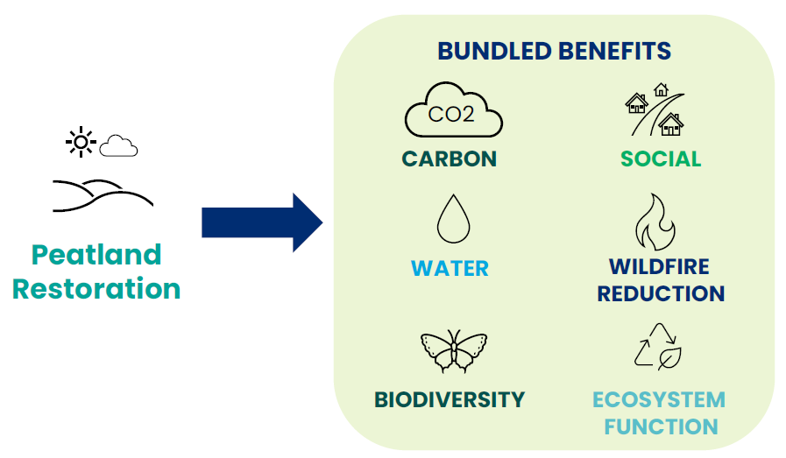
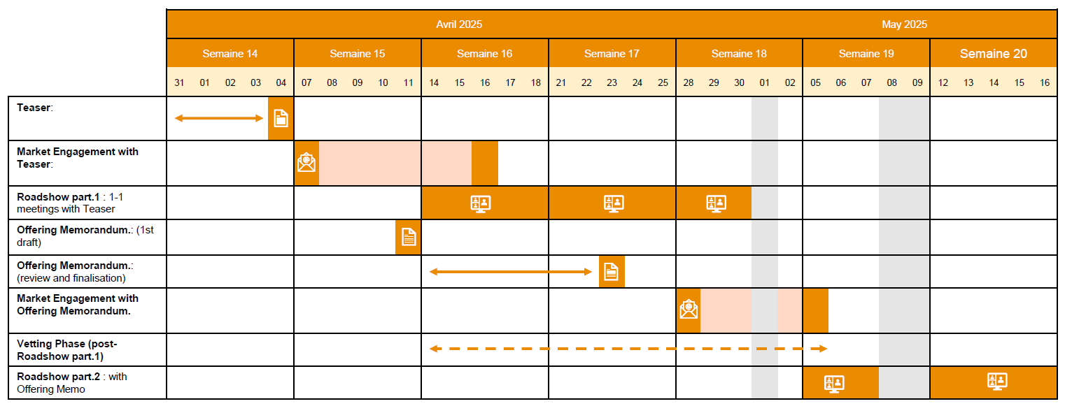
Case studies
CDC Biodiversité – Unités de Compensation (France)
Contingent loan for biodiversity offsetting credits Sale of credits to infrastructure developers as a condition of permits Risk sharing with CDC acting as both project developer and credit vendor Challenges: timing of cash flows, land acquisition, legal equivalence of offset site;
Irish Peatland Standard
Created bundled ecosystem credits (carbon, water, biodiversity) with high environmental additionality Enabled stacking of public and private funding streams Focused on long-term impact with ISO certification and registry systems Corporate interest driven by CSR and natural resource strategy alignment
Castilla-La Mancha Alliance for Ecosystem Services
Developed a voluntary funding stream to support sustainable forest management
FSC certification used for forests under public ownership
Emphasis on urban-rural partnerships and public-private co-financing
finding new suitably large sites as habitat banks / equivalence / land acquisition
Notes:
CDC acted as vendor
The case studes show adaptive models with various solutions which also covers the long term maintenance.
Examples of Adaptive Models
Irish Peatland Standard: Maintenance funded through stacked funding (CSR + CAP + national funds) with registry-based monitoring.
Spain’s Castilla-La Mancha PES model: Covers cost of sustainable forest management, not just reforestation CAPEX.
CDC Biodiversité: Ongoing habitat bank management built into credit pricing and legal obligations for offset compliance.

Slide 30
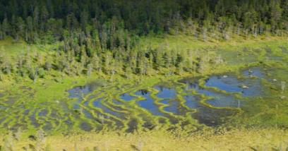
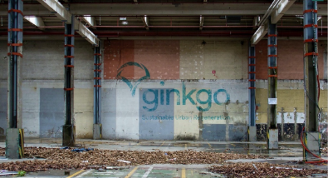
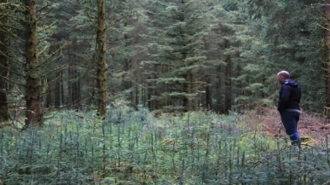
Case studies
Rewilding Europe Capital - EU 1.4m loan to SPV Rural pro nature SMEs | Athens Resilient City NBS EUR 5m loan for municipality Urban Green Infrastructure | SLB Forestry - Romania 9.5m secured loan for corporate Close-to-nature forestry | Alzette River Renaturing - Lux 9m loan for State Water Fund River restoration
CDC Biodiversite - France EUR 5m loan, part contingent Habitat banking/biodiv. credits | Gingko Fund III - EU EUR 15m loan to equity fund Brownfield development w. NBS | SLM Silva Fund - Ireland EUR 7.4m for equity fund CFF forestry portfolio | SPGE Wastewater - Belgium EUR 4.5m loan to a utility Beyond compliance….
Notes:
CDC acted as vendor

Slide 31
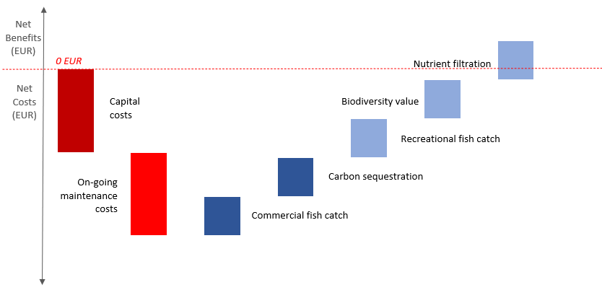
Key challenges
Intended vs Actual Beneficiaries
While designed for a broad mix of public and private actors, in reality:
Structural Barriers
Public-good nature of biodiversity: Non-rivalrous and non-excludable outcomes difficult to monetize
Financial Barriers
Return on investment too short-term: Especially for long-horizon projects like afforestation or peatland restoration
Only large, experienced entities (e.g., CDC Biodiversité) could meet eligibility and complexity thresholds Municipalities, SMEs, NGOs and community-led projects had difficulties in meeting eligibilities
Market gaps: No mature market for biodiversity credits or ecosystem services at the time
High transaction costs and complexity: Project preparation resembled large infrastructure deals
Land acquisition often required, adding cost, legal barriers, and risk perception
Small average project size (< €2 million): 44% under €1 million—too small for NCFF thresholds
Private investors remained hesitant, despite increasing curiosity
Monetisation
challenge
Private interests will only invest in public goods at scale if the benefits accruing to them exceed costs
A funding, not a financing problem
-> willingness to pay & ability to pay
Notes:
Key Barriers That Limited NCFF Uptake
1. ROI Requirements Too Stringent
The NCFF required projects to be revenue-generating or cost-saving with a positive return on investment (ROI).
Many NbS projects, especially those led by cities or NGOs, generate public goods (e.g. flood protection, biodiversity, ecosystem health) that do not generate direct revenue.
This disqualified many promising projects that provided significant environmental and social value, but not financial returns in the short term.
2. Project Size Too Large for SMEs or Municipalities
The financing range (€2–15 million) was too high for typical SMEs, small cities, or community-based initiatives.
Most eligible small-scale projects (like river restorations, green roofs, or wetland buffers) needed €500k–€2 million, making them too small to meet NCFF thresholds.
3. Complexity and Transaction Costs
The due diligence, monitoring, and application requirements were similar to large EIB loans.
For smaller actors, the administrative burden and consultant costs to prepare bankable proposals were disproportionately high.
Cities and NGOs often lacked internal financial engineering capacity to handle these processes.
4. High Perceived Risk for Nature-Based Projects
Many NbS projects were considered "non-traditional infrastructure" and had limited historical data on financial viability.
Even with a risk-sharing EU guarantee, the EIB still applied relatively conservative credit policies, which deterred early-stage or pilot nature-based solutions.
5. No Tailored Technical Assistance from the Start
Although the NCFF included some TA funding, it wasn't well-integrated into the early design stages of projects.
This meant that project promoters were on their own in developing feasibility studies or ROI models, which discouraged participation.

Slide 32
Lessons learnt
B. Project Structuring Complexity
NCFF required financial and legal capacity often beyond smaller promoters’ reach
Pre-structuring and capacity building need to be embedded earlier, ideally through advisory support
🌿 Way Forward After NCFF
InvestEU now includes climate, nature, and social windows with more flexible blending
EIB and WWF partnership explores further NbS mainstreaming
New models like the Irish Peatland Standard, nature credit markets, and regional mechanisms (e.g. Lombardy’s BIOCLIMA) offer replicable lessons
A. Market Readiness & Monetisation Gap
There is no natural financial return for many NbS; benefits are diffuse and long-term.
Markets alone cannot scale these investments—grants, public co-financing, or compliance-based demand (e.g. mandatory offsetting) are needed.
C. Limited Suitability for Small Projects
Standard financial instruments are not well adapted for small, community-level interventions
There is a need for aggregators or platforms to bundle smaller NbS projects and absorb complexity
D. Concessionality and Layering are Key
Success depends on blending multiple sources (e.g., CAP, CSR, LIFE, biodiversity funds)
New approaches must balance additionality and affordability while keeping design simple
Notes:
1. Transition from NCFF
The NCFF was instrumental in demonstrating the viability of integrating biodiversity and climate adaptation into financially sustainable projects. Its success laid the groundwork for the EIB to expand and diversify its NbS financing approaches.
2. InvestEU Programme
The EIB now channels support for NbS through the InvestEU Programme, which offers:
Blended finance instruments combining EU budget guarantees with EIB loans
Support for projects that contribute to the EU’s environmental and climate objectives, including biodiversity and ecosystem restoration
3. EIB Climate Bank Roadmap 2021–2025
Under this roadmap, the EIB has committed to:
Align all financing activities with the Paris Agreement
Increase the share of financing dedicated to climate action and environmental sustainability
4. Strategic Partnerships
The EIB has established collaborations to enhance NbS financing:
EIB and WWF Collaboration: A four-year partnership to develop NbS projects across Europe, focusing on sectors like agriculture, energy, and urban resilience.
Rewilding Europe Capital: A financing facility supporting enterprises that restore degraded landscapes while generating income through eco-tourism and sustainable resource use.

Slide 33
Survey Finding 2: Maintenance Funding is Even Harder to Secure
- Can funders offer long-term, flexible support models that include maintenance, not just capital investment?
Notes:
Any other financial sector actors in the room that would like to add to this?
33

Slide 34
Long-term maintenance funding of NbS
Key challenges
EU State Aid and budget rules
Performance uncertainty
Accounting treatment
Donor fatigue
Support models
“Stacked” or “bundled” funding models
Nature Credit markets
Public-private agreements with maintenance obligations
Framework Loans and Programme Loans
Blended Finance -
TA Grants – planning for maintenance
Notes:
1. Maintenance Is Essential for Sustainability - without adequate long-term maintenance, the benefits of nature-based and green infrastructure degrade rapidly.
This is particularly true for ecosystems such as peatlands, wetlands, urban green corridors, and restored forests, where ecological functions depend on ongoing management and monitoring. We can say Nature investments are seen as long-maturing and complex, often requiring stewardship beyond typical financial horizons.
“Mismatch between short-term funding and long-term operations/outcomes” is a core constraint in NbS implementation.
Challenge Explanation
EU State Aid and budget rules May restrict long-term subsidies or guarantees for OPEX
Performance uncertainty Ecosystem outcomes evolve slowly; difficult to tie OPEX to output-based funding
Accounting treatment OPEX often seen as recurrent costs not suitable for debt instruments
Donor fatigue Maintenance lacks visibility or prestige compared to capital works
💡 Emerging Support Models (Current Practice and Outlook)
✅ What EIB currently does:
Framework Loans and Programme Loans: Can include maintenance components if they are part of a multi-year investment plan (e.g., municipal programs for flood protection or forest management).
Blended Finance: Projects under InvestEU or Just Transition may include operational costs if linked to measurable outcomes over time.
TA Grants (e.g., ELENA): While not direct funding for maintenance, TA can fund planning for OPEX, lifecycle costing, and operational models.
🧭 What EIB is exploring or encouraging:
“Stacked” or “bundled” funding models: Allowing multiple sources (CAP, LIFE, CSR, biodiversity credits) to cover both CAPEX and OPEX.
Nature Credit markets: Where revenues from credits (carbon, water, biodiversity) are used to finance ongoing site management.
Public-private agreements with maintenance obligations, possibly under performance-based contracts.
From the banking perspective to effectively finance NbS, we must move from a project-focused mindset to a landscape stewardship approach—one that includes permanence, monitoring, and adaptive management as integral to investment logic. This requires blending funding, not just financing, and designing long-duration support mechanisms tied to verified ecosystem outcomes.”

Slide 35
Survey Finding 3: Cities cite administrative complexity, institutional gaps (capacity, political will..) and financial limitations (unattractiveness to investors) as top barriers.
Slido: What is the most important way financial actors can better support cities to access green infrastructure funding?
How can financial actors reduce complexity, build capacity, and tailor tools to city contexts?
Notes:
Select 2
35

Slide 36
Do not edit How to change the design
What is the most important way financial actors can better support cities to access green infrastructure funding?
The Slido app must be installed on every computer you’re presenting from

Slide 37
Enablers for financing NbS
Aggregation and Critical Mass of Investments:
programmatic lending that bundle multiple small projects into a single financing envelope
regional or thematic aggregators that consolidate similar NbS from multiple town
Institutional and Regulatory Clarity
Clear national guidance on NbS eligibility under climate, biodiversity, or recovery investment streams
Integration of NbS into urban development codes, master plans, and resilience strategies
Simplified procurement frameworks allowing for long-term maintenance and ecosystem stewardship
Project Preparation and Technical Assistance:
Advisory support through TA mandates like JASPERS, ELENA, or the InvestEU Advisory Hub
Standardised templates for NbS project pipelines, monitoring plans, and financing structures
Regional hubs or technical assistance units embedded in inter-municipal associations
Risk Management and Creditworthiness
Use of EU guarantees (InvestEU risk-sharing instruments) to improve lending terms
Pooling risks through inter-municipal cooperatives or loan guarantee schemes
Development of NbS scoring models aligned with EIB Climate Bank Roadmap and Do No Significant Harm (DNSH) principles
Notes:
Aggregation and Critical Mass of Investments
Challenge: Small cities often lack sufficient scale or investment size to meet minimum thresholds for loans (typically >€5–10M).
Institutional and Regulatory Clarity
Challenge: Many small cities are unsure how NbS fit within their planning, procurement, or regulatory frameworks.
Project Preparation and Technical Assistance
Challenge: Small cities often lack internal capacity to structure complex projects, apply for funding, or prepare feasibility studies.
Institutional and Regulatory Clarity
Challenge: Many small cities are unsure how NbS fit within their planning, procurement, or regulatory frameworks.
Risk Management and Creditworthiness
Challenge: Small cities may have limited borrowing capacity, perceived risk, or difficulty demonstrating creditworthiness.
Enabler:
We, at EIB and the partner institutions can play a pivotal role by offering:
Integrated frameworks (e.g., combining InvestEU, loans, and TA)
Simplified financial products
Capacity-building partnerships at regional or inter-municipal levels
When discussing instruments:
Instrument Target Sector Suitable for NbS? Type
InvestEU All green/climate/environment ✅ Loans + guarantees - EU budget guarantee blended with EIB financing , that Supports high-risk, innovative, or first-of-a-kind projects
Framework/Project Loans Municipalities, utilities, public bodies ✅ Long-term direct loans - Long-term loans directly to promoters or intermediated via banks/public bodies, that can be used Co-financing of investment programs or single large projects
Natural Resources Lending Forestry, land, agriculture ✅ Sector-specific loans
Rewilding Europe Capital SMEs/NGOs in conservation businesses ✅ Revolving loan facility, Backed by: EIB and European Commission under the former NCFF
ELENA, JASPERS, etc. Public-sector project development ⚠️ (support only) Technical assistance

Slide 38
Survey Finding 4: Missed Opportunities in Innovative Finance
Slido - Which funding mechanisms have you used for Green Infrastructure development or maintenance?
Notes:
38

Slide 39
Do not edit How to change the design
Which funding mechanisms have you used for Green Infrastructure development or maintenance?
The Slido app must be installed on every computer you’re presenting from

Slide 40
Survey Finding 4: Missed Opportunities in Innovative Finance
- Let’s hear from cities who’ve implemented some innovative mechanisms
Notes:
40

Slide 41
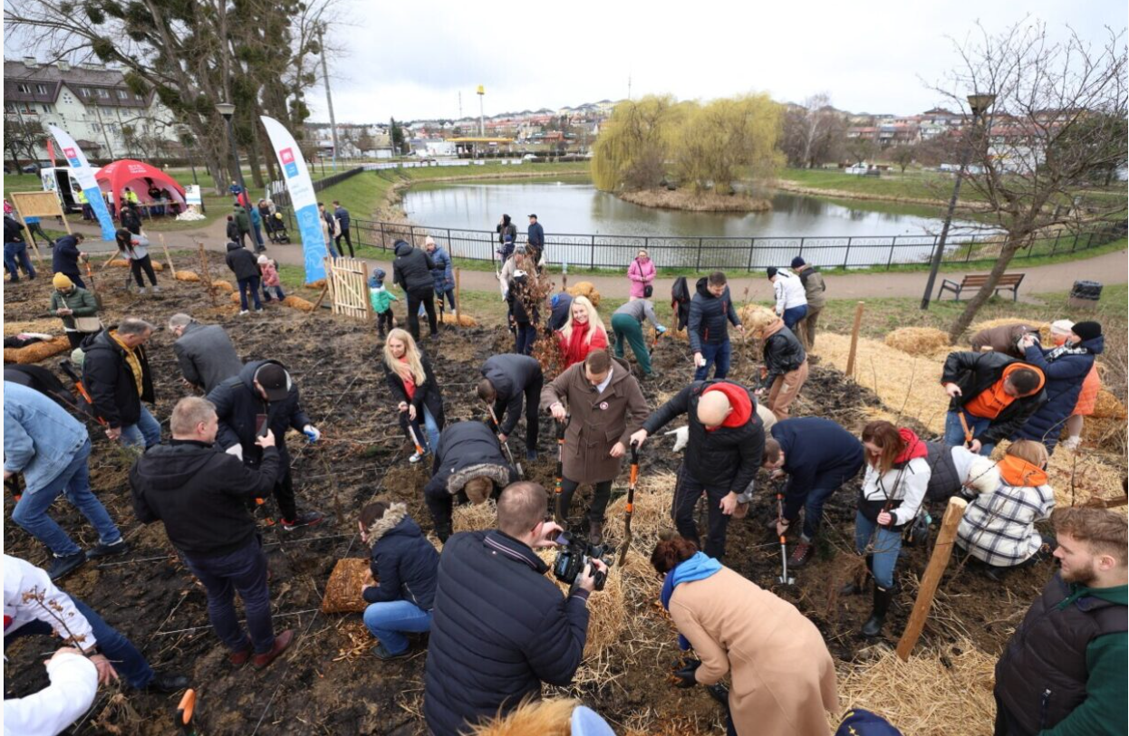
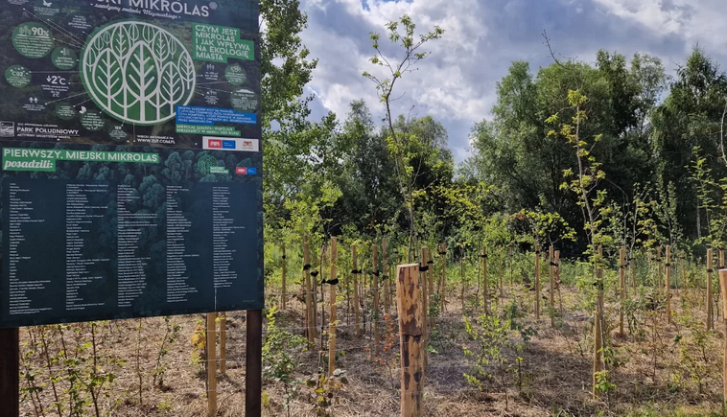
Title: Microforests in Gdańsk
Founder – Waste Utilization Facility Ltd.:
Environmental ROI - Biodiversity restoration, supporting native species and ecological balance. ·
Economic ROI - Low-cost, high-impact urban greening solution (€ 20.0k + €1.2k/year maintenance per mikroforest)
Social ROI - Stronger community engagement and support through planting events and awareness campaigns.
Educational ROI - sustainability and circular economy practices.
7 microforests
1,400 m2 of space
200 tons of compost
4,200 trees and shrubs saplings

Slide 42
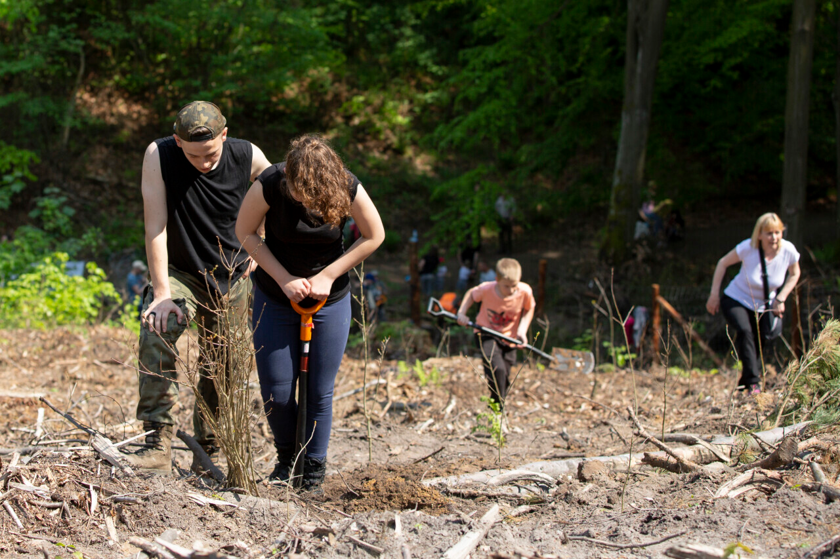
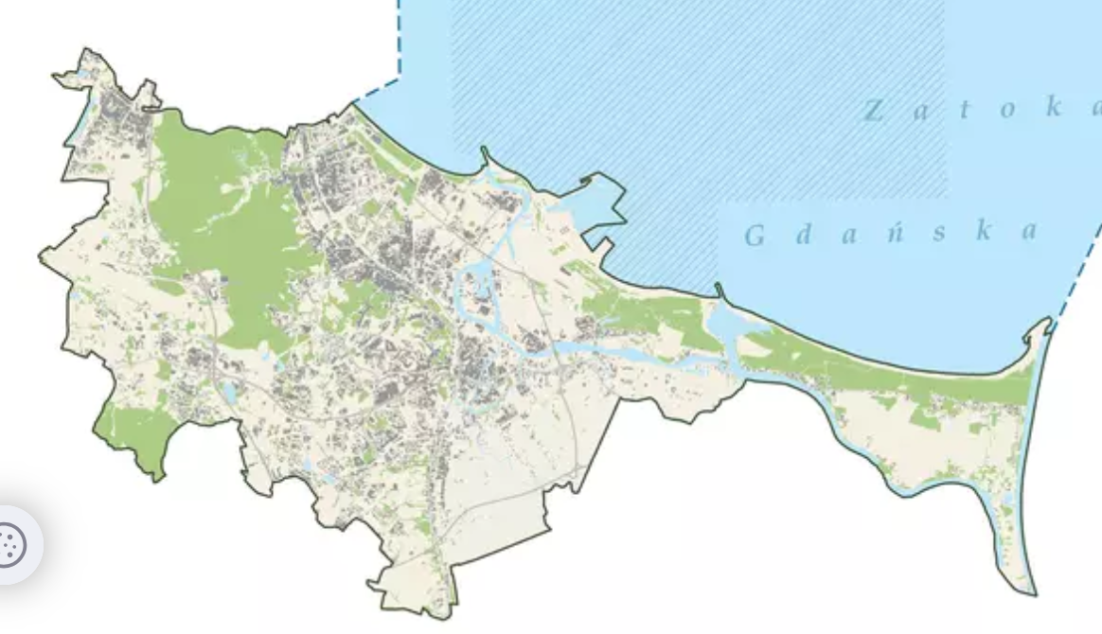
Title: NGO engagement in urban forests planting
Founder – NGOs
A Studio Agencja Kreatywna
One More Tree Foundation
2023-2025
8450 tree saplings
5 actions
€3,33k – total cost
Green lungs of Gdansk
Forest areas - 4,809.00 ha
Urban green areas - 592.00 ha
Green space per capita
98 m2 of forest area
40 m2 of landscaped green space

Slide 43
Round Table Innovative Funding mechanisms for cities – Utrecht Case
May 26 2025
Anne Marie Gout / Wessel Wikkerink

Slide 44
Utrecht – City Island Ring Park
The New Defense in the bigger Merwede Canal Development

Slide 45
Case Utrecht – The New Defense in the bigger Merwede Canal Development
Notes:
Between 1 and 10 million euro’s, in the top half.

Slide 46
Enablers
Conditions:
Municipality is 100 % landowner of The New Defense area
Use of private law instrument in a public law role:
a Prior Agreement with the developer before the municipality changes the Land Development Plan.
Negotiations municipality – developer concerning housing programme in relation to GI, mobility and social facilities.
Spatial opportunity:
to realise part of the green infrastructure (park) in this development outside the project boundary.
Municipality obtained this part of the Ring park zone from the ministery of Defense for a reasonable price.
Goals:
Progressive city council: in integral decisions green infrastructure is considered important for a healthy, attractive and sustainable city.
Spatial longterm perspective in 2040: 440 ha inside the city and 250 ha outside.
Notes:
The enablers in the Conditions work stronger than the goals. Without this spatial opportunity this would never result in this agreement with the developer. Policy goals are not enough.

Slide 47
Survey Finding 5: Cities cite institutional support, cross-department collaboration, strong leadership as key enablers.
- Where and how can the finance sector reinforce these institutional enablers?
Notes:
Invest EU, Framework Loans, TA mandate, reference the value for small cities.
47

Slide 48
Innovation in financing NbS
Innovative financial mechanism
Blended finance
Green investment platofrms
Land value capture
Green/Climate bonds
Technical Assistance to co-develop structures and finance blueprints
Blended financing – InvestEu loans+ grants
Multi-platform platforms – risk-sharing
Restructure urban financial architecture
Notes:
What More Can Be Done – Going a Step Further:
Embed Financial Innovation Inside Local Governance
Beyond capacity-building, cities need embedded financial design expertise:
Establish in-house urban finance innovation units with skills in multi-source funding, ESG metrics, and lifecycle finance.
Include financial innovation objectives in local climate plans or Sustainable Urban Mobility Plans (SUMPs).
Position CFOs and urban planners as co-leads in green investment strategy, not just engineers or project managers.
2. Institutionalise Revolving Mechanisms at Urban and Regional Scale
Move beyond pilots:
Establish city-anchored revolving climate or nature funds, integrated with EU financing cycles (PT2030, InvestEU).
Link repayment flows to avoided costs, fee structures, land value capture, or performance incentives (e.g. “pay-as-you-absorb” models for stormwater).
Pilot multi-jurisdictional NbS finance platforms that allow shared ownership and scale (e.g. county-wide wetland or riparian restoration fund).
3. Advance Performance-Linked and ESG-Aligned Investment
Mainstream NbS via results-linked disbursement and reporting:
Use green impact dashboards linked to outcome triggers (e.g. hectares restored, pollutants reduced, thermal comfort gained) to release funding tranches.
Develop nature-linked KPIs that can anchor EIB loans, or voluntary biodiversity credits in local policy delivery.
Tie revolving funding access to compliance with EU Taxonomy and Do No Significant Harm principles to improve investor confidence.
4. Design Fairness-Based Co-Financing Models
Recognize that NbS often benefit different stakeholders unequally:
Create tiered co-financing structures: local taxes, utility revenues, and EU grants can be aligned proportionally to benefit share.
Institutionalize solidarity-based ecosystem funds, where urban beneficiaries contribute to rural land stewardship.
Expand affordability-driven financing design: avoid regressive user charges by layering subsidies or offering social pricing mechanisms.
5. Leverage Philanthropy and Mission-Driven Finance as Catalysts
Rather than just gap-fillers, philanthropy and climate-aligned investors can:
Act as first-loss providers or anchor donors in revolving or impact-linked finance structures.
Help fund development of common goods infrastructure (e.g. monitoring platforms, ecosystem credit registries).
Enable governance innovations such as community benefit sharing models or stewardship trusts.
As its strategic role, The EIB is well-positioned to:
Blend grants with loans to make schemes financially feasible
Provide technical assistance to structure revolving and incentive-based finance models
Promote institutional innovation by working with cities on financial governance reforms

Slide 49
Final message to cities that are struggling to close their green infrastructure funding gap?
Notes:
Invest EU, Framework Loans, TA mandate, reference the value for small cities.
49

Slide 50
THANK YOU
Notes:
Thank you to our wonderful speakers and the collaboration of the Greening Cities Partnership and the European Investment Bank. And thank you all for attending today and for your great input and exchange. I’m dropping a few links in the chat, including the registration page for the next Innovation Lab, which will further explore public-private partnerships, both with philanthropy and insurance, in collaboration with the Invest4Nature project.
I would be delighted to hear from you if you have any questions or would just like to connect: kelly.heid@iclei.org
www.naturanceproject.eu
Naturance Innovation Lab II: ICLEI and Invest4Nature
50

Slide 51
THANKS
Notes:
51

