Slide 1

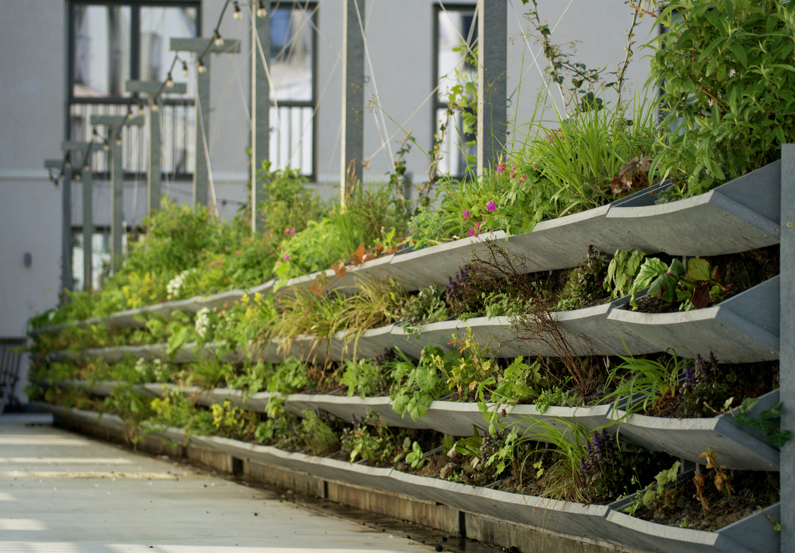
Nature Restoration Law webinar series
Webinar #5: Engaging Citizens and Businesses for Nature Restoration
Leon Kapetas
External Expert EUI
Resilient Cities Network

Slide 2



House rules
Use the code: #NRL

Slide 3
Nature Restoration Law webinar series
Article 8: urban ecosystem restoration
No net loss of urban green space or tree canopy cover in urban ecosystem areas by 2030
March-June 2025 supporting cities with the implementation of the NRL
Cities need to rethink urban planning …
Baselines and data
What are the baselines for green space and tree canopy? What data to use?
Municipal roadmap
Which departments need to be involved?
What policies need to be considered?
Building and spatial regulations
Policies for new developments
Policies for retrofitting existing developments
Citizen owned land and business collaboration
Policies to engage citizens and raise awareness
Policies to support greening efforts
Policies to support business investment in offsetting?
Targets for business?
National Restoration Plan
What do cities need to do? How can cities work with member states?
Notes:
Member States shall determine and map urban ecosystem areas as referred to in Article 8 for all their cities and towns and suburbs.

Slide 4
Webinar #5: Engaging Citizens and Businesses for Nature Restoration
Maria Sitzoglou, Architect - Urban designer & Founder of Design Clips studio
The value of engagement for urban renaturing: Best practices from Paris, Thessaloniki and Budapest
Irena Matcovic, Urban Development Expert of the City of Zagreb
Zagreb's innovative program for greening private spaces
Gijs Norden, Policy advisor for external financing, City of Rotterdam
Greening without Borders: Rotterdam's approach to engaging private landowners
Ivana Milicic, Associate Director, and Petra Remeta, Associate for Regional Policy & Strategy, European Bank for Reconstruction and Development
Financing the urban green transformation: experiences from the EBRD green cities program
Notes:
Before we jump into this, we’re going to explore some of the main findings of a survey some of you responded to on how to monitor nature plans. I’ll hand over now to Leon Kapetas who will share these key findings and take us through the presetnations today.

Slide 5
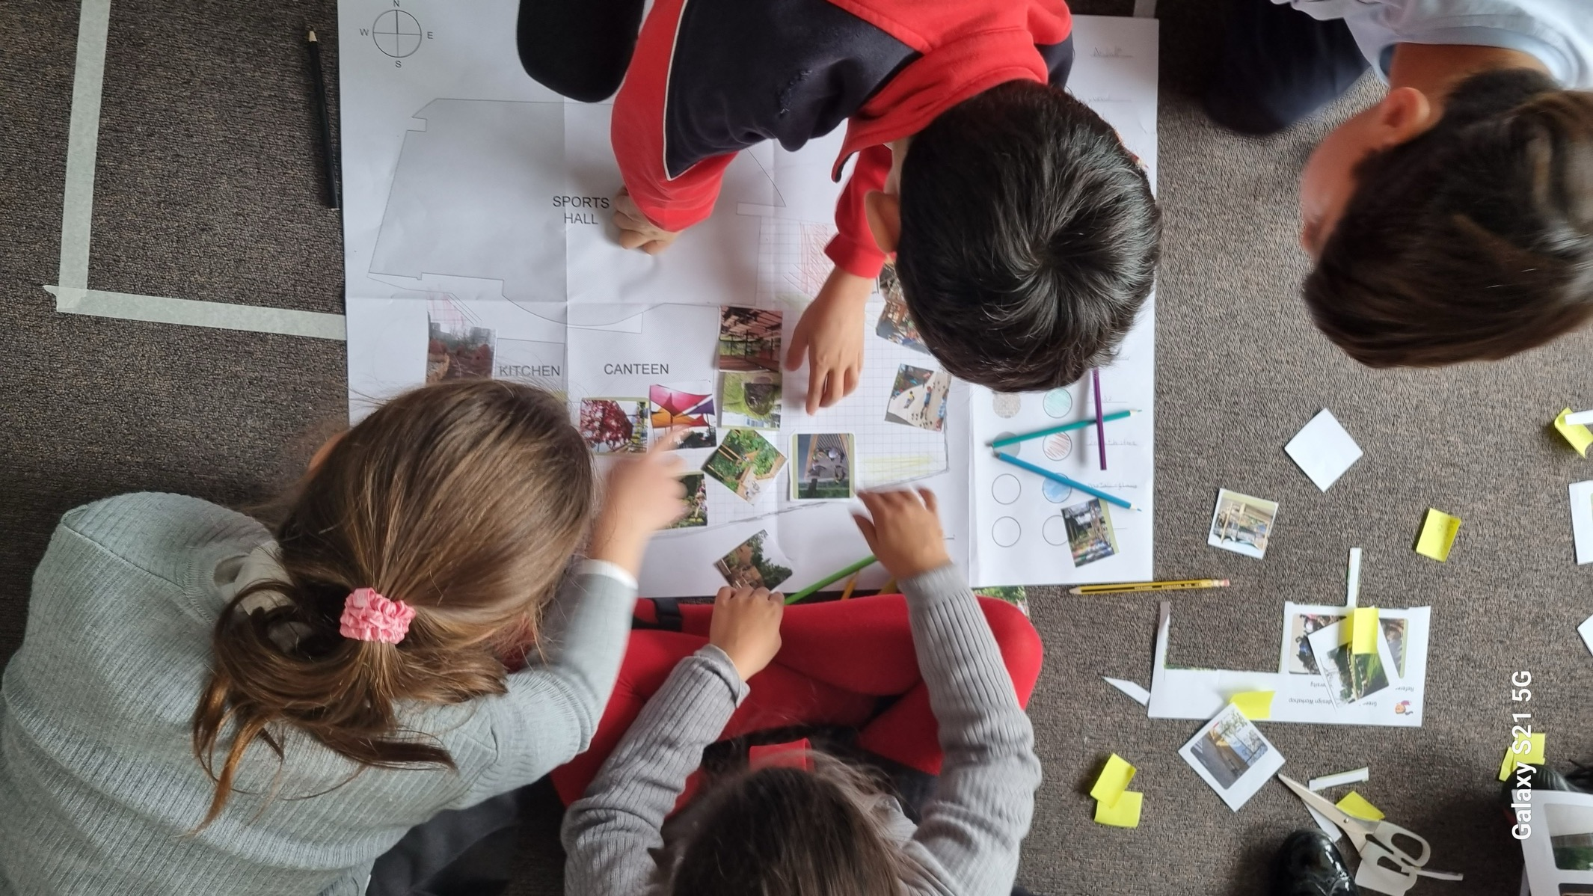

The value of engagement for urban renaturing
Maria Sitzoglou, Architect - Urban designer & Founder of Design Clips studio

Slide 6

Why ?

Slide 7
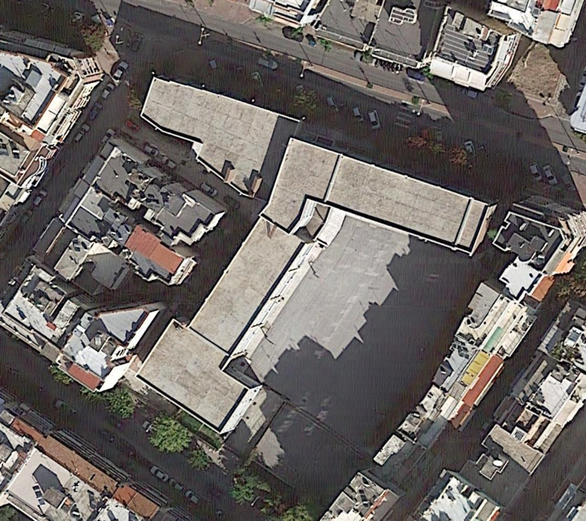
Project type: Green roof on a school building
Project details:
Project site: School complex (3 school buildings)
Direct beneficiaries: 580 students, educators, school staff
Total roof surface: 1.510m²
Total budget: 408.000€
Project scope: 95% coverage of total surface
Source: lifeasti.eu
2022
Notes:
Ξανά το περίγραμμα

Slide 8
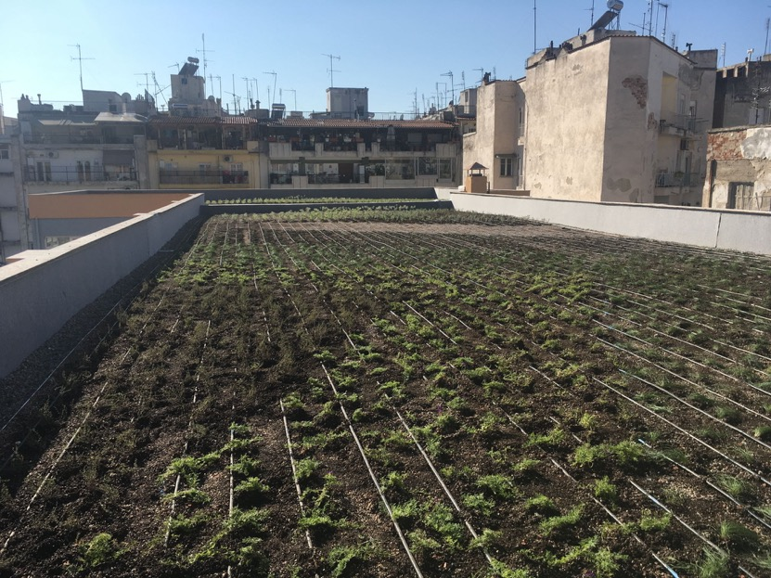


Project type: Green roof on a school building
HOW: 16.000 plants with low growth height, rapid spreading and fibrous roots and high drought tolerance.
Overall aim: to improve the thermal comfort of 580 students attending the school
Local Press headlines:
“ The largest green roof in the city”
“A green oasis in the heart of the neighborhood”
2020

Slide 9
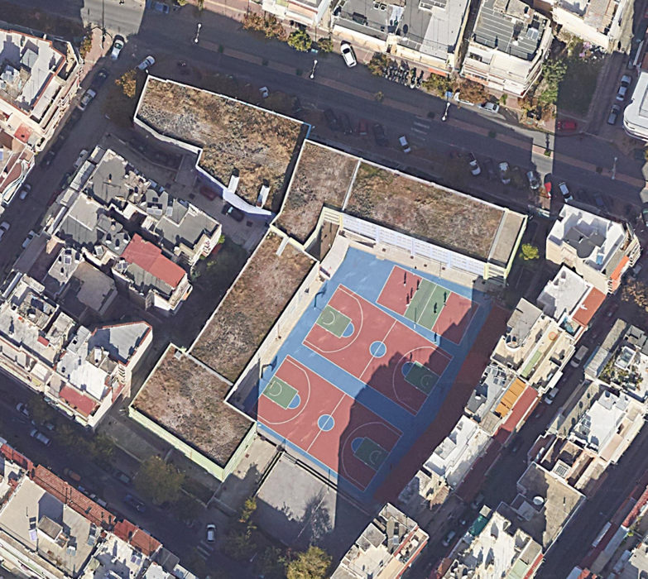

Project type: Green roof on a school building
Maintenance challenges affected the sustainability of the intervention
Contributing factors included:
Lack of engagement with the school community
Gaps in communication between Municipal departments
The project was implemented with a top-down approach from one Municipal Department:
A missed the opportunity to build co-ownership with the community
Lack of clear coordination/ communication with other departments that take charge during maintenance phase
2022

Slide 10

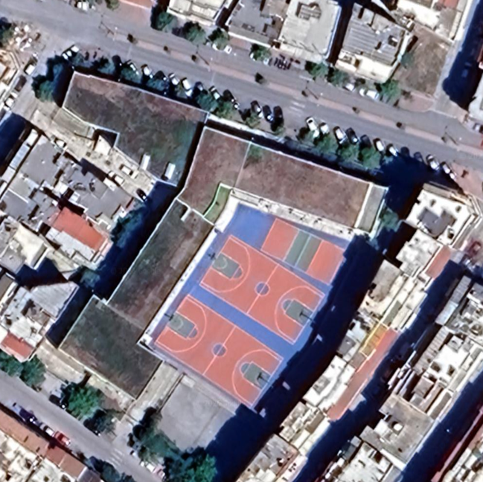
Project type: Green roof on a school building
The City has done a significant effort to revitalize it hand-in-hand with local organizations
A promising future:
Local organizations are actively involved in the project
It’s an ongoing process
A multi-level approach is anticipated to be followed for the next projects based on such experience
2024

Slide 11
How ?

Slide 12
Levels of citizen engagement – Spectrum of public participation*
4 levels of participation commonly followed for infrastructure projects
Increasing impact on the decision
 | INFORM | CONSULT | INVOLVE | COLLABORATE
 | To provide the public with balanced and objective information to assist them in understanding the problem, alternatives, opportunities and/or solutions. | To obtain public feedback on analysis, alternatives and/or decisions. | To work directly with the public throughout the process to ensure that public concerns and aspirations are consistenly understood and considered. | To partner with the public in each aspect of the decision including the development of alternatives and the identification of the preferred solution.
 | We will keep you informed. | We will keep you informed, listen to and acknowledge concerns and aspirations, and provide feedback on how public input influenced the decision. | We will work with you to ensure that your concerns and aspirations are directly reflected in the alternatives developed and provide feedback on how public input influenced the decision. | We will look to you for advice and innovation in formulating solutions and incorporate your advice and recommendations into the decisions to the maximum extent possible
GOAL
PROMISE
*Source: IAP2 ( International Association of Public Participation)

Slide 13
Citizen Engagement Processes
Citizen engagement activities may be implemented in some or all of the steps of the project cycle
Refining & Improving project elements
Start of the project
Understanding community’s needs
Receiving
feedback
Informing citizens
Evaluation
Planning
Collaborate with citizens - Sharing responsibilities
Implementation
Consulting citizens
Co- ownership
Involving citizens
Co-creation
Co-implementation
Project phasing, raising public support
Educating citizens

Slide 14
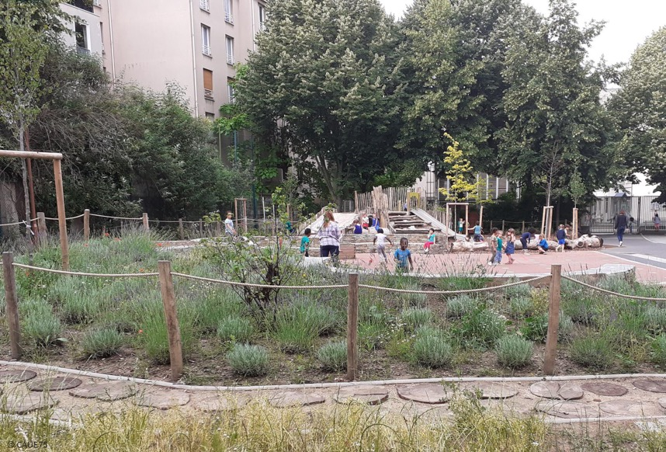


An example of nature-based schoolyard implementation in Paris – OASIS Schoolyards project
How it was initiated as a pilot:
A goal of the Paris Climate Plan & Action Plan of the Resilient Strategy of Paris
How was the pilot funded:
2019-2023 « Urban Innovative Action » Project (ERDF)
Project objectives:
Ensure appropriate places for children of all abilities that promote their healthy development and wellbeing
Integrate more nature for all
Encourage citizen engagement and active participation
Create climate adaptive and cooler schoolyards
©CAUE75

Slide 15
An example of nature-based schoolyard implementation in Paris – OASIS Schoolyards project
How it was initiated as a pilot:
A goal of the Paris Climate Plan & Action Plan of the Resilient Strategy of Paris
How was the pilot funded:
2019-2023 « Urban Innovative Action » Project (ERDF)
Entry point for engagement:
Children’s health & wellbeing
Project objectives:
Ensure appropriate places for children of all abilities that promote their healthy development and wellbeing
Integrate more nature for all
Encourage citizen engagement and active participation
Create climate adaptive and cooler schoolyards
©CAUE75

Slide 16







An example of nature-based schoolyard implementation in Paris – OASIS Schoolyards project
Project Roadmap
Preparatory phase – Project Coordination & Building synergies
Workshops with children
School Campaign & Exhibition
Final Design Proposal & Experts Approval
Detailed Design
& Procurement
Construction
Ready!
Preparatory
Phase
Participatory
Phase
Design
Phase
Construction
Phase

Slide 17

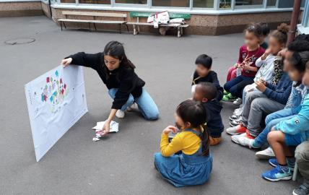
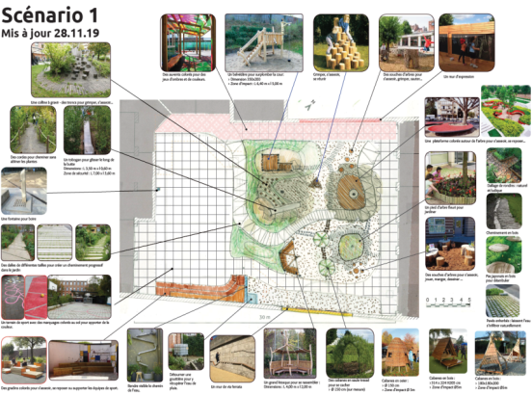
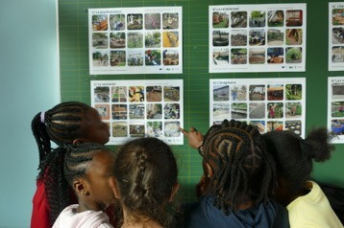
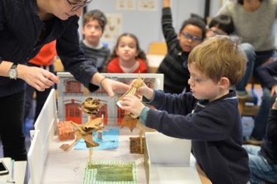
An example of nature-based schoolyard implementation in Paris – OASIS Schoolyards project
Participatory workshops with children
Source: UIA OASIS Schoolyards project – CAUE75

Slide 18
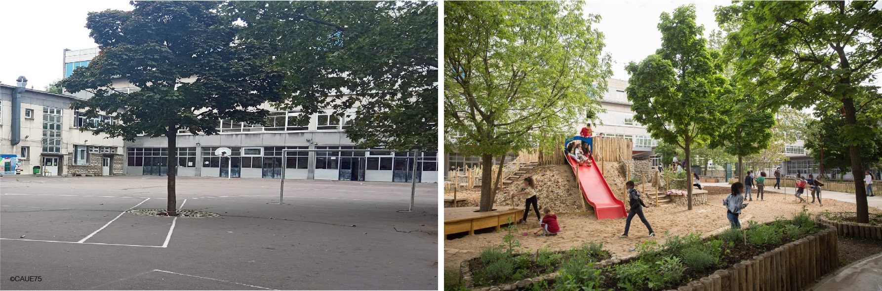
An example of nature-based schoolyard implementation in Paris – OASIS Schoolyards project
Final transformation
BEFORE
AFTER
OASIS Schoolyard, Maryse-Hilsz Elementary School , Paris, France

Slide 19
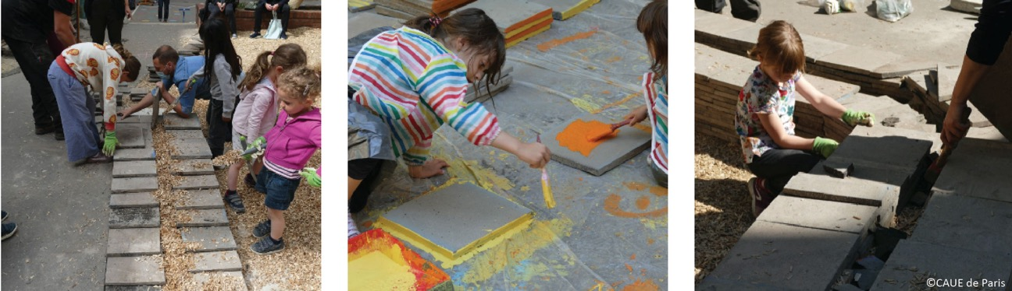
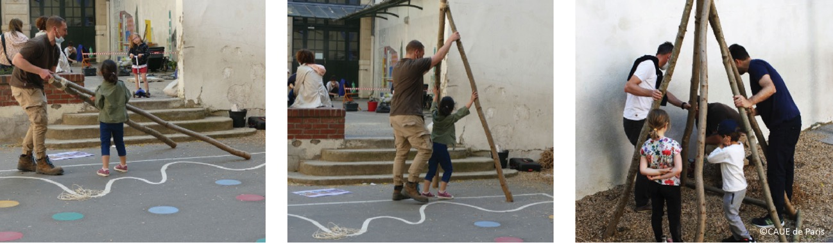
An example of nature-based schoolyard implementation in Paris – OASIS Schoolyards project
Key elements for securing the project’s acceptance and sustainability by the community
1. Co-implementation workshops – Building the sense of ownership

Slide 20
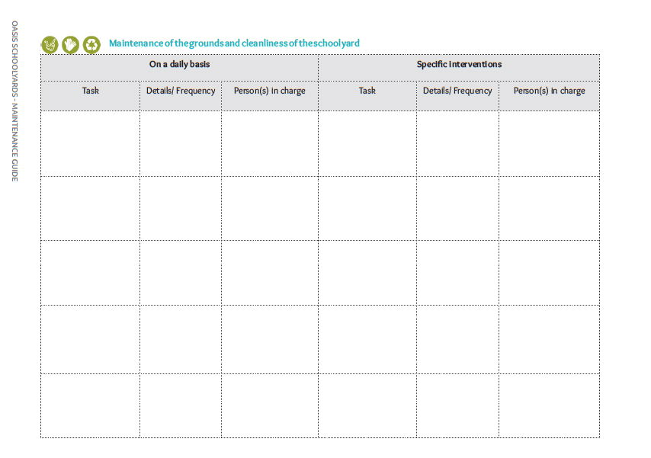
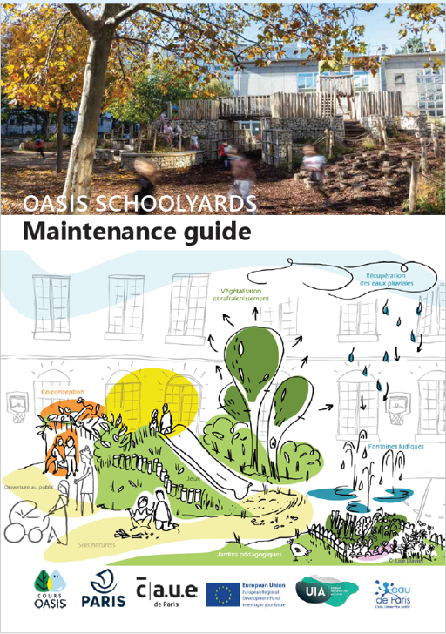
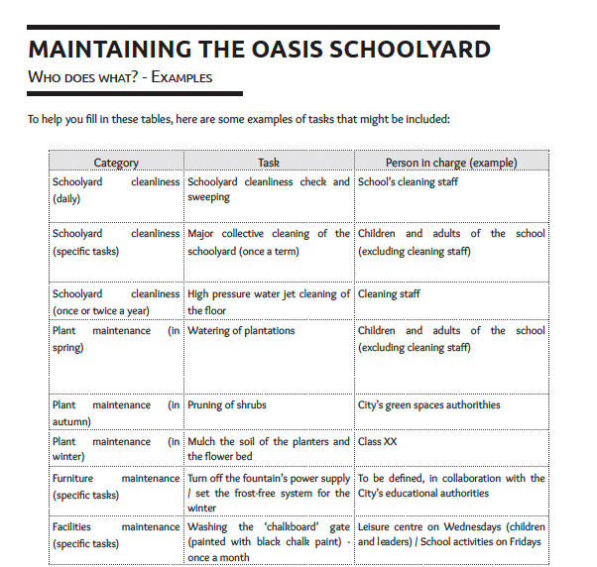
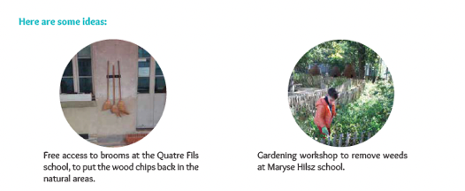
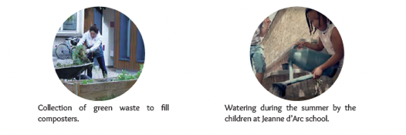
An example of nature-based schoolyard implementation in Paris – OASIS Schoolyards project
Key elements for securing the project’s acceptance and sustainability by the community
2. Maintenance Guides – Creating a shared responsibility scheme
Source: UIA OASIS Schoolyards project – CAUE75

Slide 21

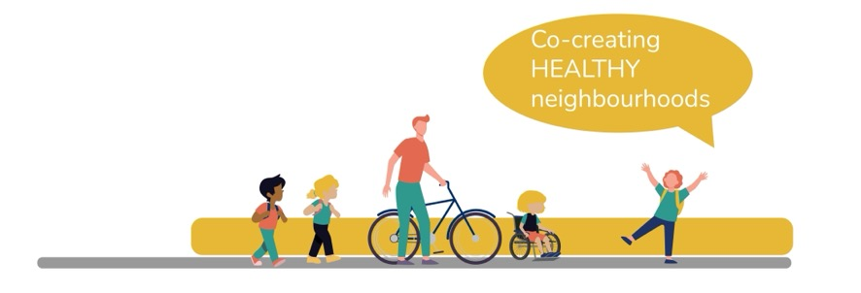
An example of a net-zero action – Promoting active travel to school in Budapest
Horizon UP2030 overall goal :
to support cities in achieving climate neutrality through innovative tools, participatory planning, and sustainable interventions
Budapest pilot objectives – around schools:
To improve air quality
To lower traffic volumes
To promote active travel
To create a pleasant experience for children and youth to walk and roll to school
©CAUE75

Slide 22
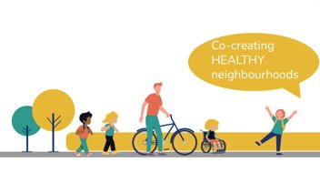
An example of a net-zero action – Promoting active travel to school in Budapest
Horizon UP2030 overall goal :
to support cities in achieving climate neutrality through innovative tools, participatory planning, and sustainable interventions
Budapest pilot objectives – around schools:
Entry point for engagement:
Children’s health & wellbeing
To improve air quality
To lower traffic volumes
To promote active travel
To create a pleasant experience for children and youth to walk and roll to school
©CAUE75

Slide 23
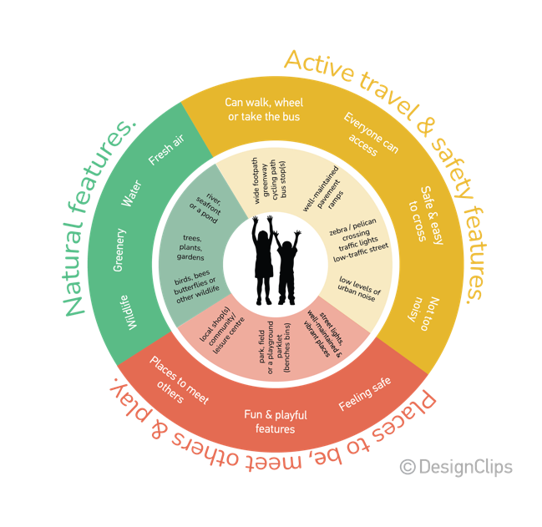
An example of a net-zero action – Promoting active travel to school in Budapest
School Street pilot scheme
Priority target groups:
Children & youth
Parents - Caregivers
Educators
School staff
What was the approach:
To create a School Street toolkit based our framework for Child and Youth Urban Design prioritizing street greening:
A full suite of resources for School Initiatives including:
participatory tools
participatory activities
coordination & campaign materials
©CAUE75

Slide 24

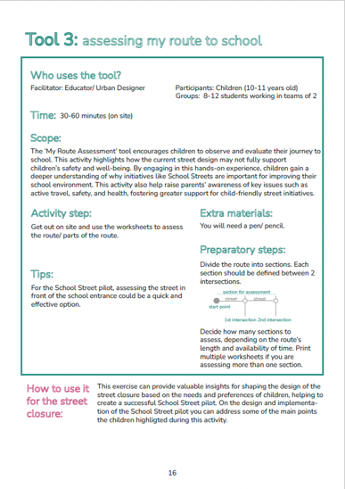
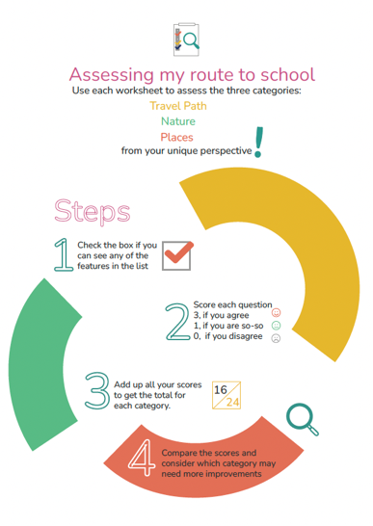
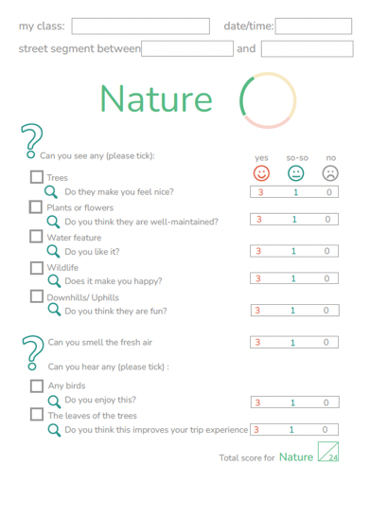
An example of a net-zero action – Promoting active travel to school in Budapest
School Street toolkit
©CAUE75
Examples of worksheets in various toolkits, by Design Clips

Slide 25
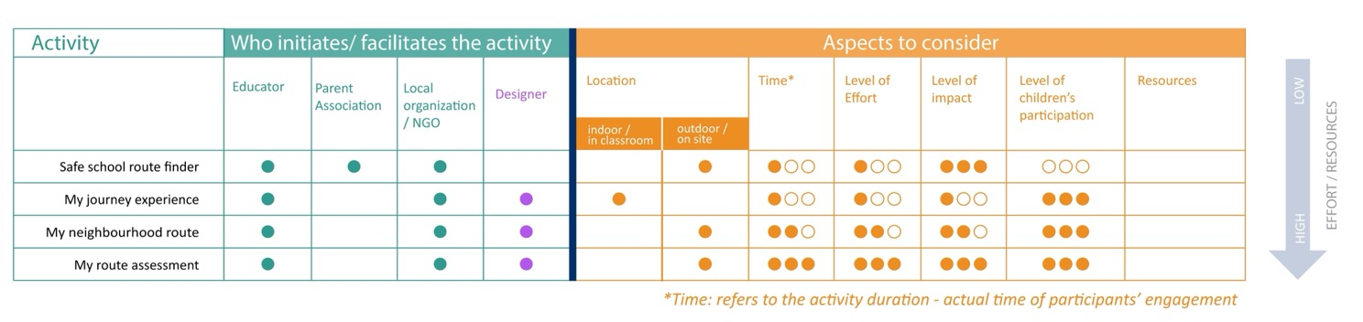
An example of a net-zero action – Promoting active travel to school in Budapest
Key elements for securing the project’s acceptance and sustainability by the community
1. The toolkit includes tools & Activities that can be initiated & facilitated by different actors depending on the scope of the project
©CAUE75

Slide 26
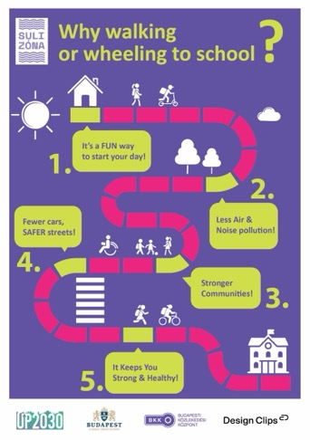
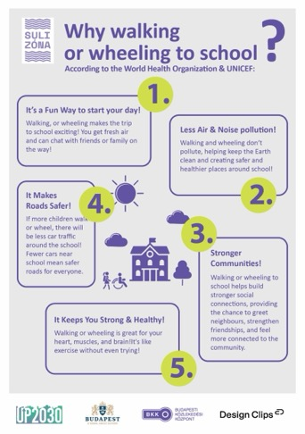
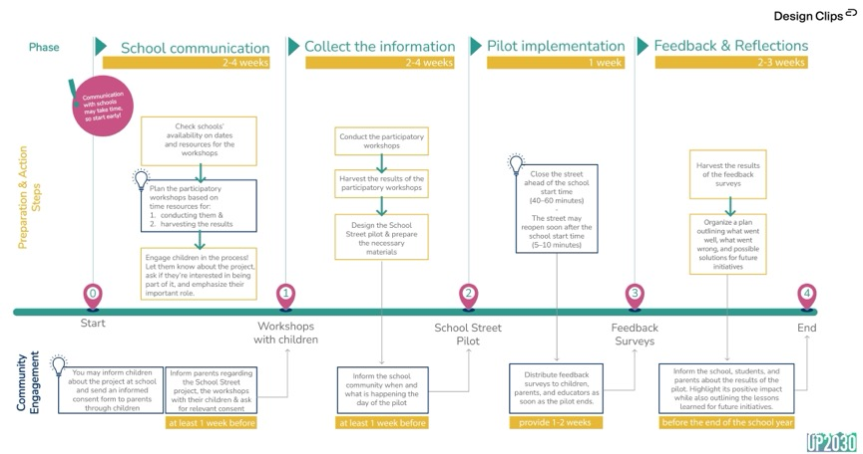
An example of a net-zero action – Promoting active travel to school in Budapest
Key elements for securing the project’s acceptance and sustainability by the community
2. A clear roadmap for preparation & implementation process / Campaign material to communicate key messages in ways that respond to priorities / interests and concerns of the target groups
©CAUE75
Process roadmap
Examples of campaigning material

Slide 27
Thank you!
Maria Sitzoglou
Architect, Μsc Urban Design | Co-founder Design Clips
maria@design-clips.com
www.design-clips.com

Slide 28

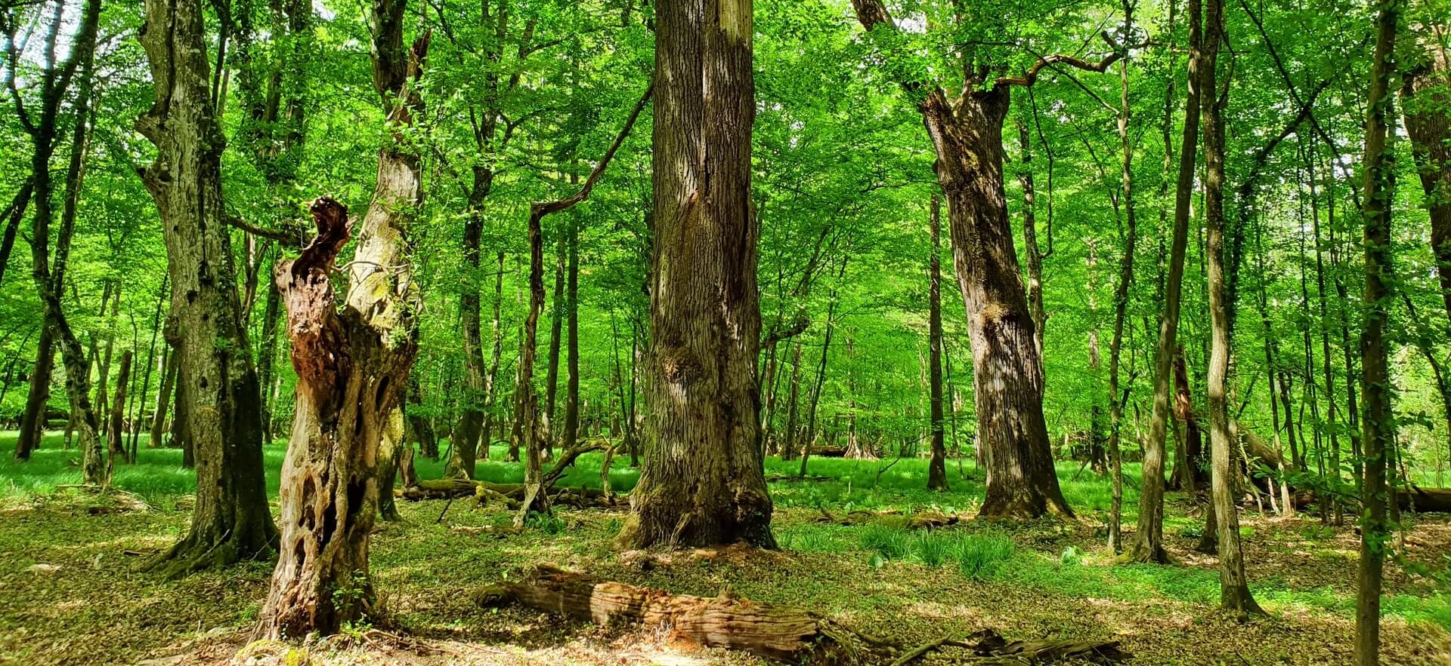
CITY OF
ZAGREB
Large & Small Scale
Urban Nature Restoration
Zagreb Green Courtyards

Slide 29
Green Urban Planning

Slide 30
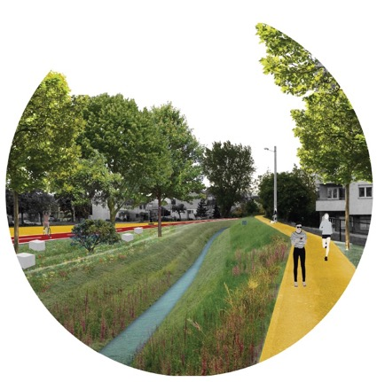
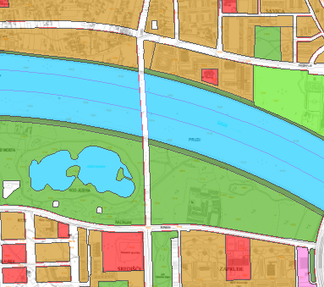
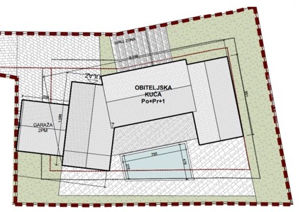
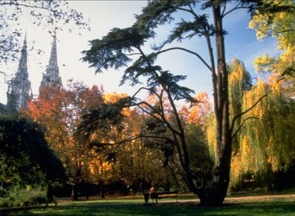
CITY OF
ZAGREB
Amendments to the City Masterplan
Total increase in areas planned for parks, urban forests, water areas, recreational areas etc.
New green/blue corridors between Medvednica Mountain and the Sava River
Increasing the mandatory area of ​​natural terrain that must be provided on building plots
Preservation and protection of existing green areas

Slide 31
Intensive Tree Planting

Slide 32
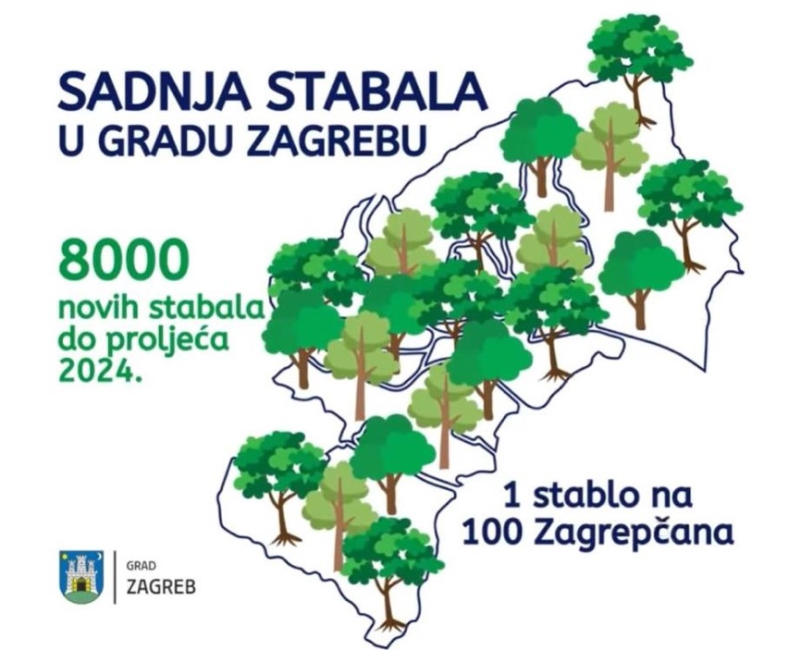
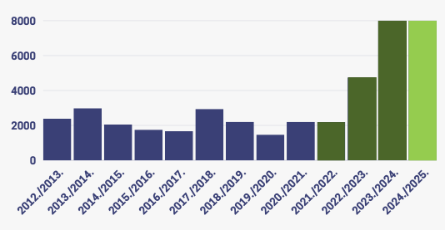
CITY OF
ZAGREB
Planting Seasons: 2023/2024
2024/2025
Planting 8,000 trees per year on public areas and City-owned land plots
CITY OF ZAGREB
TREE PLANTING PROGRAM
8000
new trees per year
1 tree per
100 citizens

Slide 33

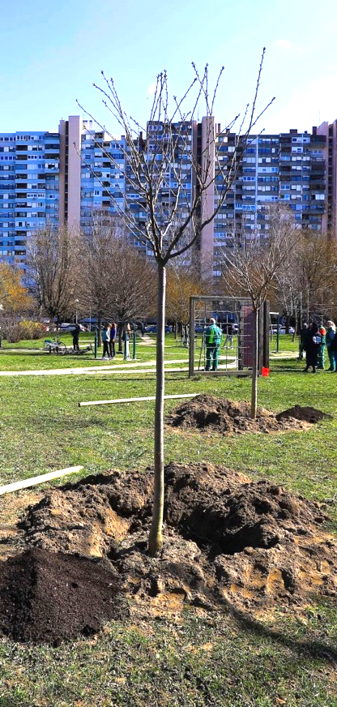
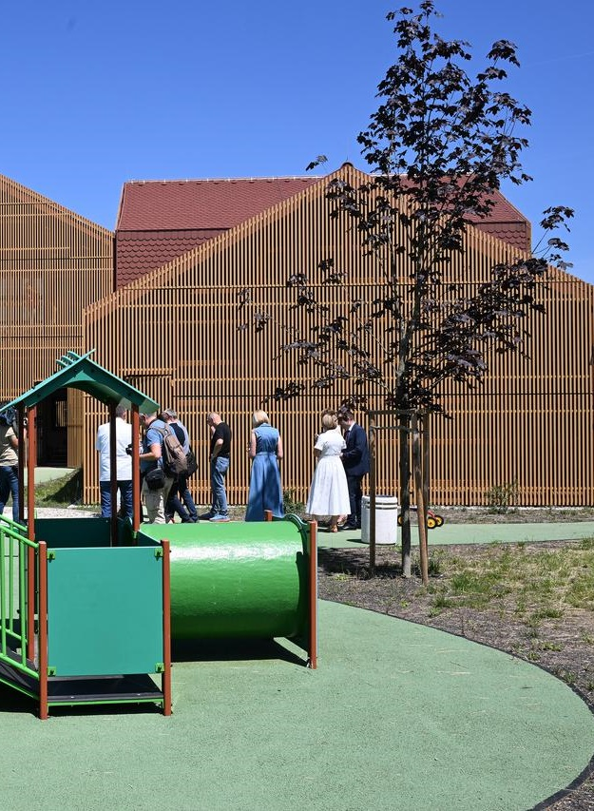
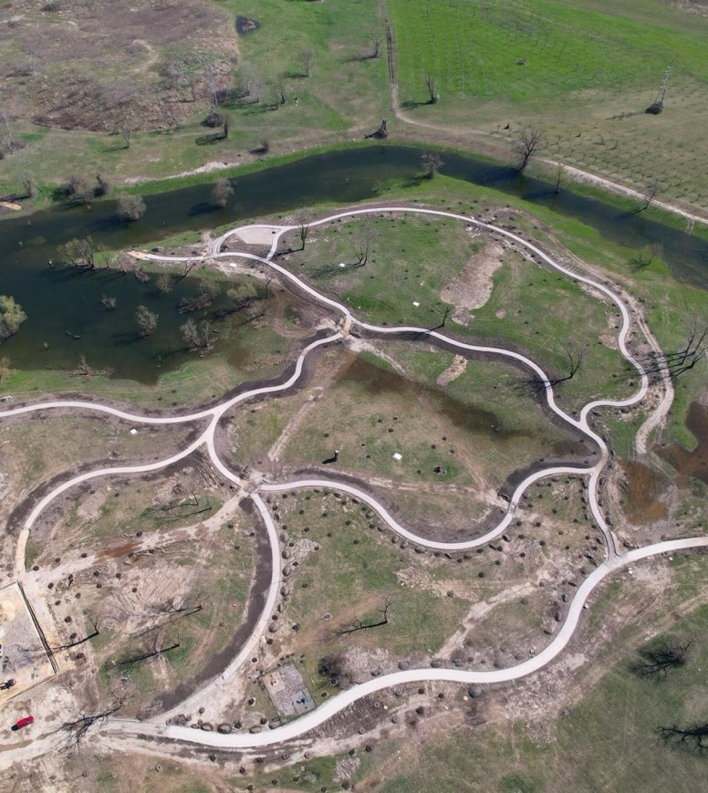
CITY OF
ZAGREB
Tree planting in public areas

Slide 34
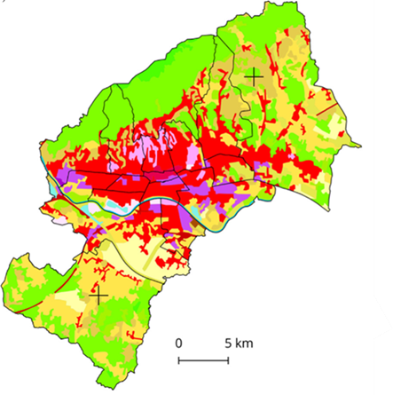
CITY OF
ZAGREB
The most densely built part of the city
asphalt, concrete and similar surfaces
the strongest heat island effect
Planting on both private and semi-private plots
Partnership with citizens

Slide 35
A Carbon Sink in your Courtyard?

Slide 36
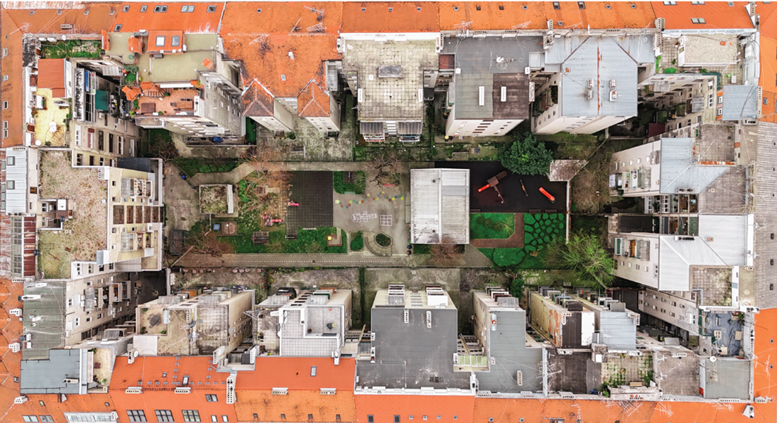
CITY OF
ZAGREB

Slide 37
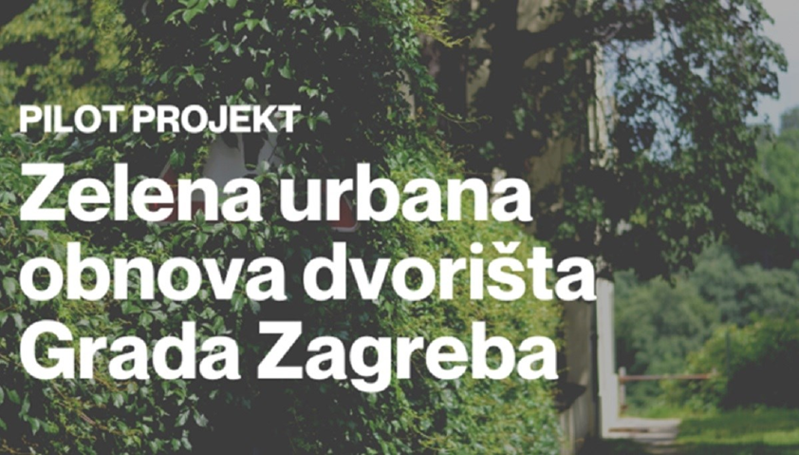
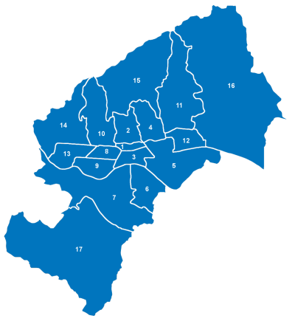
CITY OF
ZAGREB
September 2023
Call for expressions of interest to participate in the pilot project for green urban renewal of private courtyards
More than 200 expressions of interest!

Slide 38
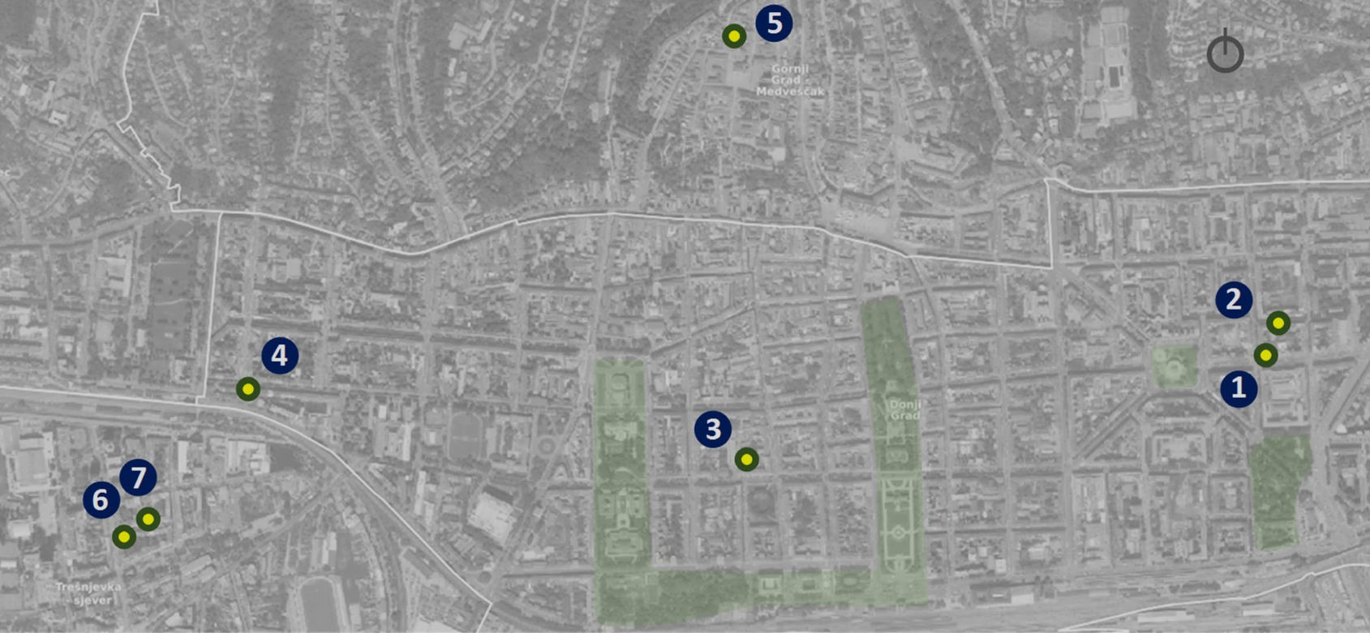
CITY OF
ZAGREB
7 pilot courtyards

Slide 39
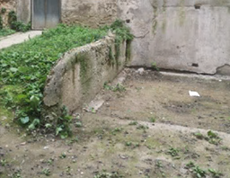
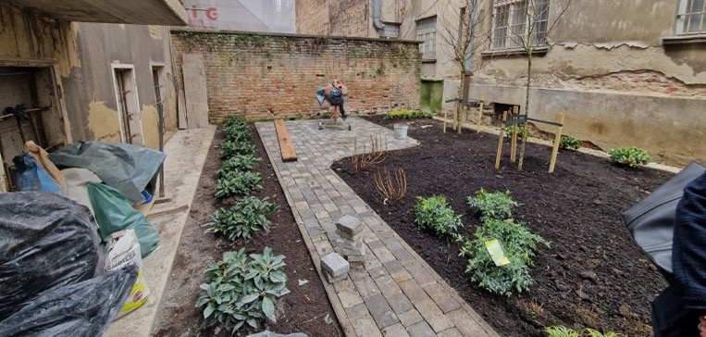
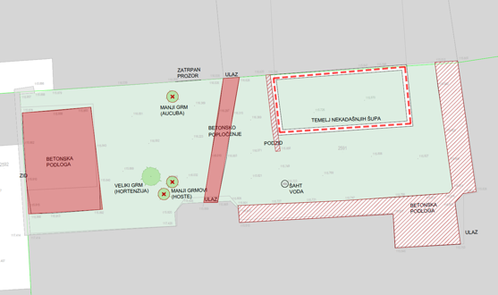

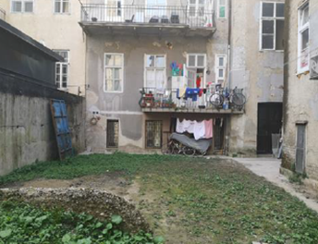

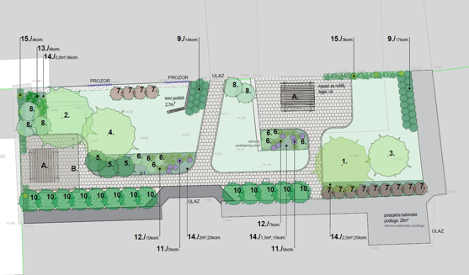
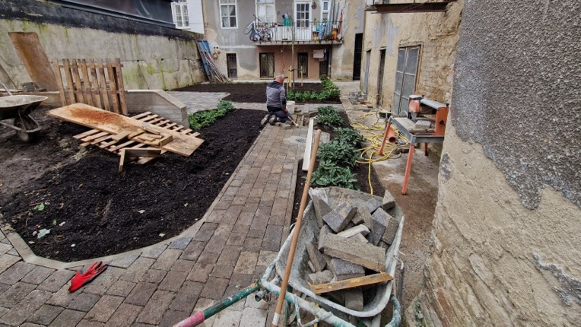


CITY OF
ZAGREB
Before
The design phase
Work in progress…
removal of impermeable surfaces
planting
urban furniture
new permeable surfaces
Izvor: Projekti krajobraznog uređenja za potrebe pilot projekta “Zelena dvorišta“, Vita projekt d.o.o. lipanj 2024.

Slide 40

CITY OF
ZAGREB
Preradovićeva 44 -Svačićev trg 17
(ožujak 2025.)
After

Slide 41


CITY OF
ZAGREB

Slide 42



CITY OF
ZAGREB
February 2024
The City of Zagreb's project, ActGREEN - Activating Green Courtyards for Carbon Neutrality, has been selected for funding from the Horizon Europe program, to test innovations for rapid decarbonization, within the Net Zero Cities Pilot Cities platform (call for the 2nd cohort of pilot cities in 2023)

Slide 43





CITY OF
ZAGREB
City of Zagreb
University of Zagreb
Faculty of Agriculture
Croatian Society of
Landscape Architects
ODRAZ
Sustainable community development

Slide 44


CITY OF
ZAGREB
Courtyard Greening Act
September 5, 2024
eligible activities funded by the City:
(Article 3 of The Courtyard Greening Act)
removal of impermeable pavements (asphalt, concrete)
new permeable surfaces (green surfaces, water-permeable pavements)
high-albedo pavements
tree planting
planting shrubs, perennials, etc.
lawn landscaping
rain garden landscaping
biodiverse flower meadow landscaping
vegetable and herb beds
green gazebos
urban furniture (benches, tables)
insect hotels
birdhouses
rainwater harvesting
children's play equipment
composters
solar-powered lighting

Slide 45

CITY OF
ZAGREB
October 2024 Public Call for Courtyard Greening - 258 applications

Slide 46




CITY OF
ZAGREB

Slide 47




CITY OF
ZAGREB

Slide 48

CITY OF
ZAGREB

Slide 49

CITY OF
ZAGREB
What do we want to see in our courtyard?
What does gardening mean to us?
What kind of courtyard do we want?
How shell we maintain a green courtyard?
What are we going to do with the increased amount of bio waste?

Slide 50

CITY OF
ZAGREB

Slide 51

CITY OF
ZAGREB

Slide 52
CITY OF
ZAGREB

Slide 53


CITY OF
ZAGREB

Slide 54

CITY OF
ZAGREB

Slide 55

CITY OF
ZAGREB
Connectedness to Nature
  Degree of feeling connected to the natural world around us
  Proven to be related to our well-being
  Before, during and after the courtyard greening
Personal values
  Motivations behind engaging in the project
  Do we focus on nature, others or ourselves when engaging in these types of climate-change-adaptation programmes?
Quality of Life
  Before, during and after the courtyard greening
  Composed of various aspects (from environmental quality to social aspects)
  Which ones are impacted by the programme?

Slide 56

CITY OF
ZAGREB
NOW THE KIDS WILL COME AND PLAY.
THE OLDER ONES HAVE STARTED SITTING IN THE YARD.
YESTERDAY I TALKED TO THEM FROM THE BALCONY, BUT I'M GOING TO START COMING DOWN TOO.
THE NEXT QUESTION IS WHERE TO PUT THE BARBECUE.

Slide 57

CITY OF
ZAGREB
NOW WE HAVE TO LEARN HOW TO MANAGE THIS.
WHO WILL ORGANIZE THE WATERING SHIFTS?
WHO WILL BUY THE WATER HOSE?
SWEET WORRIES...

Slide 58

CITY OF
ZAGREB
June 2025
The start of preparation for the new planting season!
Series of workshops with courtyard owners:
Understanding the possibilities and challenges of a specific space and the expectations of the owners
Involving landscape architecture students who will present their best sollutions and discuss them with citizens (hackathon format)
+ 25 in the 2025/2026 planting season

Slide 59
CITY OF
ZAGREB
https://actgreen.zagreb.hr/
Thank you
And keep planting!

Slide 60



EUI Project Greening without Borders (GwB)
City of Rotterdam
Dutch project name: Wijk in Bloei (Neighbourhood in bloom)
Gijs Norden MSc.
Policy Advisor External Funding
EU Funding Team for City Development
City of Rotterdam
g.norden@rotterdam.nl

Slide 61




Contents
Introduction
- City of Rotterdam
- Project Summary
What can cities do to activate private owners and businesses to contribute to greening targets of the city:
- Greening Private Land
- Challenges:
HOAs
Activating home owners
No man's land
Private Investments in Private Land

Slide 62

City of Rotterdam

Slide 63


Facts and Figures
Located in the West of the Netherlands
Known as the port of Europe
672.565 Residents
319 sq kms
60 % of the land is privately owned in the city

Slide 64


Project Neighbourhood Oud Mathenesse
Old Harbour neighbourhood
Approx. 7700 inhabitants
70% migrant population (large part EU- labour migrants)
80% of the housing built before 1968
40% owned by private landlords
Annually 16% of residents move away from the neighbourhood

Slide 65
Greening without Borders Project Summary

Slide 66

Why Greening without Borders
Sewage renewal (every 40-60 years) and raising public streets back to their original levels (sinking land)
Resulting in: private gardens of residents lower than street levels (defacto pools)
Neighbourhood Agreement: wish for more green and wish for help with raising private gardens
Low score on liveability index in this neighbourhood (neighbourhood has felt forgotten)
Project Proposal is a result of a partly bottom-up approach,
where residents had a seat at the table at an early stage
(neighbourhood organisation is an official partner in the project)

Slide 67


Project Goals GwB
A more green and climate adaptable neighbourhood
More social cohesion by greening projects and events
Helping residents move forward (economically and socially)
Sustainable greening fund for further greening after EUI Project ends
Developing a new working method for public/private cooperation with priority for resident’s well-being

Slide 68
Project Pillars
Project is roughly divided into 3 main pillars
1. Greening Efforts
Targeting private individual gardens, communal privately owned gardens, no-mans land and small greening solutions by offering green/blue packages increasing biodiversity and resilience against flood, drought and heat risks.
Social Economic Efforts
Creation of a Coalition (all partners and resident working groups), community shared-use projects of green space, creation of Green Hub and a labour market project.
Creation of a Greening Fund
Creation of a fund to continue greening efforts after EUI funding period
Creation of a Green Stamp mechanism

Slide 69

What can cities do to activate private owners and businesses to contribute to greening targets of the city?

Slide 70
Greening Private land

Slide 71

How to green private land
Make use of experience, behavioural science and motivation research by:
Gathering good data on stakeholders, who are the type of owners, residents etc.
Taking away barriers f.e. by developing low threshold and all-in green/blue packages
2. Involving Residents by supporting (willing) HOAs (setting a good example) and supporting enthusiastic individual residents (reward via Green Stamp system)
3. Involving relevant partners in the neighbourhood (organisations and key figures)
4. Building on experience on activating homeowners for building maintenance
5. Be transparent: we will provide greening, raising but homeowners will be responsible for future maintenance and costs

Slide 72
Creation of a Greening Fund for the neighbourhood
Separate Workpackage, led by partner Serendipity Ltd.
Financial Schemes for delivering Greening Activities as investment opportunity
Investors (community, insurance companies, other government layers, banks, philanthropy)

Slide 73
Challenges

Slide 74
Homeowner Associations (HOAs)
Communal gardens decided upon by several HOAs
Structure, rules and regulations for HOAs, perceived as complicated
Getting HOAs lined up and agreeing on an issue is complicated
Different categories of owners have different interests

Slide 75
Activating Residents and Home owners
Different perceptions of green (negative vs positive)
Maintenance issues (tiles perceived easy maintenance)
Greening/gardening not a main priority of residents
Key figures are usual suspects

Slide 76

No Man's Land
Co-ownership of a path/alley without proper managementstructure

Slide 77
Private Investments In Private Land: finding investors for the fund
Interest from our network (insurance companies, banks etc.)
Will they actually invest?

Slide 78
Questions?

Slide 79
Turning Strategy into Impact: How EBRD Supports Nature and Green Transition
28 May 2025

Slide 80






What we do
EBRD Mission is to develop open and sustainable market economies in countries committed to and applying democratic principles
Our transition qualities
Competitive
Building dynamic and open markets that stimulate competition, entrepreneurship and productivity growth
Well governed
Promoting the rule of law, transparency and accountability, and encouraging firms to adequately safeguard and balance the interests of their stakeholders
    EBRD works across central and eastern Europe, Central Asia and the southern and eastern Mediterranean region.
    The Bank’s HQ is in London, but 40+ local offices across our countries of operation enable a deep understanding of local challenges and opportunities
    Through investment, policy reform and advisory projects, the Bank works to make economies more competitive, well governed, green, inclusive, resilient and integrated.
Inclusive
Building inclusive market economies that ensure equal economic opportunity for all and leave no group behind
Integrated
Building geographically integrated domestic and international markets for goods, services, capital and labour
Resilient
Building resilient market economies that can withstand turbulence and shocks
Green
Building green, sustainable market economies that preserve the environment and protect the interests of future generations

Slide 81
Green Economy Transition is a strategic commitment
EBRD continues to be a majority green bank
Results
Finance in 2024 for green projects
€9.7 billion (58%)
Mobilised additional finance from private sector partners in 2024 for green projects
€19.1 billion
Expected annual reduction in CO₂ emissions
as a result of EBRD investments in 2024
10 million tonnes
Expected total reduction in CO₂ emissions
as a result of EBRD investments since 2006
+145 million tonnes
From the end of 2022, all activities are aligned with the mitigation and adaptation objectives of the Paris Agreement.
Two ambitious GET targets for 2021-2025 period:
increase green financing to more than 50% of annual business volume
achieve a net reduction in greenhouse gas (GHG) emissions of 25 to 40 million tonnes
Post-2025 GET strategy in development, with a view of further strengthening our green transition commitments.
Notes:
EBRD activities in 2024 (per Impact Report 2024)
Annual investment EUR16.6 bn
Total finance mobilises EUR 26.8 bn
Share of investments supporting green projects 58%
Number of projects (total) 584

Slide 82
Our approach
Tailored solutions to client and project needs in response to specific situation of the country, region and sector while ensuring green transition.
Instrumental to create enabling frameworks to drive green transition
POLICY DIALOGUE
Working with governments on optimal legislation for green investments
Supporting the development of legal instruments and best practice guidelines
Necessary to finance projects that measurably deliver green transition
INVESTMENTS
Commercial financing: direct (loans, equity investments or guarantees) and indirect finance via local partner financial institutions (lending, leasing)
Concessional co-financing: concessional loans with progressive interest rate discount (as milestones to support green transition ambitions in public and private sector)
Key enablers to initiate transition by unlocking pathways to investment
ADVISORY
Technical assistance: energy audits, pre-feasibility and feasibility studies, climate vulnerability assessment, low carbon pathways
Project preparation and implementation

Slide 83
Green Economy Transition methodology
Policy dialogue and advisory support governments, public, and private actors in designing and implementing ambitious, evidence-based strategies that drive the green transition - mobilising investment, strengthening institutions, and fostering partnerships for systemic, long-term impact.
Ensuring our work is green
All initiatives screened for Green Economy Transition (GET) alignment, criteria covering climate mitigation, adaptation, and broader environmental benefits
Paris Agreement compliance: no support for carbon lock-in
Green finance share calculated for each project/advisory activity
Collaboration with project proponents to strengthen GET alignment and green impact
Environmental impacts tracked through Monitoring, Reporting & Verification (MRV)
Fund- and project-level checks ensure real green outcomes
Flagship initiatives we implement (selection)
Country sector platforms
Renewable Energy Programme
Corporate Climate Governance Facility
Low Carbon Pathways
Green Cities
Notes:
Country sector platform approach helps countries to scale up the mobilisation of climate finance and accelerate the green transition. This approach has been developed in close cooperation with other multilateral development banks (MDBs) and national governments. In essence, a country sector platform coordinates the efforts of all stakeholders to deliver integrated policy and investment solutions.
It brings together all the key elements of an integrated solution: enhanced national climate ambitions; accelerated project and investment pipeline identification; mobilisation of public and private finance; and strengthening of transparency and impact monitoring.

Slide 84





EBRD Green Cities
€7 billion framework to support cities to identify, benchmark, prioritise and invest in Green City measures to improve urban environmental performance
Launched in November 2016 and implemented in 50+ cities since
Delivery of strategy and policy support
Facilitating and stimulating Green City infrastructure investment
Sharing knowledge and connecting through Green Cities Network
Supporting access to green finance
Green City Action Plans (GCAP)
Policy Dialogue
Urban Transport
Water & Wastewater
Solid Waste
Buildings
District Energy & Renewables
Climate Resilience & Nature
Partnership, Capacity Building, Governance and Impact
Ljubljana, Slovenia
www.ebrdgreencities.com #EBRDGreenCities
Notes:
EBRD Green Cities offers a systematic approach to identifying and investing in municipal infrastructure improvements that address climate change and environmental challenges in cities
The programme draws on best practice approaches linking strategic Green City planning to investments
In so doing, the EBRD introduces cities in our COO to:
a systematic approach to urban planning;
an innovative approach linking strategic urban planning to investment;
a planning process that emphasises engagement with civil society;
a focus on converting urban planning instruments into financed investments.
EBRD Green Cities has four main components:
Delivery of strategy and policy support through Green City Action Plans (GCAP), the programme’s main tool and key innovation
2. Facilitating and stimulating Green City infrastructure investments, particularly in the sectors of urban transport, water and wastewater, district energy, building energy efficiency, solid waste, renewable energy and climate resilience; and
3. Capacity building and technical assistance to support city administrators, local stakeholders, and successful implementation of investments
4. Supporting access to green finance
Photo: Vilnius

Slide 85





GCAPs: a Systematic Approach to Investments
How is the city doing?
What should be done?
Implementation
Baseline
Baseline
Setting Actions
Targeted Investments
Data & Indicators
15 Years
Vision
Providing Green Finance
10 Years
Strategic Objectives & Targets
Capacity Building
to prepare & implement
projects and policies
Stakeholder
Engagement
5 Years
Actions
Green City Action Plan (GCAP)
Green City Action Plan (GCAP)
Policy and Strategy
Infrastructure Investment
85
Notes:
The Green City Action Plans are the programme’s key tool, and are developed by cities with support from consultants procured through EBRD sourced donor funds. The GCAPs seek to involve a wide array of stakeholders in their development beyond the City, EBRD and consultant team, including civil society, local businesses, other international organisations and other public actors.
A GCAP has three key phases. The first two develop the Plan itself, with the third stage focused on implementation of the GCAP.
Green City Baseline
The GCAP first asks “How are we doing?” in relation to a city’s environmental performance
Map the City’s environmental performance and current challenges based on a benchmark of environmental indicators covering a comprehensive assessment of urban issues
The benchmark results are combined with consultation with a wide range of local stakeholders to identify priority environmental challenges
II. Green City Action Plan
The GCAP then asks “What do we want to do about it?” by developing specific investment and policy actions to address a city’s most pressing challenges
Based on the agreed priorities, the City establishes:
Long-term visions and medium-term targets for Green City development
Short term actions the City can take to address their priority challenges including a list of indicative investments and policy responses
III. Green City Implementation
The City undertakes the infrastructure investments and measures as outlined in the GCAP
Based on the City’s interest, EBRD is able to support them in these efforts
To track the progress of the GCAP in achieving its targets, cities will also regularly evaluate the effectiveness of its measures and reports the results in the context of environmental improvement as benchmarked originally.
The Green City Action Plan sets out indicative investments for the city over the mid- to long-term.
The GCAP subsequently leads to follow-on investment projects with the EBRD in the following sectors:
Solid Waste
Water & Wastewater
Urban Transport
District Heating
Public Building Energy Efficiency
Renewable Energy
Climate Change Resilience
In addition to the intended environmental benefits, the GCAP helps to demonstrate a city’s commitment to becoming green to a wider audience.
Work with other strategies and policies
GCAP is flexible that it can work with policies and visions developed under other existing and ongoing initiatives and strategies for the City so that it avoids duplication
Visibility & Knowledge-sharing
GCAP helps demonstrate city’s commitment to transforming into a greener city to a wider audience. GCAPs include a number of publicity and networking events where a city’s efforts can be showcased. Through these events and throughout the GCAP process, the city officials and other stakeholders have opportunities to learn from examples from other cities, and urban planning and environmental experts. There are also capacity building workshops where consultants can share experience from other projects or invite experts to run workshops to improve skills in specific sectors/topics.
Involve multiple stakeholders
GCAP are developed through a number of stakeholder engagement workshops. This includes not only city officials but also ministries, international organisation, utility companies, private sector, academia, NGOs, and community organisations. By adopting an inclusive development process, all key actors shaping the city will share common goals for making the city greener – thereby aiming to make the implementation of actions smoother.
Access to finance
GCAPs facilitate discussions between cities and potential external financiers, as cities can use their GCAP’s clearly articulated investment ideas as the focus of conversations. If the City requires financing from the EBRD, its own national ministries or other funding sources to implement an action of the GCAP, the city can use the GCAP to justify why such an action is necessary for the city, backed by data collected and analysed by the international consultant.

Slide 86
EBRD Green Cities – Deploying Capital
Counterparties
Central Government
Municipality
Public Services Company
Private Company
EBRD Financing Conditions
Market practice-based pricing
Mobilisation of concessional funding
Local currency lending
Longer tenor (20y+)
Extended grace periods
EBRD Financing Products
Loans
Equity and Guarantee
Bonds
Senior loan (secured/unsecured)
Subordinated loan
Government-guaranteed loan
City-/region-guaranteed loan
Green loan
Sustainability-linked loan
Equity minority participation
Equity-like instruments (mezzanine, options…)
Green bond
Sustainability-linked bond
Notes:
EBRD Green Cities can help cities implement investments targeted to address their most pressing environmental challenges
Financing Options
There is flexibility in the financing options that can benefit Cities in working with EBRD
Lending can be directly through central governments, municipalities, utility companies, or even private companies through a PPP structure
Investment Size
There is a broad range of investment available to Cities, indicatively ranging from € 2 million to € 150 million or larger
Market practice-based practice, with the exception of sovereign and sovereign guaranteed loans, where the Bank’s standard sovereign pricing is used – standardised across the Bank’s regions.

Slide 87


GCAP: Sarajevo, Bosnia and Herzegovina - 2021
Priority Environmental Challenges
Green Cities Investments
Total EBRD Finance EUR 95 million
CO₂ Savings 78,800 ton CO₂ eq / yr
Sarajevo Water
Sarajevo Public Transport – 3 project investments
Sarajevo Public Building EE
Sarajevo Public Transport E-mobility
Partnerships / Best Practice
EUR 70m of follow-on investments to date
Notes:
Sarajevo – population 608,000; largest city and capital of Bosnia and Herzegovina
Green city #13
Sarajevo GCAP (and BP)
Sarajevo is the first Bosnian city involved in EBRD Green Cities Programme in 2017. The City developed its GCAP, which was adopted by Municipal Council on 11 May 2021 and identified as an official policy document of Sarajevo. The City has completed its GCAP, workshops and trainings with a slight despite restrictions under Covid-19 pandemic.
Timeline: Adopted – May 2021 (11/05/2021); completed – Dec 2019 (31/12/2019); joined GrC May 2017 (11/05/2017).
Priority environmental challenges: Through the GCAP process high-priority challenges were identified: Air Quality, Water Quality, Soil Quality, Land Use and Green Spaces, Climate Mitigation and Land Use and Biodiversity.
Stakeholder engagement: Around 140 stakeholders have been engaged. As a final step, the city approached interested stakeholders with a 1-week online consultation for the final draft GCAP.
Portfolio
Sarajevo Water (48252)
What - priority investments into the water supply system in the Sarajevo Canton ("the Canton") to reduce leakages and to improve the quality of services provided by the Cantonal Public Utility Company "Vodovod i kanalizacija" d.o.o. Sarajevo ("the Company"). The priority investments include (i) purchase of new metering and control equipment (individual and bulk meters, telemetry); (ii) reconstruction of the water supply network in several parts of the Canton; and (iii) rehabilitation of pumping stations (including chlorination units).
Status – two tranches committed (EUR 20m out of the total EUR 25m). Tranche 1 is implemented, Tranche 2 under implementation.
Sarajevo Public Transport Part 1 (50246)
What - purchase of 25 new articulated trolleybuses (the "Project") for the benefit of the public transport operator "KJKP Gradski saobracaj" d.o.o. Sarajevo ("GRAS" or the "Company"). Contribution to the development of Sarajevo's public transport fleet by improving both the access to clean urban transport and the capacity and efficiency of public transport services. The Project will enable the Company to increase the efficiency of trolleybus operations through improved accessibility, increased average service speeds and decreased maintenance intensity and costs. It will reduce the upgraded trolleybus fleet's electricity consumption resulting, together with an effect from modality shift, in a reduction of tCO2e (Tonnes of carbon dioxide equivalent) of Green House Gases ("GHG") emissions.
Status – Contract signed with the trolleybuses provider. First trolley bus to be delivered Feb 2022. All trolleybuses by Aug 2022.
Sarajevo Public Transport Part 2 (51294)
What - financing of the overhaul of the 19.5-km long dual tramline (the "Project") for the benefit of the public transport operator "KJKP Gradski saobracaj" d.o.o. Sarajevo ("GRAS" or the "Company"). Assisting the public transport operator "KJKP Gradski saobracaj" d.o.o. Sarajevo to: (i) increase energy savings (ii) bring CO2 savings (iii) reduce local air pollution; (iv) modernisation of public transport.
Status - Contractor selected and works should start summer 2021, complete by end 2022.
Sarajevo Public Buildings (50674)
What - Contribution to installation of energy efficiency measures in up to 40 public buildings. The Project will cover 29 schools, 6 hospitals, 3 kindergartens and 2 other public buildings of general interest. The energy savings are estimated at circa 13.7 GWh that would result in 4,774 CO2 savings annually. The energy efficiency measures to be implemented under the Project are dedicated to introducing cleaner and more efficient heating, better insulation, better lighting and overall improvement of the buildings. More than 26,000 children and patients are expected to benefit directly from these improved facilities.
Status - PIU selection almost complete. Finalising contract for consultant to review energy audits and design. First works start Oct 2021
Sarajevo Public Transport Part 3 (51784)
What - The project aims to alleviate traffic congestion and minimise transport-based emissions and environmental pollution by supplying new trams to the Canton. Increasing the efficiency of tram operations will reduce the tram fleet's electricity consumption resulting, together with an effect from modality shift, in a reduction of tCO2e (tonnes of carbon dioxide equivalent) of Green House Gases ("GHG") emissions.
Status - Awaiting legal opinions to declare loan effective, goal for Sep 2021. Procurement is in final stages. First tram to arrive in 24 months after signing contract.
Sarajevo Public Transport E-mobility (52520)
What - Purchase and installation of adaptive traffic management system and construction of traffic management centre and purchase of up to 5 new trams. . Increasing the efficiency of public transport operations, promote modality shift, will result in a reduction of tCO2e (tonnes of carbon dioxide equivalent) of Green House Gases ("GHG") emissions.
Status – singed Apr 2022 – first tranche EUR 7 m (out of EUR 17m).
City narrative – Nature, water and energy are the starting points for what is meant by "green" concept in Sarajevo Canton. The Sarajevo Canton GCAP vision: “Sarajevo Canton will have cleaner, greener, affordable and smarter transport, buildings and industries. It will be served by efficient and high-quality water and wastewater infrastructure, efficient district heating, with improved waste and pollution control management. The Canton will be a healthy, compact, sustainable place to live and work, with good quality, accessible green spaces and biodiversity and natural values maintained or enhanced. Resilience to climate change and other natural disasters will be increased.” All of EBRD green projects are under implementation and the Canton as a whole will start reaping those benefits in a few years’ time.
GCAP – The development of GCAP in Canton Sarajevo started in Nov 2018. The Japanese Government, the EBRD team, the consultant team, together with the team from the Canton Sarajevo helped with the development of GCAP. Numerous meeting, discussions and 3 workshops were held until the end of 2020. The coronavirus pandemic at the beginning of 2020 slowed down the process, but nevertheless the final GCAP report was completed in April 2021.

Slide 88



GCAP: Karlovac, Croatia – 2025 (new!)
Priority Environmental Challenges
Strategic Objectives
1.1 – Decarbonisation and digitalisation in public transport
1.2 – Opportunities for Karlovac as a commuting city
Climate mitigation
2.1 – Decarbonisation and resilience of heating system
2.2 – Decarbonisation of city’s building stock
Climate adaptation
3.1 – Efficiency of water system
3.2 – Enhanced capacity on water sustainability
Water
4.1 – ‘Zero-waste’ waste management
4.2 – Circular economy in waste management
Green infrastructure
5.1 – Green infrastructure development
5.2 – Intensifying use and regeneration of underutilised urban structures
Waste and recycling
6.1 – KPIs for monitoring and evaluation
6.2 – Green City coordination system
Notes:
The GCAP has identified a total of 24 actions, requiring a combined investment of 245,072,000 EUR. Notably, 98% of this investment is allocated to investment actions, emphasising the significant focus on infrastructure and capital development within the GCAP.
Karlovac is a city on four rivers.
Actions:
Water
Increase climate resilience against flooding in the City of Karlovac.
Land Use
Realisation of Luščić urban park and development of Karlovac urban area brownfield and green infrastructure projects register.
Integration of green infrastructure and nature-based solutions in the Korana Sports and Recreation Centre.
Protection and revitalisation of urban forest Kozjača.
Innovative instruments for stimulating use of green infrastructure elements through spatial plans.

Slide 89






Contacts
Ivana Milicic
Associate Director, Senior Banker
RO Zagreb
Email: milicici@ebrd.com
Petra Remeta
Associate, Regional Policy and Strategy
RO Zagreb
Email: remetap@ebrd.com
Find us on social media

Slide 90
Supporting slides

Slide 91

Where we are
Notes:
https://www.ebrd.com/where-we-are.html

Slide 92

Green Cities Network
GCAPs completed & adopted
GCAPs completed
GCAPs underway
GCAPs ‘on hold’
>50 Cities
Vilnius
Warsaw
Walbrzych
Kyiv
Lviv
Kharkiv
Khmelnytskyi
Ust-Kamenogorsk
Balti
Kryvyi Rih
Dnipro
Ulaanbatar >
Novi Sad
Alba Iulia
Chisinau
Mariupol
Karlovac
Timisoara
Brcko
Belgrade
Medias
Iasi
Banja Luka
Bucharest
Almaty
Zenica
Tuzla
Sofia
Shymkent
Split
Pristina
Varna
Batumi
Tbilisi
Sarajevo
Skopje
Istanbul
Gyumri
Ganja
Samarkand
Osh
Bishkek
Tirana
Bursa
Yerevan
Ankara
Dushanbe
Izmir
Gaziantep
< Agadir
< Guelmim
Alexandria
Cairo
Amman
6th of October City
www.ebrdgreencities.com #EBRDGreenCities

Slide 93





Green Cities Impact
Since Nov 2016, EBRD Green Cities was implemented in 50+ cities:
€3.2bn
Invested in sustainable infrastructure
€7bn
in EBRD & donor finance
4,957k tonnes CO2
= 1.1mn polluting cars
Reduced per year
CO₂
76mn
Citizens across Green Cities
Notes:
Photo: UKT Tirana Water
Cars = ICE vehicles

Slide 94
Q&A
Notes:
Before we jump into this, we’re going to explore some of the main findings of a survey some of you responded to on how to monitor nature plans. I’ll hand over now to Leon Kapetas who will share these key findings and take us through the presetnations today.

Slide 95
Nature Restoration Law webinar series: what’s next?
Webinar #6: Collaboration on National Restoration Plans
Thursday 12 June at 10.00-12.00 CEST
➡️ Kristian Kvist, Expert, Forest Ecosystem Restoration, European Environment Agency
➡️Axelle Griffon, Senior Policy Advisor, Council of European Municipalities and Regions (CEMR)
➡️ Laura Maki, Senior Advisor, The Association of Finnish Cities and Municipalities
➡️ Virve Hokkanen, Senior Specialist in the Ministry for Environment
What are the National Restoration Plans? What format will they take?
Are cities and national ministries already in contact regarding the Nature Restoration Law?
Case study: how Finnish cities are collaborating with their national environment ministry
https://www.urbanagenda.urban-initiative.eu/news-events

