Slide 1
The New Leipzig Charter
Tilman Buchholz
German Ministry of the Interior, Building and Community
Coordinators’ & Action Leaders’ Meeting

Slide 2
The New Leipzig Charter – Starting Point
Today, the global and the local are deeply intertwined, with a direct impact on cities
(climate change, resource scarcity, migration movements, digitalisation, pandemics…)
risk of new forms of social, economic and environmental conflicts and inequalities in our societies
Leipzig Charter contributes to implement objectives of European and global agreement
(Paris, Quito, Agenda 2030 for Sustainable Development, European Green Deal)
Strengthening framework conditions for urban development as Leipzig Charter addresses all governance levels
(EU – national – regional – cities – neighbourhoods)

Slide 3
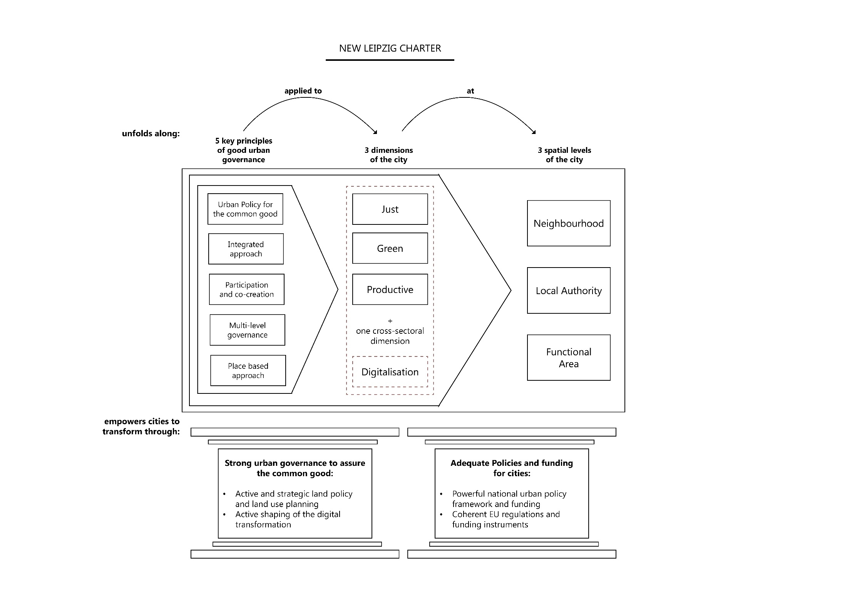
NEW LEIPZIG CHARTER
Notes:
Schaubild zur Wirkungsweise der NLC.

Slide 4
NEW LEIPZIG CHARTER
Notes:
Digital solution as a crucial backbone in pandemics

Slide 5
NEW LEIPZIG CHARTER
Notes:
local authorities: in order to account for various types of urban administrative structures and governing bodies we have replaced „municipality“ with „local authorities“

Slide 6
NEW LEIPZIG CHARTER
Notes:
…um dann die Aufgaben umsetzen/ Ziele erreichen zu können

Slide 7
THANK YOU!

